Slide 1
THE CHURCH

Slide 2
Table of contents
01
02
03
04
Section
Section
THE ORIGINS AND EARLY HISTORY OF THE CHURCH
DEVELOPMENT OF CHURCH DOCTRINE
Section
Section
THE CHURCH IN THE MIDDLE AGES
THE REFORMATION AND ITS AFTERMATH

Slide 3
05
06
07
Section
Section
MODERN DEVELOPMENT AND DIVERSITY
THE CHURCH IN GLOBAL CONTEXT
Section
CONCLUSION

Slide 4
Introduction
Understanding the history and significance of the church is vital as it unveils the cultural, religious, and moral foundations that have shaped societies over centuries. It offers insights into the evolution of spiritual beliefs, the interplay between faith and governance, and the origins of ethical values.
Knowledge of the church's history enables us to appreciate its influence on art, education, and social progress, fostering interfaith dialogue, preserving heritage, and guiding us through lessons of both achievements and mistakes, ultimately enriching our understanding of the complex tapestry of human history.

Slide 5
01
SECTION
THE ORIGINS AND EARLY HISTORY OF THE CHURCH

Slide 6
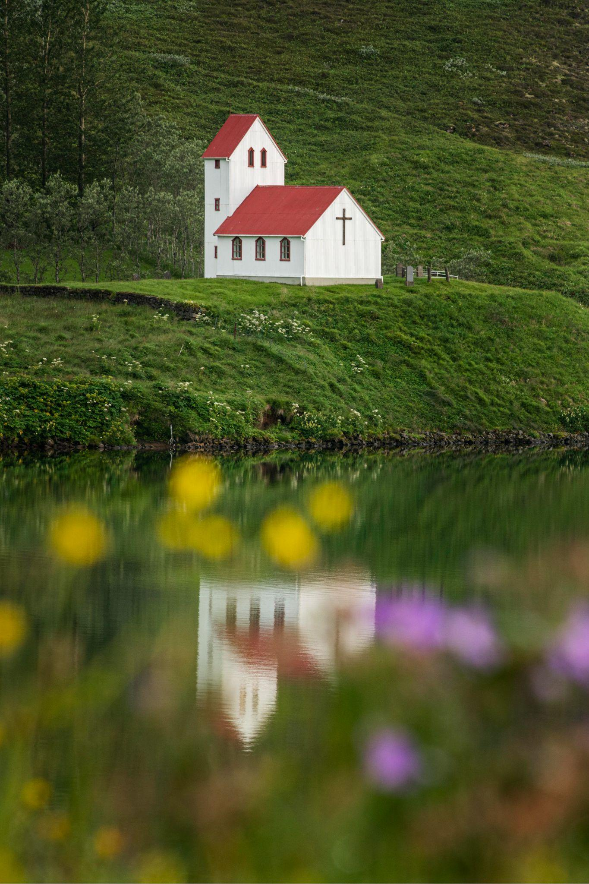
THE ORIGINS AND EARLY HISTORY OF THE CHURCH
Jesus Christ (teachings) – Disciples (fellowship) – Crucifixion (Redemption) – Great Commission (spreading the Good News) – Pentecost (Inspiration of the Holy Spirit) – Early Christian Community.
The Last Supper – the institution of the Eucharist – Unity and Fellowship – Jesus’ sacrifice
Pentecost – Book of Acts Chapter 2 (significance and establishment of the Early Church) – empowerment for Ministry – Birthday of the Church – Diversity of Language – Presence of the Holy Spirit

Slide 7
THE ORIGINS AND EARLY HISTORY OF THE CHURCH
Early Spread of Christianity (Book of Acts) – Apostolic Era – Pauline Missions – Urban Centers (Galatians, Romans, 1 Corinthians, 2 Corinthians, Philemon, Philippians, 1 Thessalonians) – Challenges and Persecutions – Conflicts with the Authorities (refusal to worship the Roman Gods and the Emperor)
Constantine and the Edict of Milan (313 AD) – Conversion of Constantine – Christianity’s Rise in Status (First Council of Nicaea in 325 AD)

Slide 8
THE ORIGINS AND EARLY HISTORY OF THE CHURCH
Theodosian Dynasty and State Recognition – Edict of Thessalonica in 380 AD ( Edict of the Emperors – official state religion and all are required to adhere to it.
Suppression of Paganism
Legacy and Impact – End of Persecutions – Religious Transformation – Christianization of the Empire

Slide 9
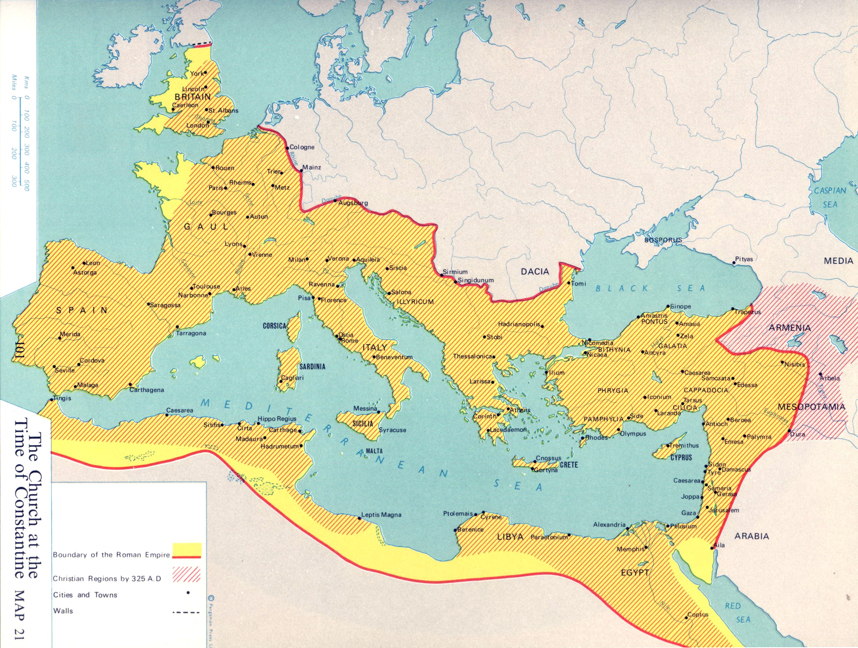

Slide 10
02
SECTION
DEVELOPMENT OF CHURCH DOCTRINE

Slide 11
Development of Church Doctrines
The emergence of theological debates within the early Christian church was intricately tied to the process of defining and clarifying core doctrines. As the church expanded and encountered diverse cultural, philosophical, and religious contexts, questions arose regarding the nature of God, the person of Jesus Christ, salvation, and other theological matters. These debates prompted the convening of various ecumenical councils that played a crucial role in formulating and solidifying key doctrines.

Slide 12
One of the earliest and most significant debates was the Christological debate, focusing on the nature of Jesus Christ—whether he was fully divine, fully human, or a combination of both. The Council of Nicaea in 325 CE addressed this issue, producing the Nicene Creed, which affirmed Jesus' "consubstantial" (of the same substance) relationship with God the Father and articulated the doctrine of the Trinity. This creed aimed to combat the heresy of Arianism, which denied the full divinity of Christ.
Another pivotal debate revolved around the nature of salvation and the relationship between faith and works. The Pelagian controversy in the 4th and 5th centuries delved into whether salvation was attainable through human effort alone or if divine grace was necessary. The Councils of Carthage and Ephesus tackled related matters, emphasizing the importance of grace while rejecting extreme positions.

Slide 13
The Council of Chalcedon in 451 CE addressed the Christological debate further by asserting the "hypostatic union," affirming that Jesus was both fully divine and fully human, without mixture, confusion, or separation. This clarification aimed to reconcile conflicting views and stabilize the church's understanding of Christ's nature.
Debates around the authority of scripture and the canonization of the New Testament also emerged. The formation of the New Testament canon was a gradual process, with discussions about which writings were authoritative and should be included. The Councils of Hippo and Carthage in the late 4th and early 5th centuries played a role in establishing the canon that aligns with the modern New Testament.

Slide 14
Overall, early church councils played a vital role in settling theological disputes and shaping the foundational doctrines of Christianity. These councils served as platforms for bishops and theologians from different regions to come together, deliberate, and arrive at a consensus on matters of faith. While these councils provided a framework for orthodoxy, they also contributed to the development of diverse theological traditions within Christianity, reflecting the complexity and diversity of early Christian thought. The decisions and creeds formulated in these councils not only helped unify the church but also laid the groundwork for the theological frameworks that continue to influence Christian beliefs and practices to this day.

Slide 15
The Nicene Creed
The Nicene Creed is a significant statement of Christian faith that was formulated during the First Council of Nicaea in 325 CE and later revised and expanded at the First Council of Constantinople in 381 CE. It is one of the most widely accepted and recited creeds in Christian tradition, serving as a foundational declaration of key theological beliefs. The creed addresses essential aspects of Christian doctrine, particularly concerning the nature of God, the Trinity, and the person of Jesus Christ. Here is the text of the Nicene Creed:

Slide 16
"We believe in one God, the Father Almighty, Maker of heaven and earth, and of all things visible and invisible. And in one Lord Jesus Christ, the only-begotten Son of God, begotten of the Father before all ages; Light of Light, very God of very God; begotten, not made, being of one substance with the Father, by whom all things were made. Who, for us men and for our salvation, came down from heaven, and was incarnate by the Holy Spirit of the virgin Mary, and was made man; and was crucified also for us under Pontius Pilate; He suffered and was buried; and the third day He rose again, according to the Scriptures; and ascended into heaven, and sits on the right hand of the Father; and He shall come again, with glory, to judge the quick and the dead; whose kingdom shall have no end. And we believe in the Holy Spirit, the Lord and Giver of Life; who proceeds from the Father and the Son; who with the Father and the Son together is worshiped and glorified; who spoke by the prophets. And we believe one holy catholic and apostolic Church. We acknowledge one baptism for the remission of sins; and we look for the resurrection of the dead, and the life of the world to come. Amen."

Slide 17
The Nicene Creed emphasizes several key theological points:
1. Monotheism and the Nature of God: The creed affirms belief in one God, the Father Almighty, who is the Creator of everything.
2. Divinity of Jesus Christ: The creed confesses Jesus Christ as the only-begotten Son of God, consubstantial (of the same substance) with the Father, and acknowledges his incarnation, crucifixion, resurrection, and ascension.
3. Role of the Holy Spirit: The creed acknowledges the Holy Spirit as the Lord and Giver of Life, who proceeds from the Father and the Son, and who is worshipped alongside the Father and the Son.
4. Salvation and Second Coming: The creed affirms that Jesus' incarnation, death, and resurrection were for the salvation of humanity and that he will return in glory to judge the living and the dead.
5. One Holy Catholic and Apostolic Church: The creed expresses belief in the unity and universality of the Christian Church and the importance of baptism for the remission of sins.

Slide 18
There are 21 councils in the church doctrine
Group Activity: Divide the class into 10 groups. Make a report of the following ecumenical councils:
Group 1 – Constantinople I and Ephesus
Group 2 – Chalcedon and Constantinople II
Group 3 – Constantinople III and Nicaea II
Group 4 – Constantinople IV and Lateran I
Group 5 – Lateran II and Lateran III
Group 6 – Lateran IV and Lyons I
Group 7 – Lyons II and Vienne
Group 8 – Constance and Florence
Group 9 – Lateran V and Trent
Group 10 – Vatican I and Vatican II

Slide 19
03
SECTION
THE CHURCH IN THE MIDDLE AGES

Slide 20
THE CHURCH IN THE MIDDLE AGES
The period of European history extending from about 500 to 1400–1500 CE is traditionally known as the Middle Ages. The term was first used by 15th-century scholars to designate the period between their own time and the fall of the Western Roman Empire.

Slide 21
THE FALL OF THE ROMAN EMPIRE
What caused the fall of Rome?
Corruption, the division of the empire, and invasion by Germanic tribes were the three main causes of the fall of Rome. Some scholars believe that there were other contributing factors as well.

Slide 22
THE FALL OF THE ROMAN EMPIRE
Corruption in the government led to problems like inflation, disease, and starvation, impacting the citizens of Rome and leading to the collapse of Rome.
Over expansion of the Roman Empire which led to administrative division
Germanic tribes from Northern and Central Europe

Slide 23
The Roman Empire lasted from 27 BC to 476 AD. This was 503 years. However, the founding of the city of Rome was in 753 BC. For much of its history, Rome was a republic. Therefore, Roman civilization lasted for 1,229 years.

Slide 24
THE ROLE OF THE CHURCH IN THE MIDDLE AGES
Spiritual Guidance – the church as an epicenter of medieval life offering comfort and meaning in an uncertain life ( understanding the world, morality, and afterlife)
Cultural Preservation – preserving knowledge and ancient texts (monasteries, centers of learning)

Slide 25
THE ROLE OF THE CHURCH IN THE MIDDLE AGES
Education - Universities in the Middle Ages closely tied to the Church. The church supported the pursuit of knowledge, theology, which gave the foundation for the Renaissance – the age of Enlightenment.
Social Services – establishment of Hospitals, Orphanages, and Hospices (guest house) by monastic orders (monks)

Slide 26
THE ROLE OF THE CHURCH IN THE MIDDLE AGES
Political Influence – the Church’s power to crown Kings and excommunicate rulers. The Church became the stabilizing force, and a source of tension in medieval politics.
Art and Architecture – The Grand Medieval Cathedrals stand as enduring symbols f the Church’s influence on art and architecture.

Slide 27
THE ROLE OF THE CHURCH IN THE MIDDLE AGES
Challenges and Reform – the Church faced challenges and calls for reform. Corruption and abuses of power led to criticism (the issue on Protestant Reformation in the 16th Century).

Slide 28
04
SECTION
THE REFORMATION AND ITS AFTERMATH

Slide 29
THE PROTESTANT REFORMATION
The Protestant Reformation was a response to perceived abuses and doctrinal disagreements within the Roman Catholic Church.
It sparked a series of religious and ideological shifts that challenged centuries-old traditions and gave birth to various Protestant denominations.

Slide 30
MARTIN LUTHER (1483 – 1546 AD)
Martin Luther is the forefront of the Protestant Revolution.
An Augustinian Monk, professor, theologian
95 Theses in Wittenberg 1517 – topics of debate like selling of indulgences, the Pope has no power over Purgatory(who can be saved and condemned)
Translating the Bible from Ancient Greek texts to German and Latin

Slide 31
JOHN CALVIN (1509-1564 AD)
A French Theologian
Emphasized the sovereignty of God and the concept of Predestination – the belief that God has already chosen who would be saved and be condemned.
The establishment of Presbyterian and Reformed Church
The Institutes of the Christian Religion book – foundational text for Protestant thought

Slide 32
HENRY VIII (1491-1547 AD)
King of England – April 22, 1509 until his death
The issue to annul his marriage to Catherine of Aragon led to a clash with the Catholic Church.
Establishment of the Church of England in 1534 and it marks the beginning of the Anglican Church

Slide 33
THE SPLIT BEHIND CATHOLICISM AND PROTESTANTISM
Theological Factors
a. Salvation by Faith alone
For Catholics – it requires the necessity of good works, sacraments, and the authority of the clergy for salvation (the clergy providing spiritual guidance and motivation)
For Protestants – “sola fide” the belief that salvation came through faith to Jesus Christ alone rather than human merit and religious rituals.

Slide 34
THE SPLIT BEHIND CATHOLICISM AND PROTESTANTISM
b. Authority of the Scripture
For Catholics – both Scripture and Tradition were authoritative sources of doctrine (theology)
For Protestants – “sola scriptura” the belief that scriptures alone should be the ultimate authority for Christian beliefs and practices. If it’s not listed and mentioned in the Scriptures, it is not acceptable

Slide 35
THE SPLIT BEHIND CATHOLICISM AND PROTESTANTISM
c. The Priesthood of all Believers – this is the protestant’s belief that all believers has access to God without the need of intermediaries like priests.
d. Sacraments and Rituals
For Catholics – 7 sacraments
For Protestants – Baptism and Holy Communion but the theological meanings shifted.

Slide 36
THE SPLIT BEHIND CATHOLICISM AND PROTESTANTISM
Social Factors
Corruption and Abuses – sale of indulgences, nepotism, and wealth accumulation
Political and National Factors – political and national interests saw potential in aligning with reform movements (The use of religion for politics and other national matters to influence). That is why, it led to independence of the Pope’s authority over them.

Slide 37
THE SPLIT BEHIND CATHOLICISM AND PROTESTANTISM
c. Printing Press and Access to Information – the invention of Printing Press in spreading Reformation Ideas.
d. Socioeconomic Changes – the rise of urban centers and the emergence of a more literate and and educated population.

Slide 38
THE COUNTER-REFORMATION: THE CHURCH’S RESPONSE
Acknowledging Criticisms – recognized the validity of some criticism of the Protestant Reformers. (e.g. corruption, indulgences, nepotism)
Council of Trent (1545-1563) – promote spiritual renewal emphasizing the importance of good works, sacraments, and the clergy

Slide 39
THE COUNTER-REFORMATION: THE CHURCH’S RESPONSE
Doctrinal Clarifications – provides clear doctrinal statements on issues that had caused divisions. It reaffirmed the number of sacraments as seven, the importance of Eucharist, rejecting the idea of salvation by faith alone.
Spiritual Renewal and Education – renewing the spirituality within the Catholic Church. The rise of Religious Orders – e.g. Jesuits promoting education and missionary work to counterbalance the Protestant’s emphasis on individual study of Scriptures.

Slide 40
THE COUNTER-REFORMATION: THE CHURCH’S RESPONSE
Art and Culture – embraced artistic expression as a tool for evangelization. Grand churches, paintings, sculptures, and music.
The Roman Inquisition – established to identify and suppress heretical teachings to preserve its core teachings. (e.g. tortures, beheading, hanging)

Slide 41
Q & A

