Slide 1
Numerical Methods
Mathematical modelling and error analysis

Slide 2
Mathematical Background requisites
Roots of Equations
Systems of Linear Algebraic Equations
Optimization
Curve Fitting
Integration
Ordinary Differential Equations
Partial Differential Equations

Slide 3
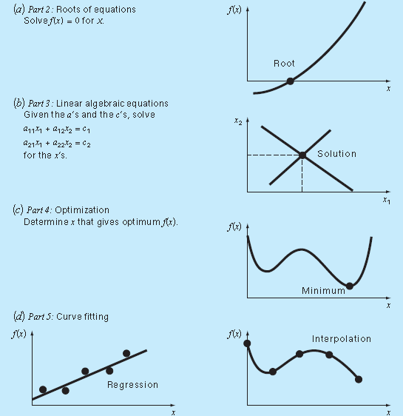

Slide 4
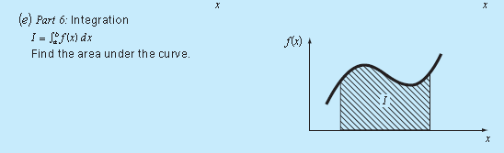
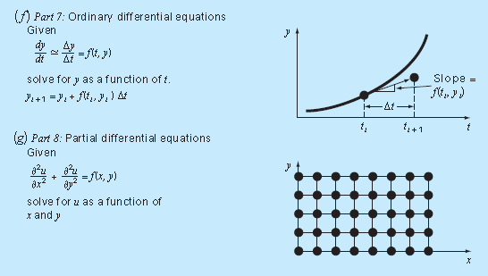

Slide 5
Mathematical Modeling and Engineering Problem Solving
Knowledge and understanding are prerequisites for the effective implementation of any tool. No matter how impressive your tool chest, you will be hard-pressed to repair a car if you do not understand how it works.
Notes:
This is particularly true when using computers to solve engineering problems. Although
they have great potential utility, computers are practically useless without a fundamental
understanding of how engineering systems work.

Slide 6

A simple mathematical model
A mathematical model can be broadly defined as a formulation or equation that expresses the essential features of a physical system or process in mathematical terms. In a very general sense, it can be represented as a functional relationship of the form
Notes:
where the dependent variable is a characteristic that usually reflects the behavior or state
of the system; the independent variables are usually dimensions, such as time and space,
along which the system’s behavior is being determined; the parameters are reflective of the
system’s properties or composition; and the forcing functions are external influences acting
upon the system.

Slide 7
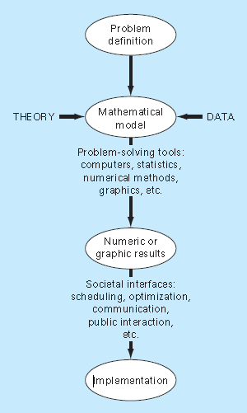

Slide 8
Approximations and round-off errors
For many applied engineering problems, we cannot obtain analytical solutions. Therefore, we cannot compute exactly the errors associated with our numerical methods. In these cases, we must settle for approximations or estimates of the errors.
How much the next error is present in our calculations and is it tolerable?

Slide 9
Significant figures
Whenever we employ a number in a computation, we must have assurance that it can be used with confidence.

Slide 10
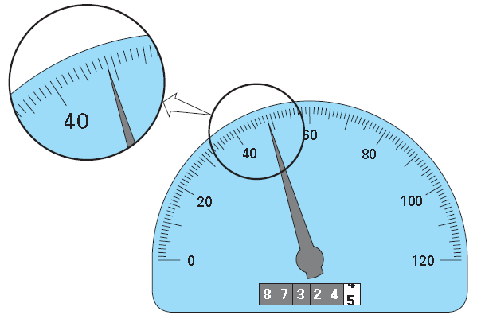
Notes:
Because the indicator is higher than the midpoint between the markers on the gauge, we can say with assurance that the car is traveling at approximately
49 km/h. We have confidence in this result because two or more reasonable individuals reading this gauge would arrive at the same conclusion. However, let us say that we insist that the speed be estimated to one decimal place. For this case, one person might say 48.8, whereas another might say 48.9 km/h. Therefore, because of the limits of this instrument,

Slide 11
Significant figure
The concept of a significant figure, or digit, has been developed to formally designate the reliability of a numerical value.
The significant digits of a number are those that can be used with confidence.
They correspond to the number of certain digits plus one estimated digit.
Notes:
If I say significant bits?
For the speedometer, the two certain digits are 48. It is conventional to set the estimated digit at one-half of the smallest scale division on
the measurement device. Thus the speedometer reading would consist of the three significant figures: 48.5.

Slide 12
How many significant figures does the ff. numbers have?
0.00001845
0.0001845
0.001845
Notes:
1. For example, zeros are not always significant figures because they may be necessary just to locate a decimal point. (they all have 4 significant figures)

Slide 13
45,300
Notes:
When trailing zeros are used in large numbers, it is not clear how many, if any, of the zeros are significant.
For example, at face value the number 45,300 may have three, four, or five significant digits, depending on whether the zeros are known with confidence.
Such uncertainty can be resolved by using scientific notation, where 4.53 × 104, 4.530 × 104, 4.5300 × 104 designate that the number is known to three, four, and five significant figures, respectively.

Slide 14
Important!
Numerical methods yield approximate results. We must, therefore, develop criteria to specify how confident we are in our approximate result. One way to do this is in terms of significant figures. For example, we might decide that our approximation is acceptable if it is correct to four significant figures.
Although quantities such as π, e, or √7 represent specific quantities, they cannot be expressed exactly by a limited number of digits. For example,
π = 3.141592653589793238462643. . .
ad infinitum. Because computers retain only a finite number of significant figures, such numbers can never be represented exactly. The omission of the remaining significant figures is called round-off error.

Slide 15
Accuracy and precision
Accuracy refers to how closely a computed or measured value agrees with the true value.
Precision refers to how closely individual computed or measured values agree with each other.

Slide 16
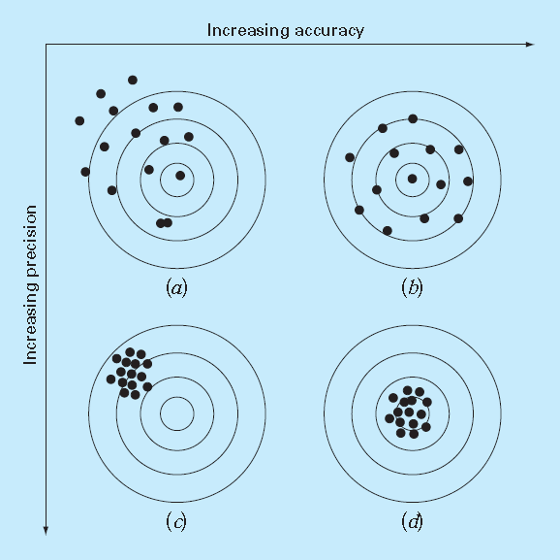
Notes:
Inaccuracy (also called bias) is defined as systematic deviation from the truth. Thus, although the shots in Fig. 3.2c are more tightly grouped than those in Fig. 3.2a, the two cases are equally biased because they are both centered on the upper left quadrant of the target. Imprecision (also called uncertainty), on the other hand, refers to the magnitude of the scatter. Therefore, although Fig. 3.2b and d are equally accurate (that is, centered on the bull’s-eye), the latter is more precise because the shots are tightly grouped.

Slide 17
Error definitions
Numerical errors arise from the use of approximations to represent exact mathematical operations and quantities.
These include truncation errors, which result when approximations are used to represent exact mathematical procedures
round-off errors, which result when numbers having limited significant figures are used to represent exact numbers.
For both types, the relationship between the exact, or true, result and the approximation can be formulated as
Et = true value − approximation
Et is used to designate the exact value of the error.
Notes:
The subscript t is included to designate that this is the “true” error. This is in contrast to other cases, as described shortly,
where an “approximate” estimate of the error must be employed.

Slide 18


A shortcoming of this definition is that it takes no account of the order of magnitude of the value under examination.
One way to account for the magnitudes of the quantities being evaluated is to normalize the error to the true value, as in
The relative error can also be multiplied by 100 percent to express it as
where εt designates the true percent relative error.

Slide 19
Example: Calculation of Errors
Problem Statement. Suppose that you have the task of measuring the lengths of a bridge and a rivet and come up with 9999 and 9 cm, respectively. If the true values are 10,000 and 10 cm, respectively, compute (a) the true error and (b) the true percent relative error for each case.
Sol’n
The error for measuring the bridge is
Et = 10,000 − 9999 = 1 cm
and for the rivet it is
Et = 10 − 9 = 1 cm

Slide 20
(b) The percent relative error for the bridge is
εt = (1/10,000)x100% = 0.01%
and for the rivet it is
εt = (1/10)x100% = 10%
Thus, although both measurements have an error of 1 cm, the relative error for the rivet is much greater. We would conclude that we have done an adequate job of measuring the bridge, whereas our estimate for the rivet leaves something to be desired.

Slide 21

For numerical methods, the true value will be known only when we deal with functions that can be solved analytically. However, in actual situations such information is rarely available. For these situations, an alternative is to normalize the error using the best available estimate of the true value, that is, to the approximation itself, as in
where the subscript a signifies that the error is normalized to an approximate value

Slide 22

One of the challenges of numerical methods is to determine error estimates in the absence of knowledge regarding the true value.
In such an approach, a present approximation is made on the basis of a previous approximation.
Notes:
The signs of these eqns maybe positive or negative.
Often, when performing computations, we may not be concerned with the sign of the error, but we are interested in whether the percent
absolute value is lower than a prespecified percent tolerance εs .

Slide 23
LAB ACTIVITY
Matlab
Excel
SciLab

Slide 24
Round-off errors
Numbers such as П, е , √7 cannot be expressed by a fixed number of significant figures. Therefore they cannot be represented exactly by a computer.
Notes:
computers retain only a fixed number of significant figures during a calculation.

Slide 25
Computer Representation of numbers
Numerical round-off errors are directly related to the manner in which numbers are stored in a computer. The fundamental unit whereby information is represented is called a word. This is an entity that consists of a string of binary digits, or bits.

Slide 26
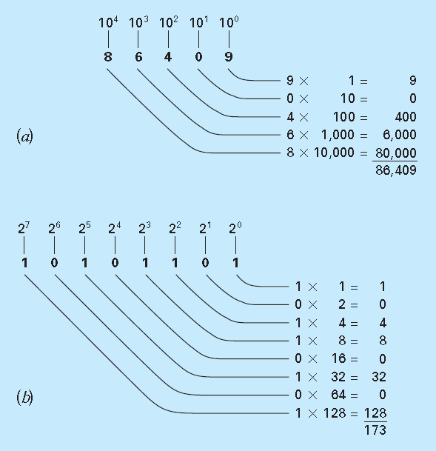

Slide 27
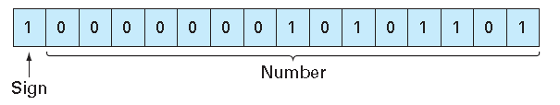
Integer representation using signed magnitude method
-173

Slide 28
Challenge
Problem Statement. Determine the range of integers in base-10 that can be represented on a 16-bit computer.
Notes:
which equals 32,767 (note that this expression can be simply evaluated as 215 − 1). Thus,
a 16-bit computer word can store decimal integers ranging from −32,767 to 32,767. In
addition, because zero is already defined as 0000000000000000, it is redundant to use the
number 1000000000000000 to define a “minus zero.” Therefore, it is usually employed to
represent an additional negative number: −32,768, and the range is from −32,768 to
32,767.

Slide 29

Floating-Point Representation
Fractional quantities are typically represented in computers using floating-point form. In this approach, the number is expressed as a fractional part, called a mantissa or significand, and an integer part, called an exponent or characteristic, as in
where m = the mantissa, b = the base of the number system being used, and e = the exponent.
For instance, the number 156.78 could be represented as 0.15678 × 10³

Slide 30
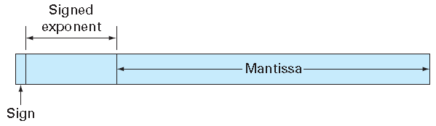
For example:
1/34= 0.029411765
If we have a base-10 system that allowed only four decimal places, thus
0.0294 x 10⁰
But in the process of doing this the inclusion of a useless zero to the right of the decimal forces us to drop 1 in the fifth decimal place.
The number can be normalized to remove the leading zero by multiplying the mantissa by 10 and lowering the exponent by 1 to give
0.2942 x 10⁻¹

Slide 31

The consequence of normalization is that the absolute value of m is limited. That is,
where b = the base. For example, for a base-10 system, m would range between 0.1 and 1, and for a base-2 system, between 0.5 and 1.

Slide 32
Challenge
Create a hypothetical floating-point number set for a machine that stores information using 7-bit words. Employ the first bit for the sign of the number, the next three for the sign and the magnitude of the exponent, and the last three for the magnitude of the mantissa. Find the smallest possible floating point number

Slide 33
Aspects to consider on floating point representation that have significance regarding computer round-off errors:
There Is a Limited Range of Quantities That May Be Represented
There Are Only a Finite Number of Quantities That Can Be Represented within the Range.
The Interval between Numbers, ∆x, Increases as the Numbers Grow in Magnitude.
Notes:
The errors introduced by approximating both these cases are referred to as quantizing errors.

Slide 34
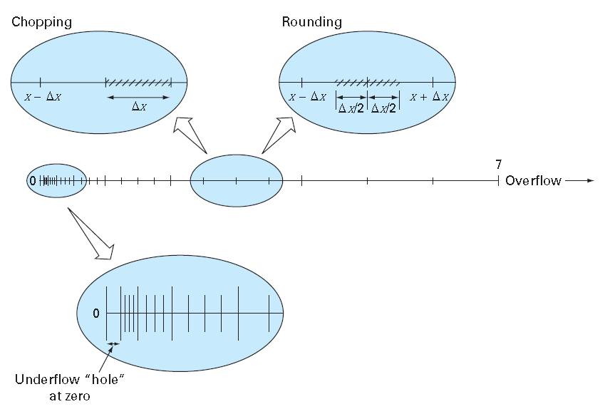

Slide 35
Arithmetic Manipulations of Computer Numbers
Addition
When two floating-point numbers are added, the mantissa of the number with the smaller exponent is modified so that the exponents are the same.
0.1557 · 10¹+ 0.4381 · 10⁻¹
Now the numbers can be added,
0.1557 · 10¹
0.004381 · 10¹
___________________
0.160081 . 10¹

Slide 36


Subtraction
0.9950 x 10¹ = 9.550
0.1000 x 10⁰ = 0.1000
Notice that the zero added to the end of the mantissa is not significant but is merely appended to fill the empty space created by the shift.
Thus, for this case, three non significant zeros are appended. This introduces a substantial computational error because subsequent manipulations would act as if these zeros were significant.
Notes:
26.86 from 36.41

Slide 37
Multiplication and Division
0.1363 · 10³ × 0.6423 · 10⁻¹ = 0.08754549 · 10²
If, as in this case, a leading zero is introduced, the result is normalized,
0.08754549 · 10² →0.8754549 · 10¹
and chopped to give
0.8754 · 10¹
Division is performed in a similar manner, but the mantissas are divided and the exponents are subtracted. Then the results are normalized and chopped.
Notes:
Multiplication and division are somewhat more straightforward than addition or subtraction.
The exponents are added and the mantissas multiplied.
Because multiplication of two n-digit mantissas will yield a 2n-digit result, most computers hold intermediate results
in a double-length register.

Slide 38
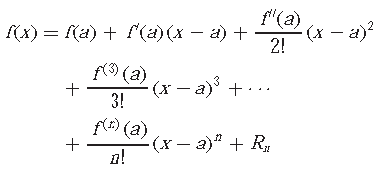
Truncation Errors and Taylor Series
Truncation errors are those that result from using an approximation in place of an exact mathematical procedure
In essence, the Taylor series provides a means to predict a function value at one point in terms of the function value and its derivatives at another point.
Notes:
Taylor series – you can rewrite a function f(x) in terms of an infinite sum of other functions

Slide 39
f(xi+1)∼=f(xi )
This relationship, called the zero-order approximation, indicates that the value of f at the new point is the same as its value at the old point.
provides a perfect estimate if the function being approximated is, in fact, a constant
However, if the function changes at all over the interval, additional terms of the Taylor series are required to provide a better estimate. For example, the first-order approximation is developed by adding another term to yield
f(xi+1)∼=f(xi ) + f ‘(xi )(xi+1 − xi )
the expression is now in the form of a straight line and is capable of predicting
an increase or decrease of the function between xi and xi+1.
Notes:
A useful way to gain insight into the Taylor series is to build it term by term.
The additional first-order term consists of a slope f ‘
(xi) multiplied by the distance between
xi and xi+1.

Slide 40

Although the last equation presented can predict a change, it is exact only for a straight-line, or linear, trend. Therefore, a second-order term is added to the series to capture some of the curvature that the function might exhibit:

Slide 41

It is often convenient to simplify the Taylor series by defining a step size h = x_{i+1} − x_{i} and expressing
where the remainder term is now
Notes:
The Taylor series can be used to calculate the value of an entire function at every point, if the value of the function, and of all of its derivatives, are known at a single point.

Slide 42
Taylor Series approximation of a Polynomial
Problem Statement. Use zero- through fourth-order Taylor series expansions to approximate the function
f(x) = −0.1x⁴− 0.15x³− 0.5x² − 0.25x + 1.2
from xi = 0 with h = 1. That is, predict the function’s value at xi+1 = 1.

Slide 43
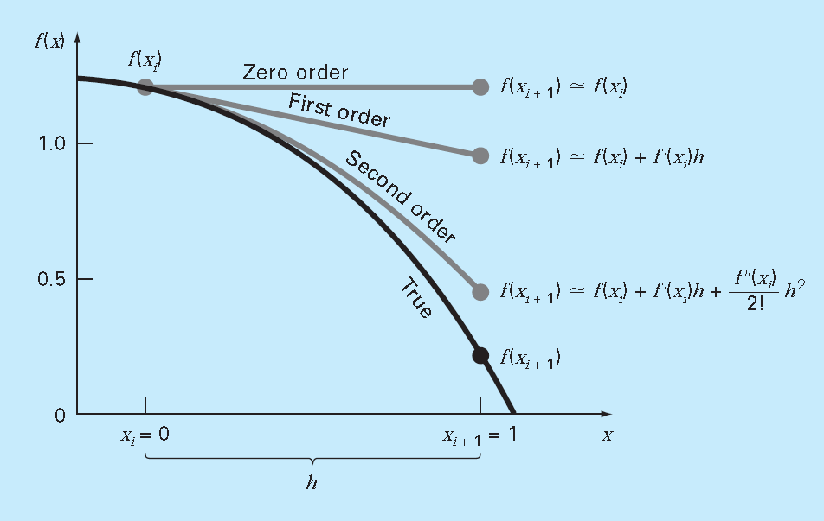

Slide 44



