Slide 1
Bracketing methods
This chapter on roots of equations deals with methods that exploit the fact that a function typically changes sign in the vicinity of a root. These techniques are called bracketing methods because two initial guesses for the root are required.

Slide 2


Graphical Approach
Problem Statement. Use the graphical approach to determine the drag coefficient c needed for a parachutist of mass m = 68.1 kg to have a velocity of 40 m /s after free-falling for time t = 10 s.
Note: The acceleration due to gravity is 9.8 m /s2.

Slide 3
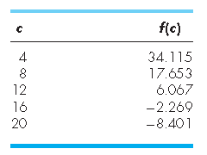
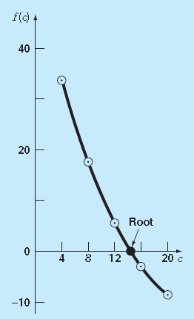


Notes:
Various values of c can be substituted into the right-hand side of this equation to compute
The root is nearing zero and the velocity nearing the desired value at 40m/s

Slide 4
Pros and Cons
Graphical techniques are of limited practical value because they are not precise.
However graphical methods can be utilized to obtain rough estimates of roots.
These estimates can be employed as starting guesses for numerical methods

Slide 5
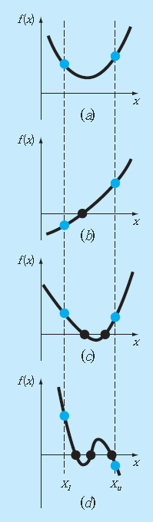
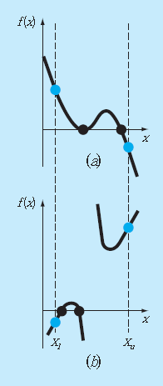
Notes:
For example, Fig. 5.2 shows a number of ways in which roots can
occur (or be absent) in an interval prescribed by a lower bound xl and an upper bound xu.

Slide 6
Problem Statement. Computer graphics can expedite and improve your efforts to locate roots of equations. The function f(x) = sin 10x + cos 3x has several roots over the range x = 0 to x = 5. Use computer graphics to gain insight into the behaviour of this function.

