Slide 1
Numerical Methods
Part: False-Position Method of Solving a Nonlinear Equation

Slide 2
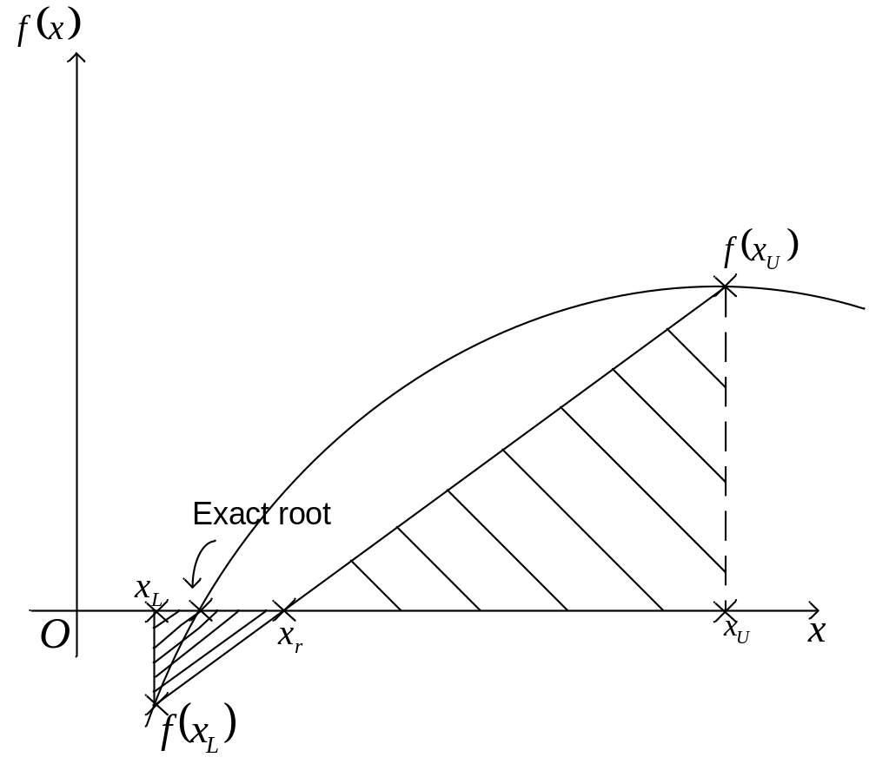
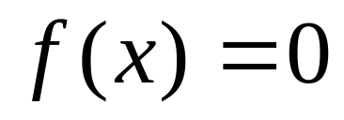
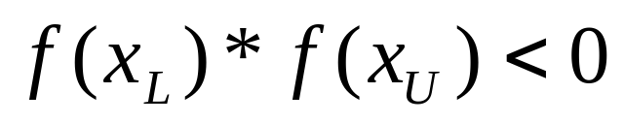
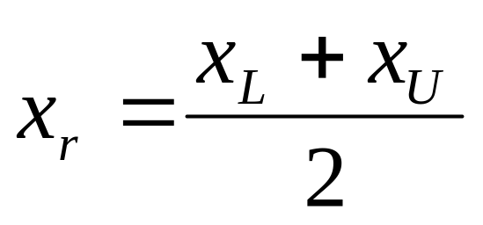
Introduction
(1)
In the Bisection method
(2)
(3)
1
Figure 1 False-Position Method

Slide 3
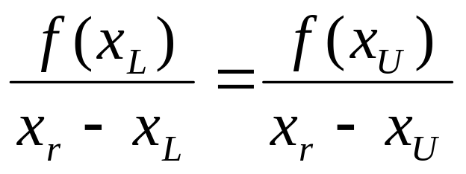
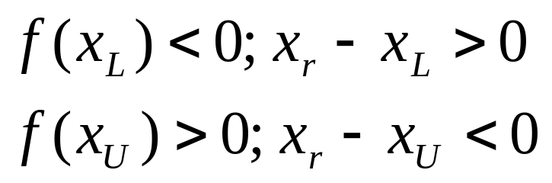
False-Position Method
Based on two similar triangles, shown in Figure 1,
one gets:
(4)
The signs for both sides of Eq. (4) is consistent, since:

Slide 4
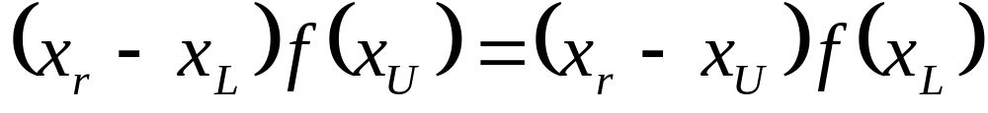

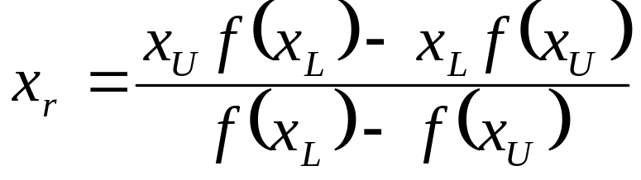
From Eq. (4), one obtains
The above equation can be solved to obtain the next
predicted root
, as
(5)

Slide 5
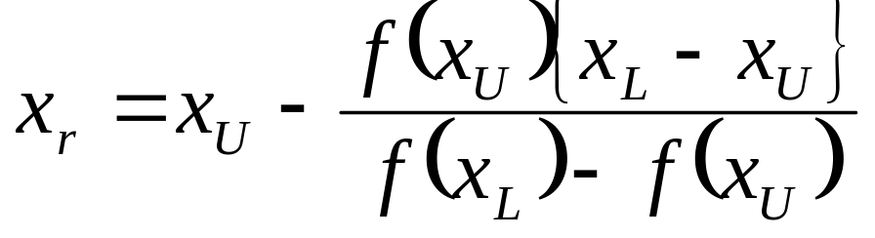
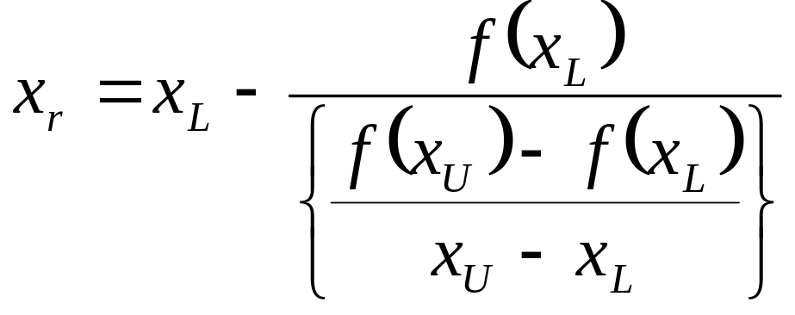
The above equation,
(6)
or
(7)

Slide 6
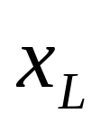
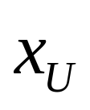
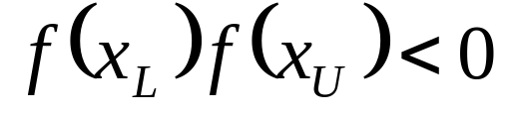
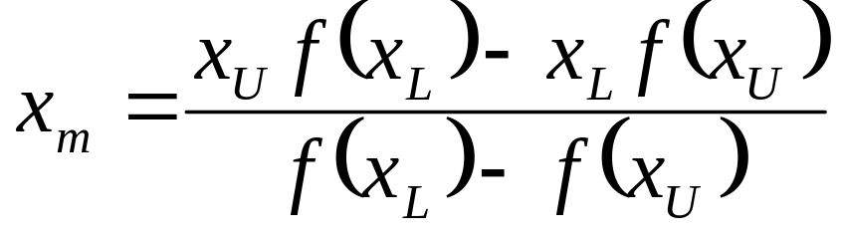
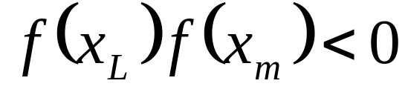
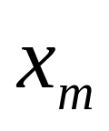
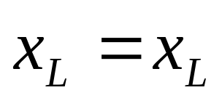
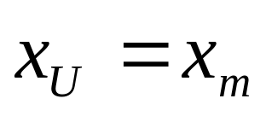
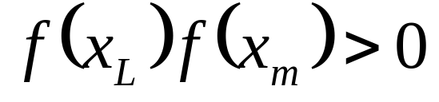
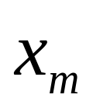
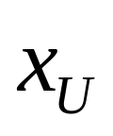
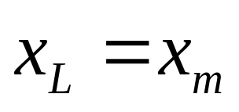
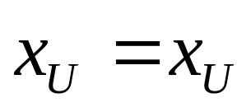
Step-By-Step False-Position
Algorithms
1. Choose
and
as two guesses for the root such
that
2. Estimate the root,
3. Now check the following
(a) If
, then the root lies between
and
; then
and
(b) If
, then the root lies between
and
; then
and

Slide 7
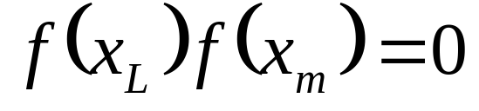
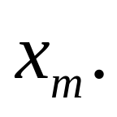
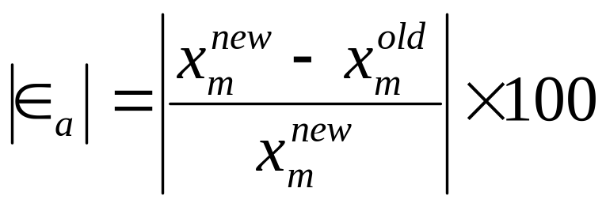
(c) If
, then the root is
Stop the algorithm if this is true.
4. Find the new estimate of the root
Find the absolute relative approximate error as

Slide 8
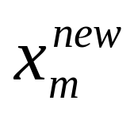
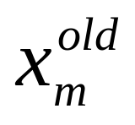
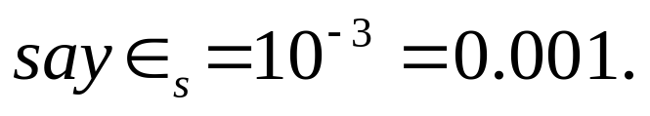
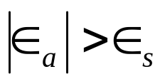
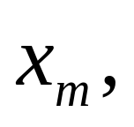
where
= estimated root from present iteration
= estimated root from previous iteration
5.
If
, then go to step 3,
else stop the algorithm.
Notes: The False-Position and Bisection algorithms are
quite similar. The only difference is the formula used to
calculate the new estimate of the root
shown in steps
#2 and 4!

Slide 9

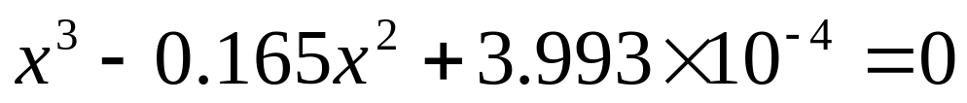
Example 1
The floating ball has a specific gravity of 0.6 and has a
radius of 5.5cm.
You are asked to find the depth to which the ball is
submerged when floating in water.
The equation that gives the depth
to which the ball is
submerged under water is given by
Use the false-position method of finding roots of
equations to find the depth to which the ball is
submerged under water. Conduct three iterations to
estimate the root of the above equation. Find the
absolute relative approximate error at the end of each
iteration, and the number of significant digits at least
correct at the converged iteration.

Slide 10
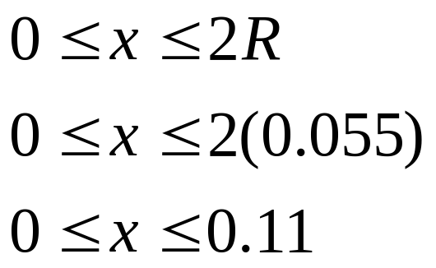
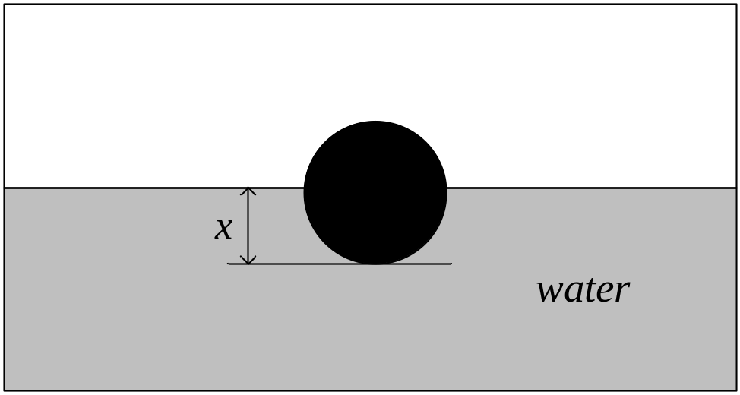
Solution
From the physics of the problem
Figure 2 :
Floating ball
problem

Slide 11
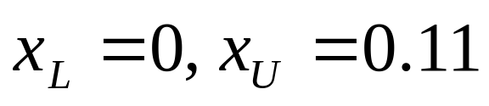
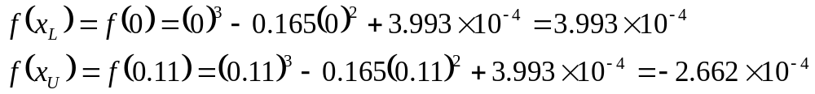
Let us assume
Hence,

Slide 12
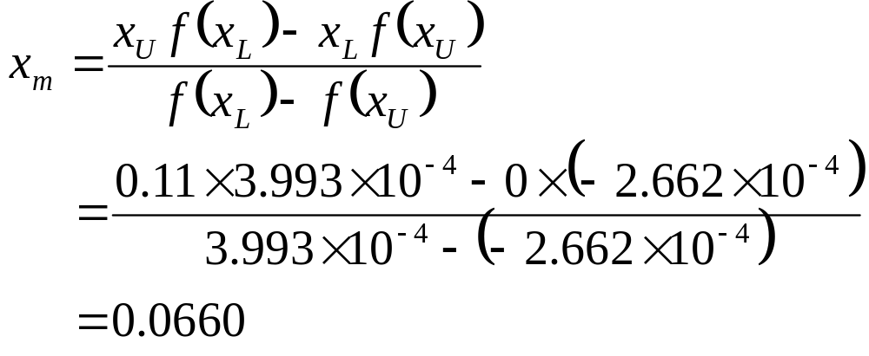
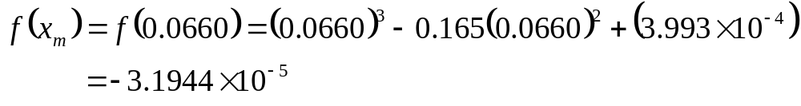
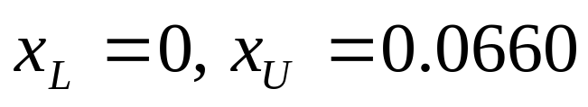
Iteration 1

Slide 13
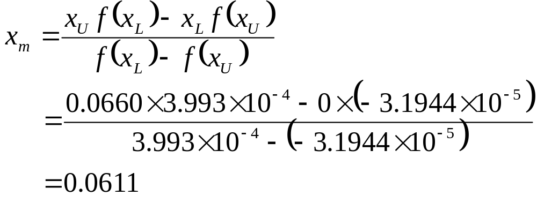
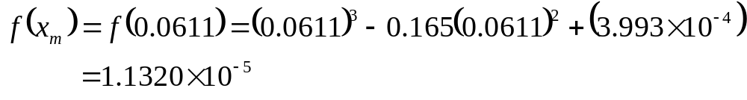
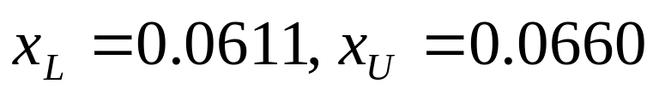
Iteration 2
Hence,

Slide 14
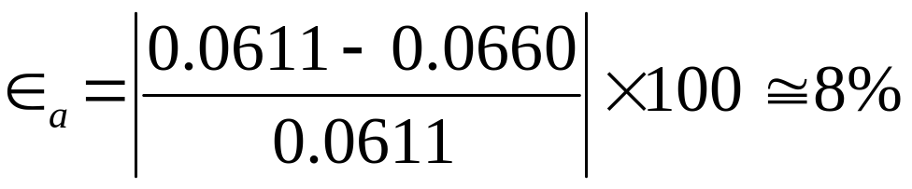
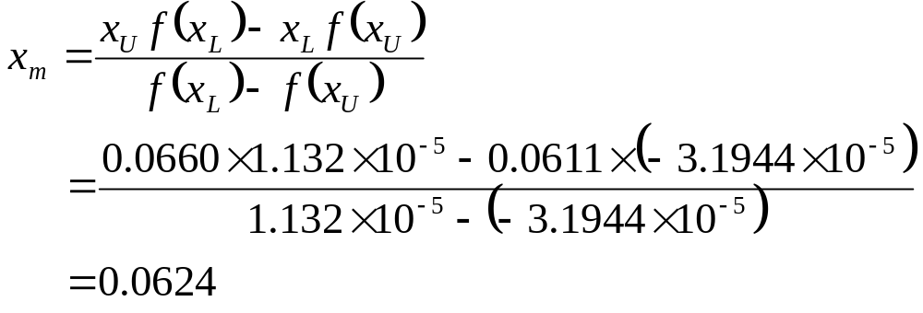
Iteration 3

Slide 15
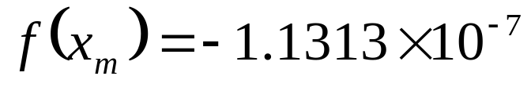
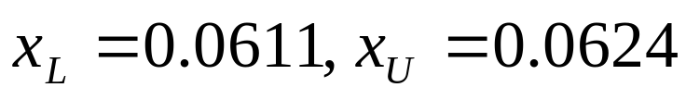
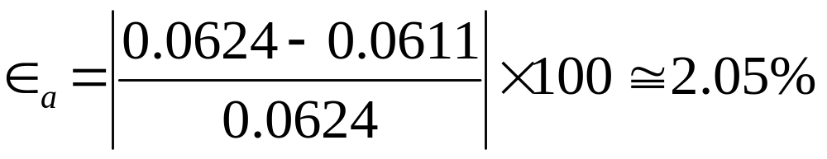
Hence,

Slide 16





Table 1: Root of
for False-Position Method.
Iteration
1 | 0.0000 | 0.1100 | 0.0660 | N/A | -3.1944x10⁻⁵
2 | 0.0000 | 0.0660 | 0.0611 | 8.00 | 1.1320x10⁻⁵
3 | 0.0611 | 0.0660 | 0.0624 | 2.05 | -1.1313x10⁻⁷
4 | 0.0611 | 0.0624 | 0.0632377619 | 0.02 | -3.3471x10⁻¹⁰

Slide 17
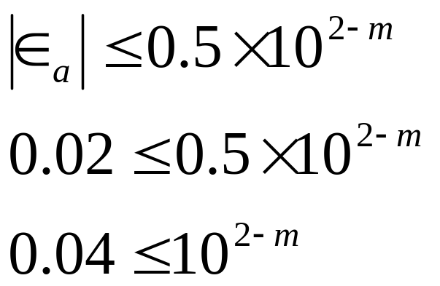
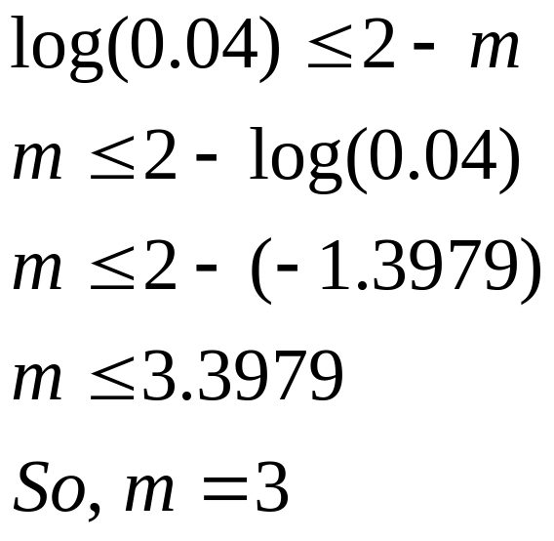
The number of significant digits at least correct in the
estimated root of 0.062377619 at the end of 4th iteration
is 3.

Slide 18
THE END

