Slide 1
False Position drawbacks
ES 84

Slide 2
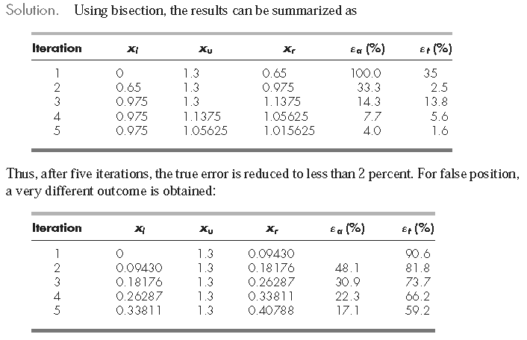
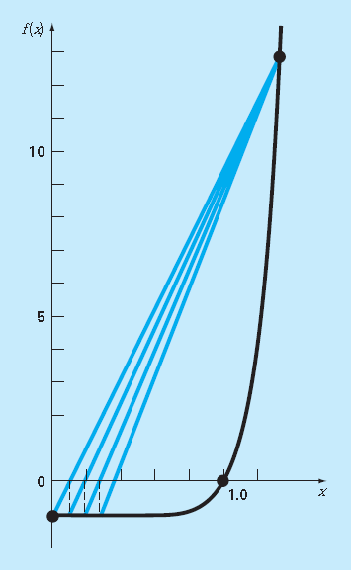
A case where Bisection is Preferable to False Position
Problem Statement. Use bisection and false position to locate the root of
f(x) = x10 − 1
between x = 0 and 1.3.
Notes:
After five iterations, the true error has only been reduced to about 59 percent.
2. In addition, note that εa < εt . Thus, the approximate error is misleading.
3. Although a method such as false position is often superior to bisection, there are invariably cases that violate this general conclusion.
4. Therefore, in addition the results should always be checked by substituting the root estimate into the original equation and determining whether the result is close to zero.
5. major weakness of the false-position method: its one-sidedness. That is, as iterations are proceeding, one of the bracketing points will tend to stay fixed. This can lead to poor convergence, particularly for functions with significant curvature
6.

Slide 3
Modified False Position
One way to mitigate the “one-sided” nature of false position is to have the algorithm detect when one of the bounds is stuck.
If this occurs, the function value at the stagnant bound can be divided in half. This is called the modified false-position method.

