Slide 1
Open methods
ES 84

Slide 2
Open Methods
For the bracketing methods , the root is located within an interval prescribed by a lower and an upper bound.
Repeated application of these methods always results in closer estimates of the true value of the root.
Such methods are said to be convergent because they move closer to the truth as the computation progresses
In contrast, the open methods that will be described are based on formulas that require only a single starting value of x or two starting values that do not necessarily bracket the root.

Slide 3
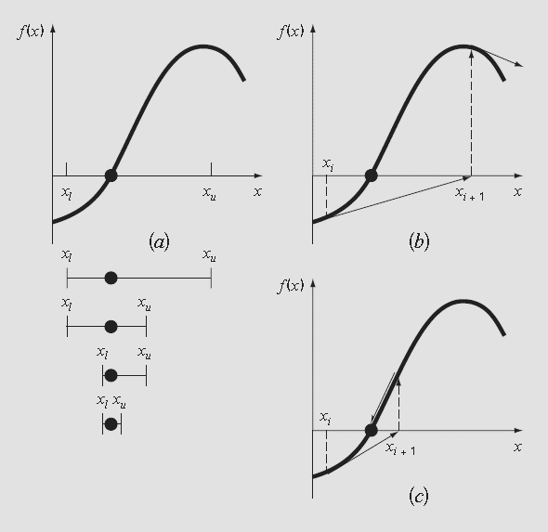

Slide 4
Simple fixed-point iteration
As mentioned above, open methods employ a formula to predict the root. Such a formula can be developed for simple fixed-point iteration by rearranging the function f (x) = 0 so that x is on the left-hand side of the equation:
x = g(x)
Ex:
x² − 2x + 3 = 0
x = (x²+3)/2

Slide 5
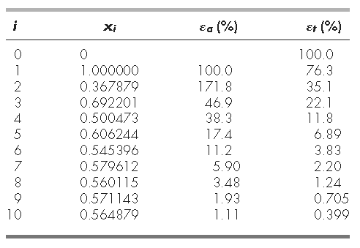
Problem Statement
Use simple fixed-point iteration to locate the root of f (x) = e^{−x} − x
Solution. The function can be separated directly and expressed in the form of
X_{i+1}=e^{-xi}
Notice that the true percent relative error for each iteration of (by a factor of about 0.5 to 0.6) to the error from the previous iteration. This property, called linear convergence, is characteristic of fixed-point iteration.

