Slide 1
Matrix Primer
ES 84
Prof. Arnel D. Zamayla

Slide 2
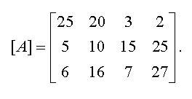

Slide 3


Slide 4
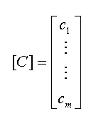

Slide 5


Notes:
submatrix

Slide 6
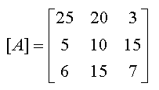
Notes:
Square matrix

Slide 7
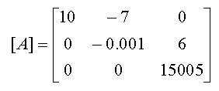
Notes:
Upper triangular matrix
Aij=0
i>j

Slide 8
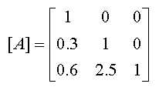
Notes:
Lower triangular matrix
Aij=0
j>i

Slide 9
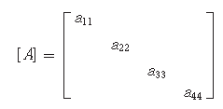
Notes:
Diagonal matrix may be a square matrix

Slide 10
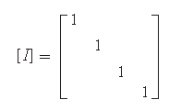
Notes:
Identity matrix

Slide 11
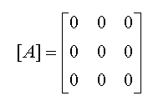
Notes:
Zero matrix

Slide 12
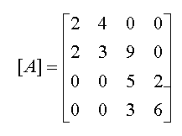
Notes:
Also a Square matrix
Tridiagonal matrix or banded matrix

Slide 13
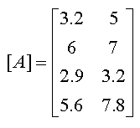
Do non-square matrices have diagonal entries?
Notes:
Diagonal entries where i=j

Slide 14
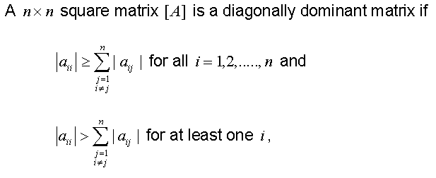
Diagonally Dominant Matrix
Notes:
Diagonally dominant matrices are important in ensuring convergence in iterative schemes of solving simultaneous linear equations.

Slide 15
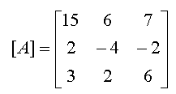

Slide 16
Strictly Diagonally Dominant Matrix
 | 15 | 6 | 7
[A] = | 2 | 5 | -2
 | 3 | 2 | 6

Slide 17
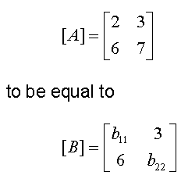
What would make
Notes:
Size and each element
Insert
Addition, subtraction,multiplication (mxp pxn),division

Slide 18
Definition of Inverse of a matrix
transpose

Slide 19
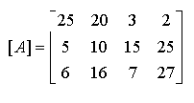
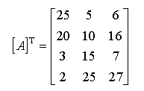
Transpose of a matrix

Slide 20

Notes:
Symmetric matrix
A12=a21 a13=131

Slide 21

Notes:
Skew symmetric matrix
Aij=-(Aji)

Slide 22
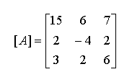
What is the trace of this matrix?
Notes:
Add all the diagonal entries

Slide 23

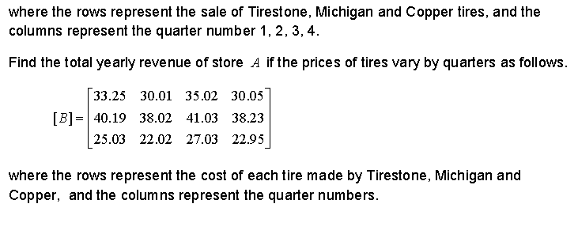
Exercise
The sales of tires are given by make (rows) and quarters (columns) for Blowout r’us
store location A , as shown below.

