Slide 1
Gauss-Seidel Method

Slide 2
Gauss-Seidel Method
An iterative method.
Basic Procedure:
Algebraically solve each linear equation for x_{i}
Assume an initial guess solution array
Solve for each x_{i} and repeat
Use absolute relative approximate error after each iteration to check if error is within a pre-specified tolerance.

Slide 3
Gauss-Seidel Method
Why?
The Gauss-Seidel Method allows the user to control round-off error.
Elimination methods such as Gaussian Elimination and LU Decomposition are prone to round-off error.
Also: If the physics of the problem are understood, a close initial guess can be made, decreasing the number of iterations needed.
Notes:
May be computationally more efficient
Control round-off error

Slide 4



Gauss-Seidel Method
Algorithm
A set of n equations and n unknowns:
If: the diagonal elements are non-zero
Rewrite each equation solving for the corresponding unknown
ex:
First equation, solve for x₁
Second equation, solve for x₂
. .
. .
. .

Slide 5
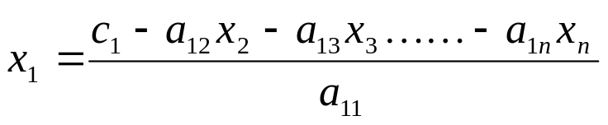
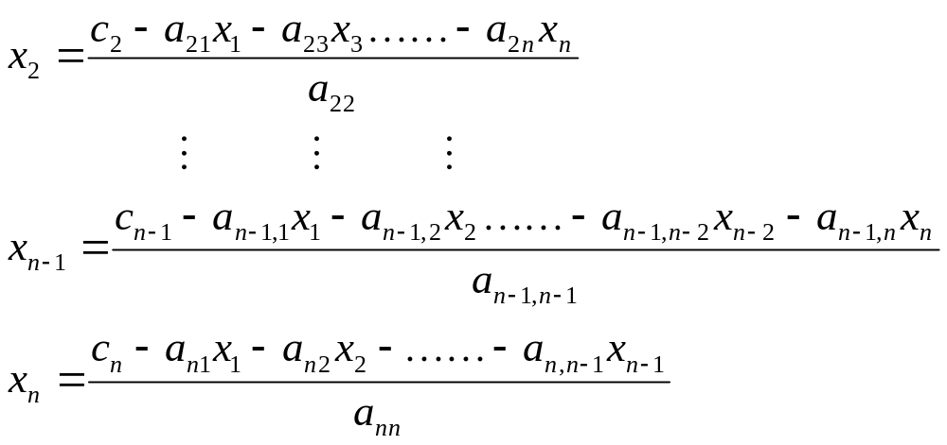
Gauss-Seidel Method
Algorithm
Rewriting each equation
From Equation 1
From equation 2
From equation n-1
From equation n

Slide 6
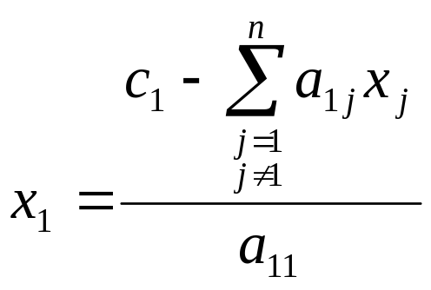
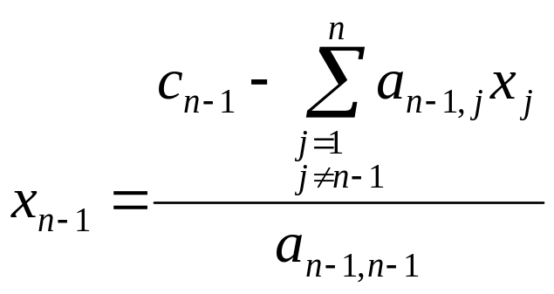
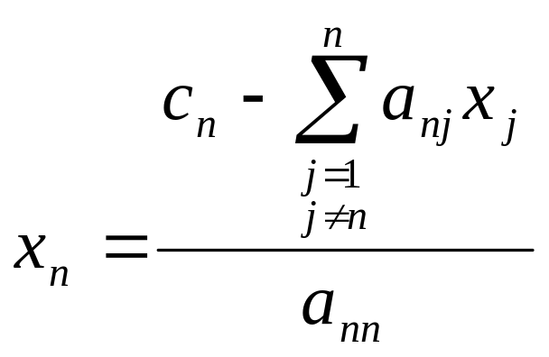
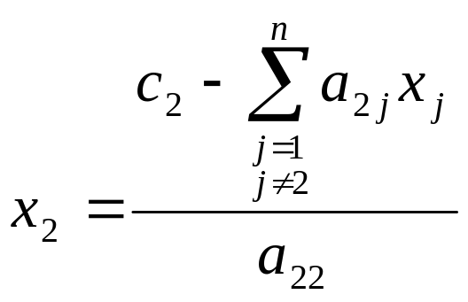
Gauss-Seidel Method
Algorithm
General Form of each equation

Slide 7
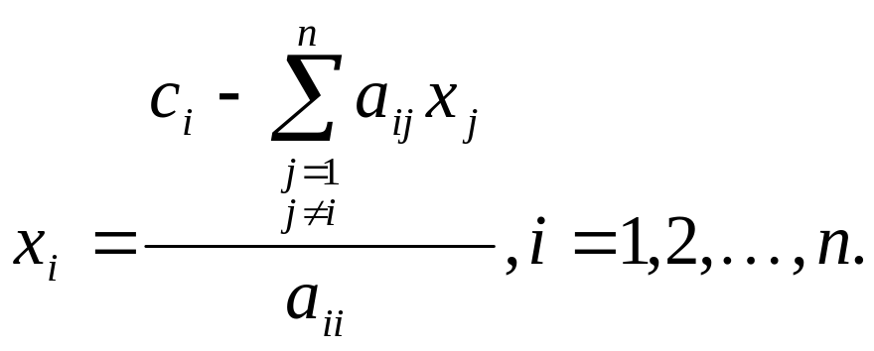
Gauss-Seidel Method
Algorithm
General Form for any row ‘i’
How or where can this equation be used?

Slide 8
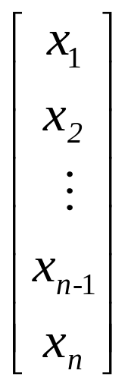
Gauss-Seidel Method
Solve for the unknowns
Assume an initial guess for [X]
Use rewritten equations to solve for each value of x_{i}.
Important: Remember to use the most recent value of x_{i}. Which means to apply values calculated to the calculations remaining in the current iteration.

Slide 9
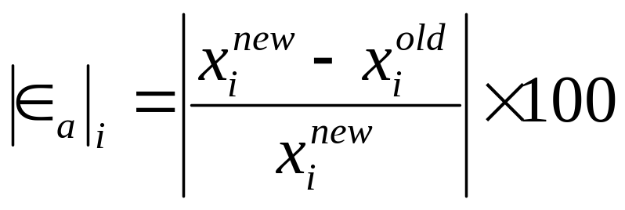
Gauss-Seidel Method
Calculate the Absolute Relative Approximate Error
So when has the answer been found?
The iterations are stopped when the absolute relative approximate error is less than a prespecified tolerance for all unknowns.

Slide 10



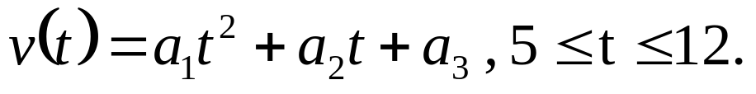
Gauss-Seidel Method: Example 1
The upward velocity of a rocket is given at three different times
Table 1 Velocity vs. Time data.
Time, | Velocity
5 | 106.8
8 | 177.2
12 | 279.2
The velocity data is approximated by a polynomial as:

Slide 11
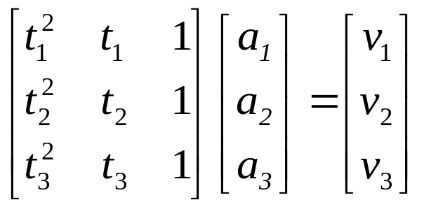
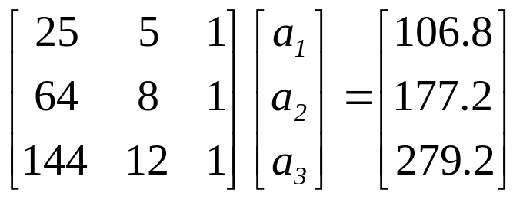
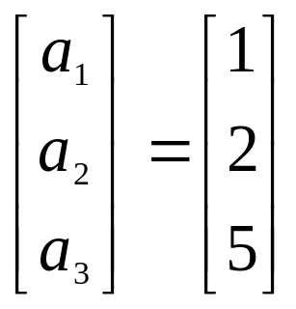
Gauss-Seidel Method: Example 1
Using a Matrix template of the form
The system of equations becomes
Initial Guess: Assume an initial guess of

Slide 12
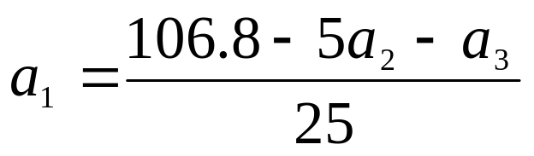
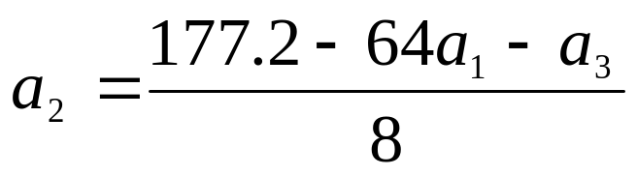
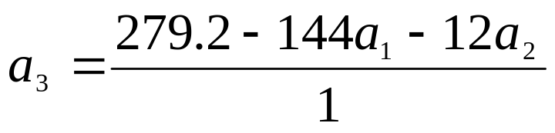
Gauss-Seidel Method: Example 1
Rewriting each equation

Slide 13
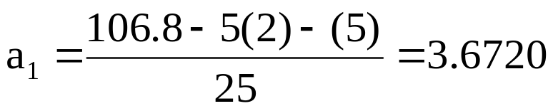
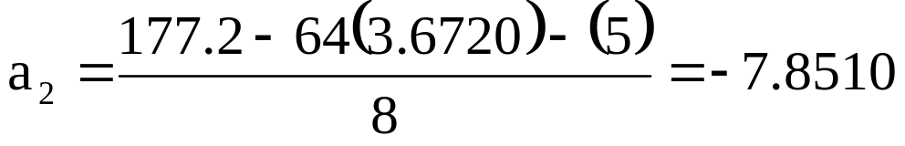
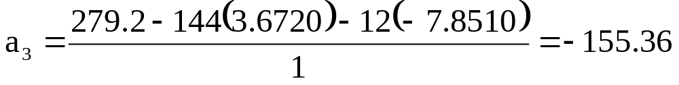
Gauss-Seidel Method: Example 1
Applying the initial guess and solving for a_{i}
Initial Guess
When solving for a₂, how many of the initial guess values were used?

Slide 14

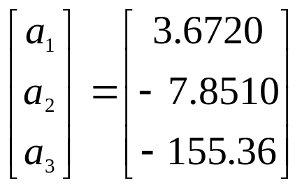
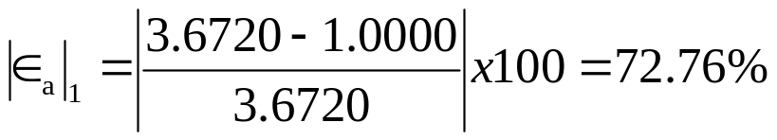
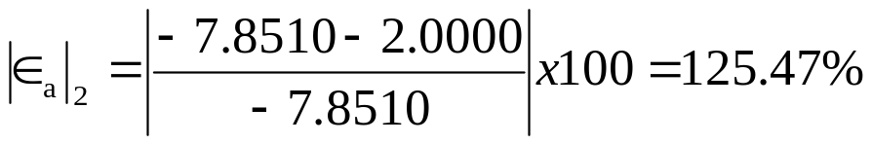
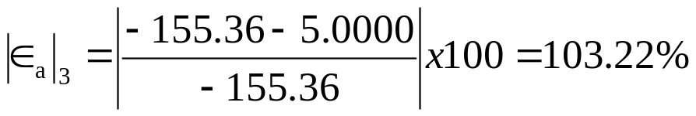
Gauss-Seidel Method: Example 1
Finding the absolute relative approximate error
At the end of the first iteration
The maximum absolute relative approximate error is 125.47%

Slide 15
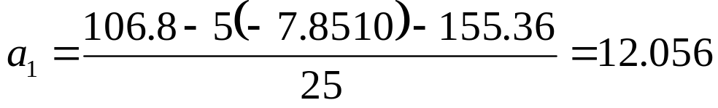
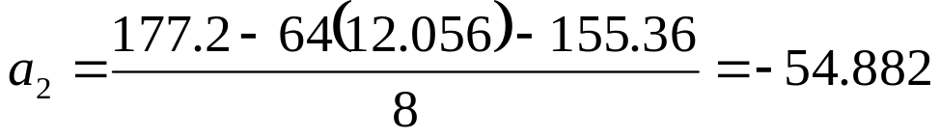
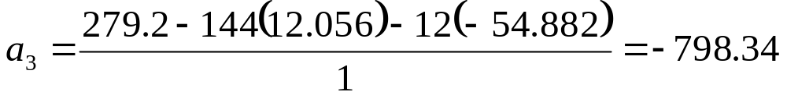
Gauss-Seidel Method: Example 1
Iteration #2
Using
the values of a_{i} are found:
from iteration #1

Slide 16
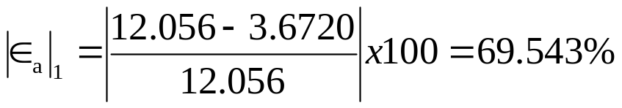
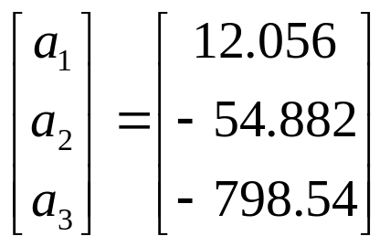
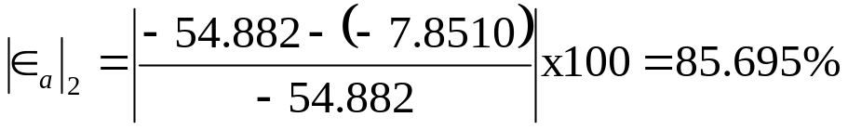
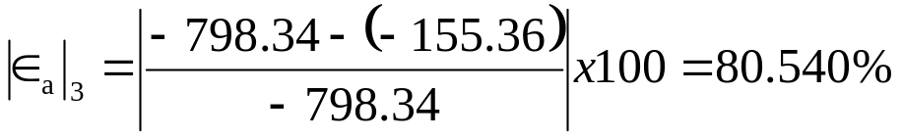
Gauss-Seidel Method: Example 1
Finding the absolute relative approximate error
At the end of the second iteration
The maximum absolute relative approximate error is 85.695%

Slide 17


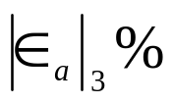
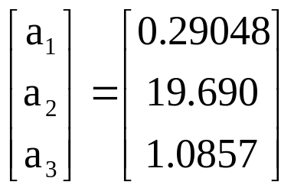
Gauss-Seidel Method: Example 1
Repeating more iterations, the following values are obtained
Iteration | a₁ |  | a₂ |  | a₃
1 2 3 4 5 6 | 3.6720 12.056 47.182 193.33 800.53 3322.6 | 72.767 69.543 74.447 75.595 75.850 75.906 | −7.8510 −54.882 −255.51 −1093.4 −4577.2 −19049 | 125.47 85.695 78.521 76.632 76.112 75.972 | −155.36 −798.34 −3448.9 −14440 −60072 −249580 | 103.22 80.540 76.852 76.116 75.963 75.931
Notice – The relative errors are not decreasing at any significant rate
Also, the solution is not converging to the true solution of

Slide 18
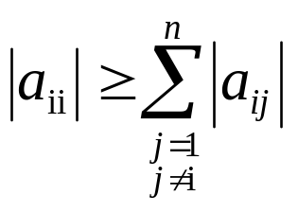
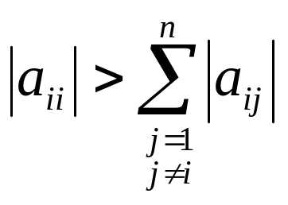
Gauss-Seidel Method: Pitfall
What went wrong?
Even though done correctly, the answer is not converging to the correct answer
This example illustrates a pitfall of the Gauss-Siedel method: not all systems of equations will converge.
Is there a fix?
One class of system of equations always converges: One with a diagonally dominant coefficient matrix.
Diagonally dominant: [A] in [A] [X] = [C] is diagonally dominant if:
for all ‘i’ and
for at least one ‘i’

Slide 19
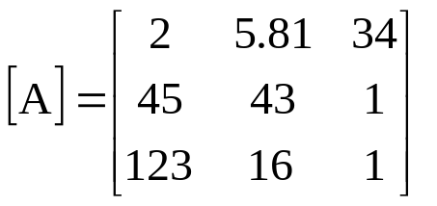
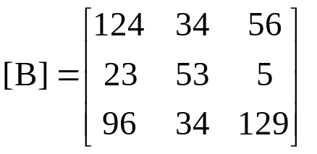
Gauss-Seidel Method: Pitfall
Diagonally dominant: The coefficient on the diagonal must be at least equal to the sum of the other coefficients in that row and at least one row with a diagonal coefficient greater than the sum of the other coefficients in that row.
Which coefficient matrix is diagonally dominant?
Most physical systems do result in simultaneous linear equations that have diagonally dominant coefficient matrices.

Slide 20

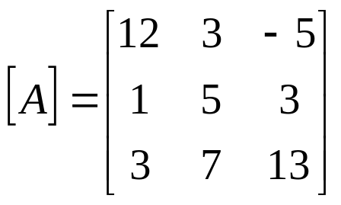


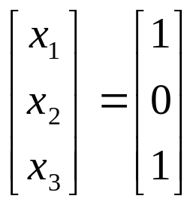
Gauss-Seidel Method: Example 2
Given the system of equations
The coefficient matrix is:
With an initial guess of
Will the solution converge using the Gauss-Siedel method?

Slide 21
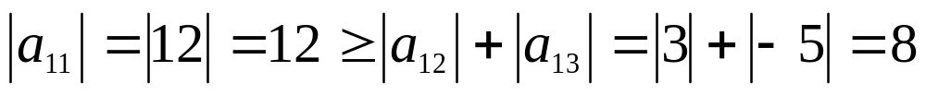
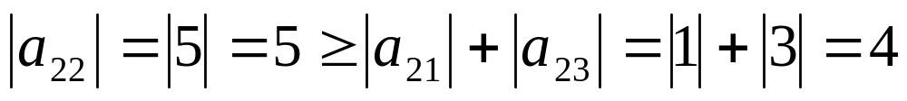
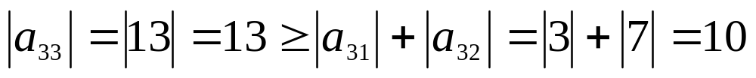
Gauss-Seidel Method: Example 2
Checking if the coefficient matrix is diagonally dominant
The inequalities are all true and at least one row is strictly greater than:
Therefore: The solution should converge using the Gauss-Siedel Method

Slide 22
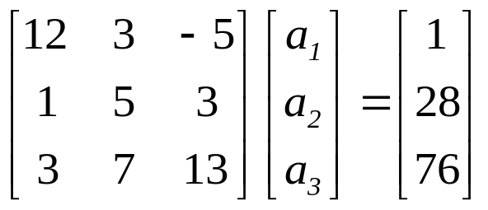
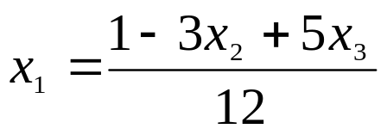
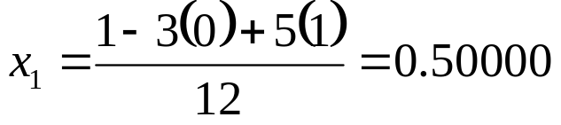
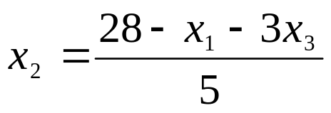
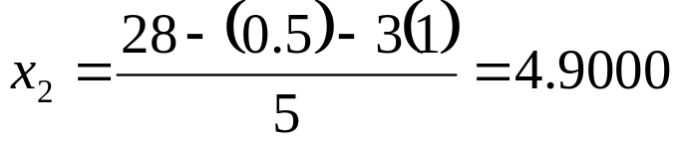
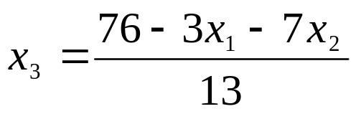
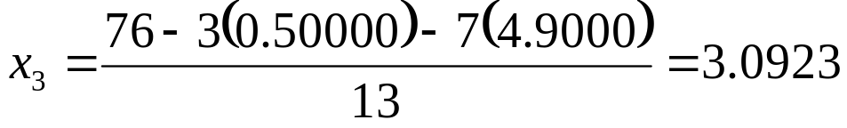
Gauss-Seidel Method: Example 2
Rewriting each equation
With an initial guess of

Slide 23
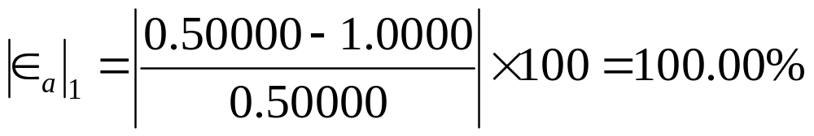
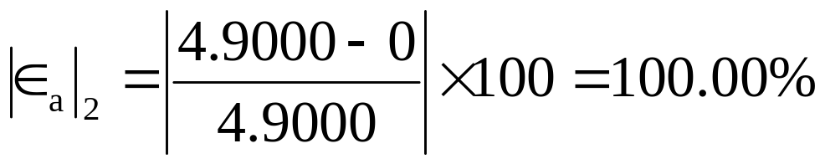

Gauss-Seidel Method: Example 2
The absolute relative approximate error
The maximum absolute relative error after the first iteration is 100%

Slide 24





Gauss-Seidel Method: Example 2
After Iteration #1
Substituting the x values into the equations
After Iteration #2

Slide 25



Gauss-Seidel Method: Example 2
Iteration #2 absolute relative approximate error
The maximum absolute relative error after the first iteration is 240.61%
This is much larger than the maximum absolute relative error obtained in iteration #1. Is this a problem?

Slide 26





Gauss-Seidel Method: Example 2
Repeating more iterations, the following values are obtained
Iteration | a₁ |  | a₂ |  | a₃
1 2 3 4 5 6 | 0.50000 0.14679 0.74275 0.94675 0.99177 0.99919 | 100.00 240.61 80.236 21.546 4.5391 0.74307 | 4.9000 3.7153 3.1644 3.0281 3.0034 3.0001 | 100.00 31.889 17.408 4.4996 0.82499 0.10856 | 3.0923 3.8118 3.9708 3.9971 4.0001 4.0001 | 67.662 18.876 4.0042 0.65772 0.074383 0.00101
The solution obtained is close to the exact solution of .

Slide 27







Gauss-Seidel Method: Example 3
Given the system of equations
Rewriting the equations
With an initial guess of

Slide 28



Gauss-Seidel Method: Example 3
Conducting six iterations, the following values are obtained
Iteration | a₁ |  | A₂ |  | a₃
1 2 3 4 5 6 | 21.000 −196.15 −1995.0 −20149 2.0364×10⁵ −2.0579×10⁵ | 95.238 110.71 109.83 109.90 109.89 109.89 | 0.80000 14.421 −116.02 1204.6 −12140 1.2272×10⁵ | 100.00 94.453 112.43 109.63 109.92 109.89 | 50.680 −462.30 4718.1 −47636 4.8144×10⁵ −4.8653×10⁶ | 98.027 110.96 109.80 109.90 109.89 109.89
The values are not converging.
Does this mean that the Gauss-Seidel method cannot be used?

Slide 29

Gauss-Seidel Method
The Gauss-Seidel Method can still be used
The coefficient matrix is not diagonally dominant
But this is the same set of equations used in example #2, which did converge.
If a system of linear equations is not diagonally dominant, check to see if rearranging the equations can form a diagonally dominant matrix.

Slide 30



Gauss-Seidel Method
Not every system of equations can be rearranged to have a diagonally dominant coefficient matrix.
Observe the set of equations
Which equation(s) prevents this set of equation from having a diagonally dominant coefficient matrix?

Slide 31
Gauss-Seidel Method
Summary
Advantages of the Gauss-Seidel Method
Algorithm for the Gauss-Seidel Method
Pitfalls of the Gauss-Seidel Method

Slide 32
THE END

Slide 33
Seatwork
Monica decided to divide a total of $42,000 into three investments: a savings account paying 5% interest, a time deposit paying 7%, and a bond paying 9%. Her total annual interest from the three investments was $2600, and the interest from the savings account was
$200 less than the total interest from the other two investments. How much did she invest at each rate?

