Slide 1
Shifts in orca phenology in the Salish Sea
1978-2017

Slide 2
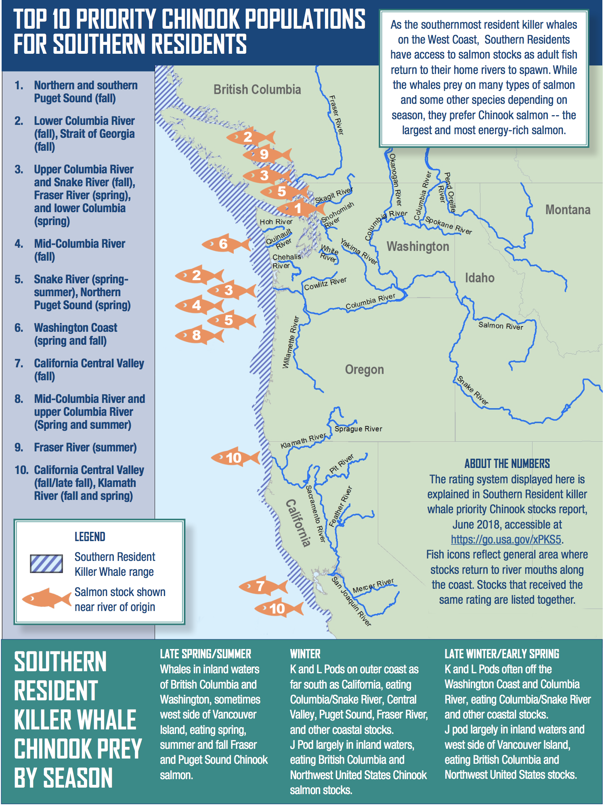
Spatial use by southern resident killer whales varies by season -Likely following prey

Slide 3
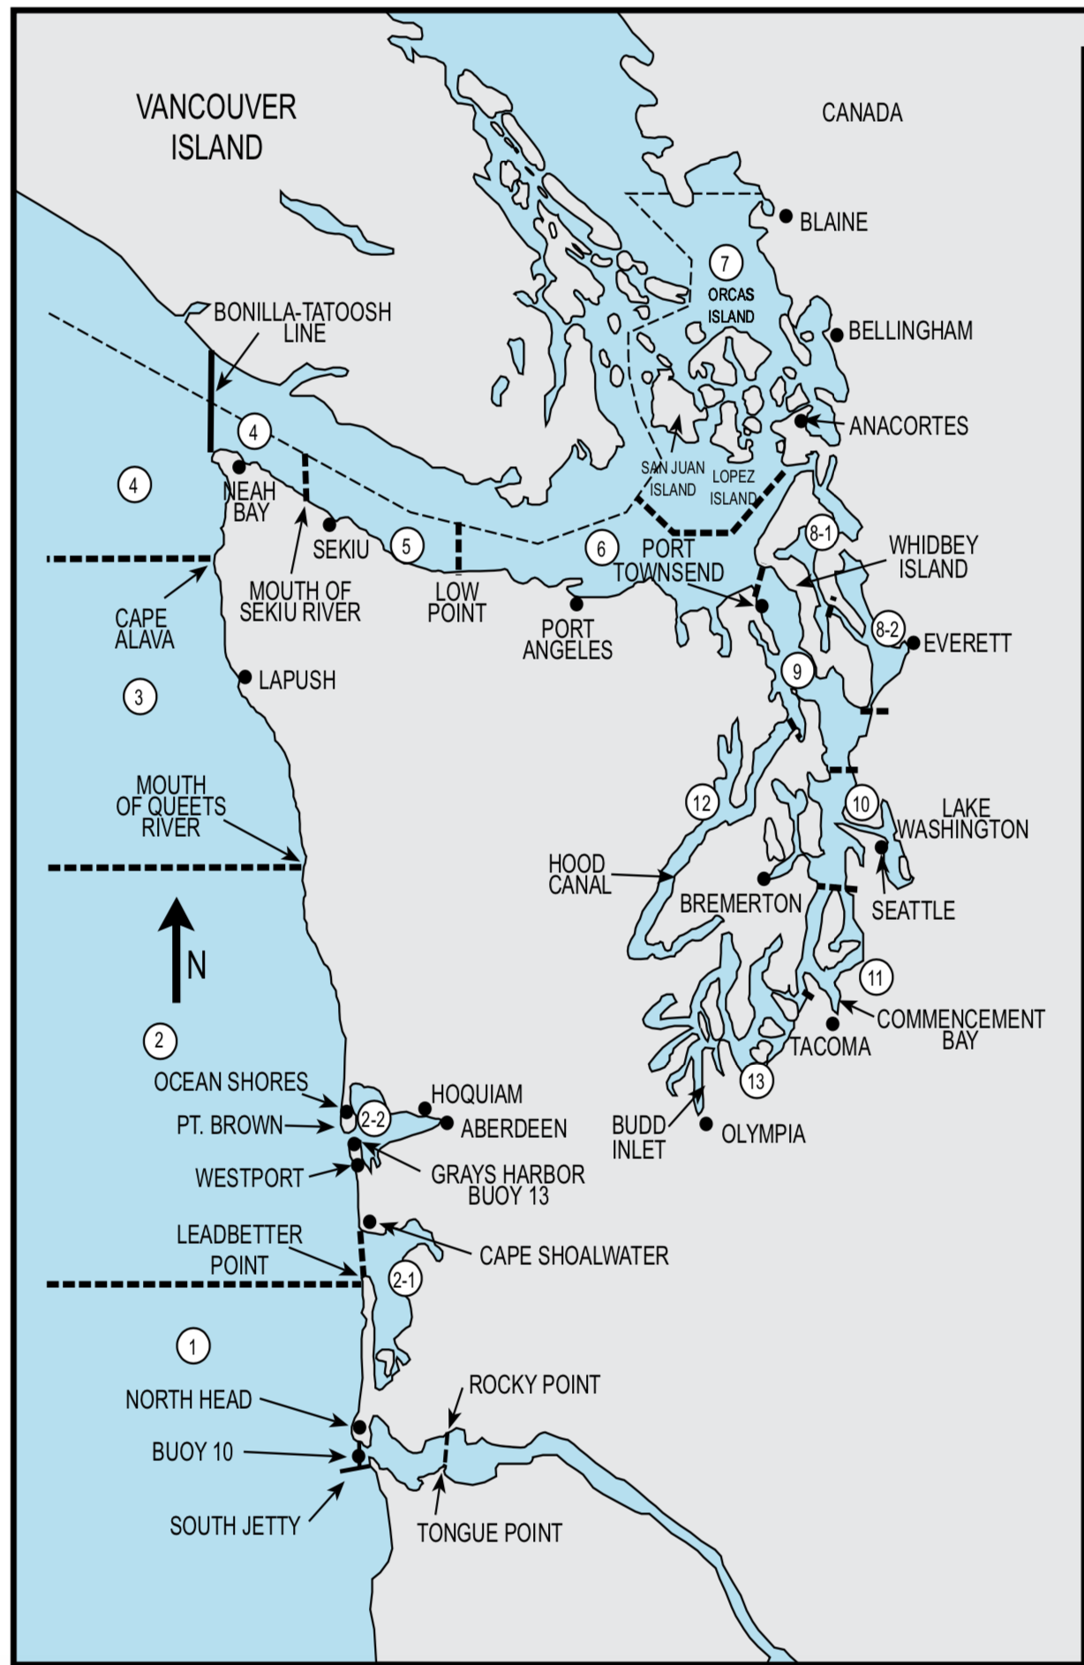
Divided Salish sea into: 1) Upper Salish Sea (FAs 4-7) 2) Puget Sound (FAs 8-13)

Slide 4
Upper Salish Sea Use (Summer, 1May-1Oct)

Slide 5
Peak Upper Salish Sea summer detectability varies a lot from year to year

Slide 6
Peak Upper Salish Sea summer detectability is advancing by 10 days per decade
Slope =-1.09 days (-01.61,-0.59 50% CI)

Slide 7
Puget Sound Use (Winter, 1Oct-1Mar)

Slide 8
Peak Puget Sound winter detectability is advancing by 4 days per decade
Slope =-0.4 days (-0.83,-0.02)

