Slide 1
Shifts in orca phenology in the Salish Sea
1978-2017

Slide 2
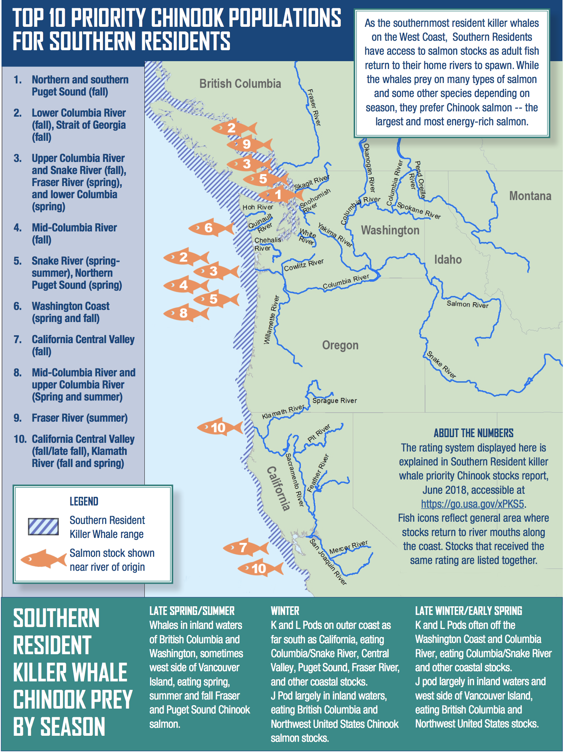
Spatial use by southern resident killer whales varies by season -Likely following prey

Slide 3
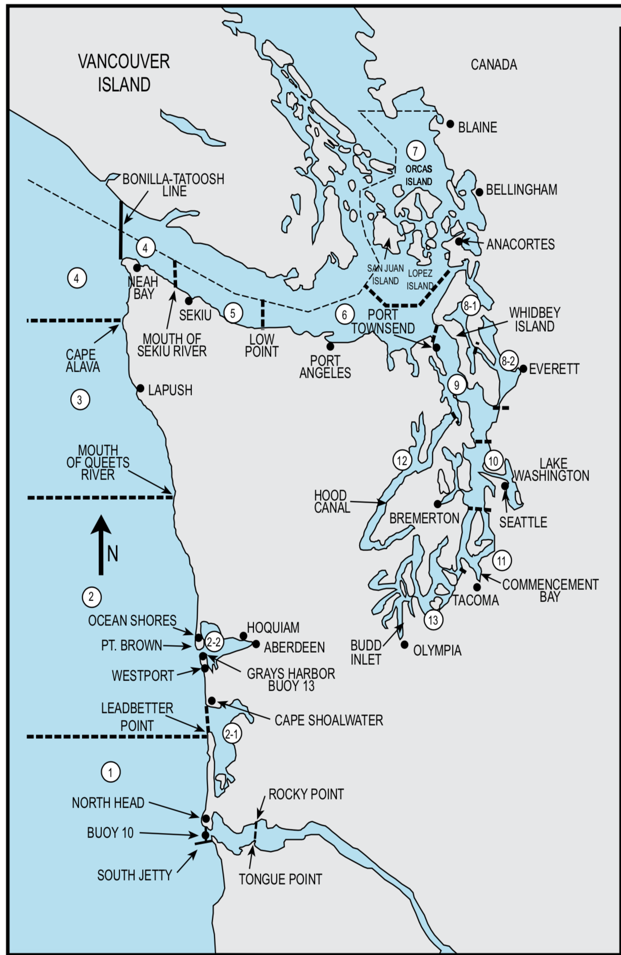
Divided Salish sea into: 1) Puget Sound (FAs 8-13) 2) Upper Salish Sea (FAs 4-7)

Slide 4
Puget Sound Use (Winter, 1Oct-1Mar)

Slide 5
Peak Puget Sound winter detectability is advancing by 4 days per decade
Slope =-0.4 days (-0.83,-0.02)

Slide 6
Upper Salish Sea Use (Summer, 1May-1Oct)

Slide 7
Upper Salish Sea Use (Summer, 1May-1Oct)

Slide 8
Peak Upper Salish Sea summer detectability appears to vary a lot from year to year

Slide 9
Peak Upper Salish Sea summer detectability appears to vary a lot from year to year
*
*

Slide 10
Peak Upper Salish Sea summer detectability appears to vary a lot from year to year
*
*
*
*

Slide 11
Peak Upper Salish Sea summer detectability is advancing by 10 days per decade
Slope =-1.09 days (-01.61,-0.59 50% CI)

Slide 13
Peak Upper Salish Sea summer detectability varies a lot from year to year
What drives this variation?
Fish

Slide 14
Odd vs Even years? (need to redo this with updated model results)

Slide 15
Peak Upper Salish Sea summer detectability varies a lot from year to year
What drives this variation?
Fish
Climate (temperature, precipitation)
Do first observation dates also show this variability (and advance)?
Determining “first” (threshold, consecutive weeks?)
Is duration of time spent in different areas changing? (can we estimate this, given strong increase in observation effort?)
Residence time? (use movement models, talk to Briana)

