Slide 1
ENGN2911X: Reconfigurable Computing
Lab 3 Tutorial Section

Slide 2
Dataflow
V2 MM Dataflow
Within each tile computation:
RHS (M * M)
256
Previous:
Each RHS row loading requires 256 cycles.
After:
After increasing port-width to 512 bits, it only requires 256/16 cycles.
256
LHS (M * M)
Output (M * M)
256
256

Slide 3
Dataflow
V2 MM Dataflow
Within each tile computation:
RHS (M * M)
256
Previous:
Each RHS row loading requires 256 cycles.
After:
After increasing port-width to 512 bits, it only requires 256/16 cycles.
256
LHS (M * M)
Output (M * M)
256
256

Slide 4
Dataflow
V2 MM Dataflow
Within each tile computation:
RHS (M * M)
256
Previous:
Each RHS row loading requires 256 cycles.
After:
After increasing port-width to 512 bits, it only requires 256/16 cycles.
256
LHS (M * M)
Output (M * M)
256
256

Slide 5
Dataflow
V2 MM Dataflow
Within each tile computation:
RHS (M * M)
256
Previous:
Each RHS row loading requires 256 cycles.
After:
After increasing port-width to 512 bits, it only requires 256/16 cycles.
256
LHS (M * M)
Output (M * M)
256
256

Slide 6
Dataflow
V2 MM Dataflow
Within each tile computation:
RHS (M * M)
256
Previous:
Each RHS row loading requires 256 cycles.
After:
After increasing port-width to 512 bits, it only requires 256/16 cycles.
256
LHS (M * M)
Output (M * M)
256
256

Slide 7
Dataflow
V2 MM Dataflow
Within each tile computation:
RHS (M * M)
256
Previous:
Each RHS row loading requires 256 cycles.
After:
After increasing port-width to 512 bits, it only requires 256/16 cycles.
256
LHS (M * M)
Output (M * M)
256
256

Slide 8
Dataflow
V2 MM Dataflow
Within each tile computation:
RHS (M * M)
256
Previous:
Each RHS row loading requires 256 cycles.
After:
After increasing port-width to 512 bits, it only requires 256/16 cycles.
256
LHS (M * M)
Output (M * M)
256
256

Slide 9
Dataflow
V2 MM Dataflow
Within each tile computation:
RHS (M * M)
256
Previous:
Each RHS row loading requires 256 cycles.
After:
After increasing port-width to 512 bits, it only requires 256/16 cycles.
256
LHS (M * M)
Output (M * M)
256
256

Slide 10
Dataflow
V2 MM Dataflow
Within each tile computation:
RHS (M * M)
256
Previous:
Each RHS row loading requires 256 cycles.
After:
After increasing port-width to 512 bits, it only requires 256/16 cycles.
256
LHS (M * M)
Output (M * M)
256
256
For each DDR access, there is an additional ~300 cycles overhead.

Slide 11
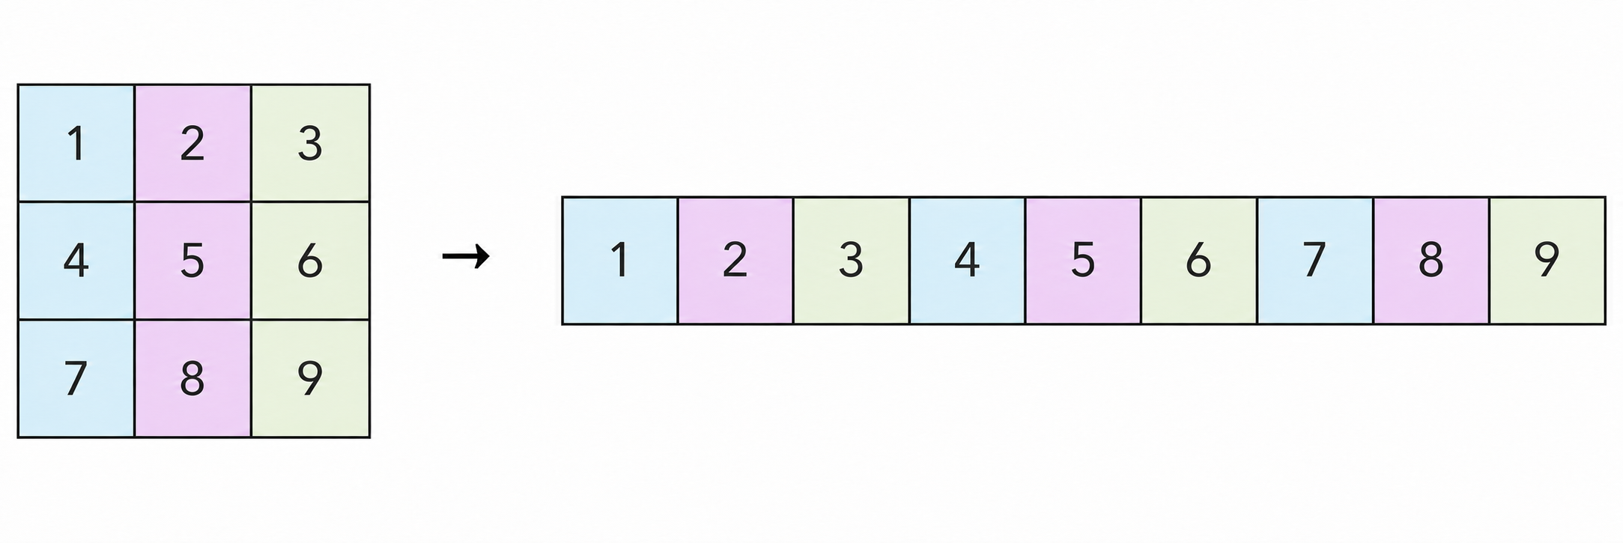
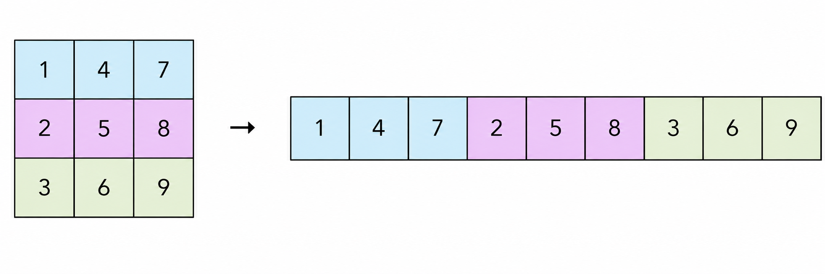
Transposed memory access
• A column becomes contiguous in memory
V2: A matrix access pattern
A[i*N+k]
Fixed k, increasing i:
N elements between loads
The required column values
are scattered in memory.
V3: Aᵀ matrix access pattern
At[k*N+i] = A[i*N+k]
Fixed k, increasing i:
next element in memory
Column values are accessed sequentially.
Notes:
The illustrated column is 1,4,7. A is logically unchanged, but At stores its columns as rows. For fixed k, A[i*N+k] has stride N whereas At[k*N+i] is consecutive. A 256-element tile column needs 16 consecutive 512-bit words at 16 32-bit integers per word. This is a transfer count, not a guaranteed latency or speedup. Matrix illustrations retained from source slide 11.
Source code: supplied Lab3/src files.
Reference: https://xilinx.github.io/Vitis_Accel_Examples/2022.2/html/wide_mem_rw.html
Code shown in the VS Code screenshots:

Slide 12
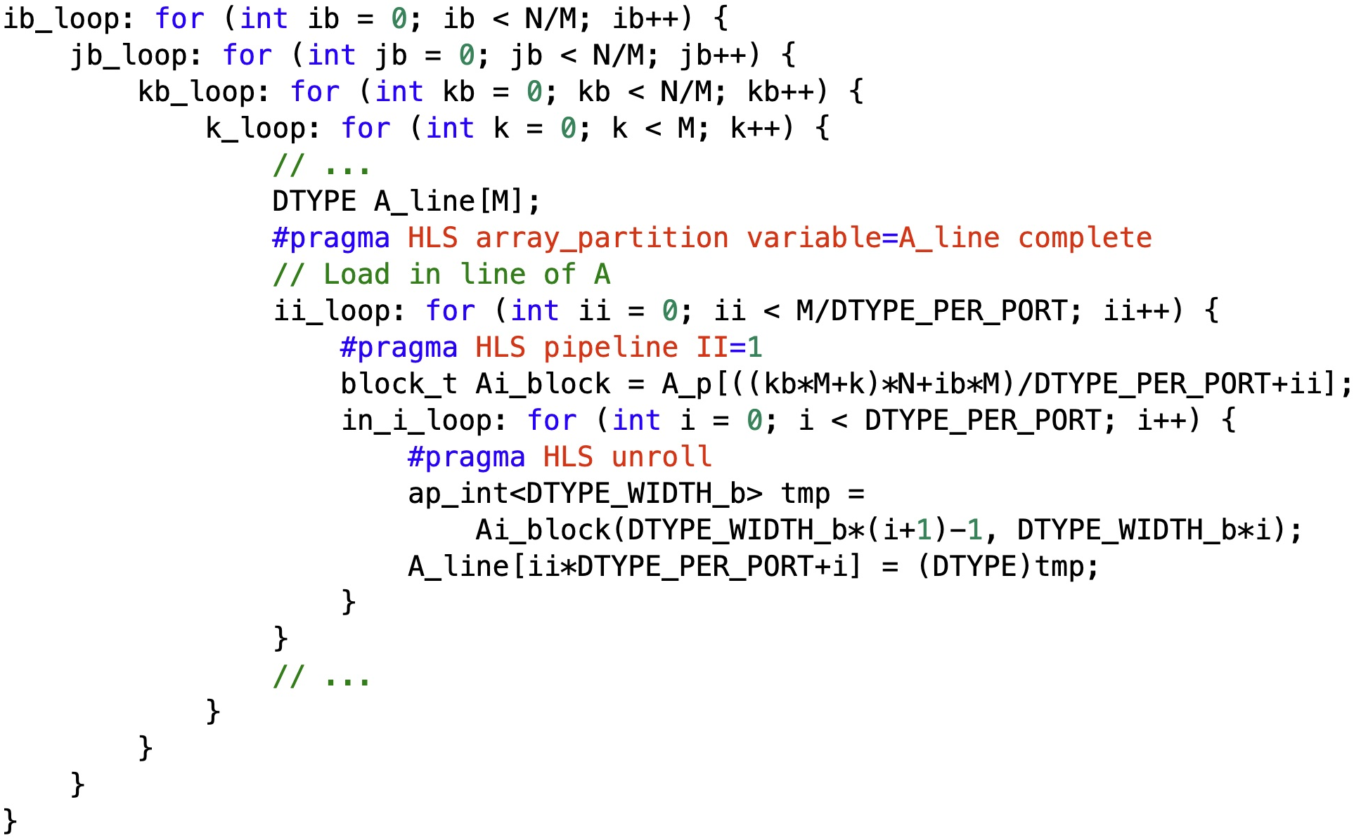
Dataflow
• V3: full loop order and transposed A loading
ib, jb: output tile
kb, k: reduction
ii: 16 wide reads
for 256 values
Unroll 16 signed
32-bit lanes into
A_line.
Notes:
Corrected full-order loading excerpt, edited and captured directly in VS Code. The invalid extra trailing word pragma has been removed. An explicit ap_int<DTYPE_WIDTH_b> temporary interprets each extracted lane as signed before conversion to DTYPE. Direct assignment to the lab's 32-bit signed DTYPE also works; the explicit type makes signedness clear.
ib and jb choose the output tile. kb and k traverse the reduction dimension. A_p stores At. At[kb*M+k][ib*M + ii*DTYPE_PER_PORT+i] is logical A[ib*M + ii*DTYPE_PER_PORT+i][kb*M+k]. The address ((kb*M+k)*N+ib*M)/DTYPE_PER_PORT+ii comprises the transposed row, tile-column offset, and wide-word index. With M=256 and DTYPE_PER_PORT=16, ii makes 16 consecutive wide reads and the unrolled in_i loop fills A_line[0..255].
Assumptions: signed 32-bit DTYPE=int; block_t=ap_int<512>; DTYPE_WIDTH_b=32; M=256; sixteen elements per word; positive N divisible by M. II=1 is a synthesis target, not a measured or guaranteed initiation interval. This is a loading excerpt, not a standalone kernel. The ellipses omit B loading and the MAC code; C initialization belongs before kb for each output tile, and output follows the full reduction.
The exact saved excerpt passed six C++ functional simulation cases with signed nonsymmetric data: M=16,N=16/32/48 and M=256,N=256/512/768. Every loaded A_line value matched the logical A column. These checks validate indexing and signed extraction, not HLS timing or hardware performance.
Copyable code:
ib_loop: for (int ib = 0; ib < N/M; ib++) {
jb_loop: for (int jb = 0; jb < N/M; jb++) {
kb_loop: for (int kb = 0; kb < N/M; kb++) {
k_loop: for (int k = 0; k < M; k++) {
// ...
DTYPE A_line[M];
#pragma HLS array_partition variable=A_line complete
// Load in line of A
ii_loop: for (int ii = 0; ii < M/DTYPE_PER_PORT; ii++) {
#pragma HLS pipeline II=1
block_t Ai_block = A_p[((kb*M+k)*N+ib*M)/DTYPE_PER_PORT+ii];
in_i_loop: for (int i = 0; i < DTYPE_PER_PORT; i++) {
#pragma HLS unroll
ap_int<DTYPE_WIDTH_b> tmp =
Ai_block(DTYPE_WIDTH_b*(i+1)-1, DTYPE_WIDTH_b*i);
A_line[ii*DTYPE_PER_PORT+i] = (DTYPE)tmp;
}
}
// ...
}
}
}
}
Reference: https://xilinx.github.io/Vitis_Accel_Examples/2022.2/html/wide_mem_rw.html
Source: Lab3/src/pl_v3.cpp and the user-supplied full-loop screenshot. Original source files remain unchanged.

Slide 13
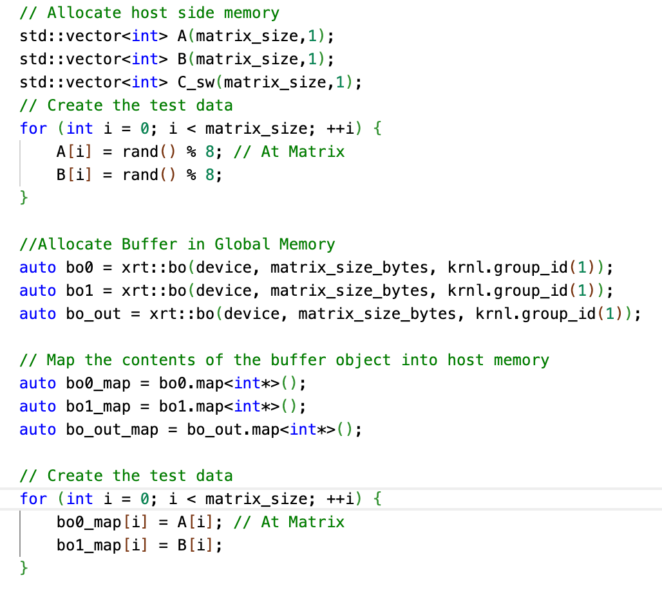
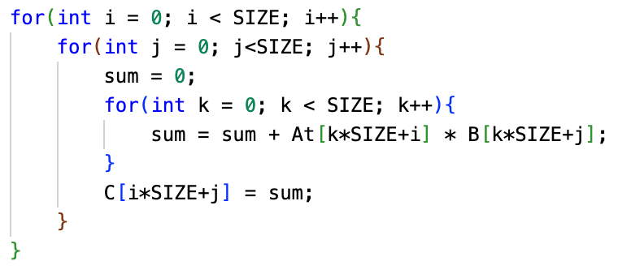
v3 Host code
CPU matrix multiplication reference:
Generate random values for At Matrix (no explicit transpose)
Notes:
Compare Lab2/lab2_src/src/host.cpp and Lab3/src/host.cpp. Snippets normalize the output variable name and use += for the equivalent sum update. The generated vector A is copied unchanged in both versions. V3 treats it as At storage and changes the CPU reference to At[k*SIZE+i]. Therefore the same random storage would represent a different logical A between versions. To multiply the same ordinary row-major A, explicitly transpose into bo0_map and retain the V2 golden reference on original A. Do not transpose the device input and also use the supplied V3 golden indexing on untransposed A. Existing allocation choices are outside this slide edit.
Source code: supplied Lab3/src files.
Code shown in the VS Code screenshots:
host_v2:
// CPU reference: row-major A
sum += A[i*SIZE+k] * B[k*SIZE+j];
host_v3:
// CPU reference: At storage
sum += At[k*SIZE+i] * B[k*SIZE+j];
host_same:
for (int i = 0; i < matrix_size; ++i) {
bo0_map[i] = A[i]; // V3: A holds At storage
bo1_map[i] = B[i];
}
bo0.sync(XCL_BO_SYNC_BO_TO_DEVICE, matrix_size_bytes, 0);
bo1.sync(XCL_BO_SYNC_BO_TO_DEVICE, matrix_size_bytes, 0);
auto run = krnl(bo0, bo1, bo_out, SIZE);
run.wait();
mm_sw(A, B, C_sw);

Slide 14
Dataflow
V3 MM Dataflow
Within each tile computation:
RHS (M * M)
256
V3 optimizes memory access for matrix A:
After transpose, a column data of A can be loaded in a sequential fashion using a larger port-width.
256
LHS (M * M)
Output (M * M)
256
What else can be further optimized?
Let’s check the execution timeline.
256

Slide 15
Execution Timeline for V3
Can we load B and A at the same time?
Load data from B:
Load data from A:
….
Compute:
T
Can we keep loading data during computation?
What is the new execution timeline?

Slide 16
Execution Timeline for V3 and V4
V3 Execution Timeline:
Load data from B:
Load data from A:
….
Compute:
T
V4 Execution Timeline:
Loading B and A at the same time.
Reduced execution latency
Load data from B:
….
Load data from A:
Compute:
….
Keep loading during computation.
T
How should we implement V4 in HLS C/C++?

Slide 17
Preliminaries for V4
Load A module keeps loading data from matrix A and sends data to the Compute module
MM kernel
Load B module keeps loading data from matrix B and sends data to the Compute module
Compute
Compute module consumes input data, do computation, and sends results to Store C module
Store C module sends results to the off-chip DDR
Load A
Load B
Store C
1. All modules should be executed in parallel.
2. Data are transferred among different modules.
Using HLS dataflow pragma and hls::stream
DDR

Slide 18
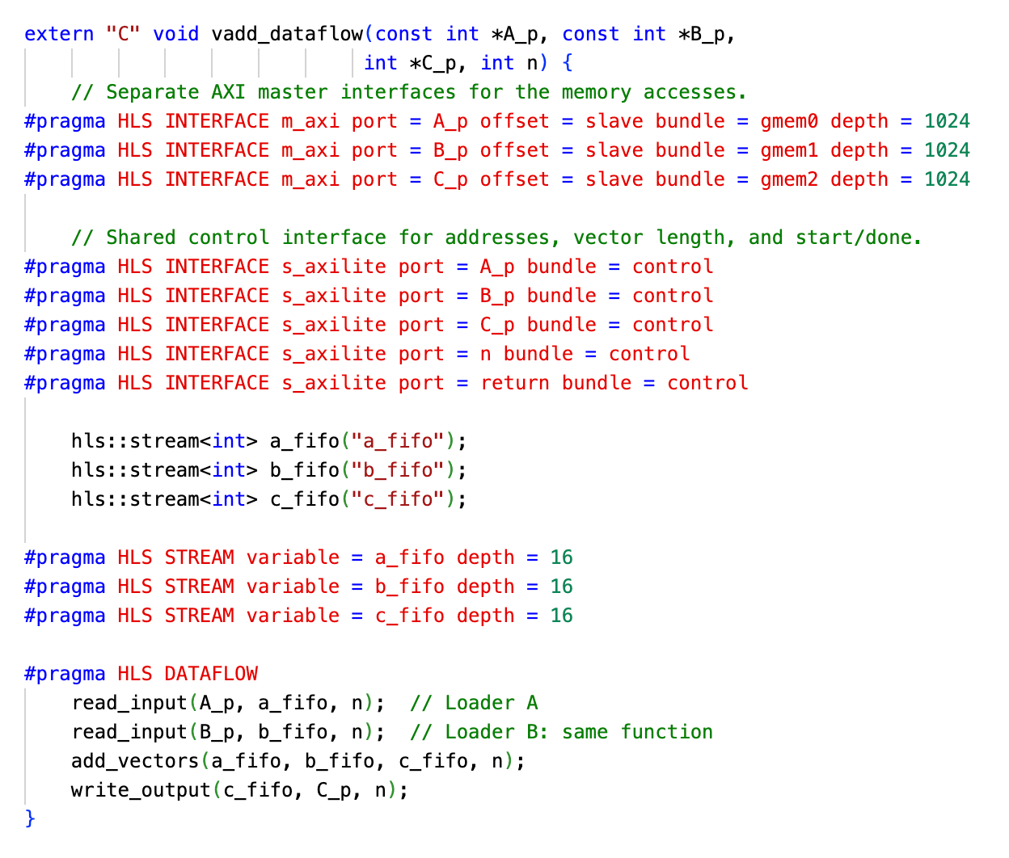
Preliminaries for V4 (an example for VecAdd)
1. All modules should be executed in parallel.
2. Data are transferred among different modules.
Using HLS dataflow pragma and hls::stream
Vector Add kernel
add_vectors
read_input
read_input
write_output
DDR

Slide 19
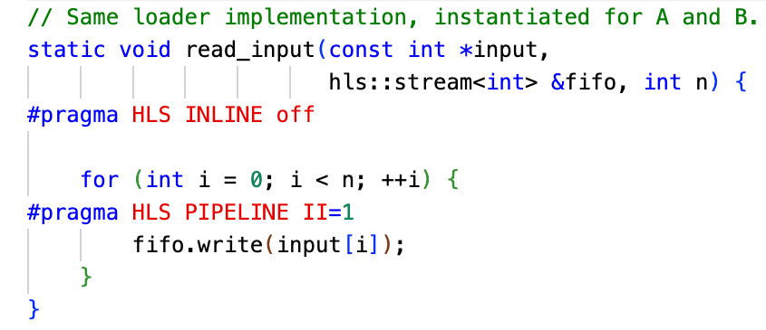
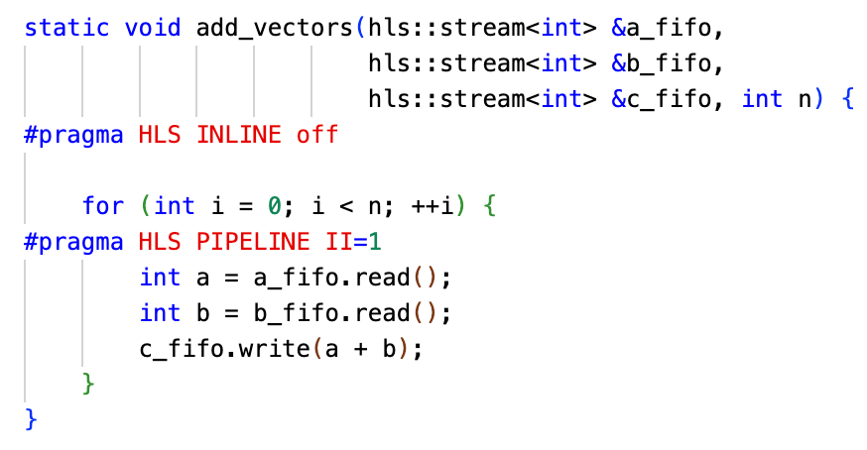
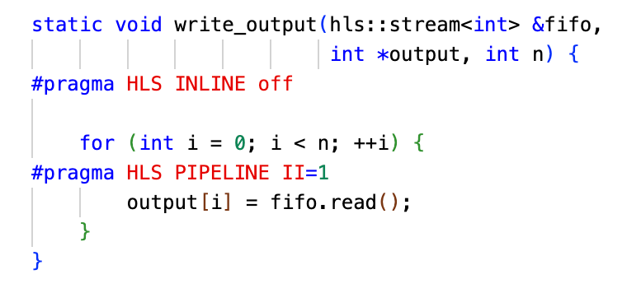
Preliminaries for V4 (an example for VecAdd)
1. All modules should be executed in parallel.
2. Data are transferred among different modules.
Using HLS dataflow pragma and hls::stream
Vector Add kernel
add_vectors
read_input
read_input
write_output
DDR

Slide 20
Dataflow
V4 MM Dataflow
MM kernel
ReadA module loads transposed A matrix with 512-bit port.
MAC
ChangeARate module unpacks the 512-bit data into 32-bit integer values.
ReadB module loads B matrix with 512-bit port.
32-bit
512-bit
512-bit
MAC module perform the computation.
ChangeARate
ReadB
WriteC
WriteC module sends results to DDR.
1. All modules should be executed in parallel.
2. Data are transferred among different modules.
Using HLS dataflow pragma and hls::stream
512-bit
512-bit
512-bit
ReadA
512-bit
DDR

Slide 21
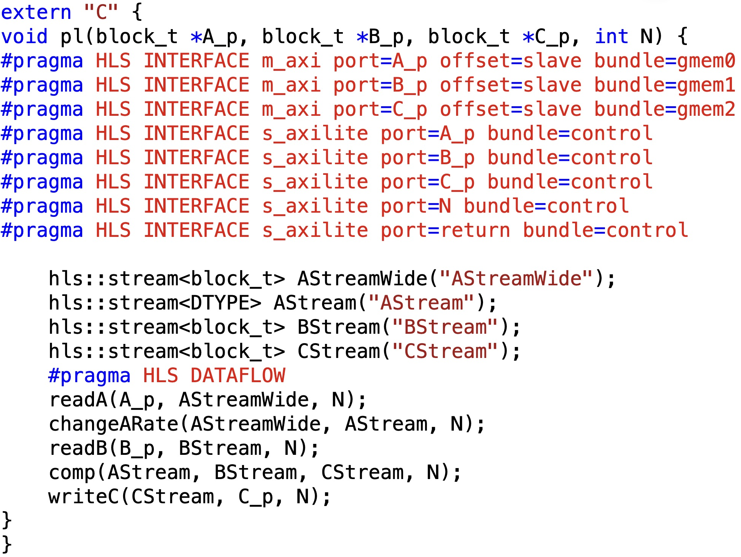
V4 kernel implementation
• Top-level DATAFLOW
4. Enable parallel DDR read/write
1. Declare hls::stream to enable inter-module communication.
3. Apply dataflow pragma.
2. Init modules (definition of these modules shows in the following slides)
Notes:
All top-level interface pragmas and stream types match pl_v4.cpp. block_t is ap_int<512>. The separate gmem bundles expose separate AXI masters but do not by themselves guarantee independent physical memory bandwidth. DATAFLOW supports concurrent stages connected with streams. II=1 pragmas in stage loops are synthesis requests. Host layout is the same as V3.
Source code: supplied Lab3/src files.
Reference: https://xilinx.github.io/Vitis_Accel_Examples/2022.2/html/dataflow_stream.html
Reference: https://xilinx.github.io/Vitis_Accel_Examples/2022.2/html/wide_mem_rw.html
Code shown in the VS Code screenshots:
pl:
extern "C" {
void pl(block_t *A_p, block_t *B_p, block_t *C_p, int N) {
#pragma HLS INTERFACE m_axi port=A_p offset=slave bundle=gmem0
#pragma HLS INTERFACE m_axi port=B_p offset=slave bundle=gmem1
#pragma HLS INTERFACE m_axi port=C_p offset=slave bundle=gmem2
#pragma HLS INTERFACE s_axilite port=A_p bundle=control
#pragma HLS INTERFACE s_axilite port=B_p bundle=control
#pragma HLS INTERFACE s_axilite port=C_p bundle=control
#pragma HLS INTERFACE s_axilite port=N bundle=control
#pragma HLS INTERFACE s_axilite port=return bundle=control
hls::stream<block_t> AStreamWide("AStreamWide");
hls::stream<DTYPE> AStream("AStream");
hls::stream<block_t> BStream("BStream");
hls::stream<block_t> CStream("CStream");
#pragma HLS DATAFLOW
readA(A_p, AStreamWide, N);
changeARate(AStreamWide, AStream, N);
readB(B_p, BStream, N);
comp(AStream, BStream, CStream, N);
writeC(CStream, C_p, N);
}
}

Slide 22
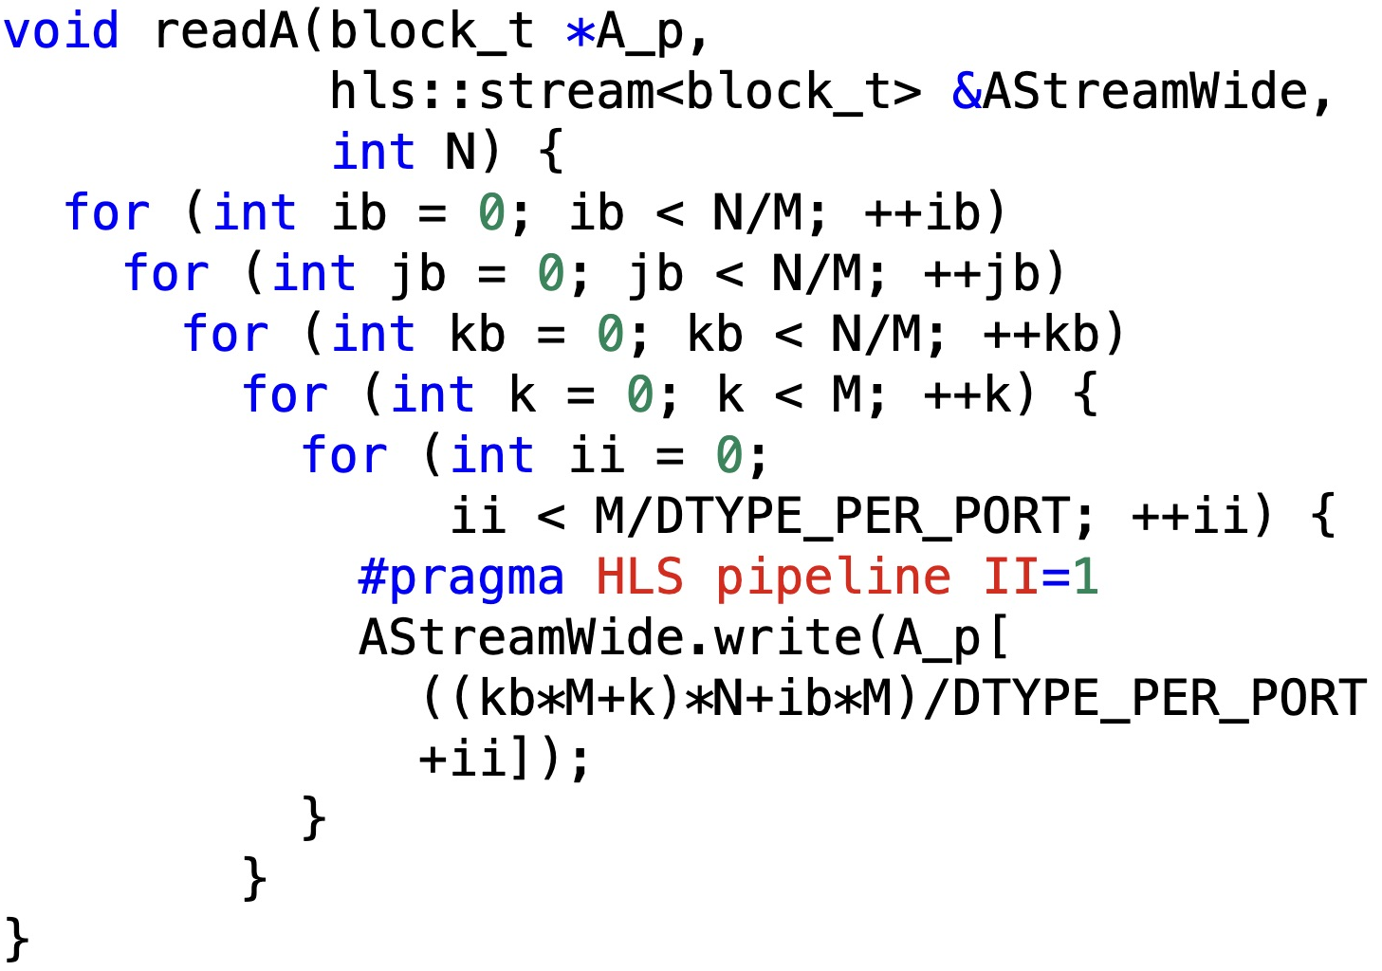

V4 kernel implementation
• Reading A and B
readA: one column of A (one row of At)
readB: one row of B
Notes:
Both function bodies are complete and preserve source loop ordering. readA reads At row kb*M+k, starting at column ib*M. readB reads B row kb*M+k, starting at column jb*M. Braceless outer for loops each have exactly one inner statement. At M=256 and 16 elements per word, each k produces 16 wide words in each input stream.
Source code: supplied Lab3/src files.
Reference: https://xilinx.github.io/Vitis_Accel_Examples/2022.2/html/wide_mem_rw.html
Code shown in the VS Code screenshots:
readA:
void readA(block_t *A_p,
hls::stream<block_t> &AStreamWide,
int N) {
for (int ib = 0; ib < N/M; ++ib)
for (int jb = 0; jb < N/M; ++jb)
for (int kb = 0; kb < N/M; ++kb)
for (int k = 0; k < M; ++k) {
for (int ii = 0;
ii < M/DTYPE_PER_PORT; ++ii) {
#pragma HLS pipeline II=1
AStreamWide.write(A_p[
((kb*M+k)*N+ib*M)/DTYPE_PER_PORT
+ii]);
}
}
}
readB:
void readB(block_t *B_p,
hls::stream<block_t> &BStream,
int N) {
for (int ib = 0; ib < N/M; ++ib)
for (int jb = 0; jb < N/M; ++jb)
for (int kb = 0; kb < N/M; ++kb)
for (int k = 0; k < M; ++k) {
for (int jj = 0;
jj < M/DTYPE_PER_PORT; ++jj) {
#pragma HLS pipeline II=1
BStream.write(B_p[
((kb*M+k)*N+jb*M)/DTYPE_PER_PORT
+jj]);
}
}
}

Slide 23
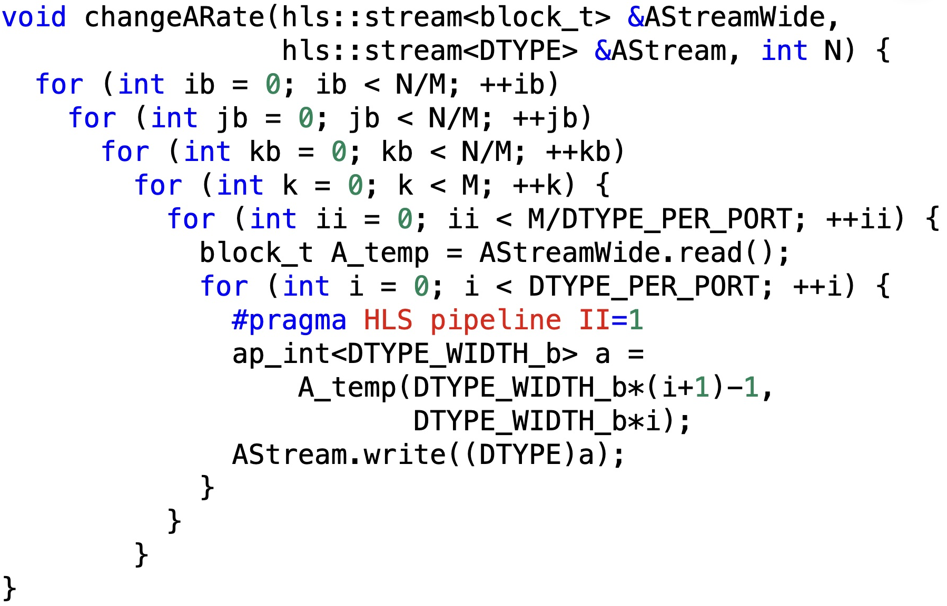
V4 kernel implementation
• Converting A from 512-bit words to 32-bit values
1. Read one 512-bit pack.
2. Unpack the 512-bit data into 32-bit integer values.
Notes:
changeARate is copied from the supplied algorithm with equivalent formatting and names. Its scalar inner loop is pipelined, not unrolled: the downstream MAC consumes one scalar per i iteration. Signed extraction is necessary for negative input values. Producer and consumer ordering must agree on ib,jb,kb,k and local row order. II=1 is a synthesis target.
Source code: supplied Lab3/src files.
Reference: https://xilinx.github.io/Vitis_Accel_Examples/2022.2/html/dataflow_stream.html
Code shown in the VS Code screenshots:
changeARate:
void changeARate(hls::stream<block_t> &AStreamWide,
hls::stream<DTYPE> &AStream, int N) {
for (int ib = 0; ib < N/M; ++ib)
for (int jb = 0; jb < N/M; ++jb)
for (int kb = 0; kb < N/M; ++kb)
for (int k = 0; k < M; ++k) {
for (int ii = 0; ii < M/DTYPE_PER_PORT; ++ii) {
block_t A_temp = AStreamWide.read();
for (int i = 0; i < DTYPE_PER_PORT; ++i) {
#pragma HLS pipeline II=1
ap_int<DTYPE_WIDTH_b> a =
A_temp(DTYPE_WIDTH_b*(i+1)-1,
DTYPE_WIDTH_b*i);
AStream.write((DTYPE)a);
}
}
}
}

Slide 24
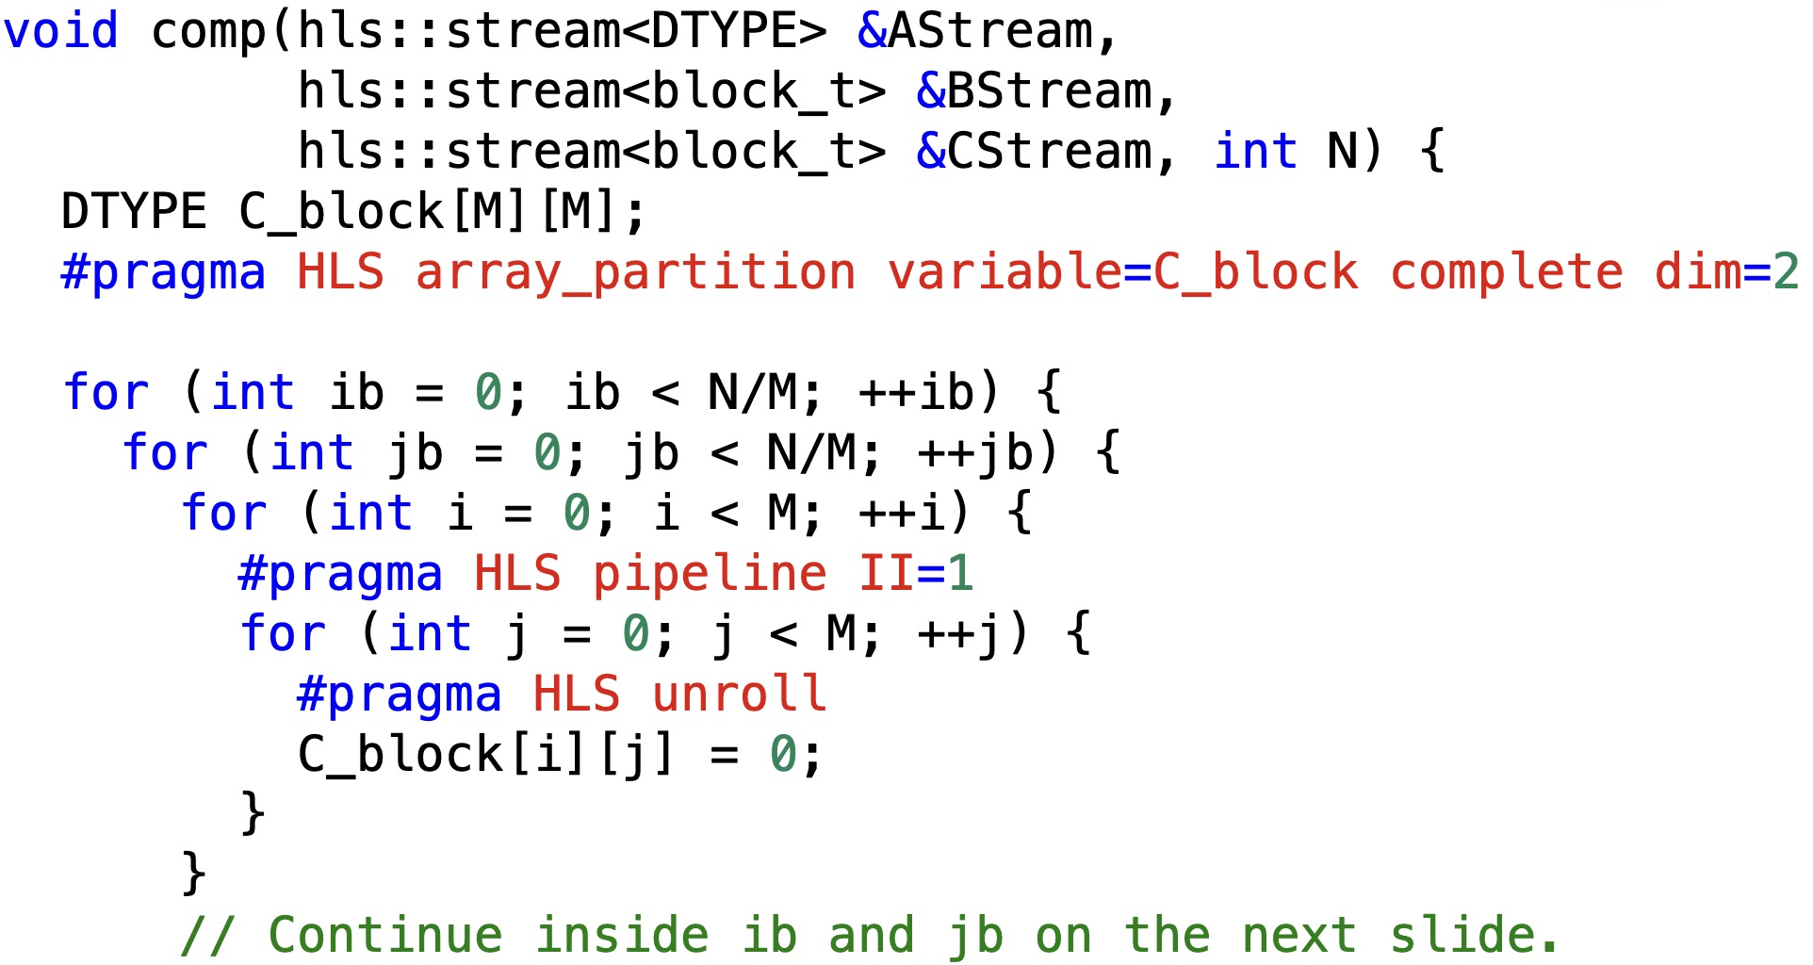
V4 kernel implementation
• MAC (1/3): output-tile initialization
1. Partition columns (dim=2).
The second dimension of C_block can be accessed at the same time
2. Init C_block once with 0
C_block holds the running sum across every reduction tile kb.
The function and output-tile loops continue on the next two slides.
Notes:
Slides 25,26,27 concatenate into the complete missing comp() function. The ib,jb loops remain open at the end of this slide deliberately. Each C output tile must be initialized once before any kb contribution. Reinitializing within kb would discard earlier partial sums. Partition dim=2 allows the unrolled j loop to update all columns.
Source code: supplied Lab3/src files.
Code shown in the VS Code screenshots:
comp_1:
void comp(hls::stream<DTYPE> &AStream,
hls::stream<block_t> &BStream,
hls::stream<block_t> &CStream, int N) {
DTYPE C_block[M][M];
#pragma HLS array_partition variable=C_block complete dim=2
for (int ib = 0; ib < N/M; ++ib) {
for (int jb = 0; jb < N/M; ++jb) {
for (int i = 0; i < M; ++i) {
#pragma HLS pipeline II=1
for (int j = 0; j < M; ++j) {
#pragma HLS unroll
C_block[i][j] = 0;
}
}
// Continue inside ib and jb on the next slide.

Slide 25
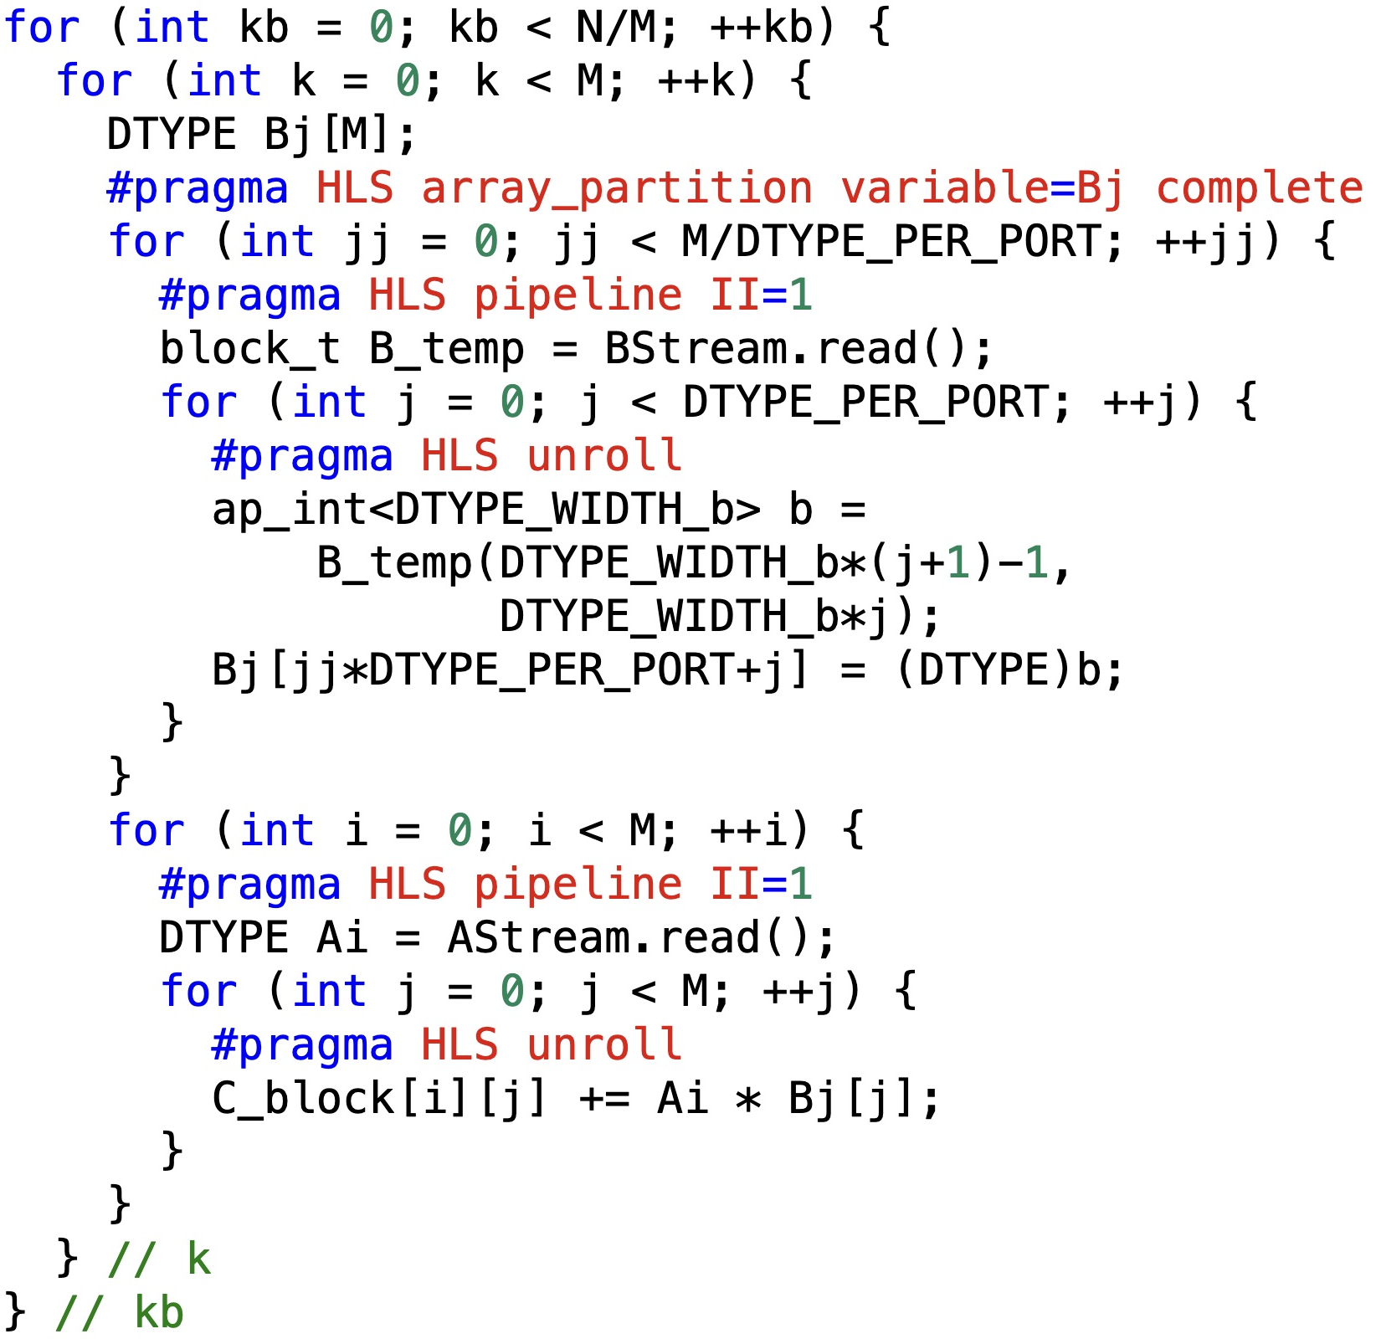
V4 kernel implementation
• MAC (2/3): B buffering and multiplication
3. Load values of matrix B from the HLS stream
+ unpack the 512-bit data into 32-bit integer values
4. Load one value of matrix A from the HLS stream
5. Compute
The B-load loop finishes before the MAC loop inside comp().
Notes:
Continuation inside the open ib,jb loops from slide 25. Per ib,jb,kb,k consume exactly 16 BStream words and 256 AStream scalar items. Signed ap_int<32> unpacking preserves negative B inputs. Bj is fully partitioned, and C_block is column partitioned. The i loop requests II=1 and the j loop is fully unrolled. DATAFLOW does not make these B-loading and MAC loops inside comp concurrent. The kb and k loops close here, while ib,jb and the function remain open.
Source code: supplied Lab3/src files.
Code shown in the VS Code screenshots:
comp_2:
for (int kb = 0; kb < N/M; ++kb) {
for (int k = 0; k < M; ++k) {
DTYPE Bj[M];
#pragma HLS array_partition variable=Bj complete
for (int jj = 0; jj < M/DTYPE_PER_PORT; ++jj) {
#pragma HLS pipeline II=1
block_t B_temp = BStream.read();
for (int j = 0; j < DTYPE_PER_PORT; ++j) {
#pragma HLS unroll
ap_int<DTYPE_WIDTH_b> b =
B_temp(DTYPE_WIDTH_b*(j+1)-1,
DTYPE_WIDTH_b*j);
Bj[jj*DTYPE_PER_PORT+j] = (DTYPE)b;
}
}
for (int i = 0; i < M; ++i) {
#pragma HLS pipeline II=1
DTYPE Ai = AStream.read();
for (int j = 0; j < M; ++j) {
#pragma HLS unroll
C_block[i][j] += Ai * Bj[j];
}
}
} // k
} // kb

Slide 26
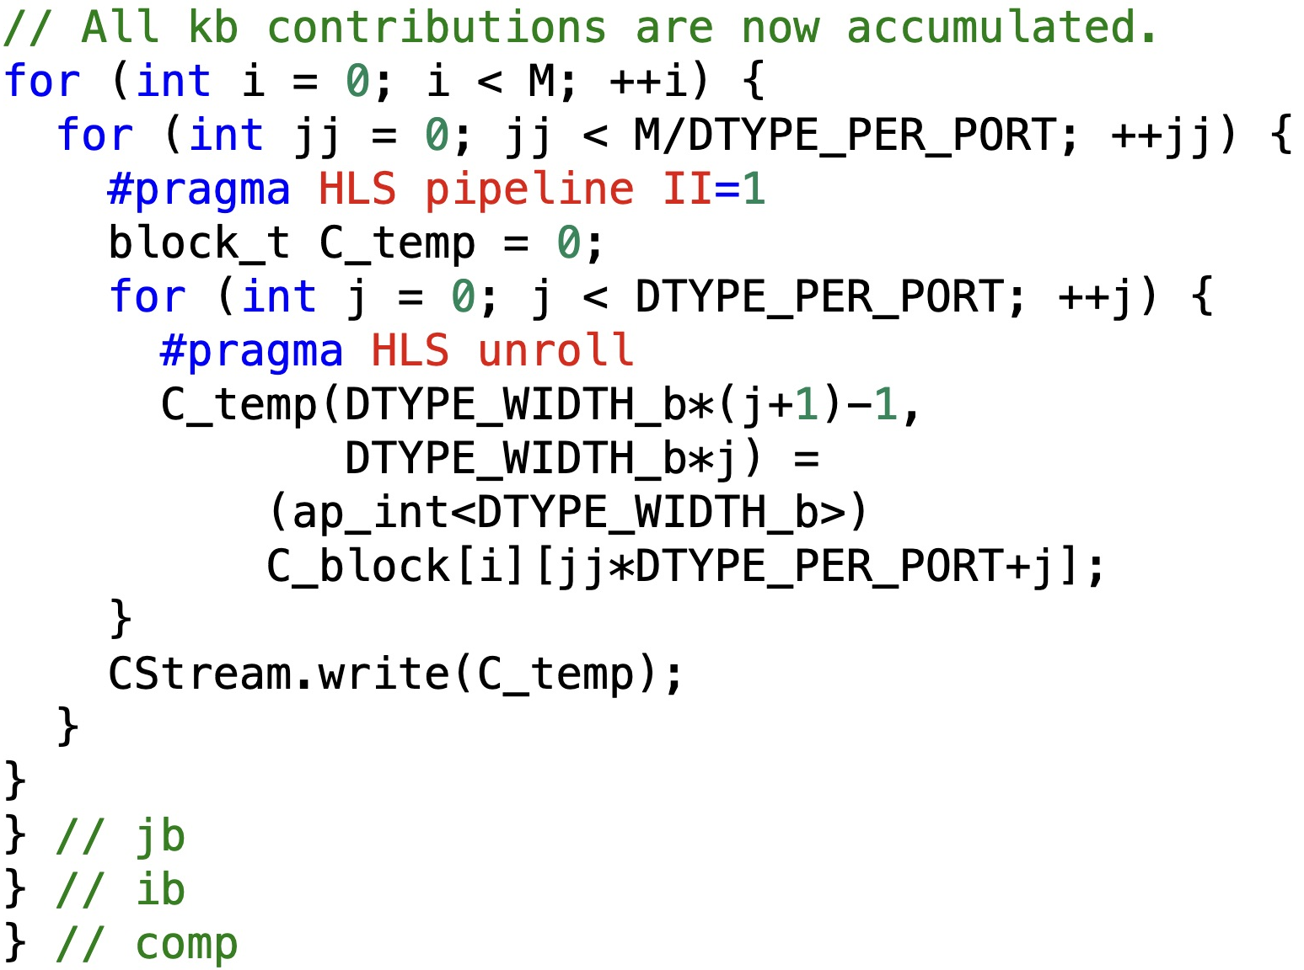
V4 kernel implementation
• MAC (3/3): packing and sending the completed tile
6. Pack 32-bit integer values to 512-bit data
7. Send the packed 512-bit data into the HLS stream
Notes:
The first line executes after the complete kb loop from slide 26. Results are packed in the same row-major tile order consumed by writeC. Each C_temp word is initialized, then all 16 32-bit lanes are assigned. Negative values retain their 32-bit representation through ap_int<32>. For M=256, one output tile produces 4096 words. Concatenate slides 25–27 without changing loop scope.
Source code: supplied Lab3/src files.
Code shown in the VS Code screenshots:
comp_3:
// All kb contributions are now accumulated.
for (int i = 0; i < M; ++i) {
for (int jj = 0; jj < M/DTYPE_PER_PORT; ++jj) {
#pragma HLS pipeline II=1
block_t C_temp = 0;
for (int j = 0; j < DTYPE_PER_PORT; ++j) {
#pragma HLS unroll
C_temp(DTYPE_WIDTH_b*(j+1)-1,
DTYPE_WIDTH_b*j) =
(ap_int<DTYPE_WIDTH_b>)
C_block[i][jj*DTYPE_PER_PORT+j];
}
CStream.write(C_temp);
}
}
} // jb
} // ib
} // comp

Slide 27
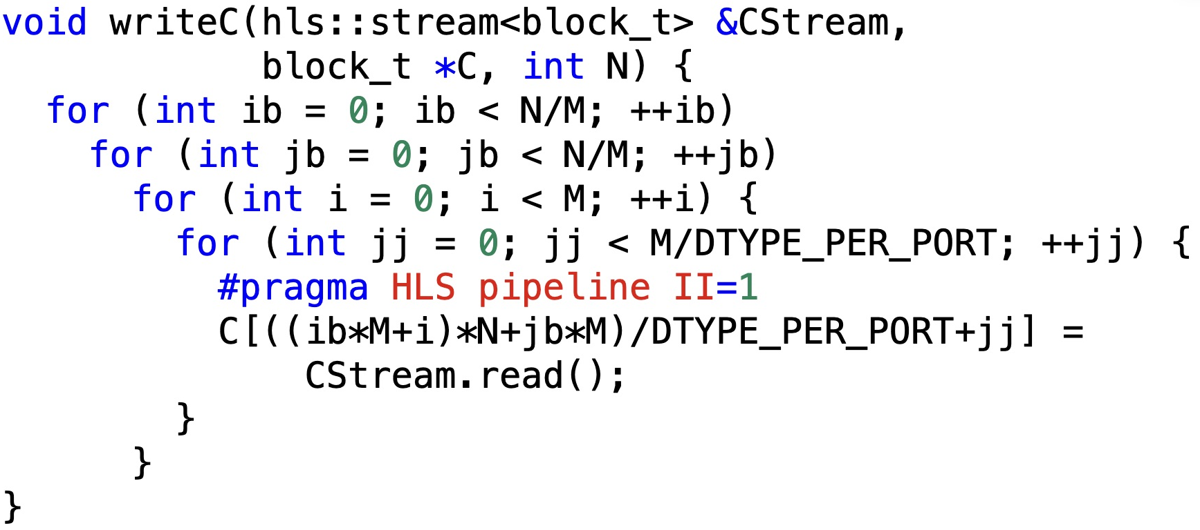
V4 kernel implementation
• Writing C and overlapping stages
Receive the packed results and send the results to DDR
Notes:
writeC consumes tiles in ib,jb,i,jj order. Its address places each packed word in ordinary row-major C storage. At every ib,jb,kb,k the consumer expects 256 A scalars and 16 B words. At every ib,jb comp emits 4096 C words. Blocking stream operations synchronize stages via backpressure. Concurrent stage execution does not imply a particular achieved II or speedup. Finite FIFO depth, dependencies, physical memory bandwidth, and synthesis scheduling determine actual throughput.
Source code: supplied Lab3/src files.
Reference: https://xilinx.github.io/Vitis_Accel_Examples/2022.2/html/dataflow_stream.html
Code shown in the VS Code screenshots:
writeC:
void writeC(hls::stream<block_t> &CStream,
block_t *C, int N) {
for (int ib = 0; ib < N/M; ++ib)
for (int jb = 0; jb < N/M; ++jb)
for (int i = 0; i < M; ++i) {
for (int jj = 0; jj < M/DTYPE_PER_PORT; ++jj) {
#pragma HLS pipeline II=1
C[((ib*M+i)*N+jb*M)/DTYPE_PER_PORT+jj] =
CStream.read();
}
}
}

