Slide 1

Modern Business Proposal
Here is where your presentation begins

Slide 2

Contents of this template
Fonts
Colors
Thanks slide
Icons and infographics
To view this template correctly in PowerPoint, download and install the fonts we used
You can see on the link all the colors used in this presentation
You must keep it so that proper credits for our design are given
These can be used in the template, and their size and color can be edited
For more info:
SLIDESGO | SLIDESGO AI TOOLS | BLOG | FAQs
You can edit the master slides easily. For more info, click here
You can visit our sister projects:
FREEPIK AI TOOLS | FREEPIK LIBRARY RESOURCES
You can delete this slide when you’re done editing the presentation

Slide 3
Table of contents
01
02
03
04
05
06
07
08
Key objectives we aim to achieve
Key resources to support this work
Financial plan and budget allocation
Possible solutions and their benefits
Detailed project timeline and milestones
Roles and responsibilities
Risk analysis and mitigation strategies
Evaluation criteria and metrics

Slide 4

How to create a
project proposal
Creating a project proposal can be done in five steps:
Define the project objectives and timeline
Identify resources needed to complete the project
Develop a budget for the project and estimate any potential risks
Write down your proposed solution and provide supporting documents
Develop a communication plan to ensure key stakeholders are kept informed

Slide 5

01
Key
objectives
we aim to achieve

Slide 6
What are key objectives?
The key objectives of a project are the specific goals that the project seeks to achieve. These objectives should be clearly defined, realistic, and measurable. Each objective plays a crucial role in guiding the project towards its intended outcomes. It is important to ensure that the objectives are aligned with the overall vision of the project and serve as a foundation for planning the necessary actions. Well-defined objectives allow for better tracking of progress, allocation of resources, and continuous adjustments throughout the project lifecycle. By setting clear objectives, the project team can stay focused, work towards specific results, and ensure that the project’s outcomes are achieved efficiently and effectively

Slide 7
Solutions
01
02
03
The first solution
The second solution
The third solution
Implementing a new CRM (Customer Relationship Management) system to improve sales tracking
Outsourcing business functions like accounting or IT to a third-party provider to reduce costs
Launching an e-commerce platform to expand the reach of the business and increase online sales
04
05
06
The fourth solution
The fifth solution
The sixth solution
Developing a new product or service to diversify the business and increase revenue streams
Implementing cost-saving initiatives such as energy-efficient practices or process automation
Establishing strategic partnerships with other businesses to access new markets or technologies

Slide 8



Photo showcase
A photo showcase can be a useful addition to a business project proposal as it can help to visually communicate the concept or idea being proposed

Slide 9
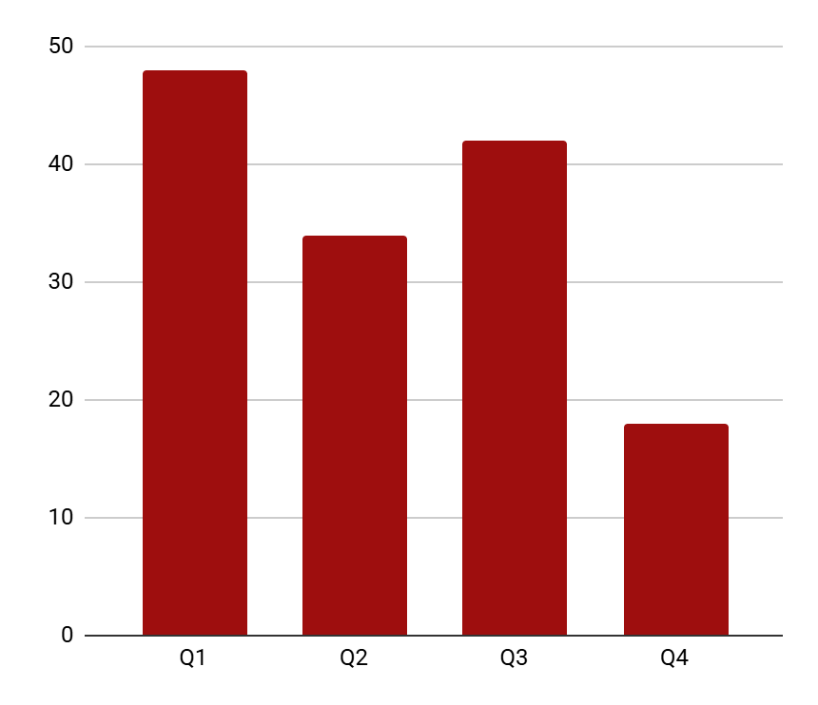
KPI dashboard
Component | Timeline | Cost
IT outsourcing | 3 months | $12,000
Process automation | 2 months | $8,500
Partnerships | 6 months | $5,000
Energy efficiency | 4 months | $3,200
Total investment | 15 months | $28,700
40%
60%
3x
Cost reduction in year one
Faster processes
Total market reach
Follow the link in the graph to modify its data and then paste the new one here. For more info, click here

Slide 10
Thank you
Do you have any questions?
youremail@freepik.com
+00 000 000 000
yourwebsite.com
Please keep this slide for attribution

Slide 11
Instructions for use
If you have a free account, in order to use this template, you must credit Slidesgo by keeping the Thanks slide
As a Free user, you are allowed to:
Modify this template
Use it for both personal and commercial projects
You are not allowed to:
Sublicense, sell or rent any of Slidesgo Content
Distribute Slidesgo Content unless it has been expressly authorized by Slidesgo
Include Slidesgo Content in an online or offline database or file
Offer Slidesgo templates (or modified versions of Slidesgo templates) for download
Acquire the copyright of
Slidesgo Content
For more information about editing slides, please read our FAQs or visit our blog

Slide 12
Fonts
Colors
This presentation has been made using the following fonts:
All the colors used in this presentation
Click on the button of the link to the fonts
#0e0e0e
#dedede
#bfc9ca
#9e0e0e
BBH Bartle
Space Mono
To view this template correctly in PowerPoint, download and install the fonts we used

Slide 13
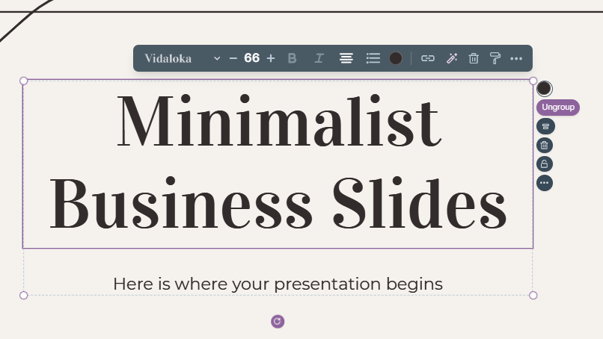
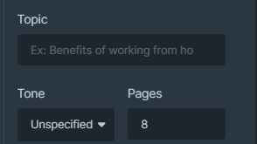
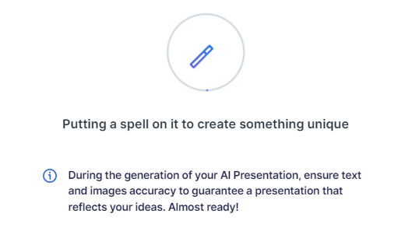
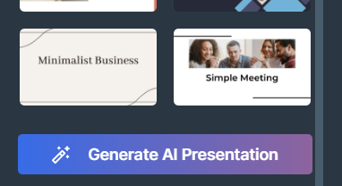
Presentation Maker
Slidesgo introduces its latest feature: the Presentation Maker. Enjoy two main functionalities - firstly, with a few clicks, create marvelous presentations with Artificial Intelligence that adapt to your needs. And it's completely free
Generate AI Presentation

Slide 14
Use our editable graphic resources...
You can easily resize these resources without losing quality. To change the color, just ungroup the resource and click on the object you want to change. You can also look for more infographics on Slidesgo

Slide 17
 | Jan | Feb | Mar | Apr | Jun
Task 1
Task 2
Task 3
 | No | Yes | Yes | No | Yes
 | Yes | No | Yes | No | Yes
 | Yes | Yes | No | Yes | No
 | Jan | Feb | Mar | Apr | Jun
Task 1
Task 2
Task 3

Slide 19
6/10 | 8/10 | 7/10 | 4/10

Slide 20
...and our sets of editable icons
You can resize these icons without losing quality
You can change the stroke and fill color; just select the icon and click on the paint bucket/pen
In Google Slides, you can also use Flaticon’s extension, allowing you to customize and add even more icons

Slide 21
Educational icons
Medical icons

Slide 22
Business icons
Teamwork icons

Slide 23
Help & support icons
Avatar icons

Slide 24
Creative process icons
Performing arts icons

Slide 25
Nature icons

Slide 26
SEO & marketing icons

Slide 27


