Slide 1

Phase II: Technology Introduction and Lab
Learning Objectives:
Technologies overview. Why? What? How do they work?
Basic know-how-to-do it through lab.
Brain-storm: how can we utilize in our project or project like ours
4 lectures. Nov 2019

Slide 2
Phase II: Technology Introduction and Lab
Review Week 2 of Phase II:
Git
pm

Slide 3
Phase II: Technology Introduction and Lab
Learning Objectives:
Technologies overview. Why? What? How do they work?
Basic know-how-to-do it through lab.
Brain-storm: how can we utilize in our project or project like ours
Week 1
AI: 1). What is AI and areas of AI
2). How we are going to use AI
3). Illustrations of Algorithm
4). NLTK and Lab
Week 2
Git and Github, PM and Open Source:
1). How does a software project work
2). What is Git
3). Final checkup for dev environment
(except py env)
4). Lab
Week 3
Web Crawling and Python
1). Python
2). Web Crawling
3). Lab
Week 4
Web/UI
1). Technologies Overview
2). Lab: build a simple site

Slide 4
Phase II: Technology Introduction and Lab
Week 3: Web Crawling and Python
1). Review / redo / do last week’s git setup
2). Python Lab
3). Programming Language
4). Python: let’s re-do week one’s homework
5). Web Crawling – Scrapy, Beautifulsoup and NLTK
6). Homework explaining – individualized homework

Slide 5
Phase II: Technology Introduction and Lab
Week 3: Web Crawling and Python
1). Review / redo / do last week’s git setup
We set up two sets of repositories:
1. Project. Place holders for projects
https://github.com/stempro-ai-pro/
2.Homework. Place holders for homework.
Even the tasks you choose don’t involve coding, github is the main channels to publish and evaluate homework.
Feedback needed: Do we need to make it private?
https://github.com/stempro-education

Slide 6
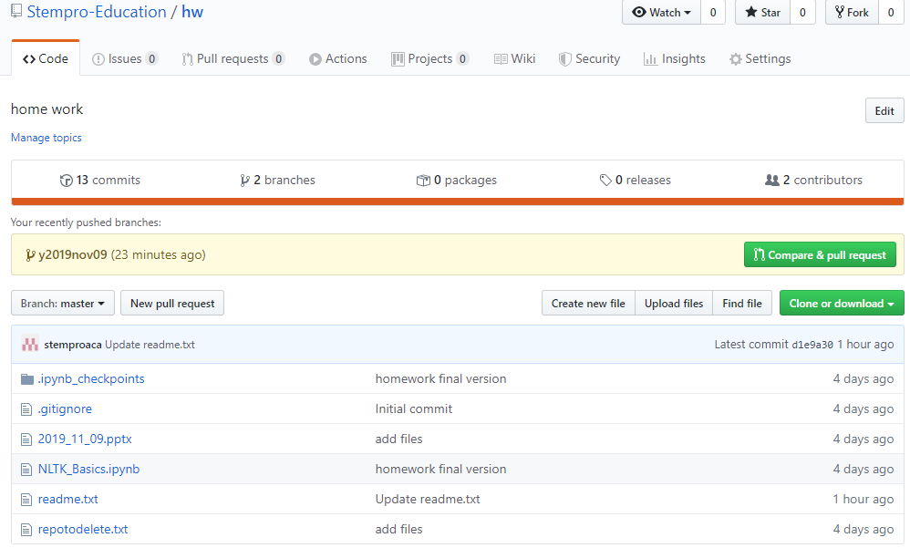
Phase II: Technology Introduction and Lab
Week 3: Web Crawling and Python
1). Review / redo / do last week’s git setup
2.Homework. Place holders for homework.
https://github.com/stempro-education

Slide 7
Phase II: Technology Introduction and Lab
Week 3: Web Crawling and Python
1). Review / redo / do last week’s git setup
2.Homework. Place holders for homework.
https://github.com/stempro-education
Setup git repo

Slide 8
Phase II: Technology Introduction and Lab
Week 3: Web Crawling and Python
2). Python Lab
For basic: Code Academy
https://www.codecademy.com/courses/learn-python-3/lessons/
For Book Readers:
Learn Python the Hard Way (amazon)
https://www.amazon.com/gp/product/0321884914/?tag=hackr-20

Slide 9
Phase II: Technology Introduction and Lab
Week 3: Web Crawling and Python
2). Python Lab
How are we going to proceed?
We use the Hard Way Book.
Exercise | Learning Point | Exercise | Learning Point
0 | The Setup | 27 | Memorizing Logic
1 | A Good First Program | 28 | Boolean Practice
2 | Comments and Pound Characters | 29 | What If
3 | Numbers and Math | 30 | Else and If
4 | Variables and Names | 31 | Making Decisions
5 | More Variables and Printing | 32 | Loops and Lists
6 | Strings and Text | 33 | While-Loops
7 | More Printing. | 34 | Accessing Elements of Lists
8 | Printing, Printing | 35 | Branches and Functions
9 | Printing, Printing, Printing | 36 | Designing and Debugging
10 | What Was That? | 37 | Symbol Review
11 | Asking Questions | 38 | Doing Things to Lists
12 | Prompting People | 39 | Dictionaries, Oh Lovely Dictionaries
13 | Parameters, Unpacking, Variables | 40 | Modules, Classes, and Objects
14 | Prompting and Passing | 41 | Learning to Speak Object Oriented
15 | Reading Files | 42 | Is- A, Has- A, Objects, and Classes
16 | Reading and Writing Files | 43 | Basic Object- Oriented Analysis and Design
17 | More Files | 44 | Inheritance vs. Composition
18 | Names, Variables, Code, Functions | 45 | You Make a Game
19 | Functions and Variables | 46 | A Project Skeleton
20 | Functions and Files | 47 | Automated Testing
21 | Functions Can Return Something | 48 | Advanced User Input
22 | What Do You Know So Far? | 49 | Making Sentences
23 | Read Some Code | 50 | Your First Website
24 | More Practice | 51 | Getting Input from a Browser
25 | Even More Practice | 52 | The Start of Your Web Game
26 | Congratulations, Take a Test!

Slide 10
Phase II: Technology Introduction and Lab
Week 3: Web Crawling and Python
2). Python Lab
a). We cover learning points by specific tasks for the project. Including ai tasks
E.g:
Exercise | Learning Point | Task
6 | Strings and Text | Build Spider
16 | Reading and Writing Files
18 | Names, Variables, Code, Functions
20 | Functions and Files
29 | What If
30 | Else and If
31 | Making Decisions
32 | Loops and Lists
33 | While-Loops
b). For those who choose to learn python, we have two examinations with difficult level ~ to AP.

Slide 11
Phase II: Technology Introduction and Lab
Week 3: Web Crawling and Python
2). Python Lab
We cover learning points by specific tasks for the project. Including ai tasks
<jupyter notebook>

Slide 12
Phase II: Technology Introduction and Lab
Week 3: Web Crawling and Python
3). Programming Languages: Per github
#1: JavaScript: JavaScript is the programming language behind much of the web, and it’s used to build interactive plugins and websites
#2: Java: Java is an object-oriented language created by Sun Microsystems, which is now owned by Oracle. It’s used for databases, developing Android apps, as a “backend” programming language for the web, desktop applications and more.
#3: Python: Python is a high-level programming language and one of the world’s fastest-growing languages. It’s an easy language to get started with, but it's often used for higher-level programming like machine learning and data analysis. One of the most popular tutorials for Python is called “Learn Python the Hard Way.”
#4: PHP: It is used to make dynamic and interactive Web pages. Large sites like Facebook and Yahoo were made using PHP
#5: C++
it’s the core language in many operating systems, browsers, and games.

Slide 13
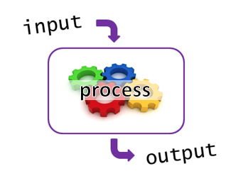
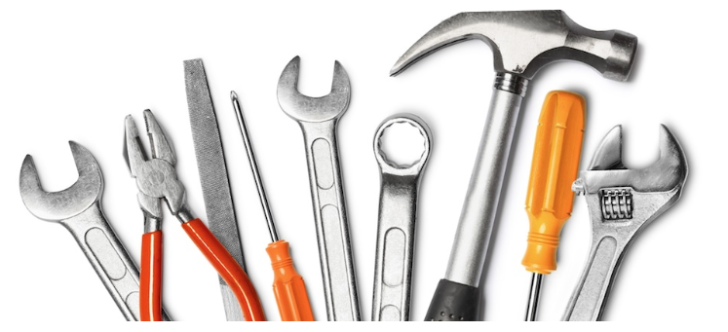

Phase II: Technology Introduction and Lab
Week 3: Web Crawling and Python
3). Programming Languages
Input: 'panacea','paradigm','pariah','partisan','paucity','pejorative','pellucid'
Process:
Tools:
output:
paradigm systematic arrangement of all the inflected forms of a word
---------------------------------------------

Slide 14
Phase II: Technology Introduction and Lab
Week 3: Web Crawling and Python
3). Programming Languages
Let’s wrap up:
Variables
Control Structures
Data Structures
Syntax
Tools

Slide 15
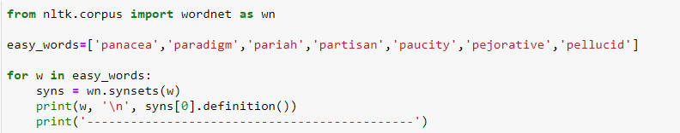
Phase II: Technology Introduction and Lab
Week 3: Web Crawling and Python
4). Python: let’s re-do week one’s homework

Slide 16
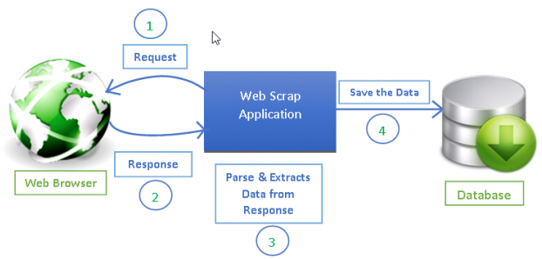

Phase II: Technology Introduction and Lab
Week 3: Web Crawling and Python
5). Web Crawling – Scrapy, Beautifulsoup and NLTK
Framework

Slide 17
Phase II: Technology Introduction and Lab
Week 3: Web Crawling and Python
5). Web Crawling – Scrapy, Beautifulsoup and NLTK
steps:
1). optional
pip install pipenv
2). create a folder for the project, e.g., pyscrape
3). cd to the foloder
4). setup virtualenv
virtualenv .
5). activate it
.\Scripts\activate
(for Mac): ./bin/activate
6). check
pip freeze
7). pip install Scrapy
8) check again
pip freeze
9)start a projectc
scrapy startproject ucaltech
<lab>

Slide 18
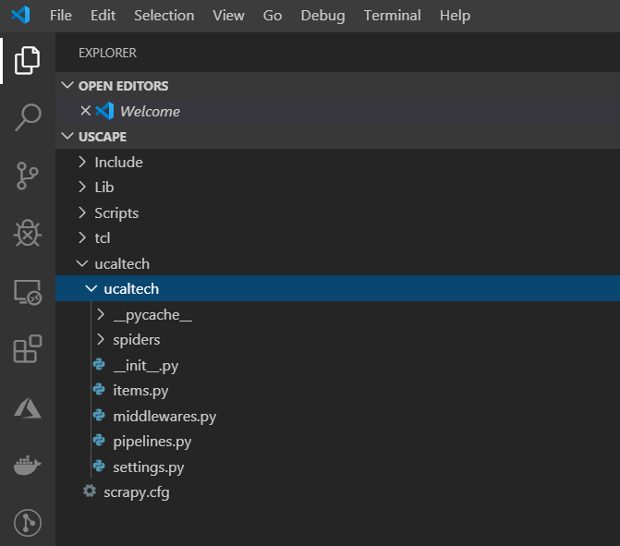
Phase II: Technology Introduction and Lab
Week 3: Web Crawling and Python
5). Web Crawling – Scrapy, Beautifulsoup and NLTK

Slide 19
Phase II: Technology Introduction and Lab
Week 3: Web Crawling and Python
6). Web Crawling – Scrapy, Beautifulsoup and NLTK
Homework – 800 scale
1). Individualized homework
<to be formulated for each student>

Slide 20
Phase II: Technology Introduction and Lab
Week 3: Web Crawling and Python
6). Web Crawling – Scrapy, Beautifulsoup and NLTK
Homework – Grading System
1). Who To Grade: Mutual agreement between students and teachers. Preferrabley come up with an action plan when full score is not achieved
2). What are grades used for:
a. TA qualifications for future projects
b. Criteria for awards based on stempro.org funding

Slide 21
Phase II: Technology Introduction and Lab
Week 3: Web Crawling and Python
Logistics and serious next steps:
Thanksgiving arrangement
Start to think about tasks

