Slide 1

Mouse Protein Clustering
0416235 劉昱劭

Slide 2
Syllabus
✓Dataset
✓ Dimensionality reduction to 2dim
✓ Clustering
✓ Dimensionality reduction to 3dim
✓ Clustering
✓ Conclustion

Slide 3
Dataset
Control
Normal
Ts65Dn
Down Syndrome (唐氏症基因)
Learning Disabilities (學習障礙)

Slide 4


2 Experiments
Drug (Memantine)
Stimulus
To estimate whether Memantine helps Down syndrome mice.
Give some stimulus to make mice learn.

Slide 5
8 Class
 |  | Stimulus
 |  | Yes | not
Drug | Yes
 | not
normal
illed

Slide 6
8 Class
 |  | Stimulus
 |  | Yes | not
Drug | Yes
 | not
normal
illed
normal
illed
normal
illed
normal
illed

Slide 7

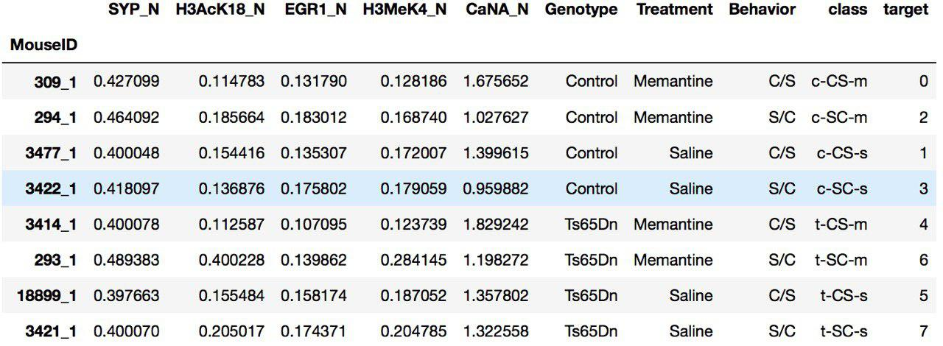
Dataset

Slide 8
Dataset

Slide 9
Dataset
encode

Slide 10
Dimensionality Reduction
✓ For visualization
✓ Speed up clustering

Slide 11
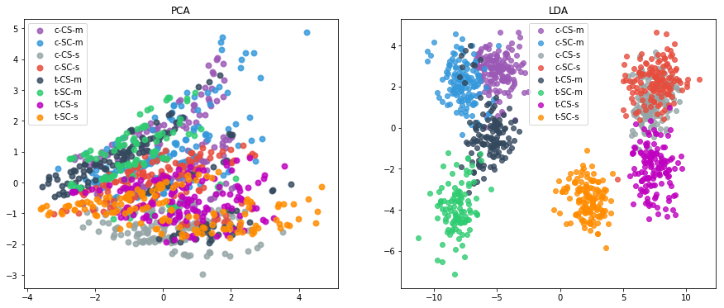
Dimensionality Reduction to 2-dim
PCA
LDA

Slide 12

Dimensionality Reduction to 2-dim
PCA
LDA

Slide 13
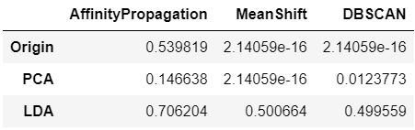
2-dim clustering without k
V-measure
[0, 1]
Larger is better
77dim
2 dim
2 dim

Slide 14
2-dim clustering without k
V-measure
[0, 1]
Larger is better
77dim
2 dim
2 dim

Slide 15
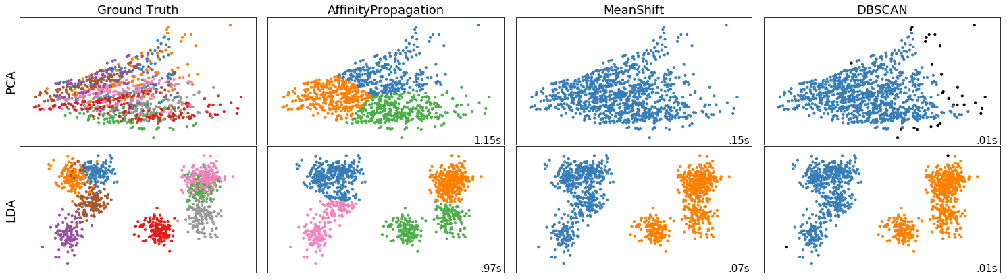
2-dim clustering without k
Ground Truth
Affinity Propagation
MeanShift
DBSCAN
PCA
LDA
Good
But only get 4 classes

Slide 16
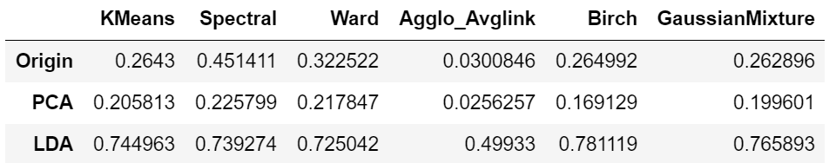
2-dim clustering with k=8
V-measure
[0, 1]
Larger is better
77d
2 d
2 d

Slide 17
2-dim clustering with k=8
V-measure
[0, 1]
Larger is better
77d
2 d
2 d

Slide 18
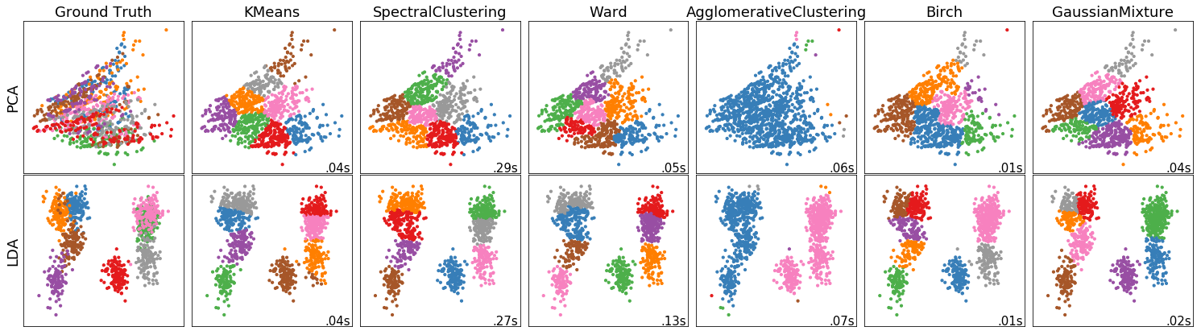
2-dim clustering with k=8

Slide 19
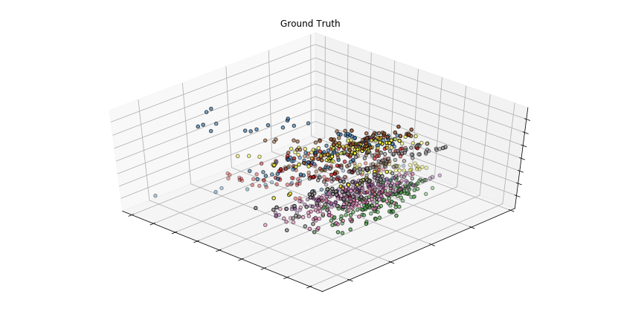
Dimensionality Reduction to 3-dim
PCA

Slide 20
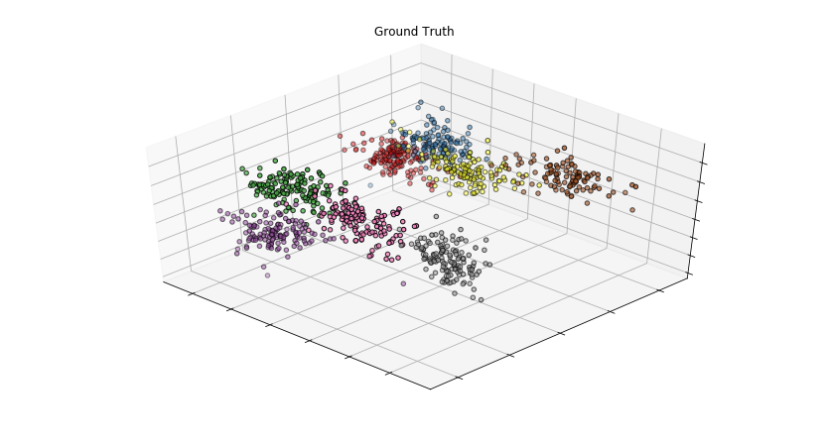
Dimensionality Reduction to 3-dim
LDA

Slide 21

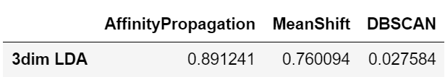
3-dim clustering without k
V-measure
77dim
2 dim
2 dim
3 dim PCA
3 dim LDA

Slide 22
3-dim clustering without k
V-measure
77dim
2 dim
2 dim
3 dim PCA
3 dim LDA

Slide 23
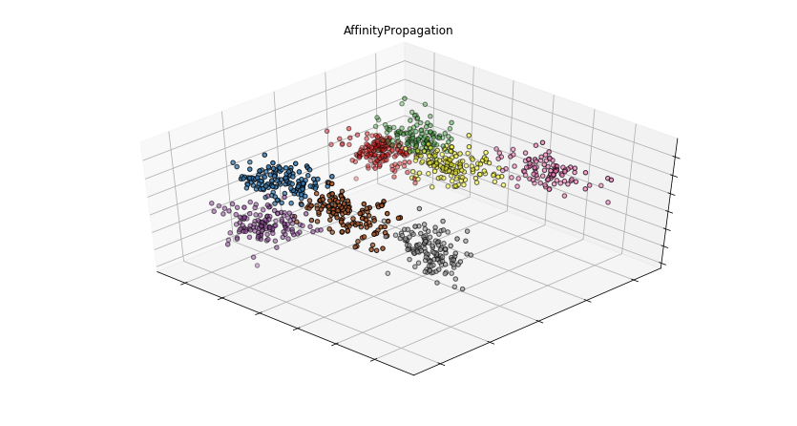
3-dim clustering without k
Affinity Propagation

Slide 24
3-dim clustering without k
Affinity Propagation
6
5
7
2
8
1
3
4

Slide 25
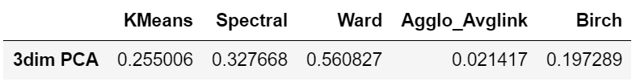
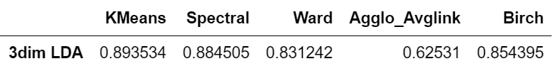
3-dim clustering with k=8
V-measure
77dim
2 dim
2 dim

Slide 26
3-dim clustering with k=8
V-measure
77dim
2 dim
2 dim

Slide 27
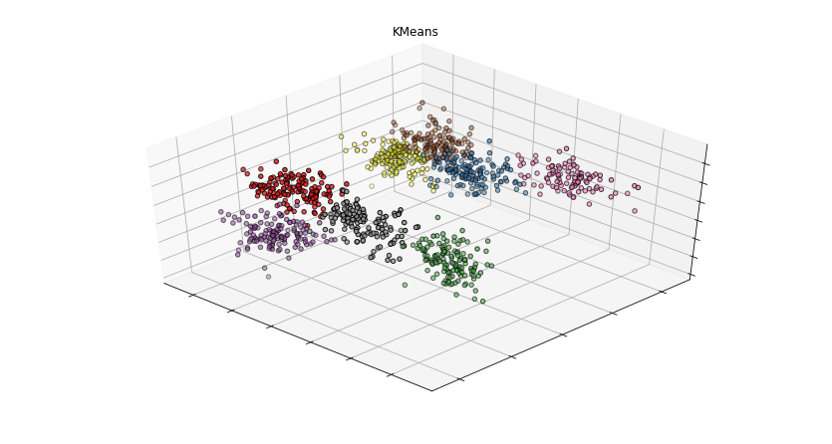
3-dim clustering with k=8
K-means
6
5
7
2
8
1
3
4

Slide 28
Conclusion
✓Reduce dimension to different dimensions may get better clustering result.
✓For touching data, clustering methods without predefined k may get few classes.

Slide 29
Reference Paper
✓V-measure (For clustering accuracy)
http://www.aclweb.org/anthology/D07-1043
✓Dataset from kaggle
https://www.kaggle.com/ruslankl/mice-protein-expression
✓ Mice Protein (提供此資料集的生物領域論文)
https://journals.plos.org/plosone/article?id=10.1371/journal.pone.0119491
✓ Mice Protein Clustering (以此資料集做分群)
https://journals.plos.org/plosone/article?id=10.1371/journal.pone.0129126

Slide 30

Q & A

