Slide 1
DragonFly © IBM 2015, 2015
A SQL and Template based Merge Tool

Slide 2
Overview
DragonFly is a powerful web based tool that allows you to generate any type of output files from simple text templates and a SQL data source.
Templates
Your Data
Merge Process
Output Files

Slide 3
Terminology
Template – The template Content and options.
Directive – Instructions for the Merge Process, associated with a Template
Merge – The process of replacing tags with data and inserting sub-templates to generate output
HashTable – An associative array with unique Keys associated with a corresponding value. When a duplicate key is added, it replace the existing value for that key.

Slide 4
Merge Process - Replace
The Merge process builds a hash of replace from/to values and then processes them
From | To
{name} | Mr. Smith
{address} | 1234 Main St.
{company} | Blue Widgets
Template
Output
Dear {name}
{company}
{address}
We are writing to invite your staff to enroll in our special training class.
Thank you
Intense Training Specialist
Dear Mr. Smith
Blue Widgets
1234 Main St.
We are writing to invite your staff to enroll in our special training class.
Thank you
Intense Training Specialist
Merge Process

Slide 5
Merge Sub-Templates
The Merge process will insert sub-templates at Bookmarks
template2
- {contact} eMail: {eMail}
Dear Mr. Smith
Blue Widgets
1234 Main St.
We are writing to invite your staff to enroll in our special training class.
We would like to extend an invitation to:
- Fred eMail: fred@gmail.com
- Betty eMail: betty@ibm.com
- Kara eMail: kk993@yahoo.com
Thank you
Intense Training Specialist
Dear {name}
{company}
{address}
We are writing to invite your staff to enroll in our special training class. We would like to extend an invitation to:
<tkBookmark name=“template2”/>
Thank you
Intense Training Specialist
Output
template1
Merge Process

Slide 6
Merge Sub-Templates Collections
Sub-Template selected based on contact preference column
Dear Mr. Smith
Blue Widgets
1234 Main St.
We are writing to invite your staff to enroll in our special training class.
We would like to extend an invitation to:
- Fred eMail: fred@gmail.com
- Betty Address: Betty Boop, 123 St.
- Kara Phone: 555-121-3312
Thank you
Intense Training Specialist
Output
- {contact} eMail: {eMail}
Template2 - eMail
Dear {name}
{company}
{address}
We are writing to invite your staff to enroll in our special training class. We would like to extend an invitation to:
<tkBookmark name=“template2”/>
Thank you
Intense Training Specialist
- {contact} Address: {addr}
template1
Template2 - Mail
- {contact} Phone: {phone}
Template2 - Phone
Merge Process
Select * from contacts
contact | preference | eMail | addr | phone
Fred | eMail | fred@gmail.com
Betty | Mail |  | Betty Boop, 123 st.
Kara | Phone |  |  | 555-121-3312

Slide 7
4 Ways to add Replace Values
The replace stack is built in the following order:
Parameters to the html request
Directives associated with the Template
Replace Value directive
Replace Column directive
Replace Row directive

Slide 8
Replace Parameters
http:/www.you.com/DragonFly/Merge?name=Mike&age=21
Note that { and } are added to the From value
The parameter “CacheReset” is reserved, with a value of “Yes” will clear the Template Cache on the server.
From | To
{name} | Mike
{age} | 21

Slide 9
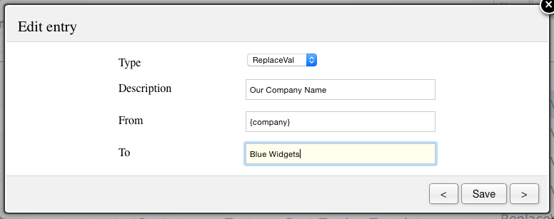
Replace Values Directive
Note that { and } are NOT added to the From value
From | To
{name} | Mike
{age} | 21
{company} | Blue Widgets

Slide 10
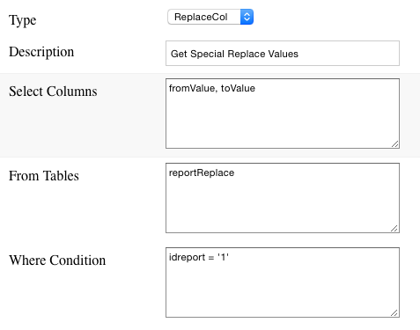
Replace Column Directive
Note { and } are added to fromValue
From | To
{name} | Mike
{age} | 21
{company} | Blue Widgets
{Division} | Sales
{CostCenter} | East
{Date} | June 1st, 2015
Select fromValue, toValue from reportReplace where idreport=‘1’
fromValue | toValue
Division | Sales
CostCenter | East
Date | June 1st, 2015

Slide 11
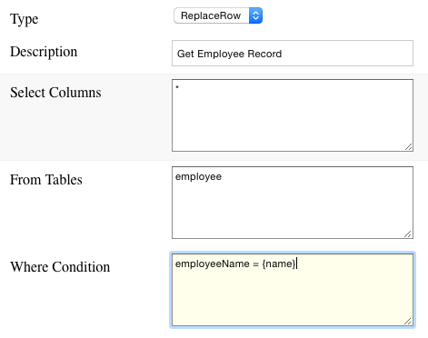
Replace Row Directive
Note: { and } are added to Column Name
All where conditions are “Replace Processed” during Merge.
A result set with more than 1 row will result in an error and merge failure.
From | To
{name} | Mike
{age} | 21
{company} | Blue Widgets
{Division} | Sales
{CostCenter} | East
{Date} | June 1st, 2015
{supervisor} | James
{title} | Janitor
Select * from employee where name=‘Mike’
name | supervisor | title
Mike | James | Janitor

Slide 12
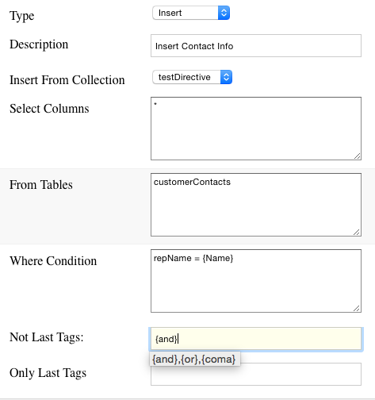
The Insert Directive
The insert directive will insert sub-templates for each row of the result set.
Sub-templates are inserted at <tkBookmark name=“subTemplate” /> tags. Multiple bookmarks are supported.
The current replace hash, along with a replace row of the current result set is the starting set for the sub-template.
Not Last tags are set to “” on the last inserted sub-template
Only Last tags are set to “” on all but the last sub-template.

Slide 13
Sub-Template Collections
Vary the sub-template inserted based on a column in the result set.
Sub-Template Collection specifies the Column used to select sub-templates to be inserted.
Template for Collection, Name, Column Value is inserted if found.
If not found, the template for a blank column value is inserted.
If the blank value is not found, the merge fails.

Slide 14
Saving Output Files
By default a template is either inserted into the parent template, or written to the servlet response. A template can specify an output file name to be created.
If a file is created, nothing is inserted into the parent template.
File names are “replace processed” before the file is saved.

