Slide 1
Network Citation
Visualising Bibliographic Citation Networks in Edubba Studies
Aim Batalova | Master's in Digital & Public Humanities
Ca'Foscari University of Venice · Information Visualization, Module 2 · May 2026
2,103
2,524
5
Publications
Citation Edges
Hypotheses

Slide 2
Presentation Structure
01
02
03
Introduction & Problem
Data & Methods
RQ & Hypotheses
Edubba schools · Why network analysis?
2,103 sources · Step-Distance Model · Pipeline
2 research questions · 5 hypotheses
04
05
Results H1–H5
Conclusions & Limitations
5 visualizations · Design choices
Findings · Future work

Slide 3
01
Introduction
& Problem
Edubba schools · The knowledge gap · Why visualisation?

Slide 4
What is Edubba — and What is the Problem?
Edubba — one of the earliest scribal schools, 2nd millennium BCE. Evidence of structured education.
This project approaches the research questions through information visualisation: citation relationships are encoded as a directed network, and visual analytics — node layout, colour, and centrality — reveal epistemic structures not accessible through linear reading.
The Problem: knowledge is fragmented. Lack of primary and reliable sources. Many interpretations and speculations.
The Target: analyse how scholarly knowledge about Edubba is structurally organised and transmitted within academic citation networks.
Approach: 2,103 publications modelled as a directed citation network. Visual analytics reveals hidden epistemic structures.
Ca'Foscari University of Venice · 2026

Slide 5
02
Data &
Methods
Collection · Parsing · Snowball · Graph Construction · Step-Distance Model

Slide 6
Data Collection Pipeline
1
Collect Anchor Sources
2
Collect Primary Sources
3
Parse & Clean
~150 academic PDFs
(DOI verified)
Archaeological site data
(CSV, open source)
pdfplumber · OCR
Metadata → CSV
4
Snowball Expansion
5
Source Merging
6
Graph Construction
AnyStyle bibliography
extraction → JSON
2,103 unified sources
138 anchor nodes
igraph · 2,103 nodes
2,524 edges
Data: DOI-verified academic publications · open archaeological excavation CSV

Slide 7
Step-Distance Model — Epistemic Classification
Each source assigned an epistemic distance from primary data (Step 1–5)
Step | Role | Criteria | N | %
Step 1 | Direct Reliance | Archaeological pubs — direct empirical evidence (manual) | 164 | 7.8%
Step 2 | Mediators | betweenness ≥ top 15% AND cites ≥ 1 Step 1 node | 37 | 1.8%
Step 3 | Authorities | in-degree ≥ top 10% AND cited by ≥2 Step2 AND age ≥10 yr | 226 | 10.7%
Step 4 | Mediated | cites no Step1 AND cites ≥2 Step3 AND out-degree ≥2 | 3 | 0.1%
Step 5 | Peripheral | All others — NOT Step 1/2/3/4 | 1,673 | 79.6%
Step-Distance Model · sources_withAll_steps_v2_LABELED.csv · N = 2,103

Slide 8
03
Research Questions
& Hypotheses
2 RQs · 5 Hypotheses forming a chain of evidence

Slide 9
Research Questions & Hypotheses Chain
RQ1
How is scholarly knowledge about Edubba schools structurally organised within the citation network — and what role do primary archaeological sources play?
RQ2
Which sources can be identified as epistemically reliable based on their structural position relative to primary data — and do the most reliable sources coincide with the most cited?
Operationalised through 5 sequential hypotheses:
H1
H2
H3
H4
H5
Network Topology
Structural Gap
Bottleneck
Epistemic Displacement
Reliability Rarity
Hierarchical structure?
Step1 vs Step3 isolated?
Step 2 — only bridge?
Eigenvector in Step 3?
Trust Triangle < 1%?

Slide 10
04
Results
H1–H5
5 visualizations · Design rationale · Key findings

Slide 11
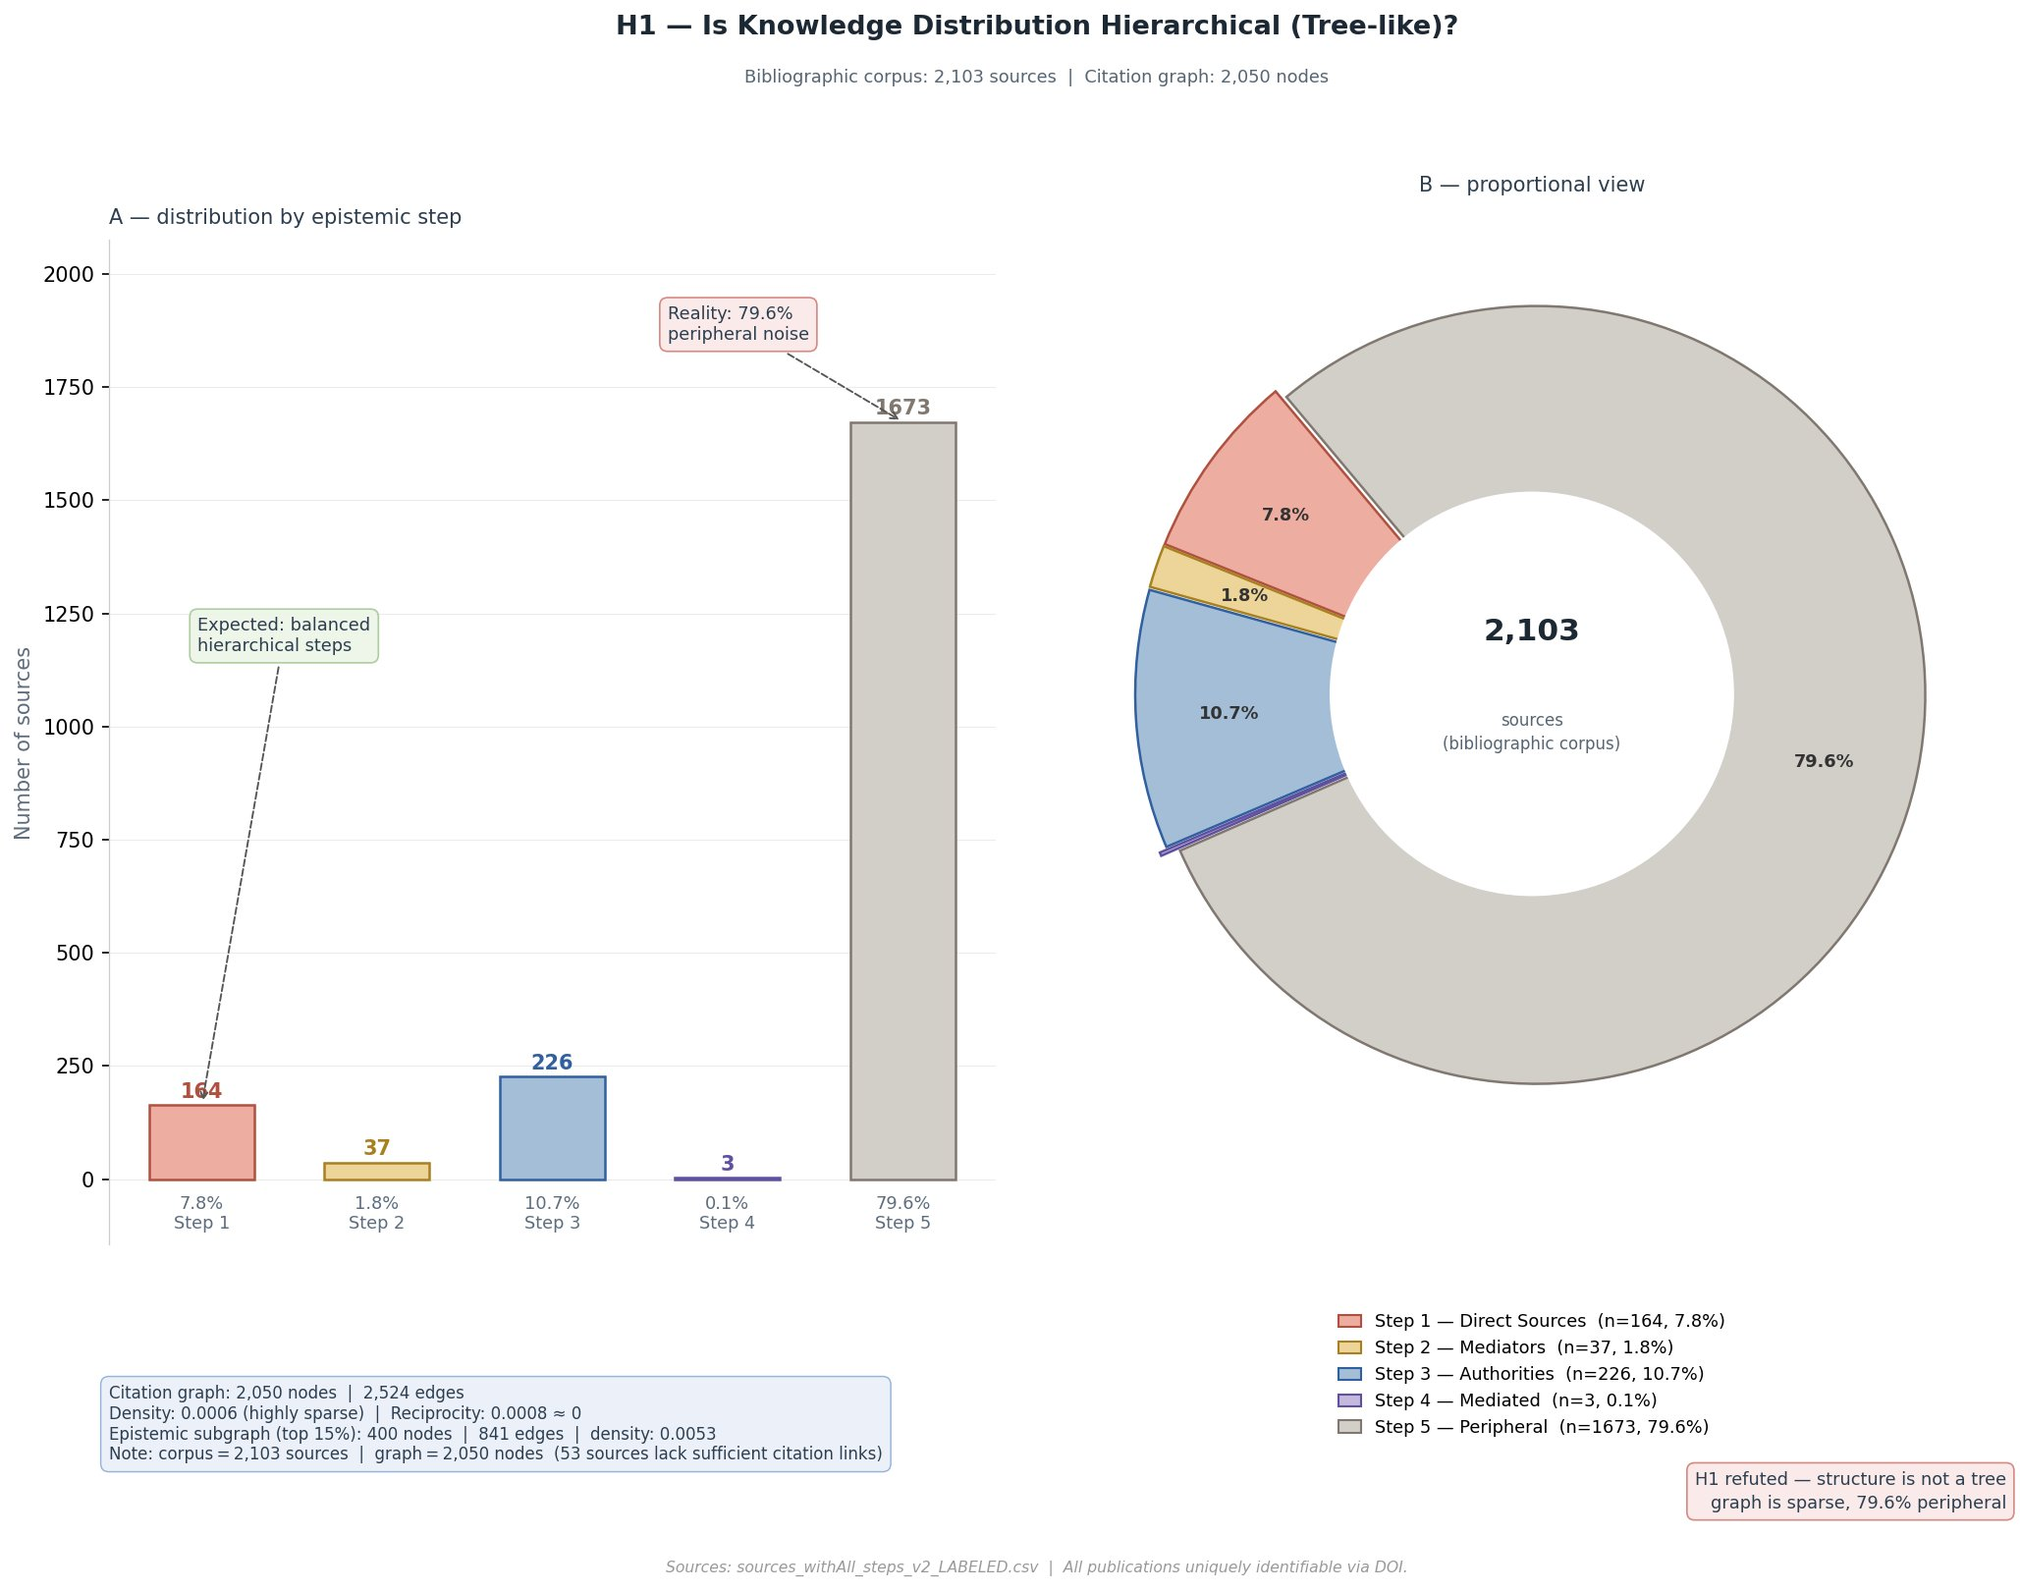
H1
Network Topology Hypothesis
X NOT CONFIRMED
Is knowledge about Edubba distributed as a hierarchy — roots (Step 1) → branches (Step 2/3)?
How to Read
Read Panel A left to right: Step 1 through Step 5. A hierarchical structure would produce a roughly bell-shaped or pyramid distribution — comparable bars for Steps 1–4 with Step 5 smaller. Instead, the bar for Step 5 dominates visually (n = 1,673, 79.6%), while Steps 2 and 4 are barely visible. Panel B reinforces this: the near-total grey segment of Step 5 makes the imbalance immediately apparent. The green annotation marks what would be expected in a hierarchy, the red annotation marks the actual result
.
79.6%
Step 5 — Peripheral
0.0006
Network Density
1.8%
Step 2 — Mediators only
.
Design: Bar chart (position on common scale) for Compare task · Donut for part-of-whole · (Cleveland & McGill, 1984)
Key Finding: network is NOT a tree — sparse, scattered, 79.6% peripheral
Source: sources_withAll_steps_v2_LABELED.csv | citation_graph.csv

Slide 12
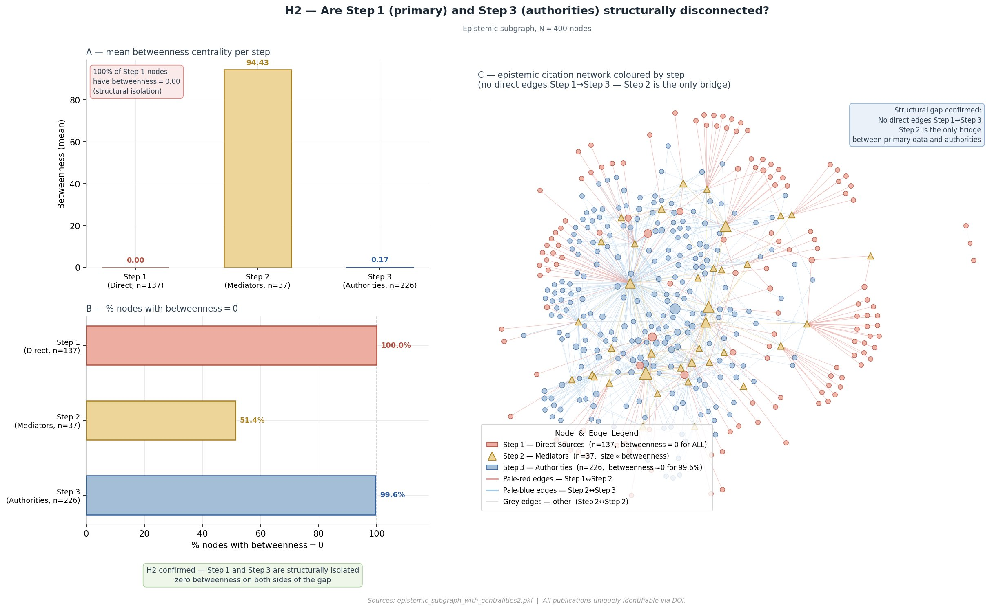
H2
Structural Gap Hypothesis
V CONFIRMED
Are primary archaeological sources (Step 1) structurally isolated from authoritative works (Step 3)?
How to Read
In Panel A: compare bar heights across the three steps. Step 2 (pale amber bar) should be visibly taller.
In Panel B: the near-total fill for Steps 1 and 3 (100% and 99.6% betweenness = 0) versus Step 2 confirms structural isolation.
In Panel C: locate the pale terracotta (red) cluster of Step 1 nodes and the pale blue cluster of Step 3 nodes — observe the spatial separation. Pale amber triangles (Step 2) act as the only visible bridge..
All 137 Step 1 nodes: betweenness = 0.00.
Primary sources are cited but never transit information.
No direct connections
Step 1 → Step 3 exist
Design: Bar chart (Panel A — Compare) · Horizontal bar (Panel B — proportions) · Node-link graph (Panel C — topological gap is the visual finding itself)
Source: epistemic_communities2.csv · N = 400 (subgraph, Steps 1–3)

Slide 13
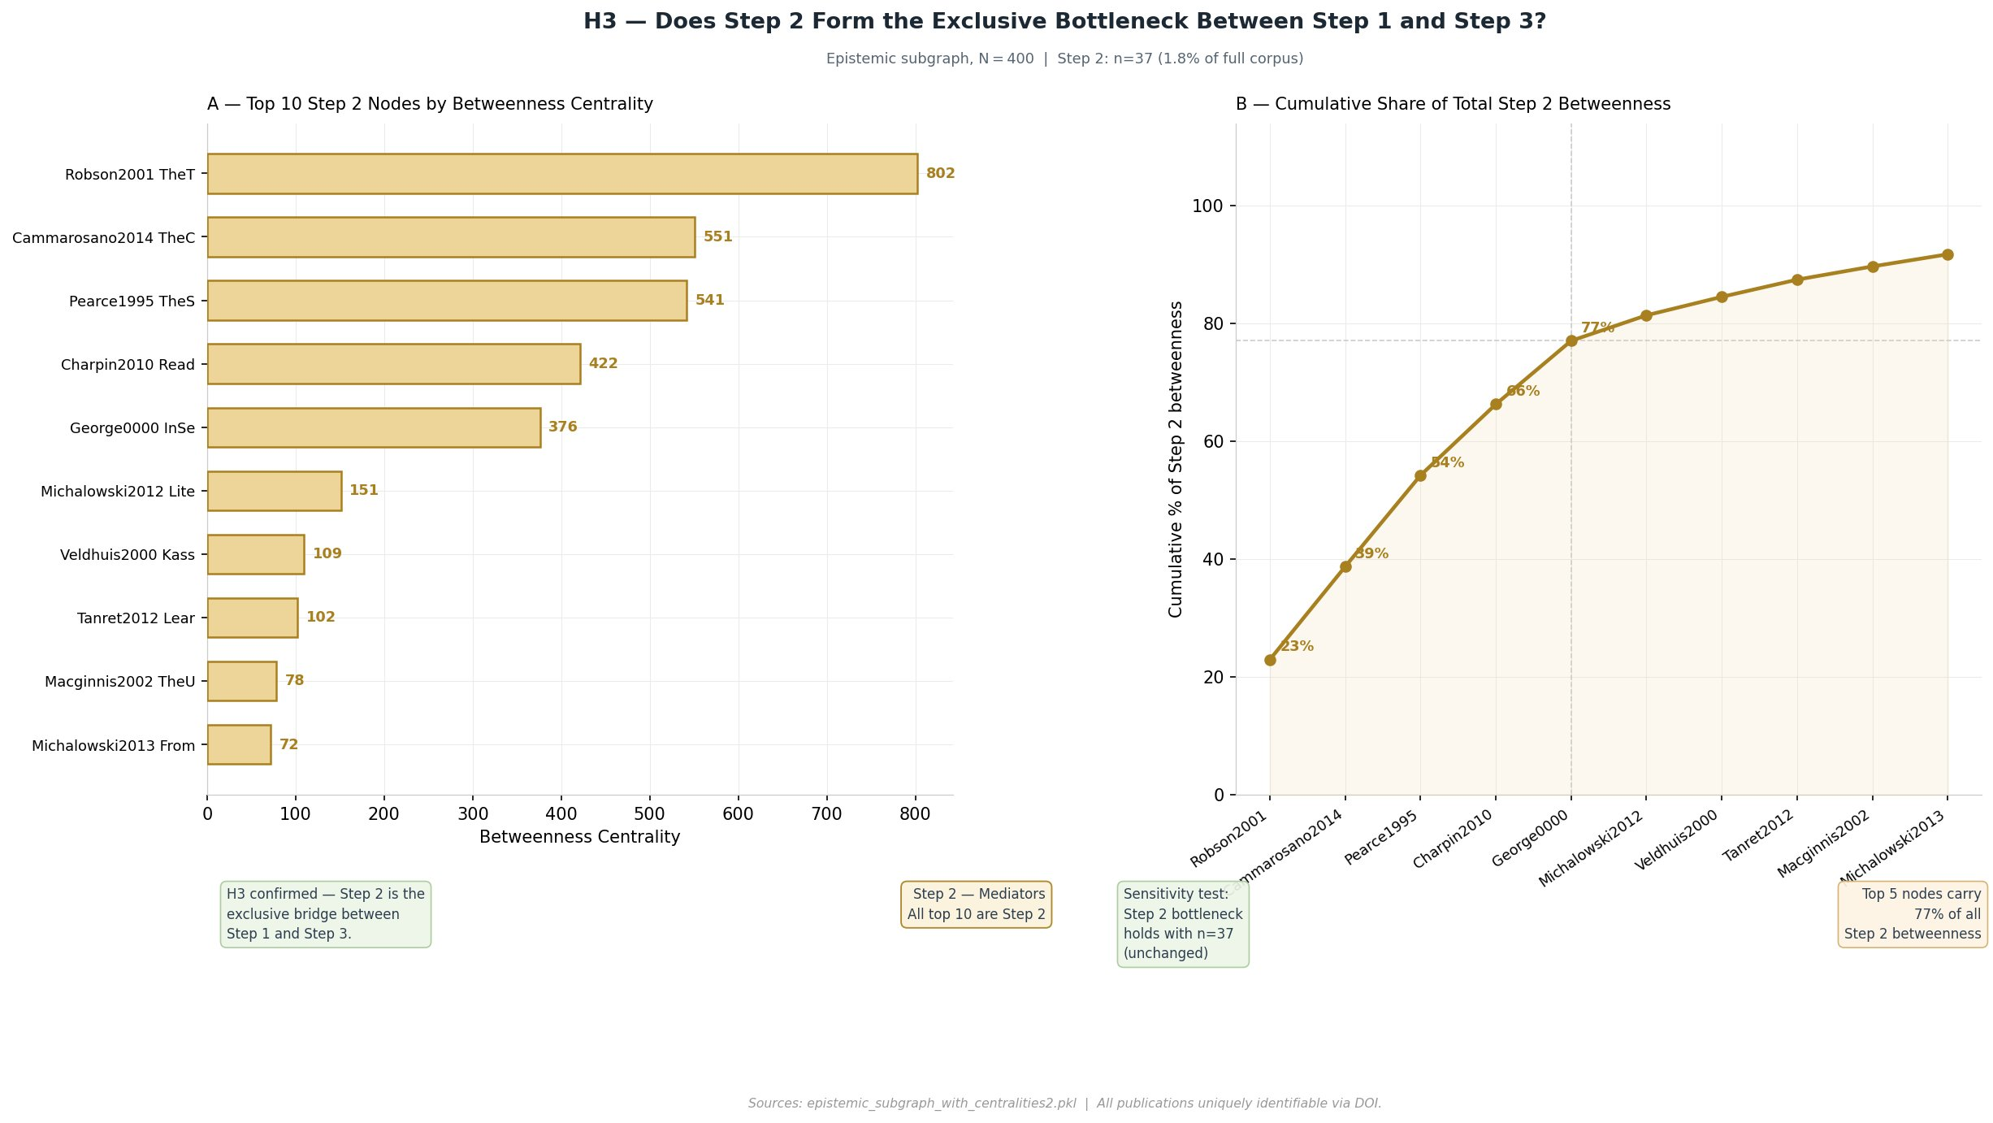
H3
Bottleneck Hypothesis
V CONFIRMED
Is Step 2 the only structural bridge between Step 1 and Step 3? Is it robust to threshold changes?
How to Read
Panel A: read bars left to right — single amber colour confirms all top-10 betweenness nodes are Step 2.
Panel B: the steeper the cumulative curve, the more concentrated the bottleneck. Top 5 mediators carry 77% of all Step 2 betweenness.
37 nodes (1.8%) = entire bridge Step 1 → Step 3. Top 5 carry 77% of all Step 2 betweenness.
Sensitivity test: With filter = 37 · Without filter = 37. Bottleneck is a REAL structural property, not a threshold artifact.
Design: Horizontal bar (Panel A — Identify Extremes, long source IDs) · Cumulative line (Panel B — concentration, Lorenz curve analogy)
Source: epistemic_communities2.csv · N = 400

Slide 14
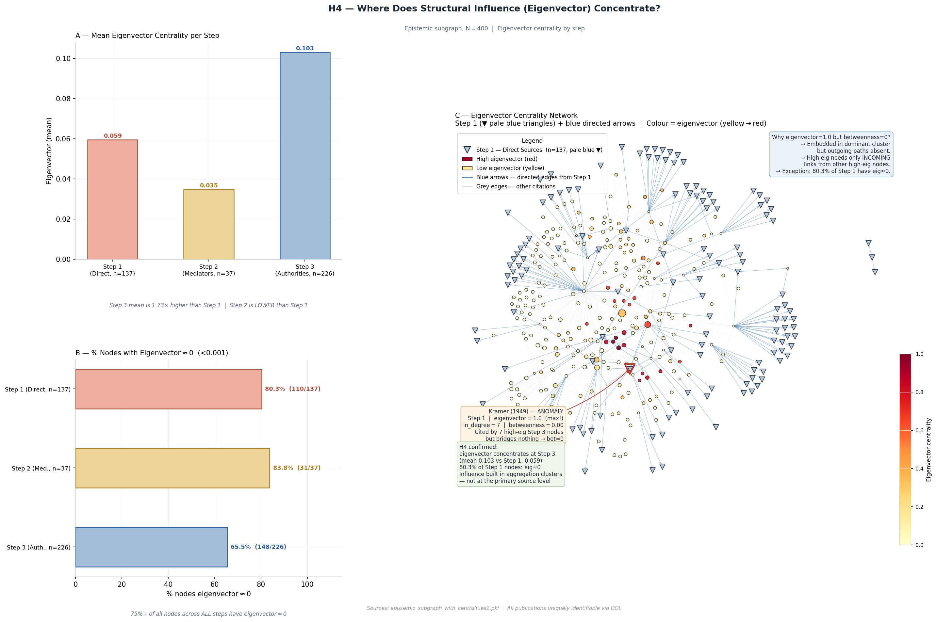
H4
Epistemic Displacement Hypothesis
V CONFIRMED
Is eigenvector centrality concentrated in Step 3 rather than Step 1? Does influence decouple from proximity to primary data?
How to Read
In Panel C: Network Heatmap warm-colored (yellow/red) nodes represent high-eigenvector publications, which demonstrate that most popular sources(red nodes) are not connected to primary sources(blue triangle). The blue triangles consistently appear in cool colors (yellow/pale) at the periphery. The one exception is Kramer1949, annotated explicitly.
Anomaly — Kramer (1949): Step 1 node with eigenvector = 1.0 (max!), cited by 7 central Step 3 nodes, but betweenness = 0. A dead end, not a bridge.
Step 2 Paradox: Mediators have the LOWEST mean eigenvector (0.035) — even below Step 1 (0.059). Bridges connect isolated zones without belonging to the epistemic core.
Design: Network heatmap (Panel C) encodes topology + scalar intensity (YlOrRd). Scatter plot rejected — loses spatial/topological dimension.
Source: epistemic_communities2.csv · N = 400

Slide 15
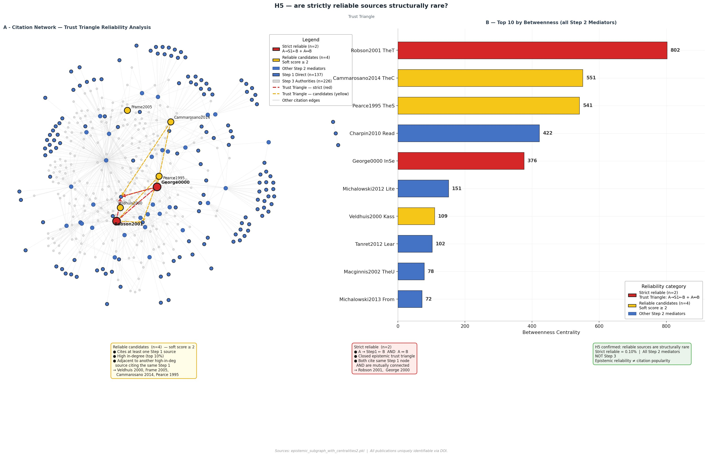
H5
Epistemic Reliability Rarity — Trust Triangle
V CONFIRMED
Are strictly reliable sources (primary link + high in-degree + mutual reinforcement) < 1% of corpus, all Step 2?
How to Read
-Two red nodes (Robson2001 and George0000) = strictly reliable sources. Three dashed red edges form a visible triangle via a shared Step 1 node.
-Yellow nodes = top-4 soft candidates — no closed triangle.
Vast majority of nodes are grey or blue, confirming reliability is structurally rare.
Strictly reliable:
Link to primary data, High in-degree. There is another node B with a high in-degree that cites the same Step 1 source as A, forming a closed trust triangle.
Key conclusion:
< 0.1%
all are Step 2
Share of corpus:
Reliability != Popularity
Adams1969 (in-deg=21) FAILED
Design: Node-link required — Trust Triangle is a topological property (closed triad). Dashed edges pre-attentively group the triangle. Bar chart (Panel B) confirms all are Step 2.
Source: sources_withAll_steps_v2_LABELED.csv (N=2,103) · epistemic_communities2.csv (N=400)

Slide 16
Unified Design System — Visual Grammar
Consistent color encoding + layout across all 5 figures enables cross-figure visual comparison
Color Encoding (Step-Distance)
Design Principles Applied
Step 1 — Direct Reliance (Primary)
· Position on scale for Compare (Cleveland & McGill, 1984)
Pale Terracotta (Melon) · H=10° S=68% L=78% · #EDADA0
· Horizontal bars for long source identifiers
Step 2 — Mediators (Bottleneck)
Pale Amber (Jasmine) · H=42° S=70% L=76% · #EDD498
· Node-link graphs for topological properties
Step 3 — Authorities (High in-degree)
· Sequential color scale (YlOrRd) for eigenvector heatmap
Pale Blue (Beau Blue) · H=210° S=40% L=75% · #A4BED8
Step 4 — Mediated
· White background, removed top/right spines (Tufte)
Pale Lavender · H=260° S=34% L=79% · #C4B8DC
Step 5 — Peripheral (Noise)
· Semi-transparent annotation boxes (alpha = 0.8)
Pale Silver · H=36° S=10% L=80% · #D2CEC8
· DejaVu Sans — consistent cross-platform font
Visualization Types by Hypothesis:
· Consistent node positions across H2–H5 figures
Bar Chart
Donut Chart
Node-Link
Graph
Network
Heatmap
Cumulative
Line
H1, H2, H3, H4
Compare task
H1
Part-of-whole
H2, H3, H5
Topology
H4
Topology + scalar
H3
Concentration

Slide 17
05
Conclusions
& Limitations
Findings · Methodological contributions · Future work

Slide 18
Key Findings & Conclusions
1
H1 — Not hierarchical
2
H2 — Primary sources are isolated
79.6% of sources are peripheral. Citation network is sparse and fragmented — not tree-like. Visual analytics immediately contradicts the hierarchical model.
Step 1 betweenness = 0.00. Primary data is cited but never mediates information flow. The gap between evidence and interpretation is structural.
3
H3 — Bottleneck confirmed
4
H4 — Influence is not proximity
37 nodes (1.8%) carry all epistemic traffic Step 1 → Step 3. Robust to threshold changes. Top 5 mediators carry 77% of all betweenness.
Eigenvector concentrates in Step 3, not Step 1. Discursive authority is decoupled from empirical proximity. Step 2 paradox: bridges without belonging.
5
H5 — Reliability is rare and unexpected
Only 2 sources satisfy all Trust Triangle criteria. Both are Step 2 Mediators — NOT the most cited Step 3 Authorities. Citation popularity and epistemic reliability are structurally different properties.
Core contribution: Visual analytics reveals hidden epistemic structures in humanities research — structures not accessible through linear reading or citation counts alone.

Slide 19
Limitations & Future Work
Limitations
Future Work
→ Incorporate temporal dynamics of citation formation
· Node-link diagrams do not scale to the full 2,103-node graph — subgraph (N=400) used for topology
· Step-Distance Model assigns roles by network position, not content validity
· Step 4 is under-represented in the dataset, with only three identified sources. This is likely due to the DOI-based sampling strategy, which favours journal articles over textbooks and encyclopedic works. As a result, the visualisations may under-represent synthesis-level scholarship. The Step 4 layer in the figures should therefore be interpreted as a partial reflection of the epistemic landscape rather than a complete one
→ Test Trust Triangle robustness under alternative reliability definitions
→ Compare Edubba network with other archaeological/historical domains
· The node-link diagram is useful for small subgraphs but does not scale to the full dataset, because visual complexity increases faster than human perceptual capacity. Therefore, alternative representations are required for global structure analysis
→ Expand corpus to include grey literature and monographs
· Network reflects the selected corpus only — not a comprehensive field map
→ Content analysis alongside structural analysis

Slide 20
Thank You
Network Citation: Visualising Bibliographic Citation Networks in Edubba Studies
Results Summary:
Data & Code
H1 NOT CONFIRMED — Not hierarchical (79.6% peripheral)
github.com/AimBtlv/
research-NetworkCitation_Edduba
Folder: 8-output_Modul2
Tools: Python · igraph · AnyStyle
pdfplumber · Tableau
H2 CONFIRMED — Primary sources structurally isolated
H3 CONFIRMED — 37 nodes (1.8%) = entire bottleneck
H4 CONFIRMED* — Eigenvector in Step 3, not Step 1
H5 CONFIRMED — Only 2 reliable sources, both Step 2
Aim Batalova · Ca'Foscari University of Venice · DAIS · May 2026

