Slide 1
Culturomics Phenomenon
Through the Wikipedia article on Michael Jackson
A 2009-2026 case study, building on J.B. Michel (2011)
Digital and Public Humanities
Aim Batalova, 2026

Slide 2
INTRODUCTION
The Culturomics Phenomenon
J.B. Michel (2011) showed that a society's collective attention to events leaves measurable traces in digital sources, and follows quantifiable patterns.
Michel's original source
Google Books corpus
40+ million books, n-gram frequency
Critique (Pechenick J.P. , 2015)
The corpus is library-like: one book equals one vote, regardless of actual readership. A growing share of scientific texts distorts word frequencies.
“...an initial response to an exogenous shock, followed by a long-term decay reflecting the process of collective forgetting”
— Michel J.B., 2011

Slide 3
METHOD FOUNDATION
Why Wikipedia
01
Michel already used Wikipedia
Fame analysis of 740,000 people in the original 2011 paper
Google Books
text publication
one signal
years of delay
02
Two independent signals
Views measure consumption, edits measure production. Books offer only one signal
03
Real time
Wikipedia
Edits are recorded within hours. Books require months to be published
consumption + production
two signals
real time
04
Collectiveness
Decentralized editing is a more direct embodiment of Halbwachs's collective memory

Slide 4
THEORETICAL FRAMEWORK
Three Phases Of The Phenomenon
2001 – JUNE 2009
25 JUNE 2009
AFTER 2009
Before the shock
The flashpoint
The residue
A stable plateau. Slow article growth, routine maintenance mode.
A phase transition. Exogenous shock: a surge in views and edits.
Views and edits decay. Article size never returns to baseline.

Slide 5
DATA and METHOD
Data And Method
Pageviews
Edits
Method
pagecounts-raw (2009)
+ Pageviews REST API (2015-2026)
MediaWiki Action API
prop=revisions, 2001-2026
Michel's half-life:
peak - first day below half
4,091 daily data points
33,893 revisions
No curve fitting

Slide 6
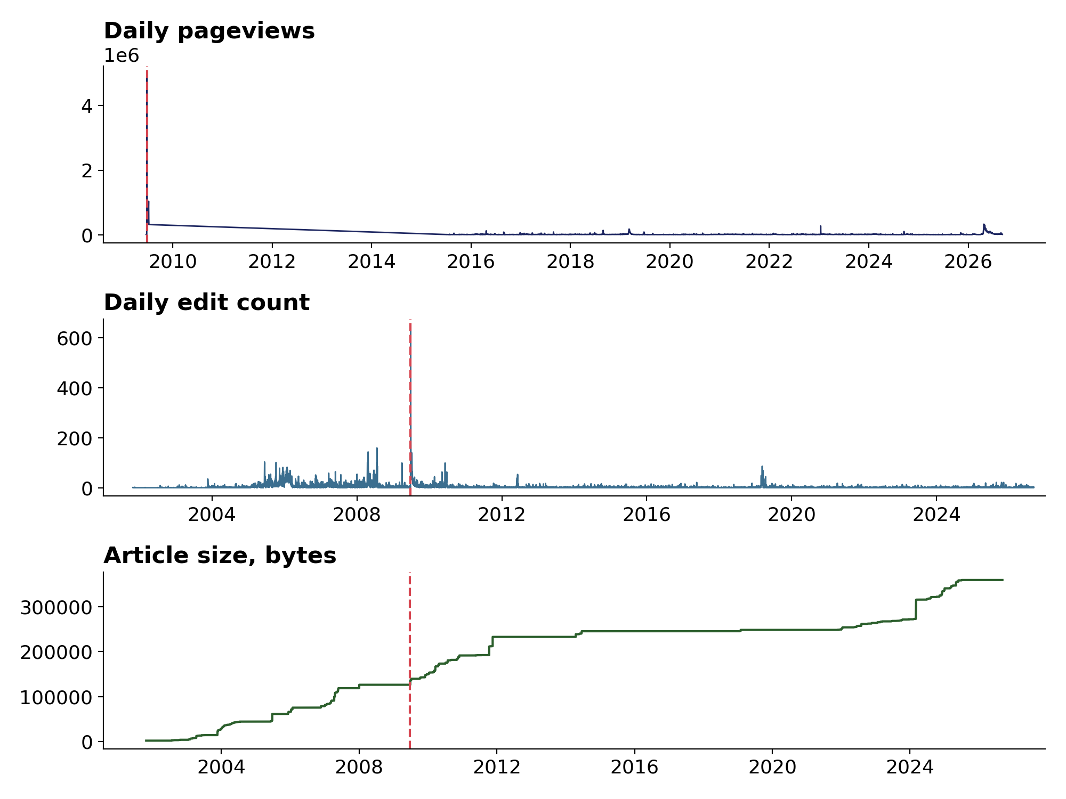
LAYER 1 DESCRIPTIVE
The Overall Picture
All three signals mark the same moment, 25 June 2009, but behave very differently afterwards.
Pageviews
12,747 to 4,972,223 in one day
Edits
5 to 642 per day
Article size
never returns to baseline

Slide 7
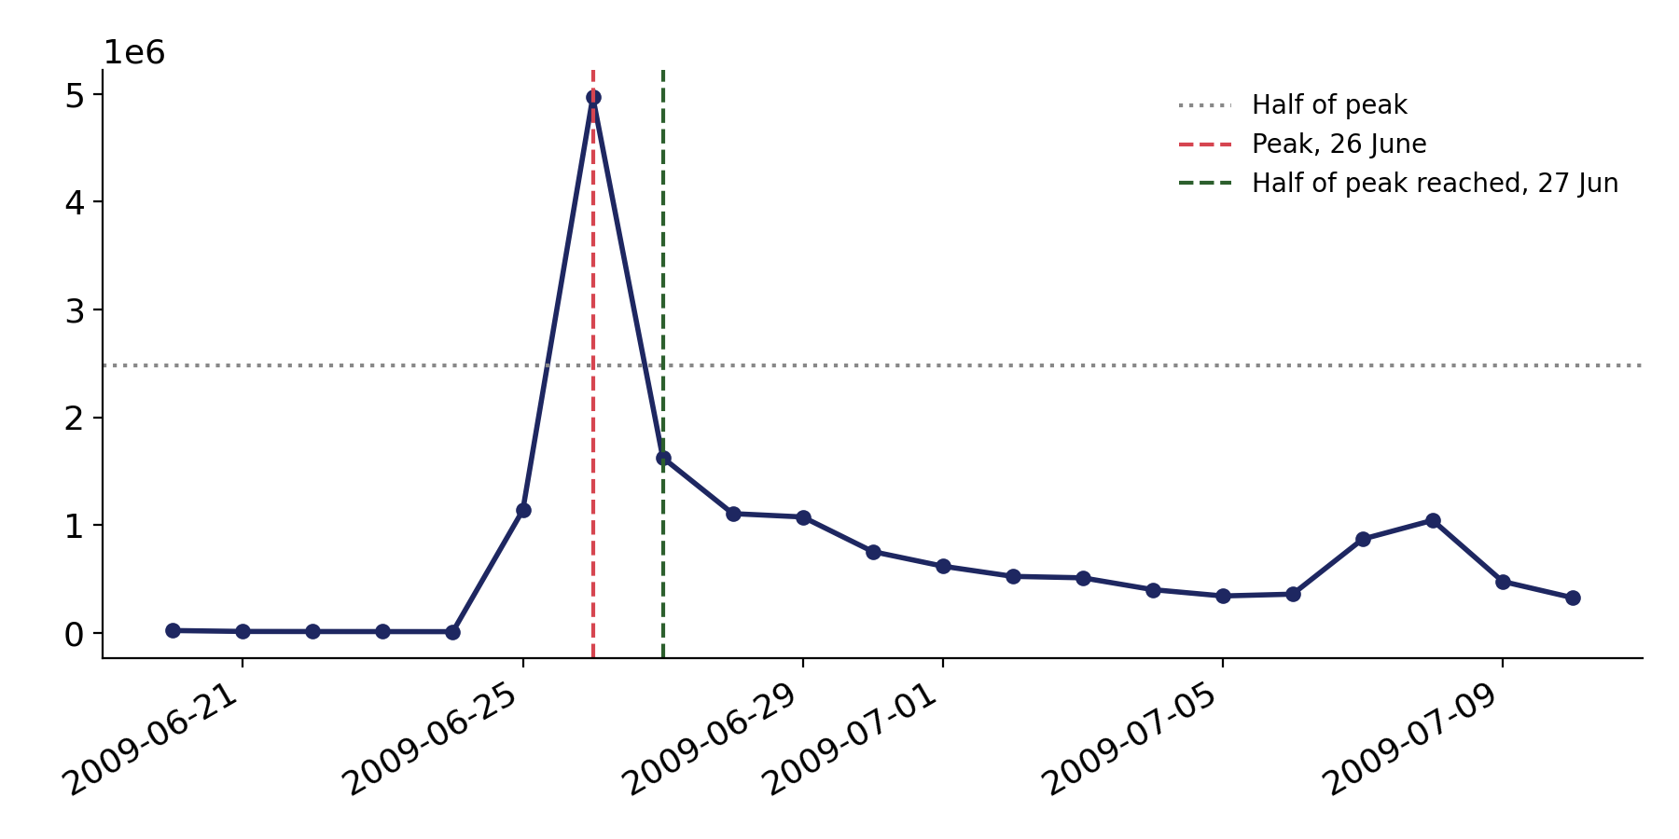
LAYER 2 AUDIENCE INTEREST DROP
How Fast Attention Faded
1
day to reach half of peak
The acute shock phase ends within a day, but a full return to baseline takes about two weeks.

Slide 8
LAYER 3 EVENT COMPARISON
2009 Versus 2026
The artist's death and the release of a movie: two attention spikes of a different kind
 | 2009 (death) | 2026 (film)
Peak pageviews | 4,972,223 | 339,354
Edits in window | 2,560 | 90
Change in size | +13,347 bytes | 0 bytes
The difference reflects not only timing but the nature of the event: a death demands a rewrite of the facts, a film release only their addition.

Slide 9
LIMITATIONS
Limitations
cummax understates size change near the article's historical maximum
The 2009 and 2026 comparison rests on only two cases, not a statistical sample
Some hourly files in the 2009 archive were unavailable on the server

Slide 10
Conclusion
Views and edits fall. Article size does not.
Culturomic analysis, originally built on Michel's book corpus, applies equally well to Wikipedia data, with the added benefit of separating consumption and production signals. Collective memory crystallizes not at the moment of attention, but at the moment of editing.

