Slide 1
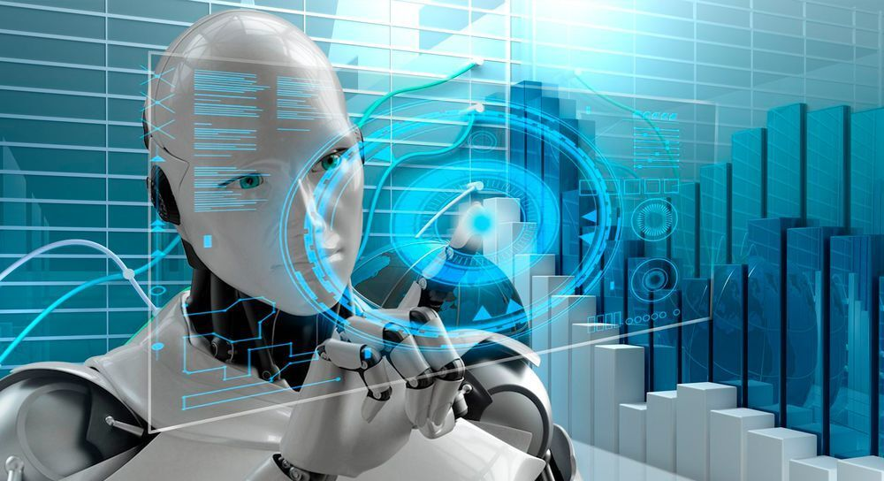
AI in Action: My Applied Projects & Industry Insights
Aima Ayaz

Slide 2
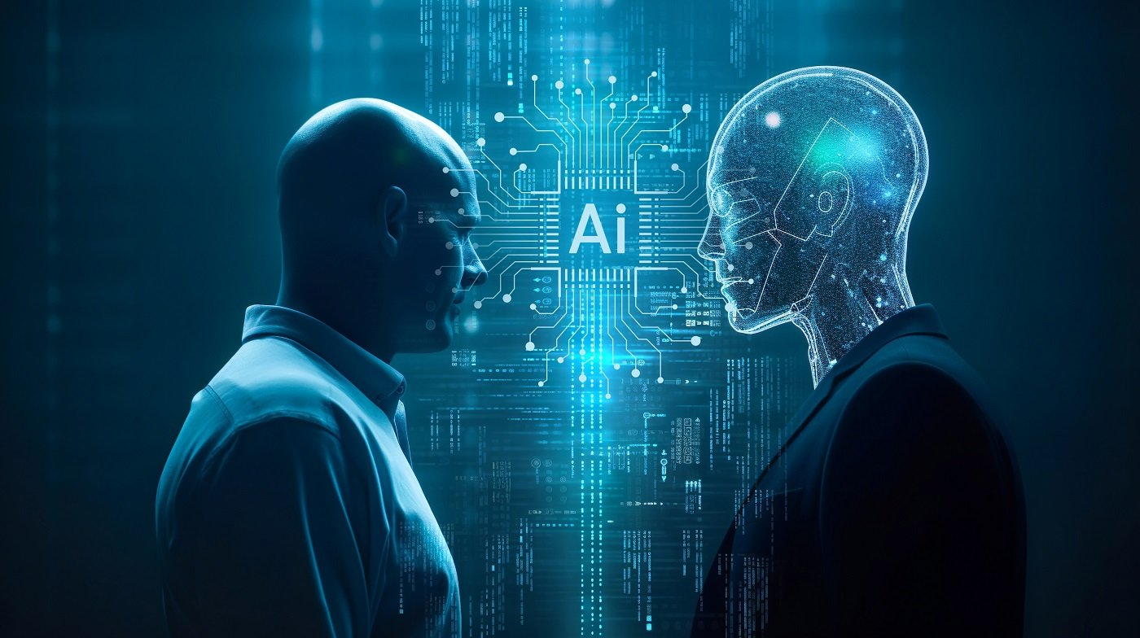
Introduction
AI student with hands‑on experience in applied machine learning, ethical AI analysis, and real‑world case study research. Skilled in Python, ML workflows, data analysis, and AI applications across multiple industries.

Slide 3
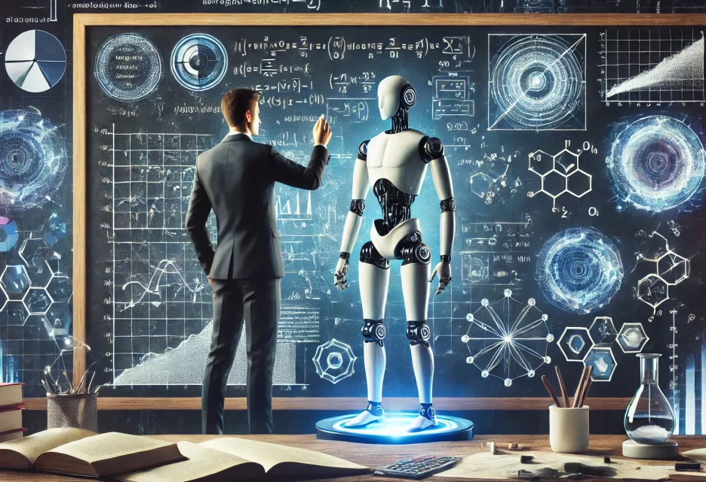
AGI in Healthcare
• Explored how AGI could transform diagnostics, treatment planning, and global health systems.
• Learned to analyze high‑risk AI systems and ethical implications.
NASA Space Mission Classification (ML Project)
• Built a classification pipeline using real mission data.
• Practiced preprocessing, feature engineering, model training, and evaluation.
Key Projects & Learnings

Slide 4
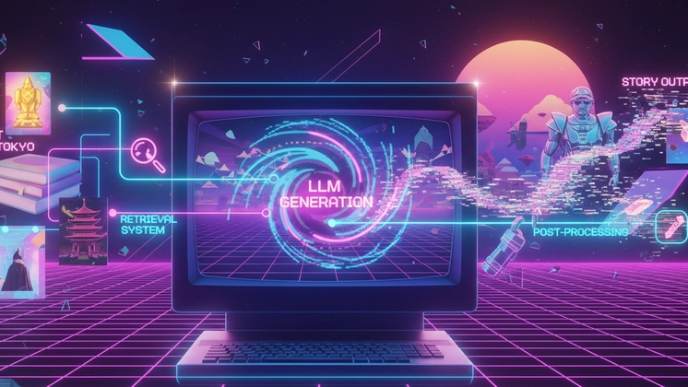
Key Projects & Learnings
AI Abuse Case Study (Synthesia Video)
• Investigated misuse of AI in an industry (e.g., deepfakes, surveillance, fraud).
• Focused on societal risks, accountability, and prevention strategies.
AI in Manufacturing, Government, Finance, Retail, Smart Cities
• Studied predictive maintenance, public health AI, fraud detection, personalization, and urban intelligence.
• Strengthened understanding of AI’s operational and ethical challenges.

Slide 5

• Applying ML for diagnostics, fraud detection, predictive analytics, and automation.
• Designing ethical AI frameworks for fairness, transparency, and safety.
• Using AI to solve problems in healthcare, finance, manufacturing, public sector, and smart cities.
• Building data‑driven solutions with Python, ML models, and research‑based analysis.
Real‑World Applications

Slide 6
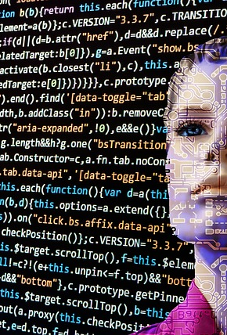
Info
GitHub Portfolio: https://github.com/AimaAyaz/AI-Applications-Portfolio.git
Email: w216981450@student.hccs.edu
Skills: Machine Learning • Python • Data Analysis • AI Ethics • Case Study Research Additional Work: NASA ML Project • Synthesia AI Abuse Case Study • Multi‑industry AI Reports

