Slide 1

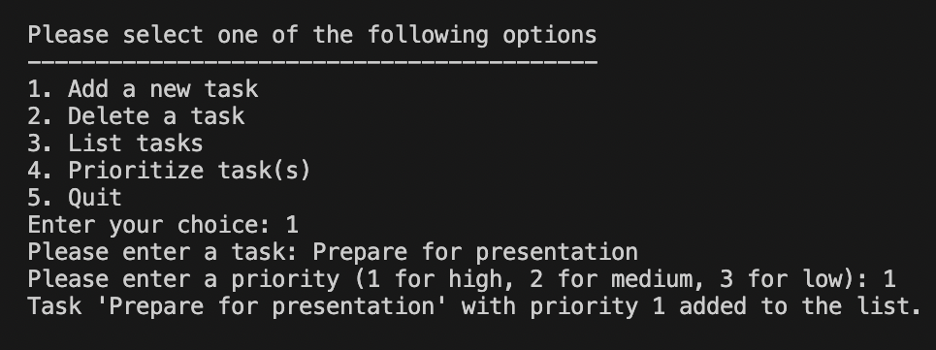
TaskTrack
TaskTrack is a task management app that allows users to create, prioritize, and organize tasks.
How it works:
"TaskTrack: Maximize Your Productivity, Minimize Your Stress"​
GitHub Repository Link:
https://github.com/ksu-is/TaskTrack
By Trinity Zamora

