Slide 1
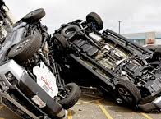
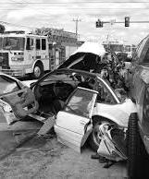
Car Accident Severity Prediction
IBM Data Science Capstone Project
By: Aimad GUALLAL, engineering student at ECOLE CENTRALE CASABLANCA

Slide 2
Business Understanding
In order to reduce the frequency of car collisions in a city, I will use an algorithm which must be developed to predict the severity of an accident based on several factors such as : the weather, road and visibility conditions. When the conditions are bad, the model or algorithm must alert drivers to be carful.

Slide 3
Data acquisition and cleaning
Source of data
Firstly, we will use the dataframe found with the course material, data collision in Seattle City. Data provided by the Seattle Department of Transportation (SDOT) on vehicle accidents along with its severity
Some information about data
The dataset consists of 38 columns having different kinds of data like, collision severity, road conditions, number of people involved, location of collision, weather etc.
I will just use 6 columns for my new dataset.
Predict the severity of accident
Download data
https://s3.us.cloud-object-storage.appdomain.cloud/cf-courses-data/CognitiveClass/DP0701EN/version-2/Metadata.pdf

Slide 4
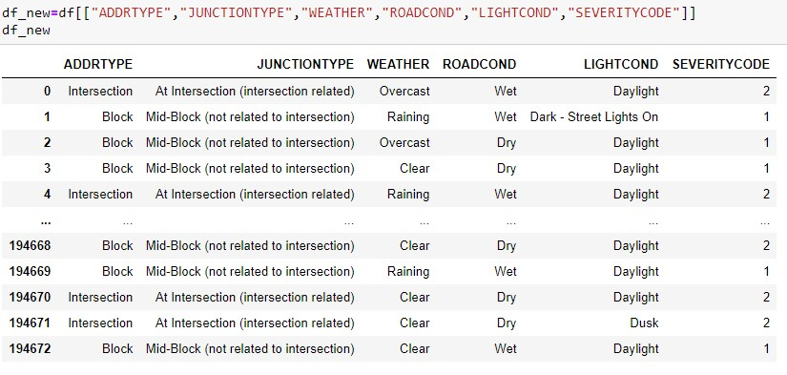

Slide 5
Methodology
Our target is the severity code 1 and 2(property damage only and injury respectively). Our features are: WEATHER,ROADCOND,LIGHTCOND,ADDRTYPE,JUNCTIONTYPE.
So, we use the classification methods to predict the target after normalizing our data. ( KNN, LogisticRegression…)
In the common slide we will show some figures that can help to visualize the relation between the attributes.

Slide 6
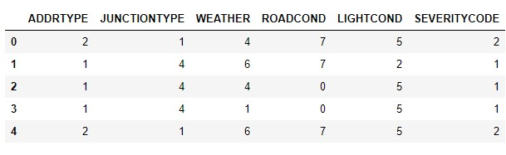
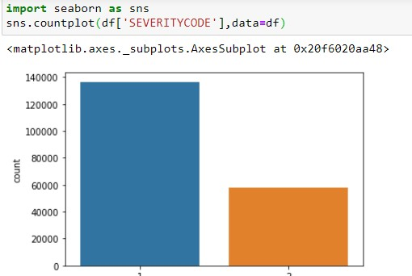
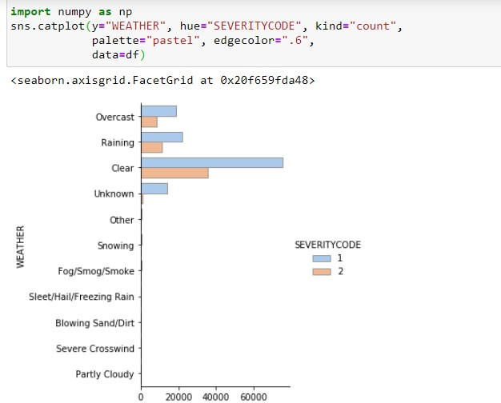
Data standarization
Show Severity code of accidents
Relation between weather and severity code

Slide 7
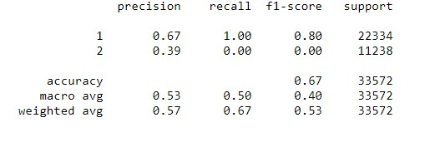
Results and evaluation:
Algorithm | Jaccard | F1-Score | Log Loss
KNN | 0.6587 | 0.5729 | -
Decision Tree | 0.6652 | 0.5315 | -
Logistic Regression | 0.6650 | 0.5320 | 0.6222
SVM | 0.6652 | 0.5315 | -
We notice that the values of metrics, Jaccard for all algorithms, F1-Score for Decision Tree and Logistic Regression and SVM, are nearly the same. We can conclude that all the algorithms have 0.66 for the Jaccard index. But the F1-Score of KNN is higher than others.

Slide 8
Discussion:
Now, as we have the higher values of F-Score associated to K Nearest Neighbor. We can assure that is more precise than other algorithms. So, it may be the best classifier to our Capstone project.
But since the metrics of the four algorithms were generally near to each other. We can use them all. And we will have approximatively the same predictions.

Slide 9
Conclusion
After our ML modeling, we can conclude that particular conditions like weather, road, and light conditions have a somewhat impact on whether or not travel could result in property damage (severitycode = 1) or injury (severitycode = 2).
In the end, there’s no perfect solution, only a solution that is good enough for the intended purpose.

Slide 10
THANK YOU for watching

