Slide 1
Online Shopping Management System (SMS)
Group Members: Bakytzhan Rustombekov – Aimal Khan

Slide 2
Tools and Technologies Used
Java EE, JSPs and Servlets
Java, JavaScript
Bootstrap for front end
MySQL database
JUnit
StarUML

Slide 3
Core Use Cases
Category Management
Product Management
Users Management – (Users and Admin)
Registration/Login/Logout
Account Verification
Product Review
Shopping Cart Management
Email Notifications
Password Recovery

Slide 4
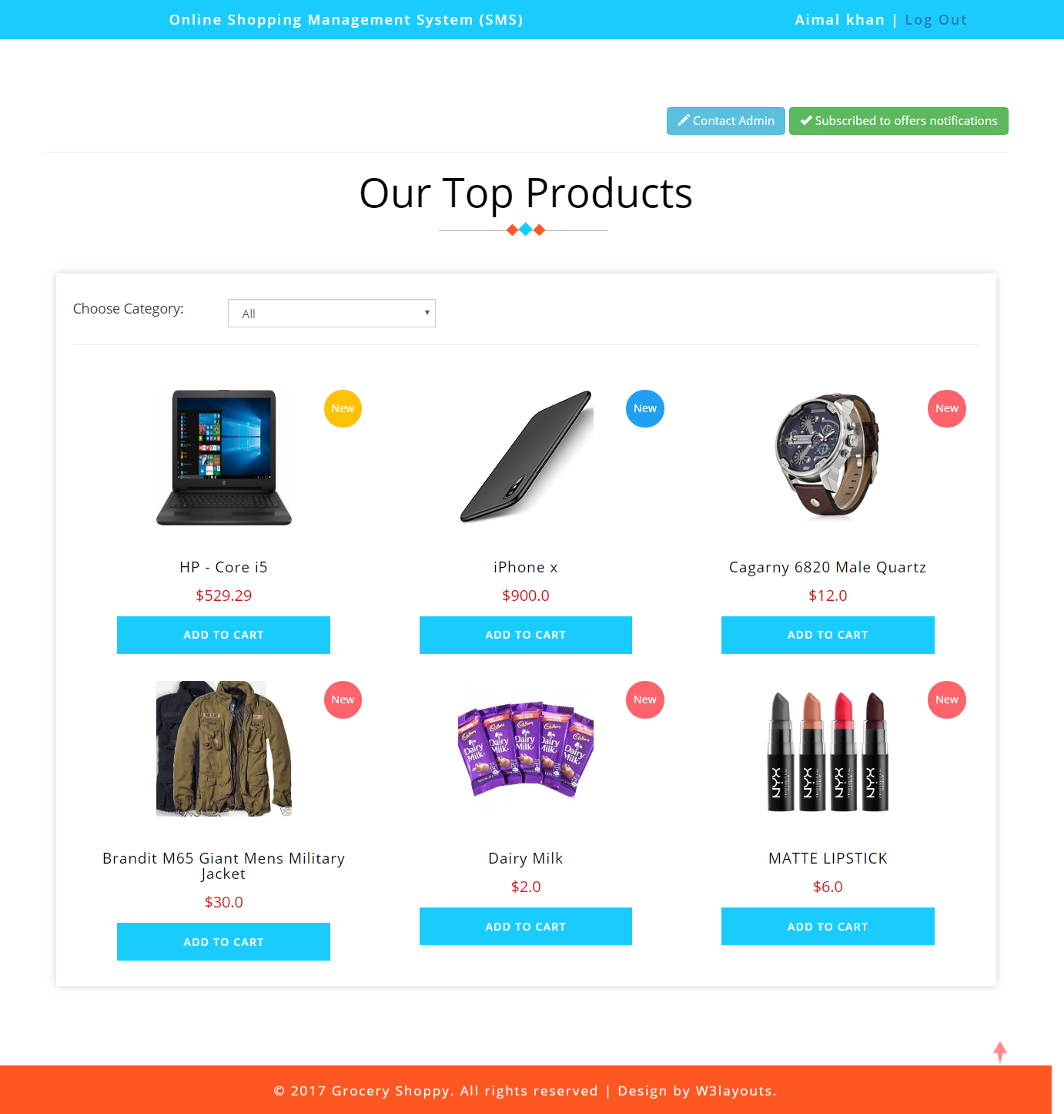
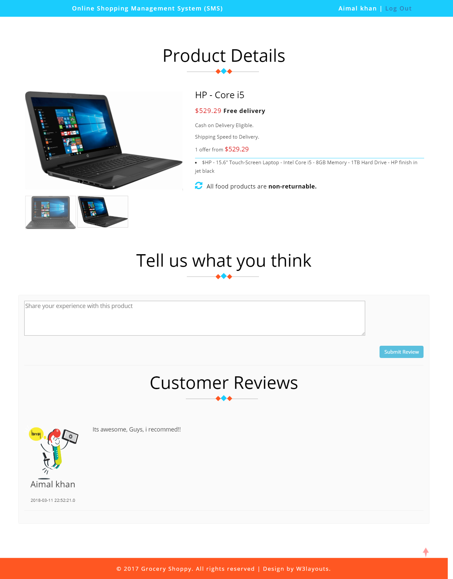
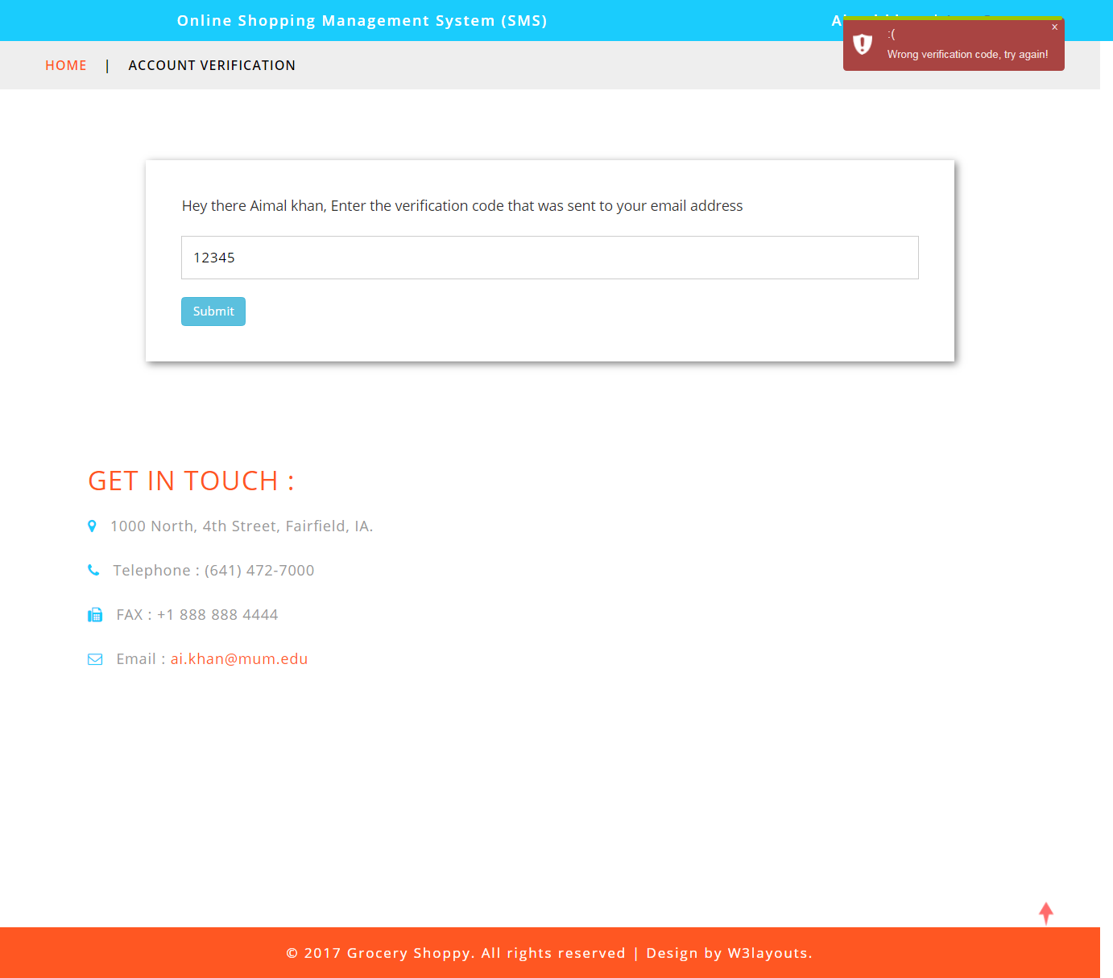

Slide 5
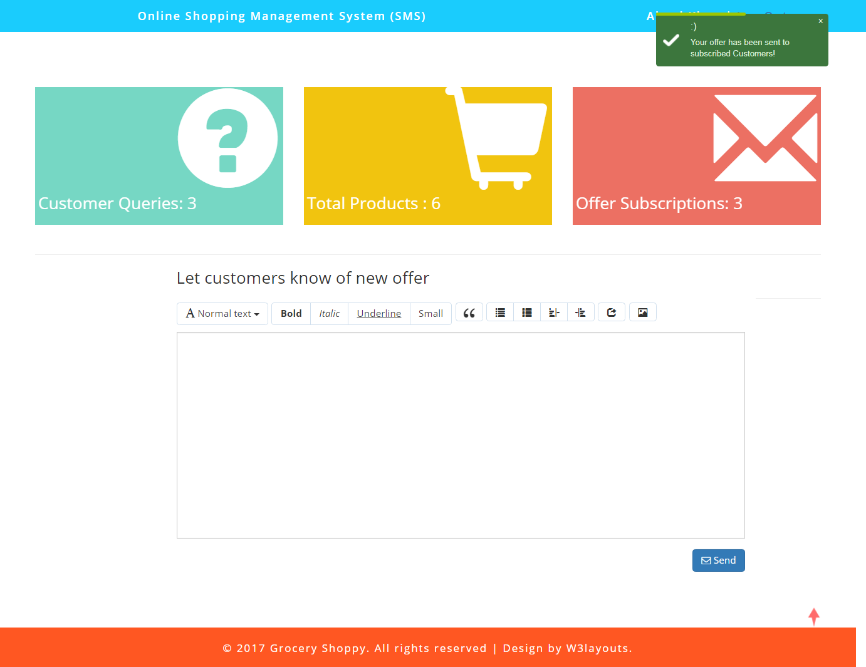
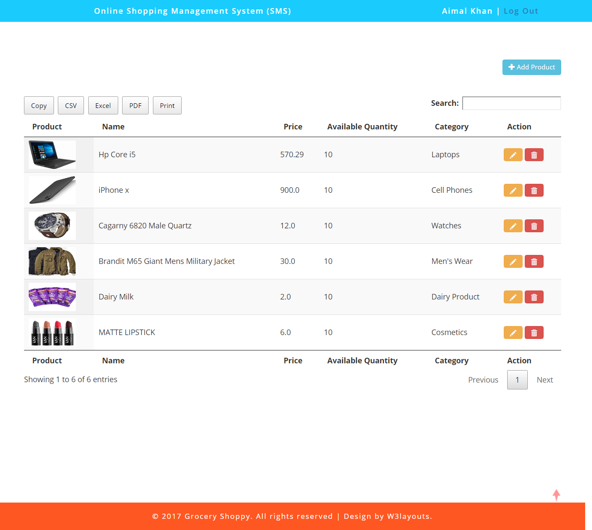
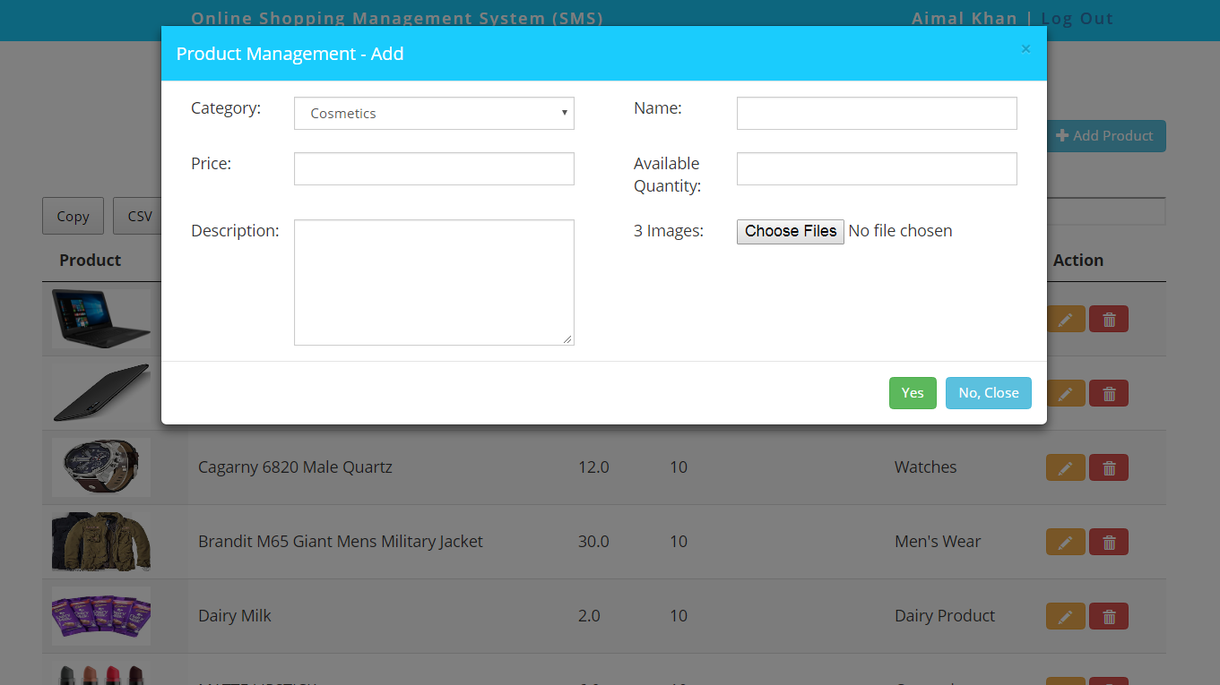

Slide 6
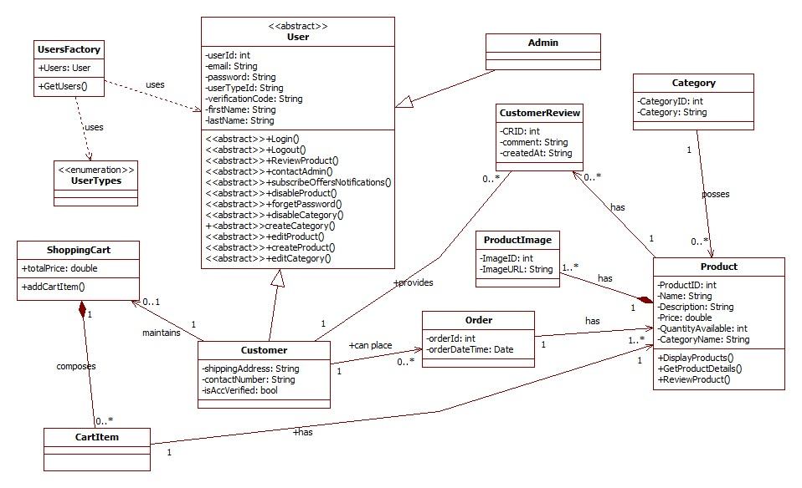
Class Diagram

