Slide 1






“Report on Sports Insights: Unveiling Patterns in the Sports_Stats Dataset"

Slide 2
Project Focus:
Analyzing Sports Insights with SQL and Data Science
Objective:
Uncover Valuable Insights from Sports Data
Collaborators:
Sports_Stats, Local News Agencies, Elite Personal Trainers
Methods:
Utilizing SQL and Data Science Techniques
Audience:
News Agencies, Personal Trainers, Sports Enthusiasts, Researchers

Slide 3
Contents
Review of Questions to Answer/Hypotheses/Approach
Discuss Technical Challenges
Detail: Entity Relationship Diagram (ERD)
Initial Findings
Deeper Analysis
Hypotheses Results

Slide 4
Questions to Answer
1. To what degree does an athlete's age impact their chances of winning a medal?
2. Do developed countries perform better than less developed countries?
3. How has the ratio of male to female participants changed over time?
4. Is there a connection between a country's success in winter and summer Olympics?
5. Does a country's performance vary more in Winter Olympics or Summer Olympics over the years?

Slide 5
Approach:
Age and Medals Distribution: Examine age distribution among medal winners to determine peak age for success.
Medals and Countries Distribution: Analyze historical Olympic medal counts by country. Identify top-performing nations and explore the relationship between development status and medal achievements.
Gender Distribution Over Time: Analyze historical gender representation trends to evaluate progress towards gender balance.
Correlation Analysis: Assess link between Winter and Summer Olympics performance using Pearson Correlation Coefficient.
Performance Variation: Compare medal count standard deviation (1924-2016) to identify more dynamic event.

Slide 6
Technical Challenges
Encountered challenges with getting the starting year of the Summer Olympics different from that of the Winter Olympics
Limitation of Pandasql (SQLite) made some SQL difficult to execute but manageable

Slide 7

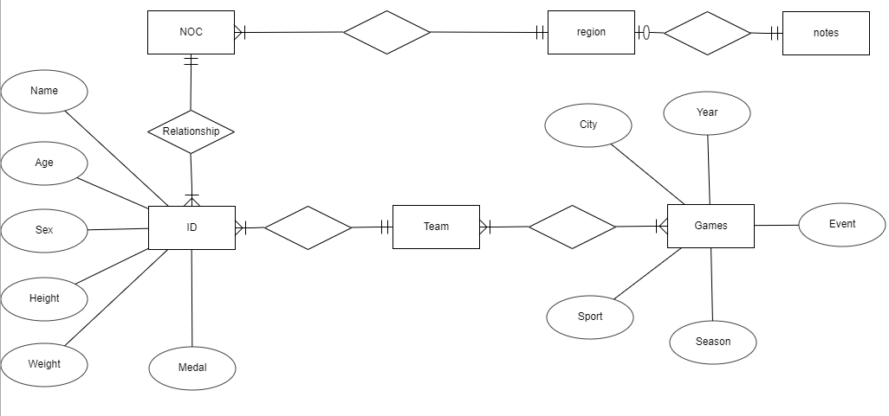
Entity Relationship Diagram (ERD)

Slide 8
Initial Findings 1
Gender Age Gap in Winter Olympics: Smaller age gap between male and female participants in Winter Olympics compared to Summer, indicating evolving gender dynamics and age distributions. Effect of Global Events: World Wars influenced athlete participation and medal distribution, highlighting external factors shaping Olympic outcomes.

Slide 9
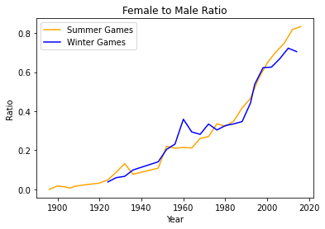
Initial Findings 2
Changing Gender Ratio: Long-term increase in women's participation, disrupted by Second World War, followed by recovery in participation ratio. Further analysis needed to understand underlying causes.
Gender participation ratio increased over time, with a dip during World War II in Summer Olympics. Further analysis needed for underlying causes.

Slide 10
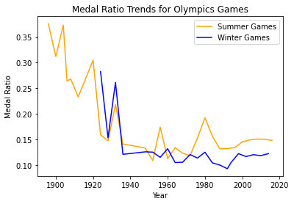
Initial Findings 3
Stabilization of Medal Outcomes: Recent data shows consistent medal-winning percentages and ratios (gold, silver, bronze), suggesting established performance norms.

Slide 11
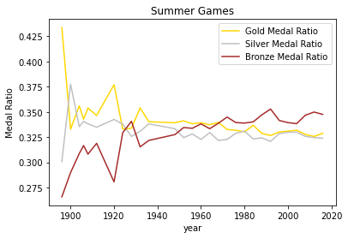
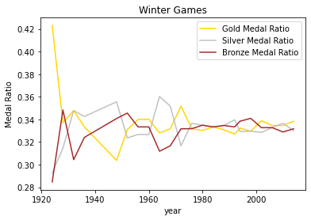
Initial Findings 4
Notably, recent Olympic data indicates that the percentage of participants who win medals and the relative ratio of different medal types (gold, silver, and bronze) have reached a point of stability.

Slide 12
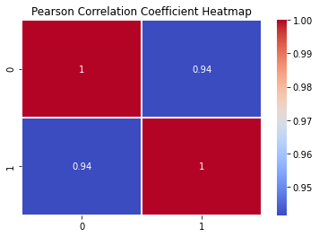
Deeper Analysis
The length of the array of the number of medal count in the winter Olympics and summer Olympics are different because Winter Olympics started in 1924, but Summer Olympics started in 1896. Therefore, I created a new shortened table of the summer Olympics started in 1924 to match the length of the winter Olympics. The Pearson correlation coefficient between the total number of medals in the winter and summer Olympics from 1924 to 2016, is 0.94, which is highly positive. Therefore, the performance of a country in winter Olympics is highly correlated to that in summer Olympics

Slide 13
Deeper Analysis
standard deviation of summer's medal count: 475.3
standard deviation of winter's medal count: 152.5
From 1924 to 2016, Summer Olympics' medal counts exhibited greater variability (standard deviation: 475.32) compared to Winter Olympics (standard deviation: 152.57), indicating more pronounced fluctuations in Summer Games.

Slide 14
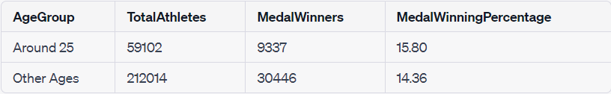
Final Findings / Result of Hypotheses/ Answers to Questions
Yes, Athlete's age influences medal-winning likelihood, with a peak around 25 years.
2. Yes, Developed nations tend to outperform less developed ones in medal counts.
3. Over time, gender balance in Olympic participation has improved, despite disruptions.
4. A link exists between a country's success in winter and summer Olympics.
5. Summer Olympics show greater performance variation compared to Winter Olympics.

Slide 15
Recommendations
Optimized Training: Design tailored training for athletes around age 25 to capitalize on their peak performance.
Development Support: Support less developed nations with resources for improved medal achievements.
Gender Balance: Promote gender equality in sports participation through sustained efforts.
Strategic Analysis: Countries can strategize based on historical performance in both Olympics.

