Slide 1
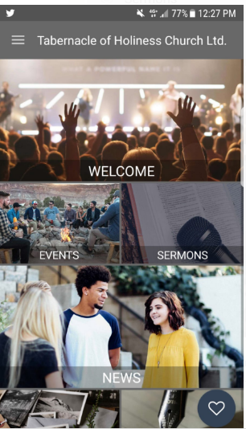
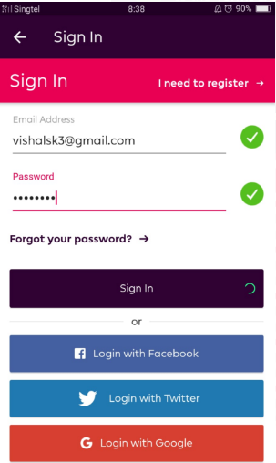
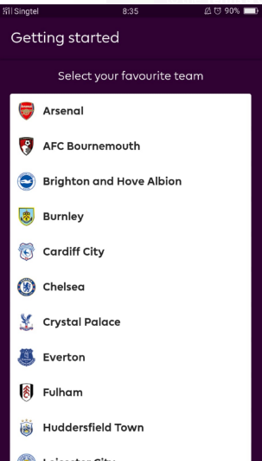
Sample – using tiles for the main page
Sample – log in page with FB / Google
Sample – part of registration, to capture user’s favorite team

Slide 2
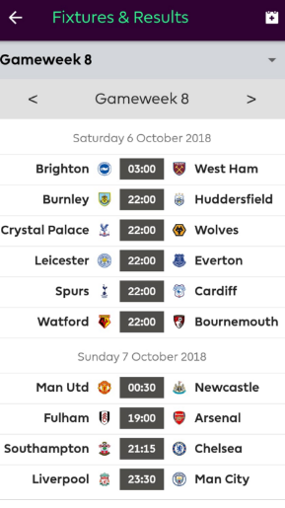
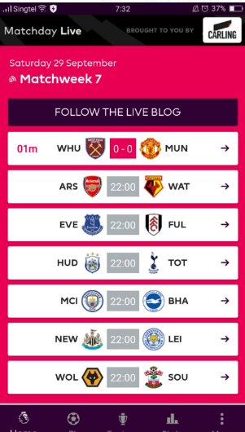
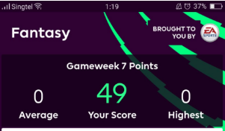

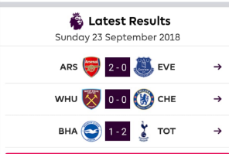
Sample – countdown timer to the next game week.
Sample - points earned after a gameweek
Sample – Upcoming gameweek / matches
Sample – live score page / function
Sample – Results page after actual matches are completed

Slide 3


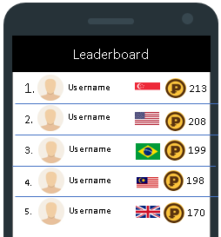
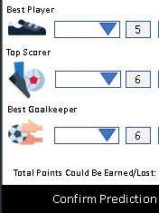
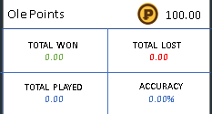

This should be view of an user who signed up for Public and Private league
User will have to input the score & save the score for that match. App should be able to recognize the same game that may be in the other private leagues & offer “All” option to mirror the same score for all the leagues with the same game in it
H
Private League 1
Private League 2
Private League 3
Private League 4
Private League 5
Public League
Home button. Opens when user clicks on it. Should be collapseable
1) Man Utd vs Liverpool (2 points)
Double Ole!
Predict
Form Guide
Click on this for user to double their points for a match. App should be able to recognize the same game that may be in the other private leagues & offer the option double ole for all the leagues involved
2) Arsenal vs Chelsea (2 points)
Double Ole!
Predict
Form Guide
3) Tottenham vs Liverpool (2 points)
Double Ole!
Predict
Form Guide
Once User completes this page, it should prompt the user to complete the “Specials” (direct to page 2). Note the Specials is only done once at the start, not part of the weekly games
10) West Ham vs Watford (2 points)
Double Ole!
Predict
Form Guide
Leaderboard
League Stats
Create League
Invite Friends
App should not allow more than X users per private league
Once all the scores are entered, user submits the predications for the gameweek. Users are unable to make amendments once submitted & if its after the cutoff time. users who did not input all scores, app should prompt that its incomplete.
Let’s OLE!
user who already created / enrolled in max 5 private league, the app should not allow a new private league to be created.

