Slide 1


Slide 2
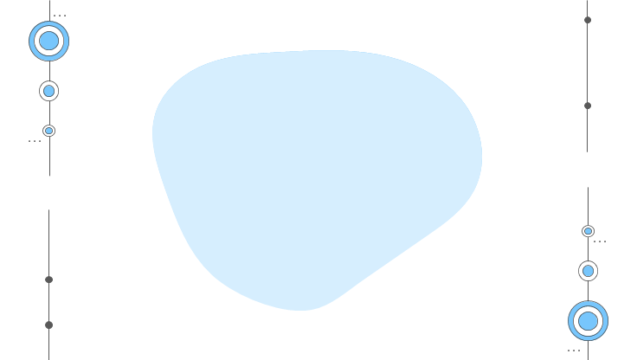
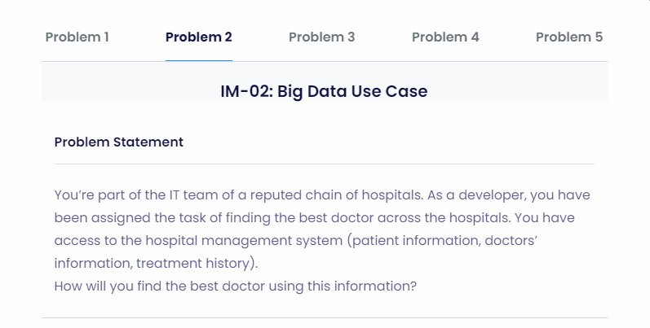

Slide 3
AVAILABLE DATASETS:
PATIENT INFORMATION
DOCTORS INFORMATION
TREATMENT HISTORY

Slide 4
PATIENT INFORMATION :
Patient’s Review Contribution – 25%
Ethical Behavior
Patient Review is about:
Cleanliness
Empathy
Sentiment Analysis Of Patient’s Review

Slide 5
DOCTOR’S INFORMATION :
Contribution- 25%
Years of Experience
Regularity/Availability
Department

Slide 6
TREATMENT HISTORY:
Contribution- 50%
Success Rate
No of Patient Visits per week
No of Failures
Special Achievements
Contribution to the Department he/she specializes in.

Slide 7
DEPLOYMENT DIAGRAM
DATABASE
DOCTOR’S INFORMATION
PATIENT INFORMATION
TREATMENT HISTORY
A
B
C

Slide 8
A
YEARS OF EXPERIENCE
AVAILABILITY
Converted to number
50%
Converted to number
50%
ADD
A1

Slide 9
B
REVIEW
ETHICAL BEHAVIOUR
Converted to number
60% USING SENTIMENTAL ANALYSIS
Converted to number
40%
ADD
B1

Slide 10
C
SUCCESS RATE
NO OF PATIENTS
FAILURES
CONTRIBUTIONS
Converted to number
25%
Converted to number
25%
Converted to number
-25%
Converted to number
25%
ADD
C1

Slide 11
DEPLOYMENT DIAGRAM
A1
B1
C1
ADD
PERFORMANCE

Slide 12
DEVELOPMENTS:
The prediction of doctor based on special achievements can be done by analyzing the value of the achievement .. Rather than just including the numbers.

Slide 13
Libraries Used:
Matplotlib
Numpy
Pandas
TextBlob
Seaborn

