Slide 1
Advanced Management System
A Modern Python-based Employee Management Solution

Slide 2
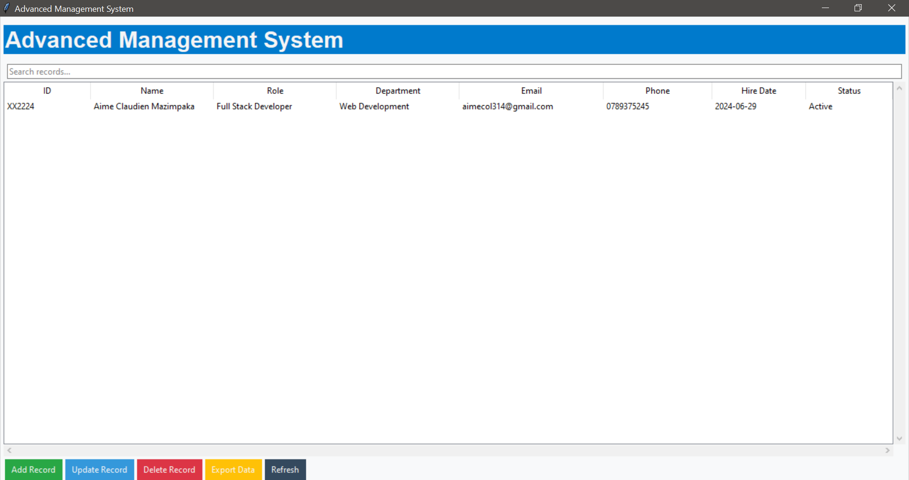
System Overview
Modern Employee Management Solution
Built with Python & Tkinter
Clean Interface
Secure Data Management

Slide 3
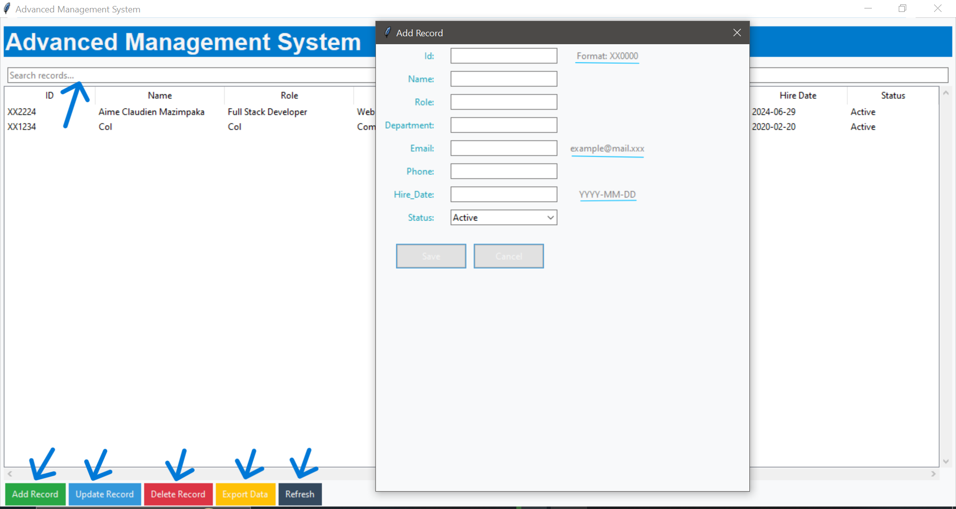
Key Features
CRUD Operations (Create, Read, Update, Delete)
Advanced Search with Smart Filtering
Data Export to CSV
Modern UI with Responsive Design

Slide 4
Technical Architecture
User Interface Layer: Tkinter Components, Custom Widgets
System Logic Layer: Validation, Record Management
Data Layer: JSON Storage, File Operations
Presentation: html file, pptx file

Slide 5
Smart Validation System
Code Example:
-def validate_id(id_str: str) -> bool: return bool(re.match(r'^[A-Z]{2}\d{4}$’, id_str))
Features:
- Employee ID Format (XX0000)
- Email Validation
- Phone number validation
- CSV file naming conviction

Slide 6
Modern User Interface
Keyboard Shortcuts: Ctrl+F (Search), Ctrl+N (New Record)
Responsive Tables with Custom Styling
Modern Color Scheme and Navigation

Slide 7
Thank You
Contact Information: 0789375245
GitHub: https://github.com/Aimecol/Python_advanced_management_System.git

