Slide 1

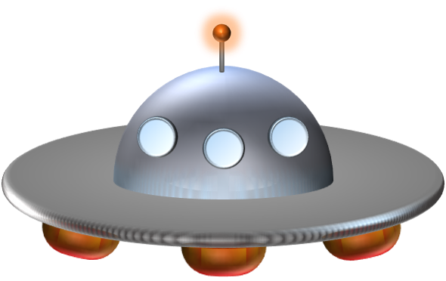

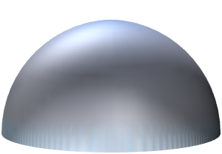


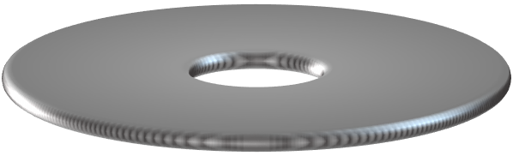

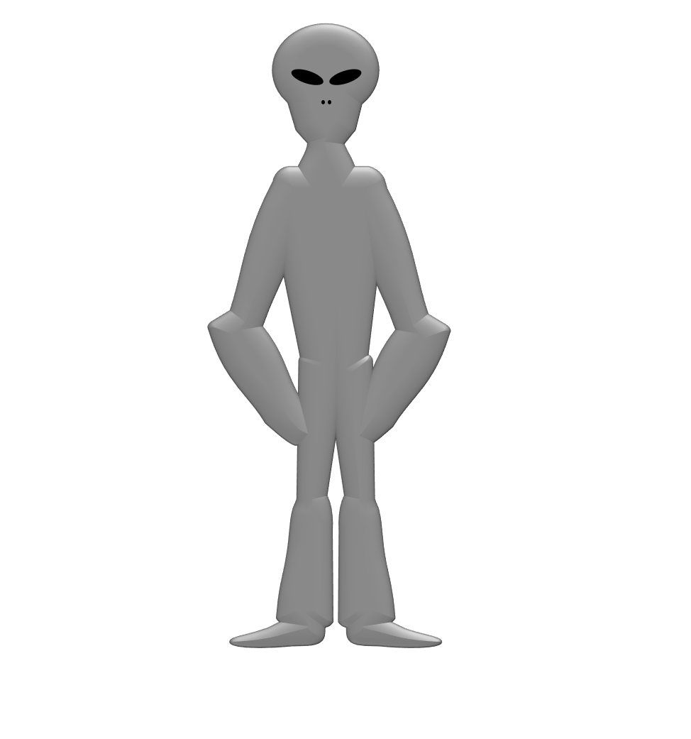



A
B
C
D
E
F
G
H
I
J
K
L
M
N
O
P
Q
R
S
T
U
V
W
X
A
A
A
A
A
A
A
A
A
Y
Z
BUILD
A
A
A
A
A
A
A
A
A
Notes:
Write the answer here

