Slide 1

Windows Azure
Scott Guthrie
Corporate Vice President
Windows Azure
Email: scottgu@microsoft.com
Twitter: @scottgu
玩转大学PPT素材 更多好素材请访问 http://daxue101.100get.cn

Slide 2



Windows Azure
flexible
open
solid
玩转大学PPT素材 更多好素材请访问 http://daxue101.100get.cn

Slide 3

Global Footprint
玩转大学PPT素材 更多好素材请访问 http://daxue101.100get.cn

Slide 4
Inside a Datacenter →
video
玩转大学PPT素材 更多好素材请访问 http://daxue101.100get.cn

Slide 5
pay only for what you use
→
玩转大学PPT素材 更多好素材请访问 http://daxue101.100get.cn
Notes:
And with Windows Azure you pay only for what you use – enabling you to avoid upfront costs, and scale as your business grows.

Slide 6


Virtual Machines
Windows Server and Linux
Flexible Workload Support
Virtual Private Networking
玩转大学PPT素材 更多好素材请访问 http://daxue101.100get.cn

Slide 7


demo
Windows Azure
玩转大学PPT素材 更多好素材请访问 http://daxue101.100get.cn

Slide 8
virtual machine portability
玩转大学PPT素材 更多好素材请访问 http://daxue101.100get.cn

Slide 9


Windows Azure
Your Data Center
玩转大学PPT素材 更多好素材请访问 http://daxue101.100get.cn

Slide 10
Windows Azure
Your Data Center
玩转大学PPT素材 更多好素材请访问 http://daxue101.100get.cn

Slide 11
Windows Azure
Other Service Providers
Your Data Center
玩转大学PPT素材 更多好素材请访问 http://daxue101.100get.cn

Slide 12
Windows Azure
Other Service Providers
no lock-in
Your Data Center
玩转大学PPT素材 更多好素材请访问 http://daxue101.100get.cn

Slide 13



VM with persistent drive
Windows Azure Storage
玩转大学PPT素材 更多好素材请访问 http://daxue101.100get.cn

Slide 14

VM with persistent drive
Windows Azure Storage
玩转大学PPT素材 更多好素材请访问 http://daxue101.100get.cn

Slide 15

VM with persistent drive
Windows Azure Storage
玩转大学PPT素材 更多好素材请访问 http://daxue101.100get.cn

Slide 16
VM with persistent drive
reliable and always on
Windows Azure Storage
玩转大学PPT素材 更多好素材请访问 http://daxue101.100get.cn

Slide 17
WEST
DC
EAST
DC
> 500 miles
continuous storage
geo-replication
Windows Azure Storage
玩转大学PPT素材 更多好素材请访问 http://daxue101.100get.cn

Slide 18

Web Sites
Build with ASP.NET, Node.js or PHP
Deploy in seconds with FTP, Git or TFS
Start for free, scale up as your traffic grows
玩转大学PPT素材 更多好素材请访问 http://daxue101.100get.cn

Slide 19
demo
Web Sites
玩转大学PPT素材 更多好素材请访问 http://daxue101.100get.cn
Notes:
IaaS

Slide 20


Web Sites
shared
reserved
1
shared
Shared instanceS
:-)
玩转大学PPT素材 更多好素材请访问 http://daxue101.100get.cn

Slide 21
Web Sites
shared
reserved
2
shared
Shared instanceS
:-)
:-)
玩转大学PPT素材 更多好素材请访问 http://daxue101.100get.cn

Slide 22

Web Sites
shared
reserved
1
0
reserved
Shared instanceS
RESERVED instance
:-)
:-)
:-)
玩转大学PPT素材 更多好素材请访问 http://daxue101.100get.cn

Slide 23
Web Sites
shared
reserved
2
reserved
RESERVED instance
RESERVED instance
:-)
:-)
玩转大学PPT素材 更多好素材请访问 http://daxue101.100get.cn

Slide 24



Web Sites
shared
reserved
2
reserved
RESERVED instance
RESERVED instance
:-)
:-)
:-)
:-)
:-)
:-)
:-)
:-)
玩转大学PPT素材 更多好素材请访问 http://daxue101.100get.cn

Slide 25

Mobile Services
Easily build cloud back-ends
Data, identity, push notifications, background jobs
Windows 8, Windows Phone, iOS, Android, HTML5
玩转大学PPT素材 更多好素材请访问 http://daxue101.100get.cn

Slide 26




Data
ID Services
<//>
Custom Script(s)
玩转大学PPT素材 更多好素材请访问 http://daxue101.100get.cn
Notes:
(Step 2. As part of quickstart, we give you a pre-configured Win8 to do app connected to your mobile service. It would be ideal to show future of multiple client)

Slide 27

Notification Hubs
iOS app
Windows 8
app
Tag: Breaking News
Service Bus
Notification Hub
App back-end
玩转大学PPT素材 更多好素材请访问 http://daxue101.100get.cn

Slide 28
Notification Hubs
iOS app
Windows 8
app
APNs
WNS
Service Bus
Notification Hub
Tag: Breaking News
App back-end
玩转大学PPT素材 更多好素材请访问 http://daxue101.100get.cn

Slide 29
demo
Mobile Services
玩转大学PPT素材 更多好素材请访问 http://daxue101.100get.cn
Notes:
IaaS

Slide 30

Cloud Services
Build infinitely scalable apps and services
Support rich multi-tier architectures
Automated application management
玩转大学PPT素材 更多好素材请访问 http://daxue101.100get.cn

Slide 31
demo
Cloud Services (Dev)
玩转大学PPT素材 更多好素材请访问 http://daxue101.100get.cn

Slide 32


service
package
service
package
玩转大学PPT素材 更多好素材请访问 http://daxue101.100get.cn

Slide 33










→ Provision Role Instances
→ Deploy App Code
→ Configure Network
service
package
virtual machine
virtual machine
virtual machine
virtual machine
Server Rack 1
Server Rack 2
玩转大学PPT素材 更多好素材请访问 http://daxue101.100get.cn

Slide 34

→ Provision Role Instances
→ Deploy App Code
→ Configure Network
service
package
Windows Azure Datacenter
玩转大学PPT素材 更多好素材请访问 http://daxue101.100get.cn

Slide 35

→ Provision Role Instances
→ Deploy App Code
→ Configure Network
service
package
Windows Azure Datacenter
玩转大学PPT素材 更多好素材请访问 http://daxue101.100get.cn

Slide 36




→ Provision Role Instances
→ Deploy App Code
→ Configure Network
Network Load Balancer
← Network load-balancer configured for traffic
Windows Azure Datacenter
玩转大学PPT素材 更多好素材请访问 http://daxue101.100get.cn

Slide 37




Network Load Balancer
Windows Azure Datacenter
玩转大学PPT素材 更多好素材请访问 http://daxue101.100get.cn

Slide 38
demo
Cloud Services (Mgmt)
玩转大学PPT素材 更多好素材请访问 http://daxue101.100get.cn

Slide 39
focus on apps, not infrastructure
玩转大学PPT素材 更多好素材请访问 http://daxue101.100get.cn

Slide 40









application building blocks
big data
database
storage
traffic
cloud services
caching
messaging
identity
media
CDN
networking
玩转大学PPT素材 更多好素材请访问 http://daxue101.100get.cn

Slide 41

SQL Database
Relational SQL Server Engine in the Cloud
Clustered for high availability
Fully Managed Service
SQL Reporting support
玩转大学PPT素材 更多好素材请访问 http://daxue101.100get.cn

Slide 42
demo
SQL Database
玩转大学PPT素材 更多好素材请访问 http://daxue101.100get.cn

Slide 43

Cache
Low latency, in-memory distributed cache
Dynamically grow and shrink cache size
High availability support
Memcached protocol support
玩转大学PPT素材 更多好素材请访问 http://daxue101.100get.cn

Slide 44

distributed cache
Web Roles
300MB
300MB
300MB
300MB
1.2GB Distributed Cache
玩转大学PPT素材 更多好素材请访问 http://daxue101.100get.cn

Slide 45
Web Roles
12GB Cache
Worker Role
12GB Cache
Worker Role
24GB Distributed Cache
2
玩转大学PPT素材 更多好素材请访问 http://daxue101.100get.cn

Slide 46
Web Roles
12GB Cache
Worker Role
12GB Cache
Worker Role
12GB Cache
Worker Role
12GB Cache
Worker Role
48GB Distributed Cache
24GB Distributed Cache
4
玩转大学PPT素材 更多好素材请访问 http://daxue101.100get.cn

Slide 47

Service Bus
Secure messaging and relay capabilities
Easily build hybrid apps
Enable loosely coupled solutions
玩转大学PPT素材 更多好素材请访问 http://daxue101.100get.cn

Slide 48



Tightly Coupled
Drivers
Tracking
Store Front End
Shipping Service
玩转大学PPT素材 更多好素材请访问 http://daxue101.100get.cn

Slide 49



Tightly Coupled
Drivers
Tracking
Store Front End
Shipping Service
玩转大学PPT素材 更多好素材请访问 http://daxue101.100get.cn

Slide 50
Loosely Coupled
Drivers
Tracking
Store Front End
Order Queue
Shipping Service
玩转大学PPT素材 更多好素材请访问 http://daxue101.100get.cn

Slide 51

Loosely Coupled
Drivers
Tracking
Store Front End
Order Queue
Shipping Service
玩转大学PPT素材 更多好素材请访问 http://daxue101.100get.cn

Slide 52
Loosely Coupled
Drivers
Tracking
Store Front End
Order Queue
Shipping Service
玩转大学PPT素材 更多好素材请访问 http://daxue101.100get.cn

Slide 53



Loosely Coupled
Tracking
Tracking
Store Front End
Order Queue
Shipping Service
玩转大学PPT素材 更多好素材请访问 http://daxue101.100get.cn

Slide 54
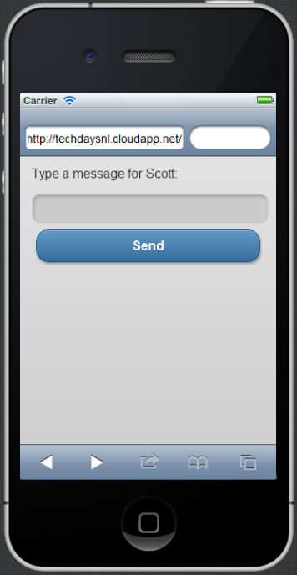




ASP.NET MVC 4 Mobile App
Service Bus Queue
Internet
Hi!
玩转大学PPT素材 更多好素材请访问 http://daxue101.100get.cn

Slide 55
demo
Services Bus Queues
玩转大学PPT素材 更多好素材请访问 http://daxue101.100get.cn

Slide 56






cloud application
service bus relay
Internet
Enterprise
app behind
firewall
玩转大学PPT素材 更多好素材请访问 http://daxue101.100get.cn

Slide 57
demo
Service Bus Relay
玩转大学PPT素材 更多好素材请访问 http://daxue101.100get.cn

Slide 58

Media Services
Create, manage and distribute content
Target any device or media format
Ingest, Encode, Protect, Stream
玩转大学PPT素材 更多好素材请访问 http://daxue101.100get.cn

Slide 59
demo
Media Services
玩转大学PPT素材 更多好素材请访问 http://daxue101.100get.cn

Slide 60
application building blocks
big data
database
storage
traffic
cloud services
caching
messaging
identity
media
CDN
networking
玩转大学PPT素材 更多好素材请访问 http://daxue101.100get.cn

Slide 61
Windows Azure Store
Consume services from ecosystem of partners
Easily try and purchase
Billing integrated within your Azure bill
玩转大学PPT素材 更多好素材请访问 http://daxue101.100get.cn

Slide 62

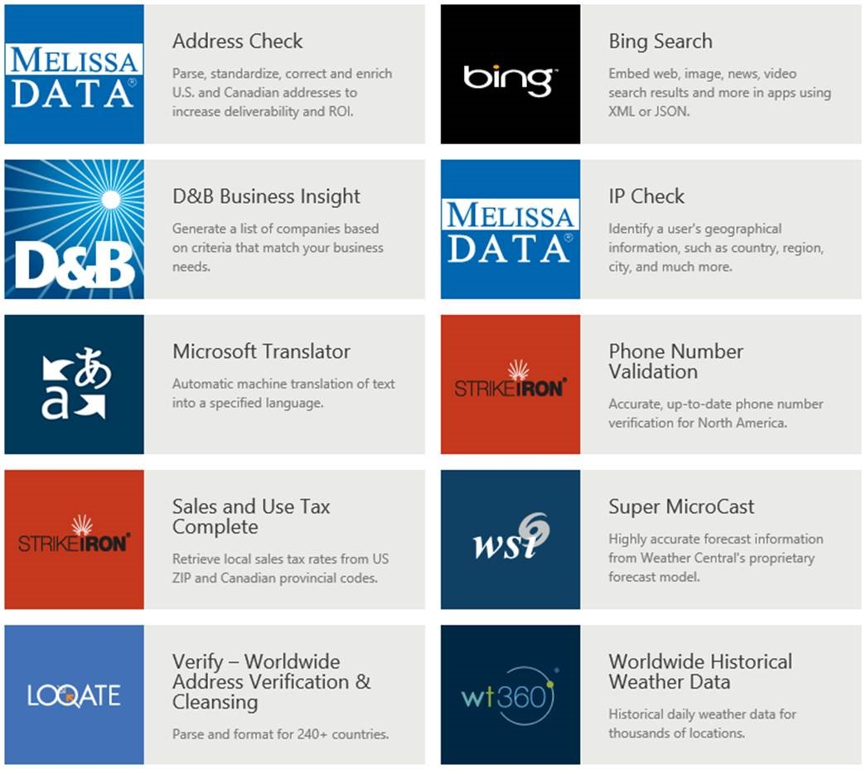
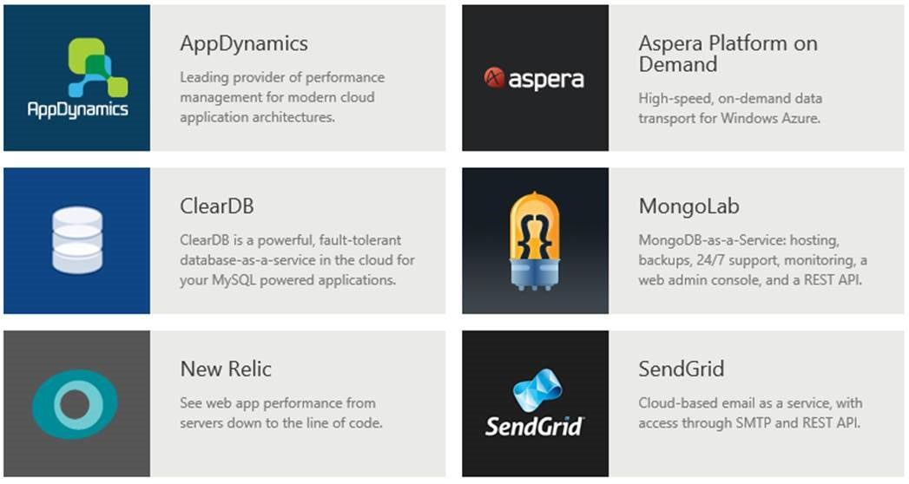

玩转大学PPT素材 更多好素材请访问 http://daxue101.100get.cn

Slide 63
demo
Windows Azure Store
玩转大学PPT素材 更多好素材请访问 http://daxue101.100get.cn

Slide 64
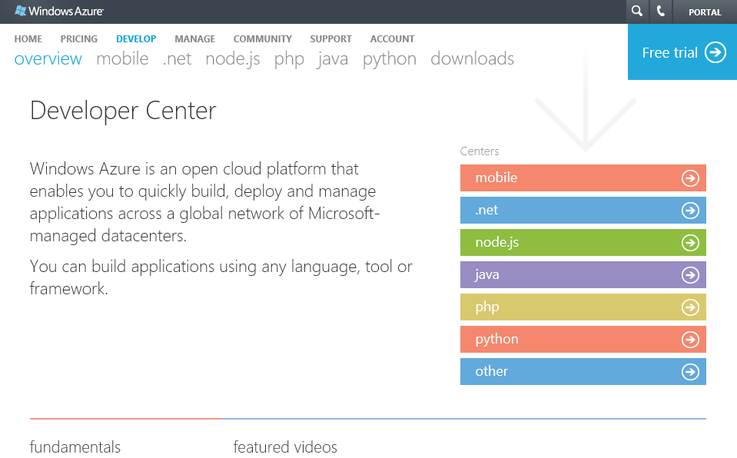
multiple languages
→ http://www.windowsazure.com/en-us/develop/overview/
玩转大学PPT素材 更多好素材请访问 http://daxue101.100get.cn

Slide 65
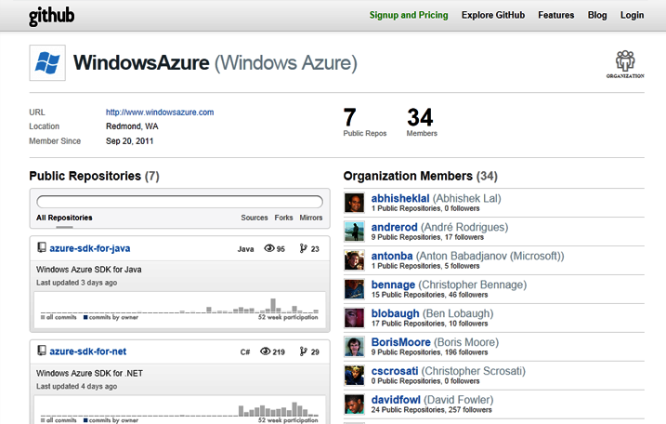
open source
→ http://github.com/windowsazure
玩转大学PPT素材 更多好素材请访问 http://daxue101.100get.cn

Slide 66
Australia
Austria
Belgium
Brazil
Canada
Chile
Colombia
Costa Rica
Cyprus
Czech Republic
Denmark
Finland
France
Germany
Greece
Hong Kong
Hungary
India
Ireland
Israel
Italy
Japan
Korea
Luxembourg
Malaysia
Mexico
Netherlands
New Zealand
Norway
Peru
Philippines
Poland
Portugal
Puerto Rico
Romania
Russia
Singapore
Spain
Sweden
Switzerland
Trinidad & Tobago
UK
United States
New Countries:
Algeria
89
countries and territories
Argentina
Belarus
Bulgaria
Croatia
Dominican Rep
Ecuador
Egypt
El Salvador
Estonia
Guatemala
Iceland
Indonesia
Jordan
Kazakhstan
Kenya
Kuwait
Latvia
Liechtenstein
Lithuania
Macedonia
Malta
Montenegro
Morocco
Azerbaijan
Nigeria
Oman
Pakistan
Panama
Paraguay
Qatar
Saudi Arabia
Serbia
Slovakia
Slovenia
South Africa
Sri Lanka
Taiwan
Thailand
Tunisia
Turkey
UAE
Ukraine
Uruguay
Venezuela
Bahrain
玩转大学PPT素材 更多好素材请访问 http://daxue101.100get.cn
Notes:
Australia
Austria
Belgium
Brazil
Canada
Chile
Colombia
Costa Rica
Cyprus
Czech Republic
Denmark
Finland
France
Germany
Greece
Hong Kong
Hungary
India
Ireland
Israel
Italy
Japan
Korea
Luxembourg
Malaysia
Mexico
Netherlands
New Zealand
Norway
Peru
Philippines
Poland
Portugal
Puerto Rico
Romania
Russia
Singapore
Spain
Sweden
Switzerland
Trinidad & Tobago
UK
United States
New Countries:
Algeria
Argentina
Azerbaijan
Bahrain
Belarus
Bulgaria
Croatia
Dominican Rep
Ecuador
Egypt
El Salvador
Estonia
Guatemala
Iceland
Indonesia
Jordan
Kazakhstan
Kenya
Kuwait
Latvia
Liechtenstein
Lithuania
Macedonia
Malta
Montenegro
Morocco
Nigeria
Oman
Pakistan
Panama
Paraguay
Qatar
Saudi Arabia
Serbia
Slovakia
Slovenia
South Africa
Sri Lanka
Taiwan
Thailand
Tunisia
Turkey
UAE
Ukraine
Uruguay
Venezuela

Slide 67
Windows Azure
flexible
open
solid
玩转大学PPT素材 更多好素材请访问 http://daxue101.100get.cn
Notes:
With today’s release, Windows Azure is more flexible than ever.
Windows Azure helped pioneer the concept of Platform as a Service – and provides a rich set of managed, scalable services. Today, we are making these services even richer.
Windows Azure also now supports Infrastructure as a Service – including the ability to host both Windows and Linux Virtual Machines in the cloud.
Some of you might be surprised to hear the word Linux at a Microsoft event. Our support of Linux is just one example of how we are embracing openness in a fundamental new way.
With today’s release, we are supporting more operating systems, more languages, more open protocols, and releasing all of our SDKs on GitHub under an open source license.
The end result is a truly unique offering.
You can now use both Platform as a Service and Infrastructure as a Service together.
You can now use the best of both the Microsoft ecosystem and open source ecosystem together.
And you can now build better and more scalable solutions than ever before.

Slide 68

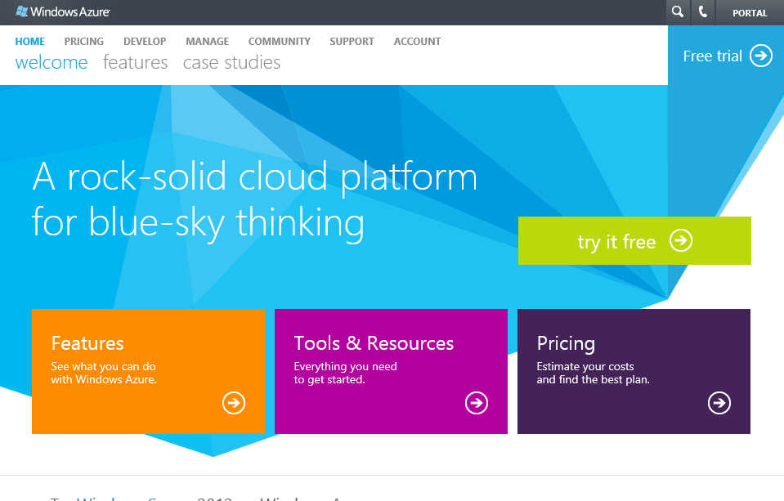
start now.
http://WindowsAzure.com
玩转大学PPT素材 更多好素材请访问 http://daxue101.100get.cn

Slide 69

© 2011 Microsoft Corporation. All rights reserved. Microsoft, Windows, Windows Vista and other product names are or may be registered trademarks and/or trademarks in the U.S. and/or other countries.
The information herein is for informational purposes only and represents the current view of Microsoft Corporation as of the date of this presentation. Because Microsoft must respond to changing market conditions, it should not be interpreted to be a commitment on the part of Microsoft, and Microsoft cannot guarantee the accuracy of any information provided after the date of this presentation. MICROSOFT MAKES NO WARRANTIES, EXPRESS, IMPLIED OR STATUTORY, AS TO THE INFORMATION IN THIS PRESENTATION.
玩转大学PPT素材 更多好素材请访问 http://daxue101.100get.cn

