Slide 1


Distributed Computing
Group Members:
Syeda Ayesha Alam CT-003
Aimen Ahmed CT-004
Misbah Haroon CT-009

Slide 2

INTRODUCTION
Easy Walk Shoe Corporation is a leading shoe company.
By their online system, want to render their services to their customer at their door steps.
Karachi
(Headquarter)
Faisalabad (Branch)
Lahore (Branch)

Slide 3
REASON BEHIND THE DISTRIBUTION
Data Sharing
Reliable Data Communication
Transaction and Analytical Processing
Multiple Application Vendor
Data Recovery
Distributed Nature of Organizational Units

Slide 4
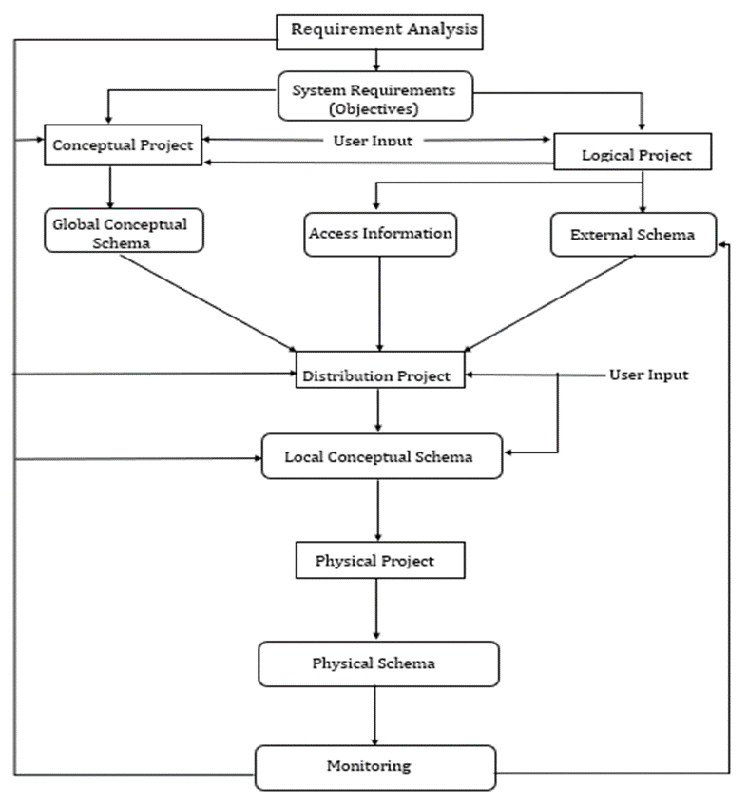
Design Strategy of Easy Walk
TOP-DOWN APPROACH

Slide 5
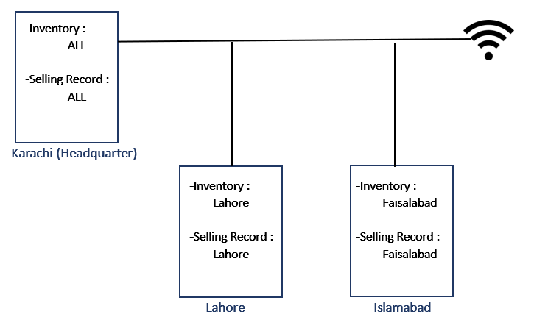
SCENARIO OF EASY WALK DISTRIBUTED DATABASE:
Faisalabad

Slide 6
TABLES
Karachi
Inventory Table:
Product_ID | Article_No | Size | Color | Gender | Price | Branch
Primary Key
Selling Record:
Product_ID | CustomerName | Date | Price | Branch
Primary Key

Slide 7
TABLES (Cont.)
Lahore and Faisalabad
Inventory Table for Synchronous and Asynchronous:
Product_ID | Article_No | Size | Color | Gender | Price
Primary Key
Selling Record for Synchronous and Asynchronous:
Product_ID | CustomerName | Date | Price
Primary Key

Slide 8
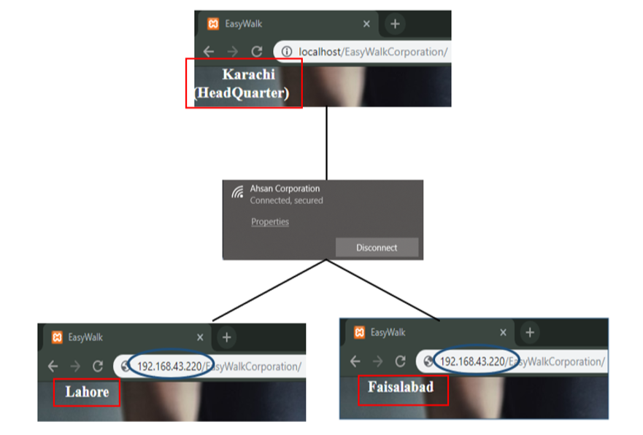
IMPLEMENTATION
Step No: 01

Slide 9
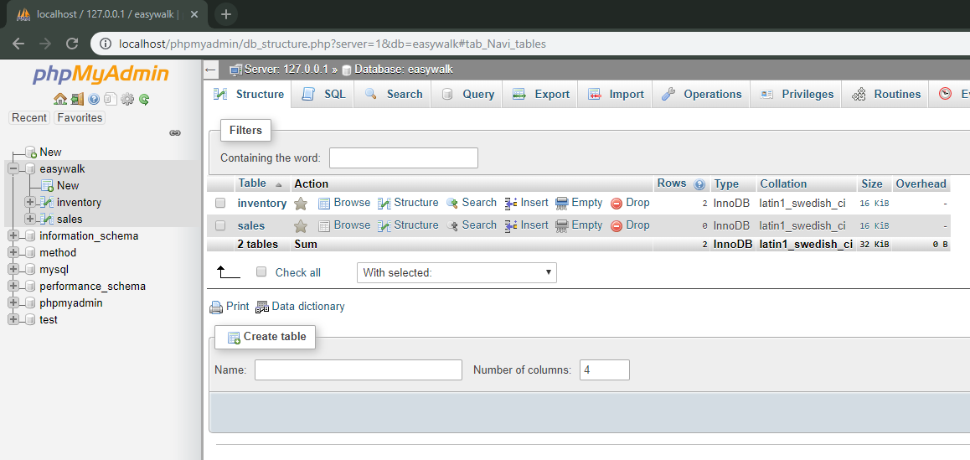
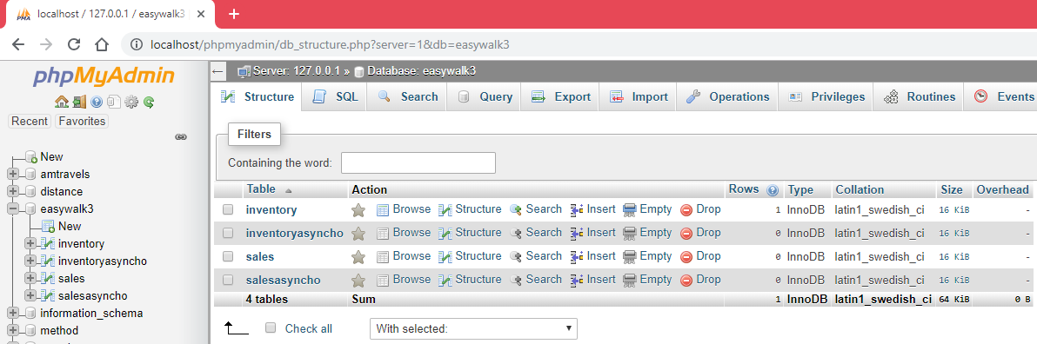
IMPLEMENTATION (Cont.)
Step No: 02
Karachi (Head Quarter)
IP: 192.168.43.220
Lahore and Faisalabad (Branch)
IP: 192.168.43.21
IP: 192.168.43.94

Slide 10
IMPLEMENTATION (Cont.)
Step No: 03
Karachi (Head Quarter)
Lahore (Branch)
Faisalabad (Branch)

Slide 11


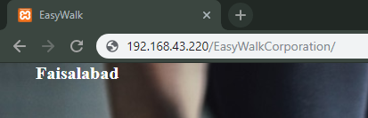
IMPLEMENTATION (Cont.)
Step No: 04
IP: 192.168.43.220 (Local Host)
IP: 192.168.43.220
IP: 192.168.43.220

Slide 12
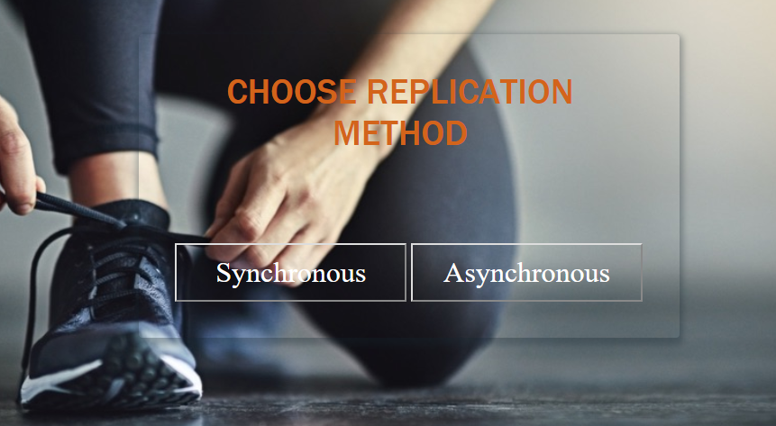
Working
For Lahore and Faisalabad (Branches):

Slide 13
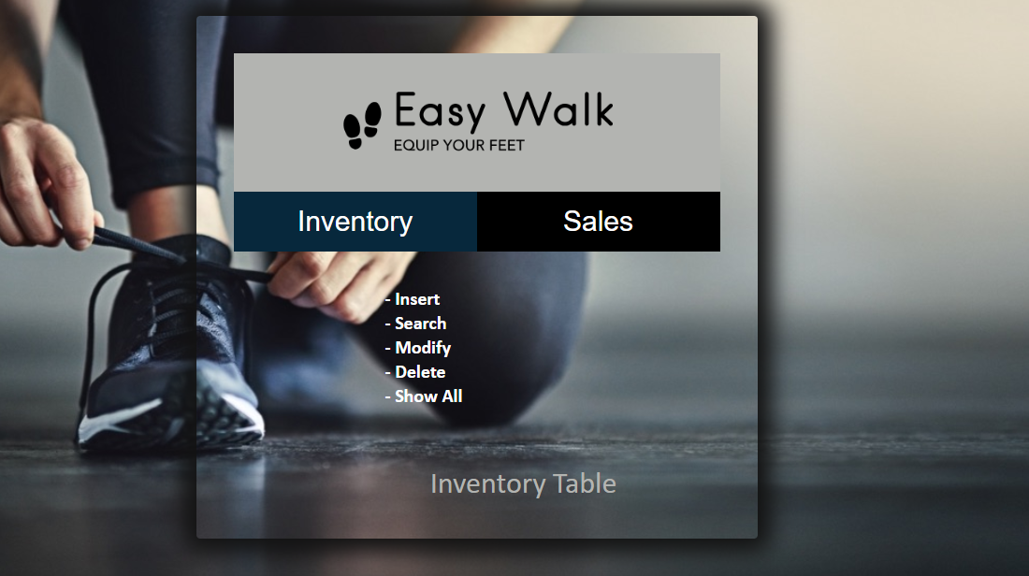
Working (Cont.)
For Karachi (Head Quarter):

Slide 14
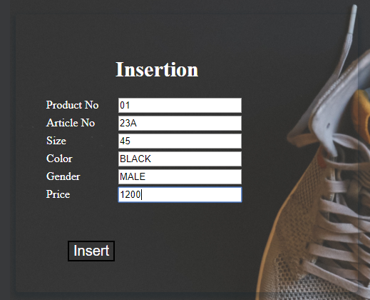
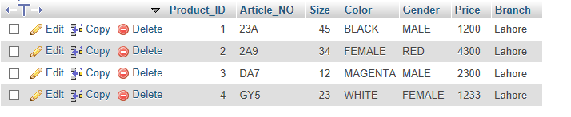
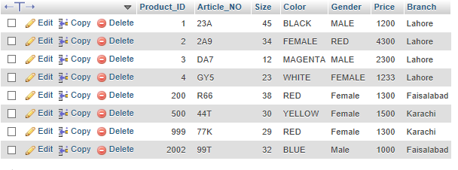
Example
Synchronous Insertion
Branch
Head Quarter

Slide 15
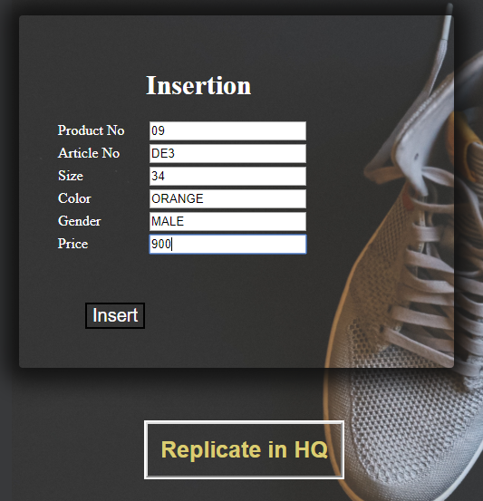
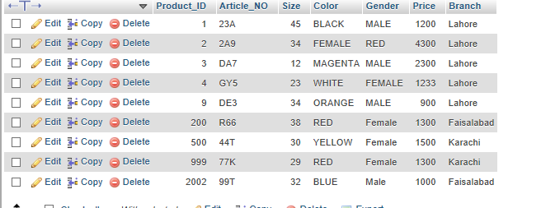
Example (Cont.)
Asynchronous Insertion
Temporary Table in Branch:
Karachi (Head Quarter) Database Replicate:

Slide 16
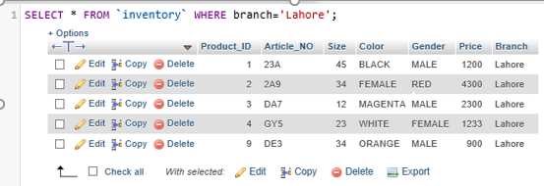
Fragmentation
Horizontal Fragmentation
SQL Query

Slide 17
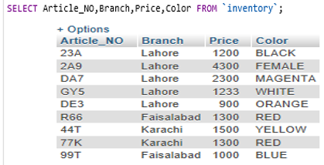
Fragmentation
Vertical Fragmentation
SQL Query

