Slide 1
ESI-SBA | 3rd Year IASD | Pr. MALKI Abdelhamid
AGENDA
Homework 1:
Deep Q-Network
0
Environments & Setup
CartPole · LunarLander · Pong
1
DQN Ablation Study
Hard · Soft · No replay · No target
Ablation Study, Double / Dueling DQN
& Custom Environment
2
Double & Dueling DQN
CartPole · LunarLander · Pong
3
Custom Env: TreasureGrid
CartPole-v1
LunarLander-v3
Pong-v5
TreasureGrid
V1 Sparse · V2 Dense · V3 Random goal
Seeds 0, 1, 2 | γ = 0.99 | Results reported as mean [min, max]
S
Synthesis
Key takeaways & limits
1 / 16

Slide 2
Environments & Setup
PART 0: SETUP
EX 1
EX 2
EX 3
SYNTHESIS
 | CartPole-v1 | LunarLander-v3 | ALE/Pong-v5
State | ℝ⁴ | ℝ⁸ | 4×84×84 uint8 frames
Actions | 2 | 4 | 6
Network | MLP 4→64→64→2 | MLP 8→128→128→4 | Nature CNN → FC512 → 6
lr / batch | 5e-4 / 64 | 5e-4 / 64 | 1e-4 / 32
learn_every / C | 1 / 100 | 4 / 250 | 1 / 1000
ε decay | 1→0.05 (10k) | 1→0.05 (25k) | 1→0.01 (200k*)
Loss | MSE | MSE | Huber + clip 10
Budget | 300 episodes | 800 episodes | 200k steps*
Solved | ≥ 475 | ≥ 200 | ≥ 18
* Pong budget reduced from 10⁶ to 200k steps (GPU limit, all variants)
γ = 0.99 · 3 seeds (0, 1, 2)
ESI-SBA | Homework 1: Deep Q-Network
2 / 16

Slide 3
Ablation Setup: Four Variants
PART 0
EX 1: ABLATION
EX 2
EX 3
SYNTHESIS
1
REFERENCE
2
VARIANT
3
ABLATION
4
ABLATION
Hard Update
Soft Update
No Replay
No Target Net
θ⁻ ← θ every C steps
θ⁻ ← τθ + (1−τ)θ⁻
batch = last B transitions
y = r + γ max Q(s′; θ)
Reference: copy online weights periodically.
τ = 0.01, applied every step.
Consecutive, correlated samples only.
Online network chases itself.
EVALUATION PROTOCOL
1
3
100
20
setting changed at a time
seeds (0, 1, 2), same hyperparameters
episodes for train score (Pong: 20)
unseen greedy episodes (ε = 0)
ESI-SBA | Homework 1: Deep Q-Network
3 / 16

Slide 4
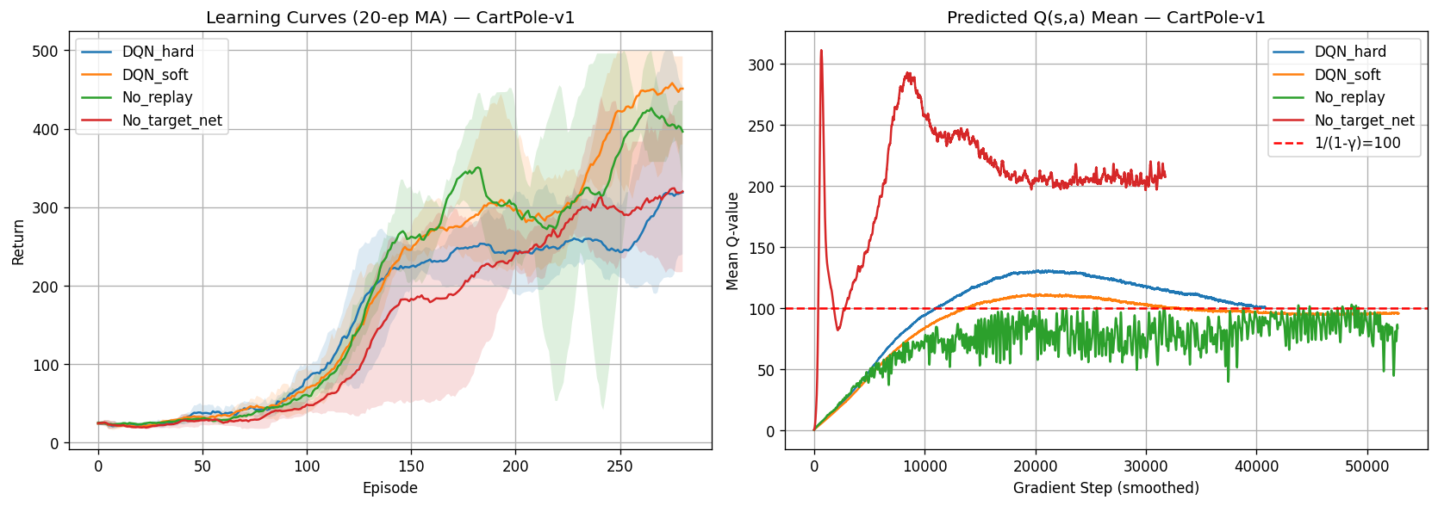
CartPole-v1 Results
PART 0
EX 1: ABLATION
EX 2
EX 3
SYNTHESIS
SOLVED: Soft Update (500.0 on 3/3 seeds)
KEY INSIGHT
No_target Q-values explode to ~310
3× above theoretical 1/(1−γ) = 100
Hard & Soft converge cleanly to 100
Variant | Train mean | Train [min, max] | Greedy mean | Greedy [min, max] | Read-out
Hard (Ref) | 266.8 | [248, 290] | 416.8 | [250, 500] | Reference; wide greedy band
Soft (τ=0.01) | 371.4 | [336, 405] | 500.0 | [500, 500] | Solved on all 3 seeds
No replay | 342.1 | [293, 412] | 330.4 | [231, 500] | Unreliable (band 231–500)
No target | 286.8 | [258, 307] | 282.6 | [119, 444] | Q-values explode to ~310
ESI-SBA | Homework 1: Deep Q-Network
Best greedy
Failure
Unstable
4 / 16

Slide 5
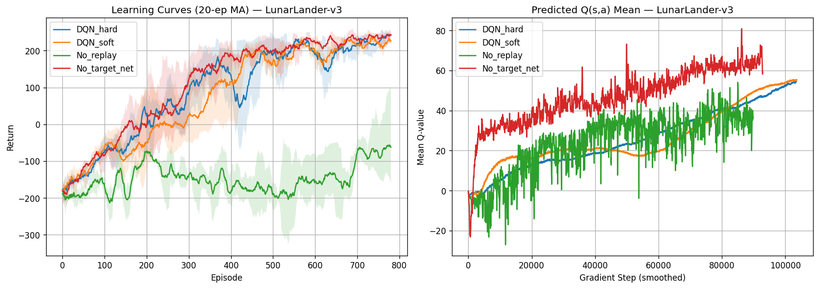
LunarLander-v3 Results
PART 0
EX 1: ABLATION
EX 2
EX 3
SYNTHESIS
BEST: Hard Update (245.5, tightest band)
CRITICAL FAILURE: No Replay (−91.9)
KEY INSIGHT
Soft greedy 63.5: one seed crashed (−196)
Another seed solved it (+245)
No replay fails on shaped rewards
Variant | Train mean | Train [min, max] | Greedy mean | Greedy [min, max] | Read-out
Hard (Ref) | 227.6 | [213, 250] | 245.5 | [232, 261] | Best & tightest band
Soft (τ=0.01) | 219.2 | [209, 232] | 63.5 | [−196, 245] | 1 seed crashed, 1 solved
No replay | −73.2 | [−93, −38] | −91.9 | [−150, −54] | Complete collapse
No target | 236.1 | [231, 240] | 216.1 | [174, 242] | Still solves (> 200)
ESI-SBA | Homework 1: Deep Q-Network
Best greedy
Failure
Unstable
5 / 16

Slide 6
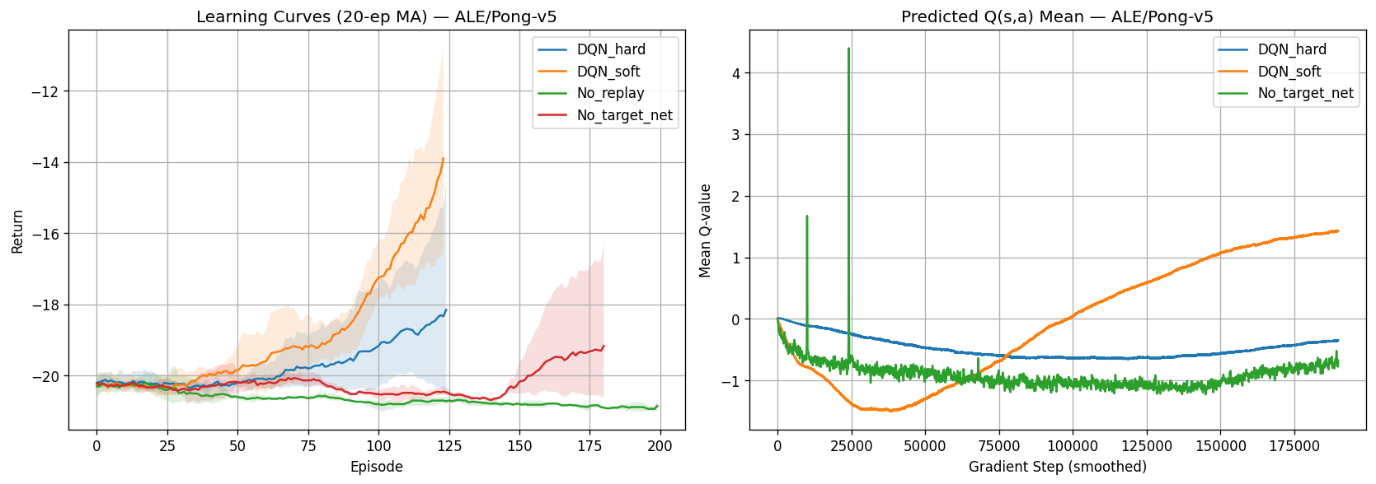
ALE/Pong-v5 Results
PART 0
EX 1: ABLATION
EX 2
EX 3
SYNTHESIS
LEADER @200k: Soft Update (−12.1)
STUCK AT RANDOM: No Replay (−21.0)
KEY INSIGHT
No_target Q-values spike >4.4 at 25k steps
Soft learns fastest from pixels
No variant solves Pong (≥ 18) at 200k
Variant | Train mean | Train [min, max] | Greedy mean | Greedy [min, max] | Read-out
Hard (Ref) | −17.9 | [−20, −15] | −15.5 | [−19, −12] | Slow at 200k steps
Soft (τ=0.01) | −12.0 | [−14, −10] | −12.1 | [−16, −9] | Clear leader at 200k
No replay | −20.6 | [−21, −20] | −21.0 | [−21, −21] | Stuck at random
No target | −19.1 | [−21, −17] | −18.6 | [−21, −14] | Q-value spike, worse than hard
ESI-SBA | Homework 1: Deep Q-Network
Best greedy
Failure
Unstable
6 / 16

Slide 7
Cross-Environment Comparison
PART 0
EX 1: ABLATION
EX 2
EX 3
SYNTHESIS
Ablation | CartPole-v1 | LunarLander-v3 | ALE/Pong-v5
Soft vs Hard | Soft better (500.0 vs 416.8) | Hard better greedy (245.5 vs 63.5) | Soft better (−12.1 vs −15.5)
No replay | Mixed: greedy band [231, 500] | Fails (−91.9) | Fails (−21.0)
No target net | Q-values explode to ~310 | No clear harm (216.1) | Worse than hard (−18.6)
Verdict | Easy task hides ablations | Replay is essential | Replay + soft target matter
REPLAY
TARGET NET
SEED BANDS
PONG
Critical on LunarLander & Pong
Stabilises Q-values on CartPole
Many gaps overlap: not significant
All variants unsolved at 200k
ESI-SBA | Homework 1: Deep Q-Network
7 / 16

Slide 8
Double & Dueling: Concepts
PART 0
EX 1
EX 2: DOUBLE / DUELING
EX 3
SYNTHESIS
DOUBLE DQN
DUELING DQN
Decouple selection from evaluation
Split value and advantage streams
The max operator on one network overestimates Q. Double DQN splits the job in two.
Q(s,a) = V(s) + A(s,a) − mean(A)
a* = argmax Q(s′, a′; θ)
Shared
trunk
V(s) · 1 out
Combine
→ Q(s,·)
y = r + γ(1−done) · Q(s′, a*; θ⁻)
A(s,a) · |A| outs
Online net θ
selects a*
Target net θ⁻
scores Q(s′, a*)
→ less bias
Net | Trunk | V | A
CartPole | MLP 4→64→64 | 1 | 2
LunarLander | MLP 8→128→128 | 1 | 4
CNN (Pong)* | Nature CNN → FC512 | 1 | 6
Online picks, target scores: bias drops.
* CNN streams used for Pong (Ex 2, 200k steps).
COMPARED:
CartPole · Lunar · Pong · 3 seeds
DQN
Double DQN
Dueling DQN
Dueling Double
ESI-SBA | Homework 1: Deep Q-Network
8 / 16

Slide 9
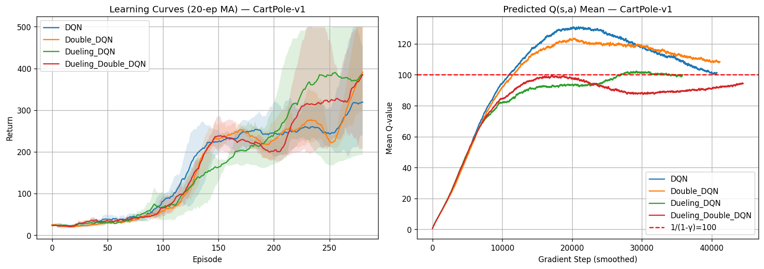
Double & Dueling — CartPole-v1
PART 0
EX 1
EX 2: DOUBLE / DUELING
EX 3
SYNTHESIS
BEST GREEDY: Double DQN (471.7)
BEST TRAIN: Dueling DQN (340.0)
KEY INSIGHT
DQN & Double overshoot Q to ~125–130
Dueling variants stay at ~95–100
Overestimation vs 100 line removed
Agent | Train mean | Train [min, max] | Greedy mean | Greedy [min, max] | Read-out
DQN | 266.8 | [248, 290] | 416.8 | [250, 500] | Q overshoots (~125–130)
Double DQN | 280.2 | [242, 315] | 471.7 | [415, 500] | Best greedy, tightest band
Dueling DQN | 340.0 | [270, 381] | 402.7 | [299, 500] | Best train; Q ≈ 100
Dueling Double | 301.9 | [264, 366] | 375.2 | [268, 500] | Q ≈ 100; lowest greedy
ESI-SBA | Homework 1: Deep Q-Network
Best greedy
Failure
Unstable
9 / 16

Slide 10
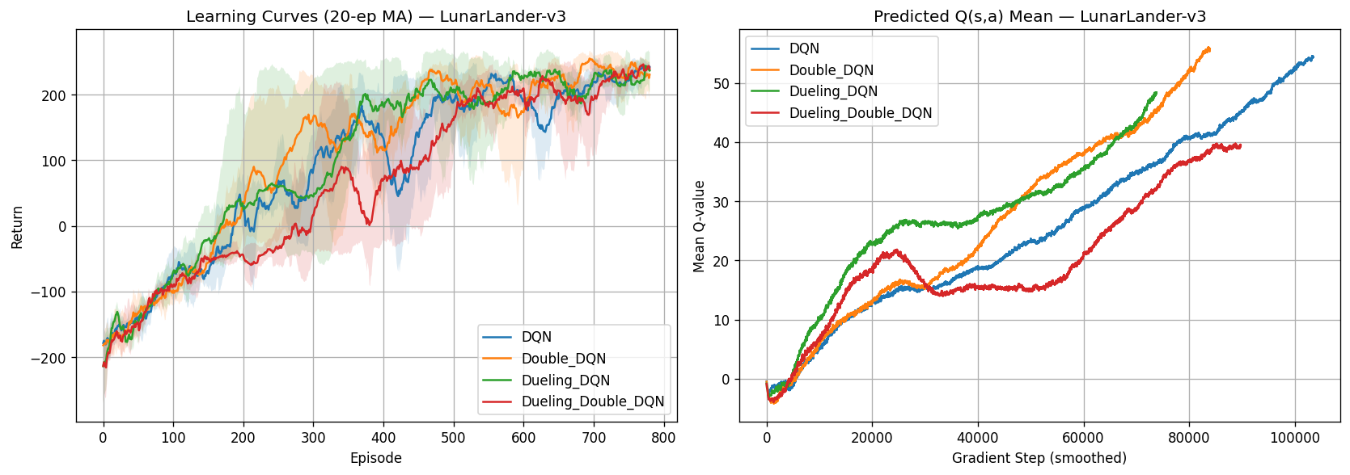
Double & Dueling — LunarLander-v3
PART 0
EX 1
EX 2: DOUBLE / DUELING
EX 3
SYNTHESIS
ALL 4 AGENTS SOLVE (> 200)
DIFFERENCES INSIDE SEED BANDS
KEY INSIGHT
All 4 agents exceed 200 greedy
Double best train; DQN best greedy
Gaps lie inside [min, max] bands
Agent | Train mean | Train [min, max] | Greedy mean | Greedy [min, max] | Read-out
DQN | 227.6 | [213, 250] | 245.5 | [232, 261] | Best greedy
Double DQN | 238.1 | [225, 249] | 234.1 | [226, 249] | Best train
Dueling DQN | 225.2 | [210, 237] | 234.7 | [209, 257] | Solved, wide band
Dueling Double | 222.8 | [212, 232] | 211.1 | [194, 243] | Lowest greedy; one seed < 200
ESI-SBA | Homework 1: Deep Q-Network
Best greedy
Failure
Unstable
10 / 16

Slide 11
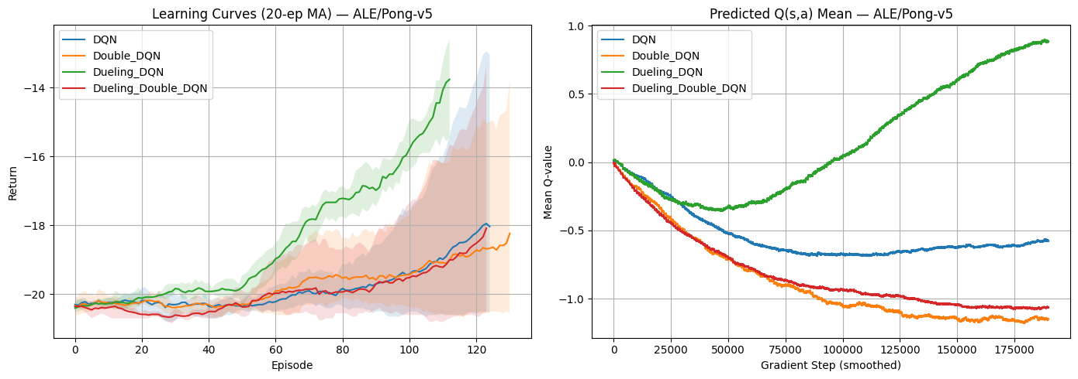
Double & Dueling — ALE/Pong-v5
PART 0
EX 1
EX 2: DOUBLE / DUELING
EX 3
SYNTHESIS
BEST: Dueling DQN (−4.0 greedy)
OTHER 3 STUCK AT ≈ −18
KEY INSIGHT
Dueling: train −11.4, greedy −4.0
Band clear of all 3 other agents
Dueling Q rises to +0.9; others fall below 0
Agent | Train mean | Train [min, max] | Greedy mean | Greedy [min, max] | Read-out
DQN | −17.6 | [−20.0, −13.1] | −18.0 | [−21.0, −12.0] | Slow; unsolved
Double DQN | −18.2 | [−20.4, −13.8] | −18.1 | [−21.0, −12.2] | Unsolved; Q ≈ −1.1
Dueling DQN | −11.4 | [−12.6, −10.6] | −4.0 | [−9.2, −1.1] | Best train & greedy; Q ≈ +0.9
Dueling Double | −17.9 | [−20.4, −13.3] | −17.8 | [−21.0, −11.3] | Unsolved; Q ≈ −1.1
ESI-SBA | Homework 1: Deep Q-Network
Best greedy
Failure
Unstable
11 / 16

Slide 12
Cross-Environment Synthesis
PART 0
EX 1
EX 2: DOUBLE / DUELING
EX 3
SYNTHESIS
Agent | CartPole train | CartPole greedy | Lunar train | Lunar greedy
DQN | 266.8 [248, 290] | 416.8 [250, 500] | 227.6 [213, 250] | 245.5 [232, 261]
Double | 280.2 [242, 315] | 471.7 [415, 500] | 238.1 [225, 249] | 234.1 [226, 249]
Dueling | 340.0 [270, 381] | 402.7 [299, 500] | 225.2 [210, 237] | 234.7 [209, 257]
Duel+Double | 301.9 [264, 366] | 375.2 [268, 500] | 222.8 [212, 232] | 211.1 [194, 243]
CARTPOLE
Double wins greedy (471.7);
Dueling wins train (340.0)
LUNARLANDER
All 4 solve it;
no clear winner
Q-OVERESTIMATION
Dueling ≈ 100;
DQN & Double ≈ 125–130
TAKEAWAY
Double DQN is the most consistent upgrade. Dueling fixes Q-overestimation; its gains stay within seed bands on CartPole / Lunar, but it clearly leads on Pong (−4.0).
ESI-SBA | Homework 1: Deep Q-Network
12 / 16

Slide 13
TreasureGrid: Design & Versions
PART 0
EX 1
EX 2
EX 3: CUSTOM ENV
SYNTHESIS
GRID SCHEMATIC (6×6)
ENVIRONMENT
A
6×6 grid with walls
2 moving traps, 1 treasure
✕
Actions: up, down, left, right
Ends: treasure, trap, or 144 steps
Baselines: Random & BFS optimum
State: 8-dim normalized vector
✕
V1 · SPARSE
V2 · DENSE
V3 · RANDOM GOAL
Illustrative layout, not to scale
T
−0.05 step, −0.2 wall,
±10 at episode end
−0.05 − 0.01 × distance,
±10 at episode end
V1 reward,
random treasure position
Agent
Treasure
Trap (moves)
Wall
PASSES Gymnasium check_env (all 3 versions)
Hyperparameters: CartPole column
500 episodes
Greedy score = ε = 0 return; success % = treasure reached; steps compared against the BFS optimum.
ESI-SBA | Homework 1: Deep Q-Network
13 / 16

Slide 14
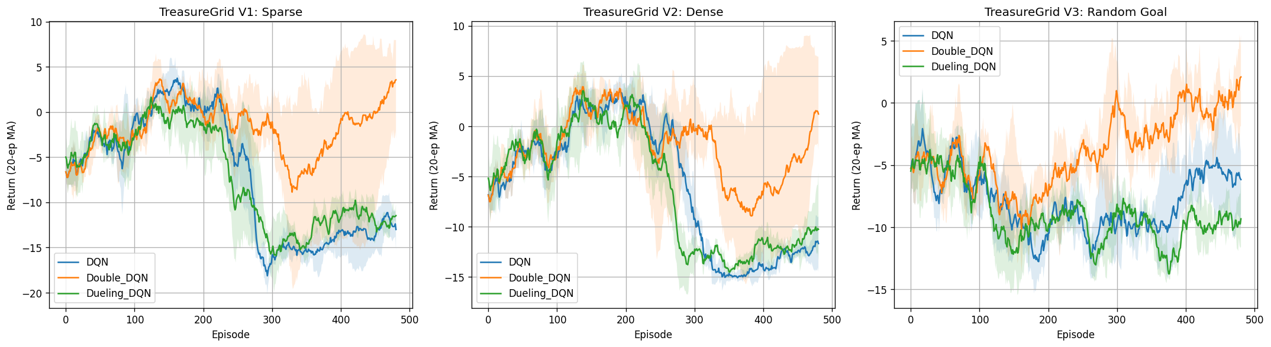
TreasureGrid: Learning Curves
PART 0
EX 1
EX 2
EX 3: CUSTOM ENV
SYNTHESIS
V1 · SPARSE
V2 · DENSE
V3 · RANDOM GOAL
51.7%
Double DQN success
18.3%
Double DQN success
23.3%
Double DQN success
DQN 0.0% · Dueling 0.0%
DQN 0.0% · Dueling 0.0%
DQN 11.7% · Dueling 8.3%
ESI-SBA | Homework 1: Deep Q-Network
14 / 16

Slide 15
TreasureGrid: Full Comparison
PART 0
EX 1
EX 2
EX 3: CUSTOM ENV
SYNTHESIS
Version | Agent | Greedy | Success | Steps
V1 Sparse BFS 3.4 | Random | −3.04 | 40.0% | 13.4
 | DQN | −13.24 | 0.0% | 144
 | Double | −0.99 | 51.7% | 69.6
 | Dueling | −12.60 | 0.0% | 144
V2 Dense BFS 3.4 | Random | −6.86 | 25.0% | 21.1
 | DQN | −11.59 | 0.0% | 144
 | Double | −6.95 | 18.3% | 118.1
 | Dueling | −11.81 | 0.0% | 144
V3 Random BFS 4.3 | Random | −5.62 | 30.0% | 26.2
 | DQN | −8.93 | 11.7% | 127.6
 | Double | −5.58 | 23.3% | 105.0
 | Dueling | −12.25 | 8.3% | 132.6
WINNER: Double DQN (51.7% Success on V1)
WHY DOUBLE DQN WINS (HYPOTHESIS)
Moving traps make Q-targets noisy
DQN & Dueling overestimate Q-values
They loop into walls: 144-step timeout, 0% success
Double decouples target evaluation, breaking the loop
V2: Double (18.3%) still below Random (25.0%)
All agents far from BFS (3.4 / 4.3 steps)
Steps = mean steps per episode (144 = timeout). BFS = optimal path length.
ESI-SBA | Homework 1: Deep Q-Network
15 / 16

Slide 16
Global Synthesis & Key Takeaways
PART 0
EX 1
EX 2
EX 3
SYNTHESIS
1
REPLAY IS ESSENTIAL
2
SOFT UPDATE: STABLE
Fails without it on LunarLander (−91.9) and Pong (−21.0).
Solves CartPole 3/3, leads Pong at 200k; Lunar greedy unstable.
3
DOUBLE DQN: MOST CONSISTENT
4
DUELING: BIG WIN ON PONG
Best CartPole greedy (471.7); 51.7% success on Grid V1.
Pong −4.0 vs ≈ −18 for the rest; CartPole / Lunar gaps inside seed bands.
LIMITS
Pong at 200k steps only · custom env far from BFS · 3 seeds only
ESI-SBA | Homework 1: Deep Q-Network
16 / 16

