Slide 1
COMPUTER NETWORKING
SCENARIO 4

Slide 2
Group Members:
Maheen Akhtar Khan
Aiman Munawar
Hadia Ali
Muqaddas Anees

Slide 3
Problem:
50 nodes
5 AS systems
Gateway nodes
Bandwidth as link cost
PDR

Slide 4
SOLUTION:
01
02
03
04
05
06
Topology
Gateway nodes
Intra
connections
Dijkstra Algorithm
Link Cost
PDR

Slide 5
Topology

Slide 6
Gateways

Slide 7
Intra-
connection

Slide 8
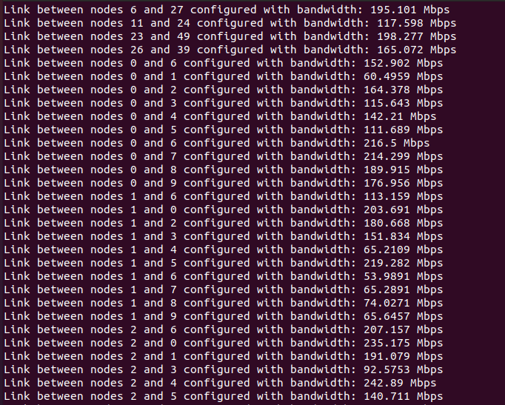
Bandwidth

Slide 9
Dijkstra

Slide 10
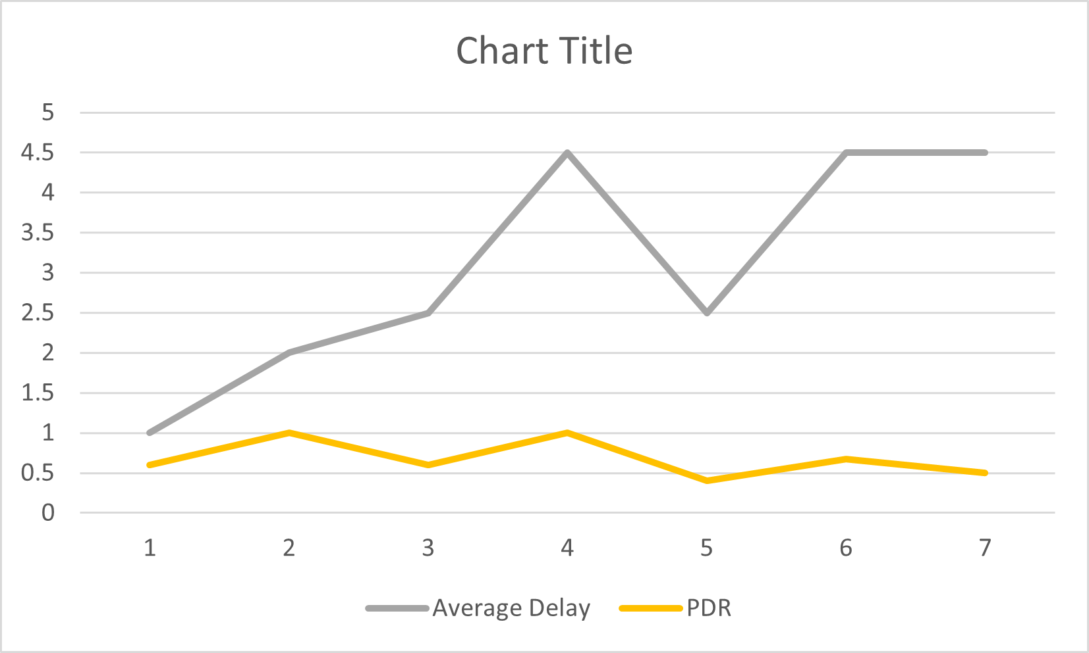
PDR

Slide 11
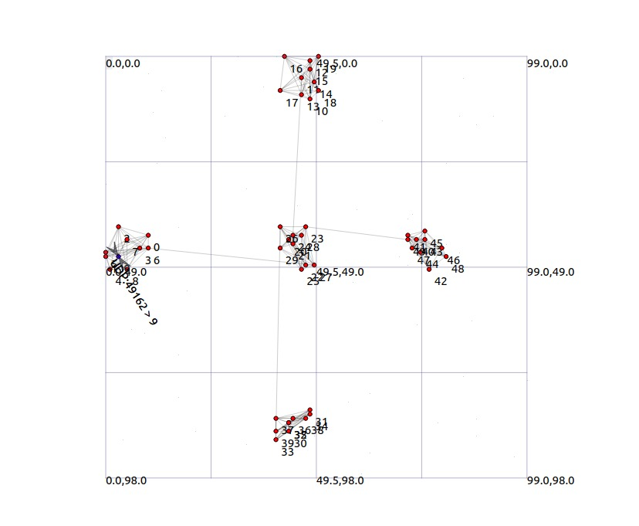

Slide 12
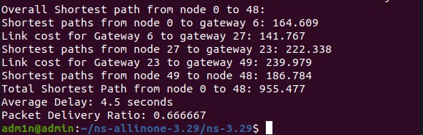

Slide 13
Thank You!

