Slide 1
Project X: Academic Marketplace
Browse, buy, and sell projects with ease

Slide 2
Table of contents
Problem & Context
Requirement Elicitation
01
02
03
Prototyping
04
Evaluation

Slide 3
Group Members
Aimen Munawar
Hadia Ali
01
02
Maheen Khan
Aima Sibtain
03
04

Slide 4
01
Problem & Context

Slide 5

Valuable student work disappears after grading, knowledge capital wasted.
New cohorts struggle to find quality references; entrepreneurs lack a showcase venue.
No fine-grained categorisation
Weak domain-specific search & documentation support
Result: No trusted market for academic project exchange.

Slide 6
Primary Stakeholders
Student Sellers
Student Buyers
Non-student Buyers

Slide 7
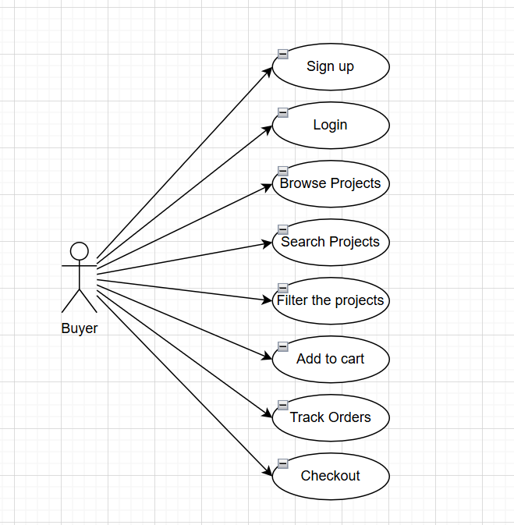
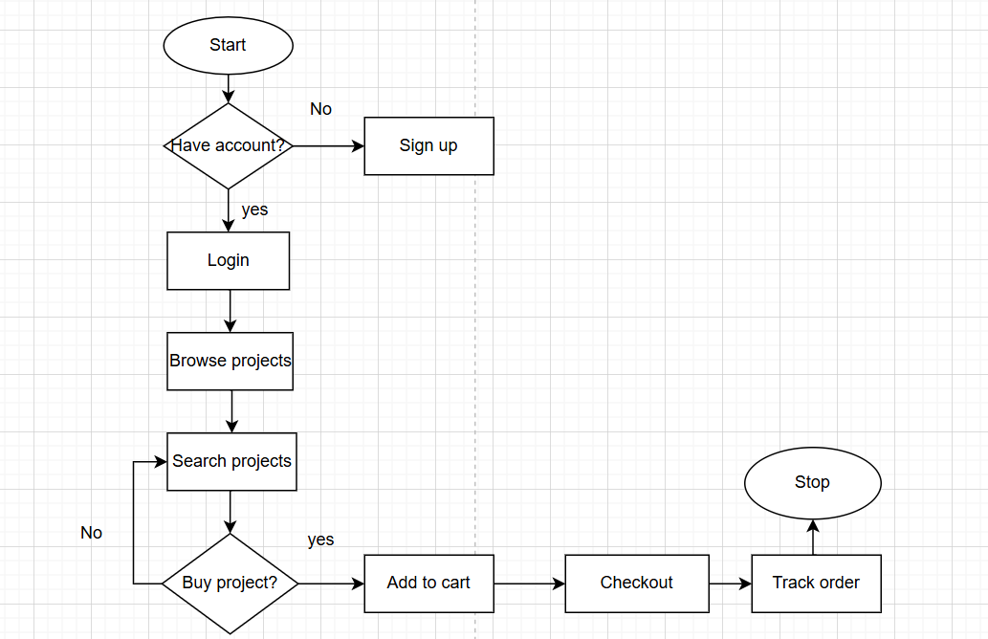
User Flow Diagrams

Slide 8
02
Requirement Elicitation

Slide 9
Requirement Elicitation
Online Questionnaire
Semi-structured Interviews
Observations

Slide 10
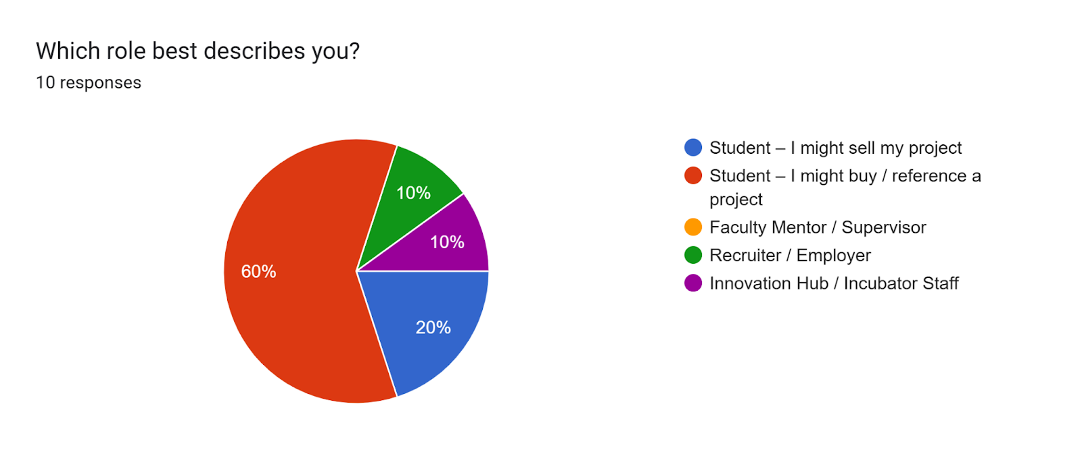
Online Questionnaire

Slide 11
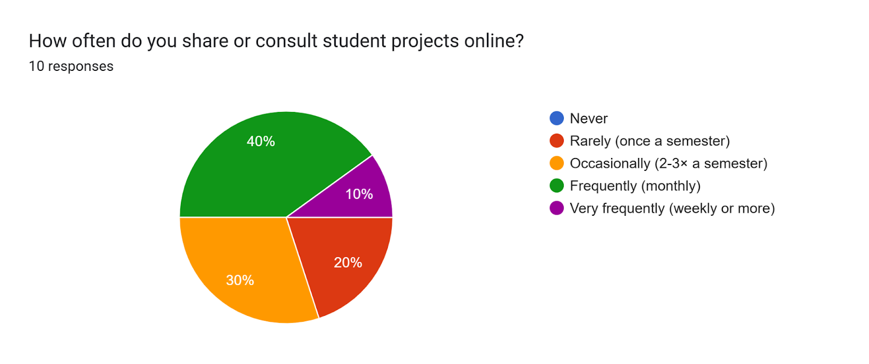
Online Questionnaire

Slide 12
Semi-Structured Interview
Name: Asma
Customer Segment : Buyers
Where do you usually look for academic or project references when starting your own work?
GitHub, YouTube, Google Scholar, and sometimes I ask seniors or use WhatsApp groups.
What features would be most useful to you when searching for a relevant project?
Category and language filtering, previews (demo or screenshots), transparent pricing, and full documentation.
What concerns do you have when purchasing a project online?
I need working code, complete report, relevance to my course, and fair pricing.

Slide 13
Observations
Sellers struggle with existing gig sites (e.g., Upwork fees & policies) and want a simpler, fee-light way to monetize their projects.
Buyers first hunt on free channels (YouTube, GitHub, seniors’ WhatsApp groups) before paying—speed & completeness sway them to purchase.
While browsing, buyers filter by topic, tool stack, difficulty & price.
Top buyer worries: originality, working code, and affordability; they request tutorials or step-by-step guides to shorten learning curves.

Slide 14
Functional Requirements
Elicitation | Requirement
Project upload with docs & media; buyers must be able to discover projects quickly | Project Listings under categories + Search & Filters
Buyers want to track order status; sellers need timely sale alerts | Delivered via NodeMailer (for software projects) + Order tracking (for physical projects)
Sellers request earnings stats; admins need listing oversight | Admin Dashboard (listings, analytics)
Easy registration & role-based login to separate seller / buyer workspaces | Easy registration & role-based login to separate seller / buyer workspaces

Slide 15
Non-Functional Requirements
Elicitation | Requirement
Interviewees highlight the need for a “user-friendly interface, clear instructions” | Usability — intuitive, responsive UI
Students complain that digging through internet “wastes too much time”; they expect pages to load quickly | Performance ≥ 1 000 concurrent users
Buyers & sellers want the portal “always up” during peak capstone weeks | Availability 99.9 % uptime
Sellers insist on role-based controls before they upload work | Security — data encryption & RBAC

Slide 16
03
Prototyping

Slide 17
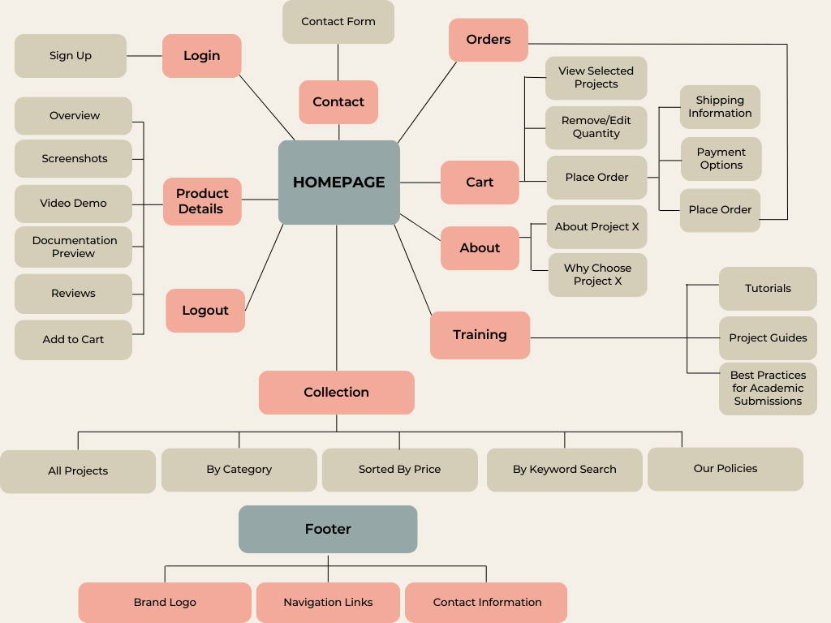
Navigation Map

Slide 18
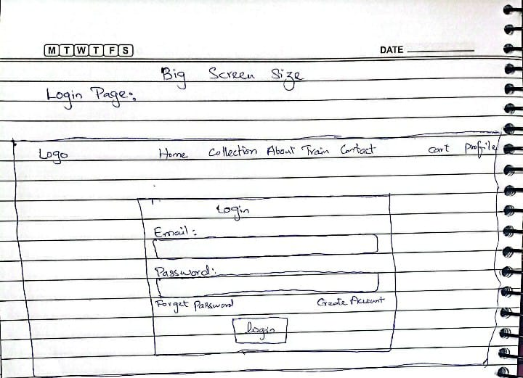
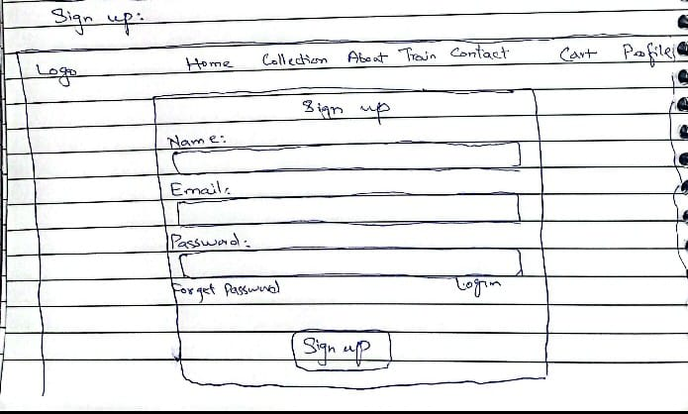
Low Fidelity Prototype

Slide 19
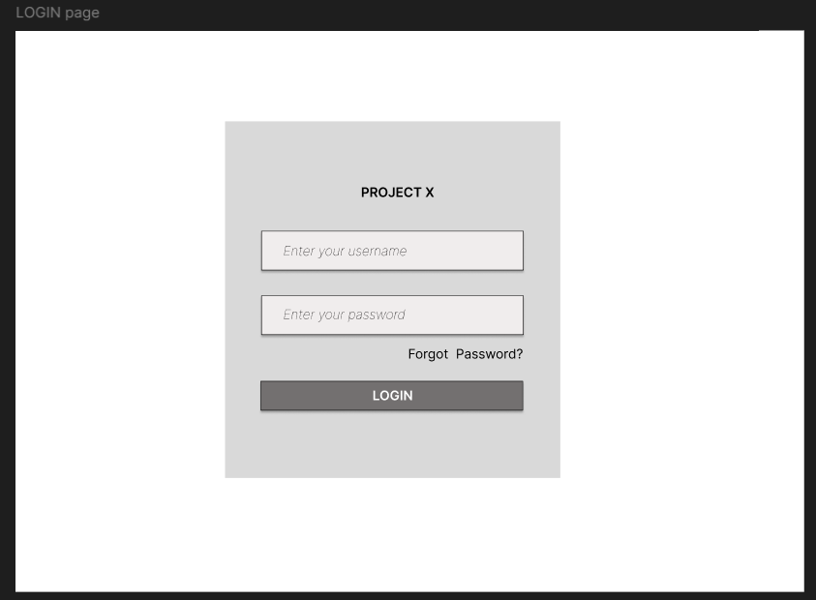
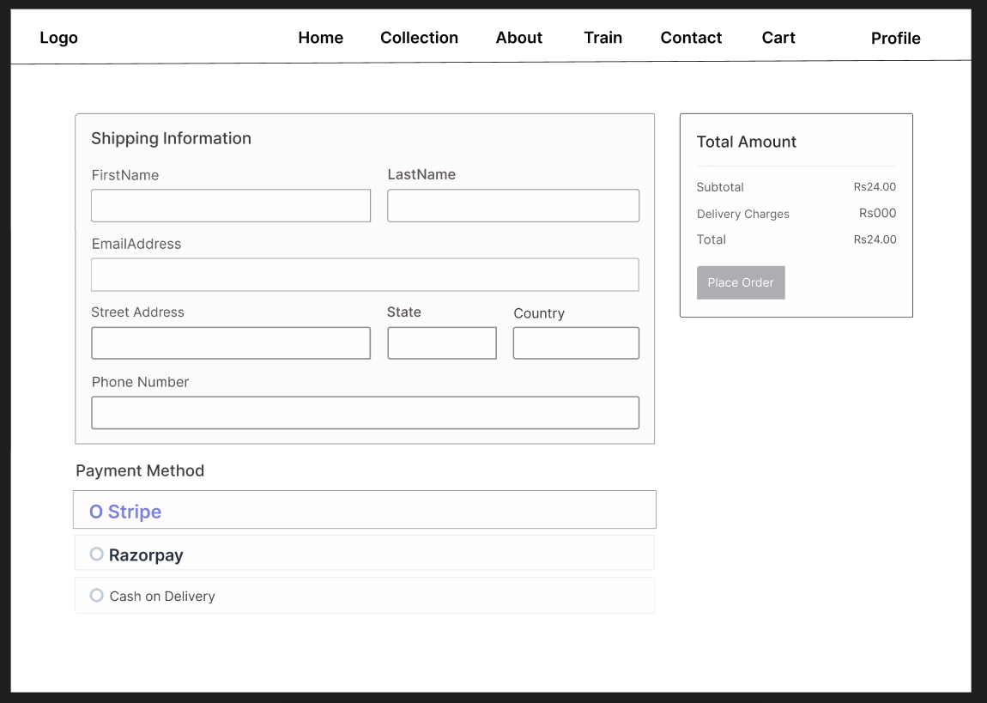
Medium Fidelity Prototype

Slide 20
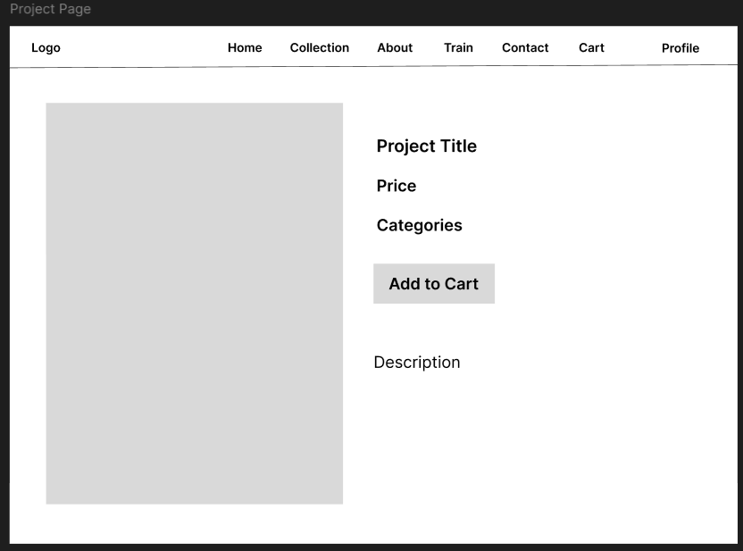
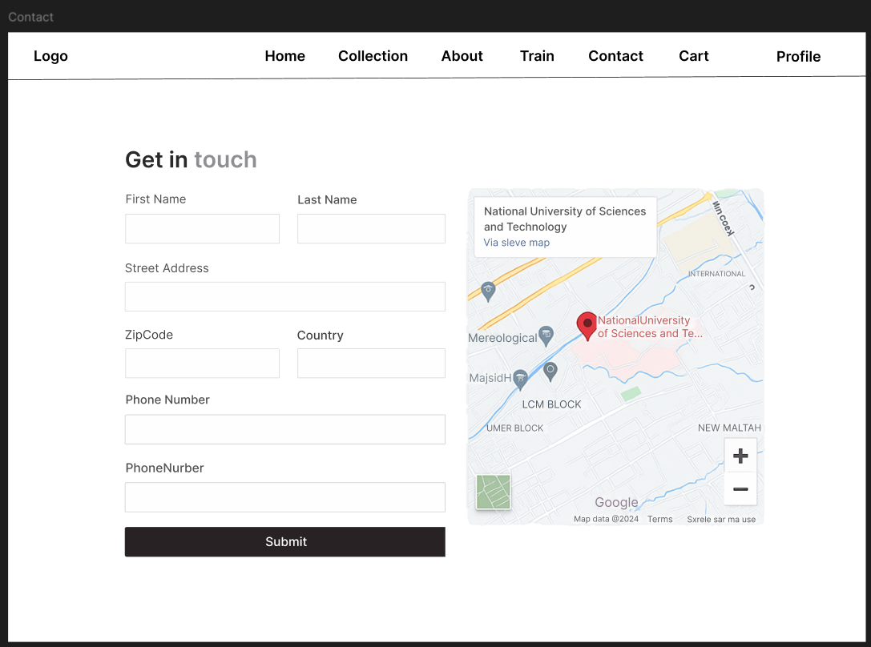
Medium Fidelity Prototype

Slide 21
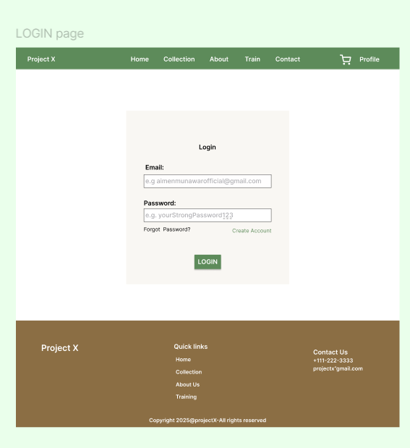
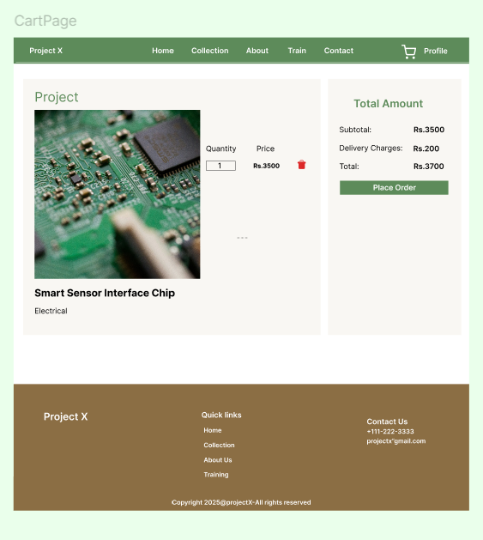
High Fidelity Prototype

Slide 22
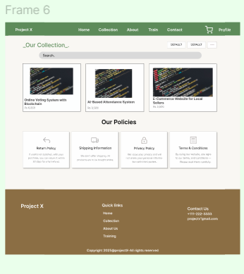
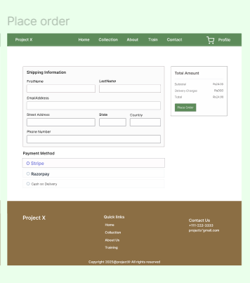
High Fidelity Prototype

Slide 23
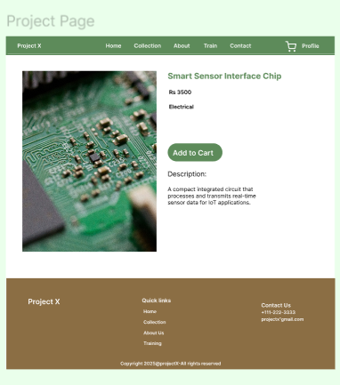
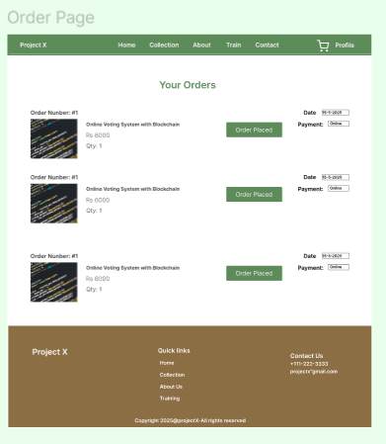
High Fidelity Prototype

Slide 24
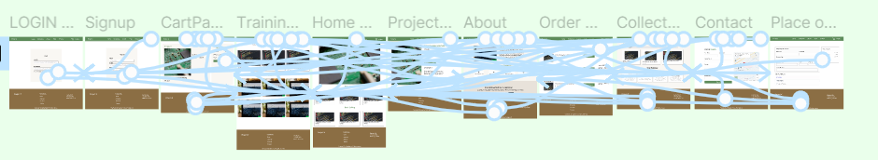
Prototyping

Slide 25
04
Evaluation

Slide 26
Evaluation Methodologies
Usability Testing & Post-Task Questionnaires
Accessibility Evaluation
Competitive Analysis
Heuristic
Evaluation

Slide 27
Competitive Analysis
StudentShare (academic resource marketplace)
GitHub Student (code repository with education focus)
Behance Student Showcase (design portfolio platform)
Etsy Academic (handmade and digital academic goods)
Academia.edu (research sharing platform)

Slide 28
Heuristic Evaluation
Visibility of system status
User control and freedom
Consistency and standards
Aesthetic and minimalist design
Error handling
Recognition rather than recall

Slide 29
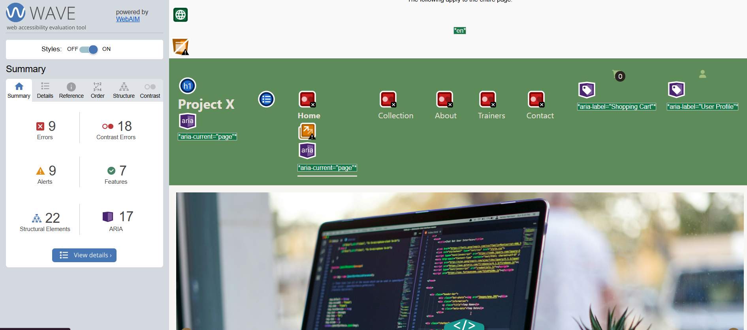
Accessibility Evaluation

Slide 30
Key Usability Testing Findings
Navigation
Active page not clearly highlighted, Transitions between pages jarring
Cart & Checkout
Users wanted visible cart preview, Quantity dropdowns were unintuitive, Checkout felt too long and no button to edit cart, Missing order summary
Seller Panel
No confirmation on delete; accidental deletions reported,Sellers want dashboard with sales metrics
Form Validation
No real-time validation, subtle error messages,Users want field-by-field feedback and error hints, Password strength indicator missing, Form submission should be blocked until valid

Slide 31
Active Page Highlight in Navbar

Slide 32
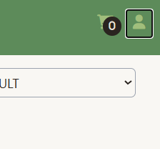
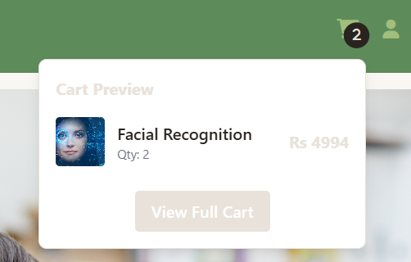
Cart Preview Added

Slide 33
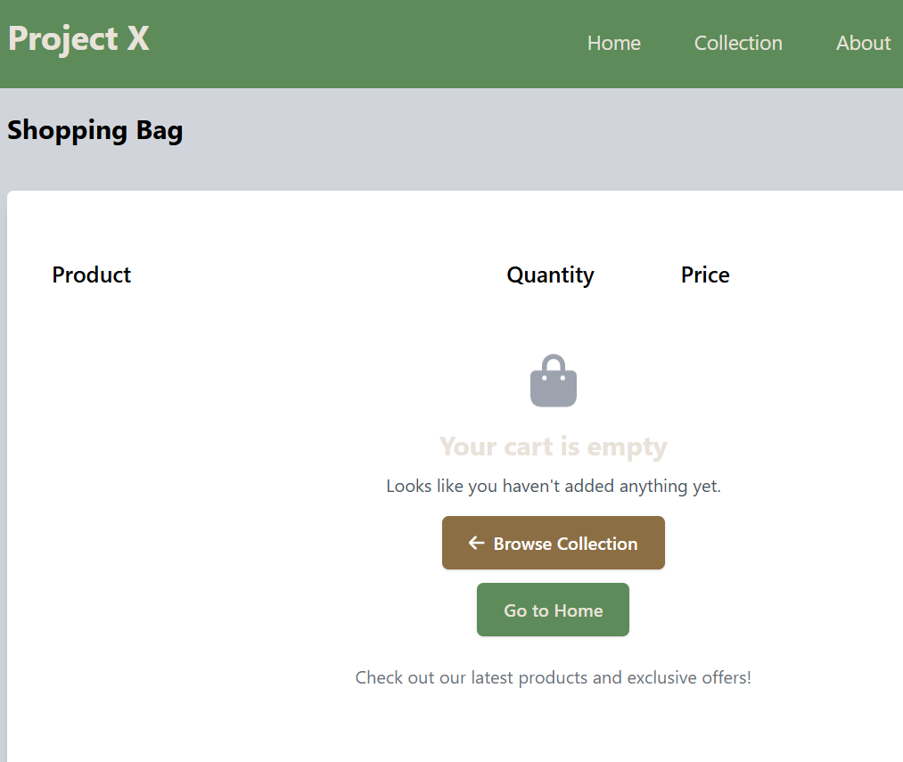
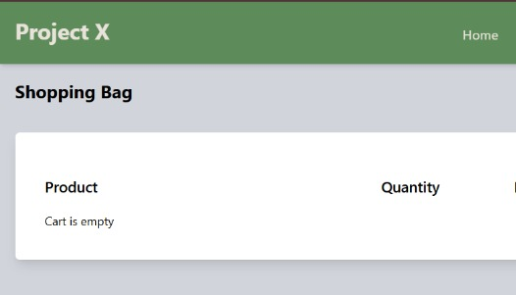
Empty Cart Navigation Clarity

Slide 34
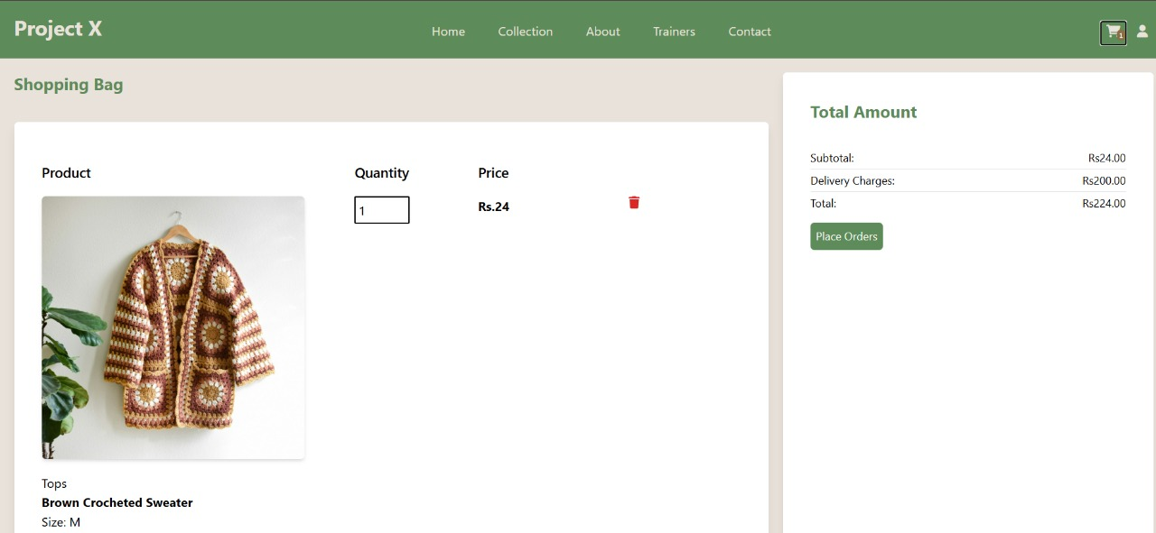
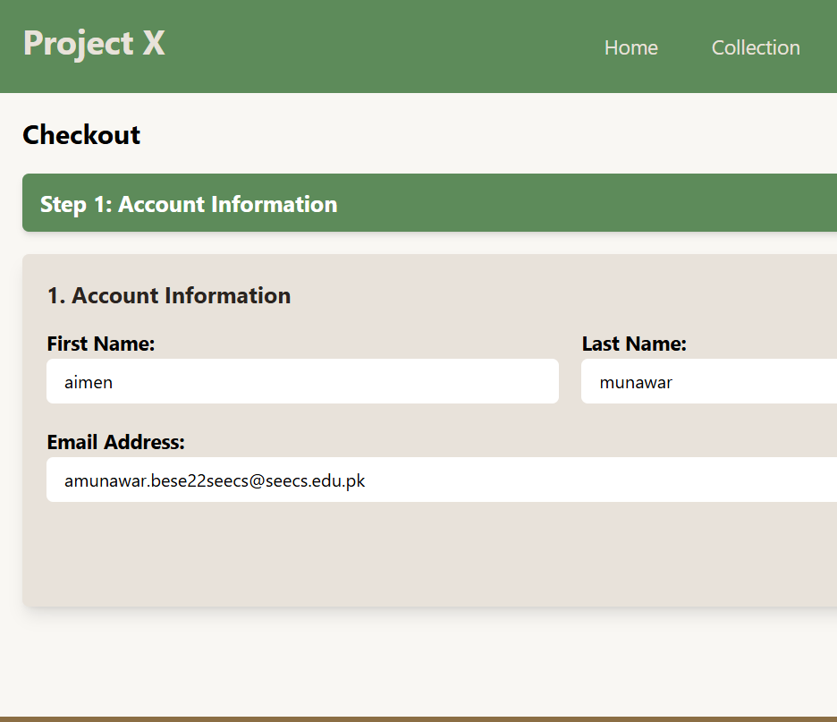
Indicating User Progress During Checkout

Slide 35
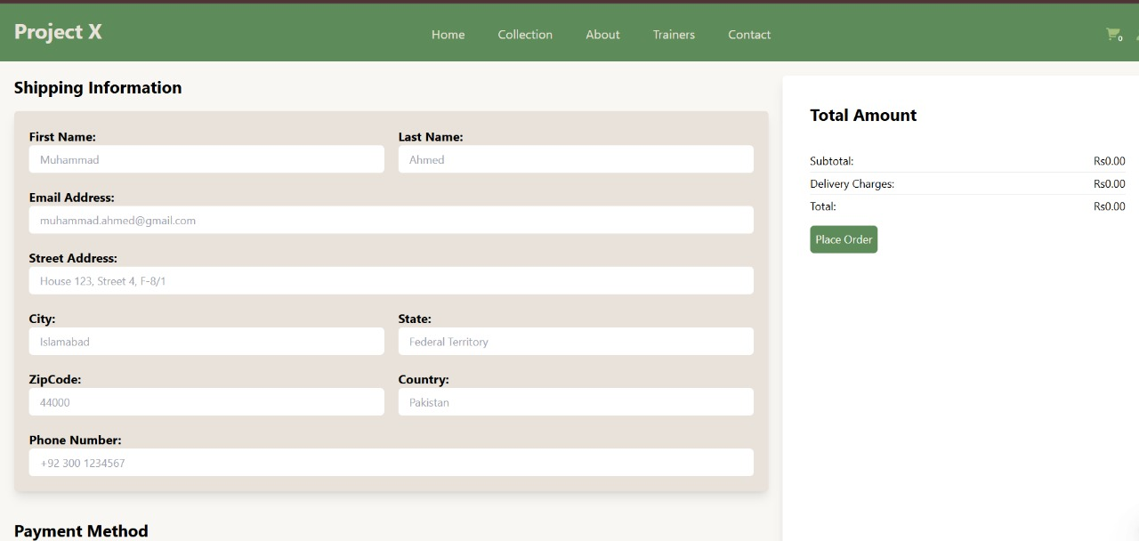
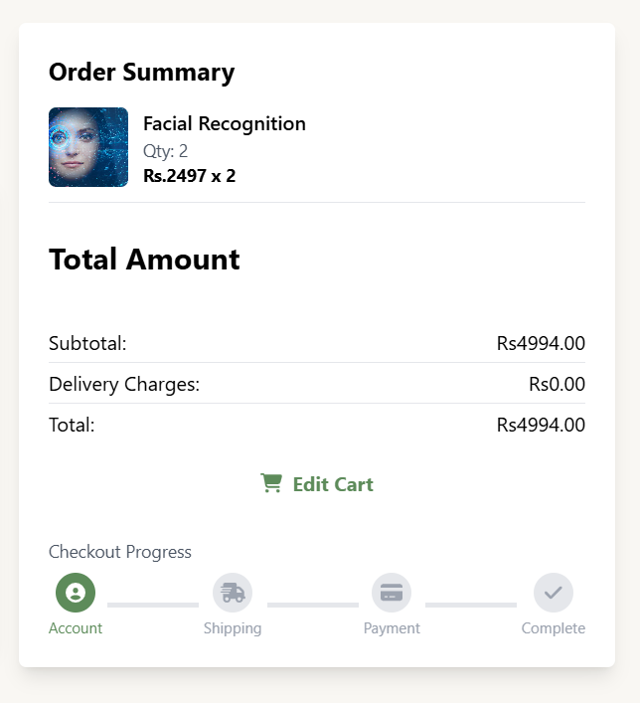
Option to Edit Cart

Slide 36
Before Intuitive Cart Quantity Control

Slide 37
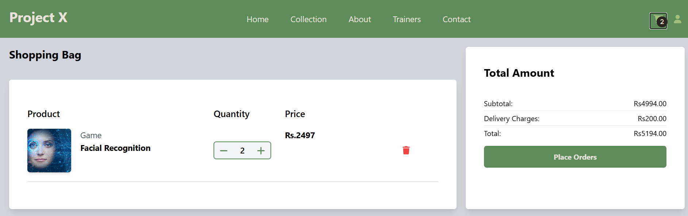
After Intuitive Cart Quantity Control

Slide 38
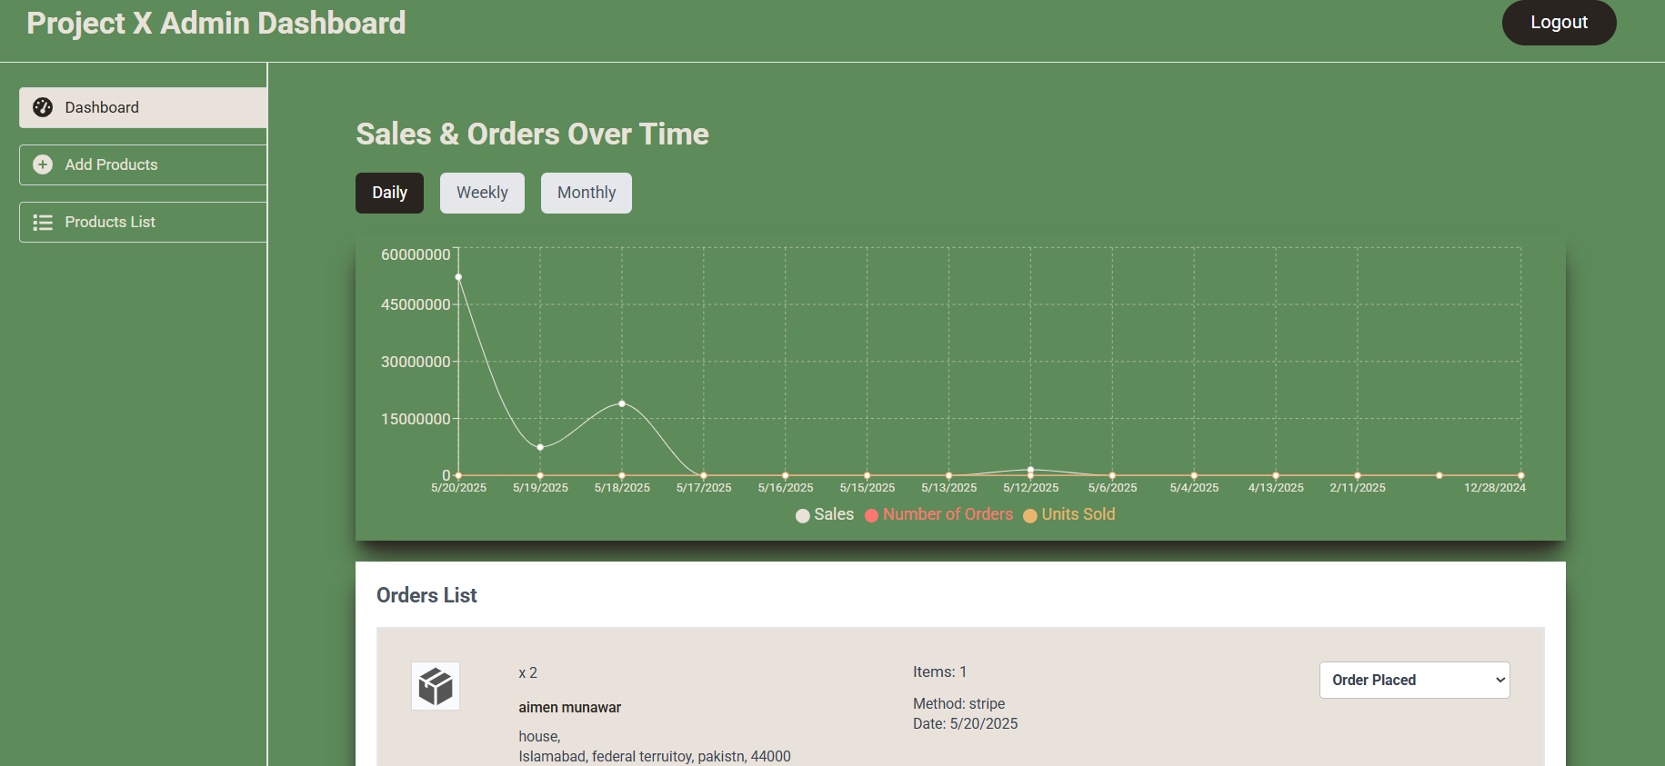
Sales Dashboard

Slide 39
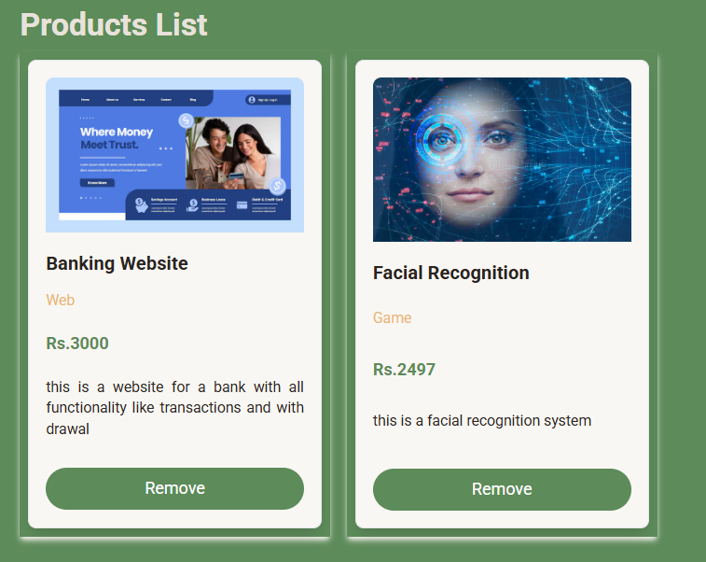
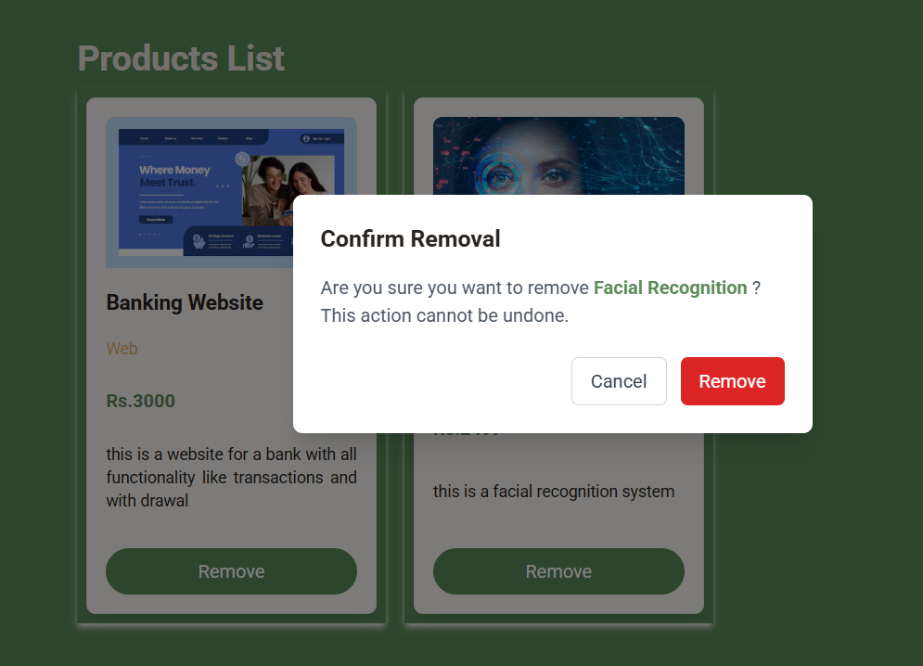
Asking Confirmation Before product Deletion

Slide 40
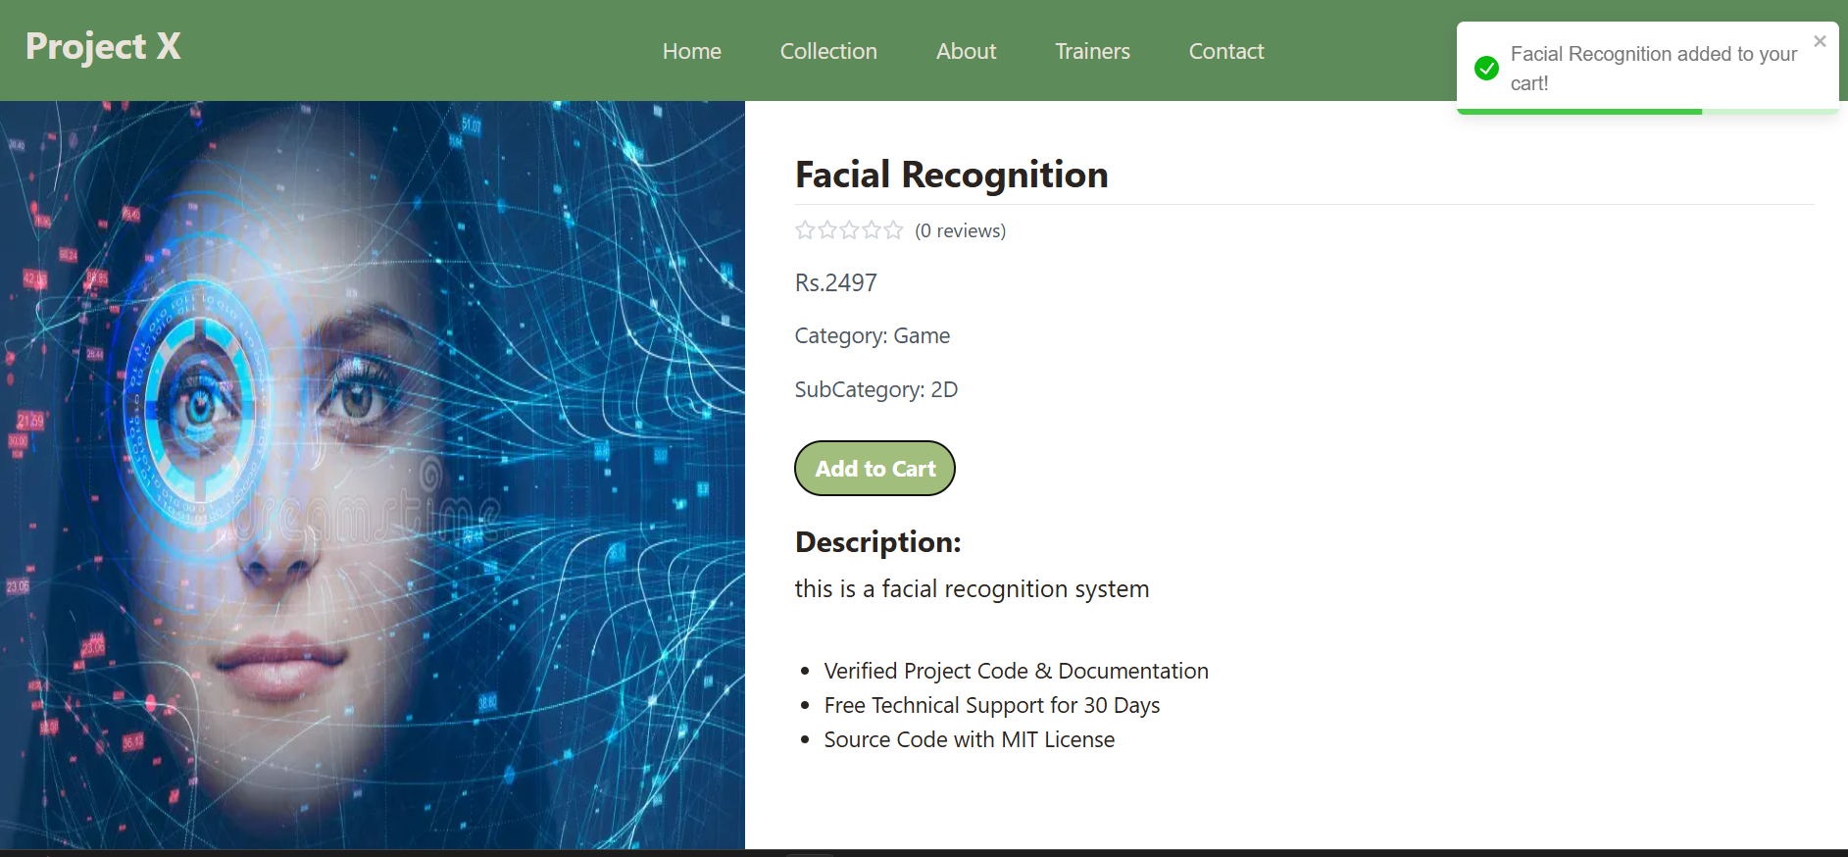
Toast on Adding Items to Cart

Slide 41
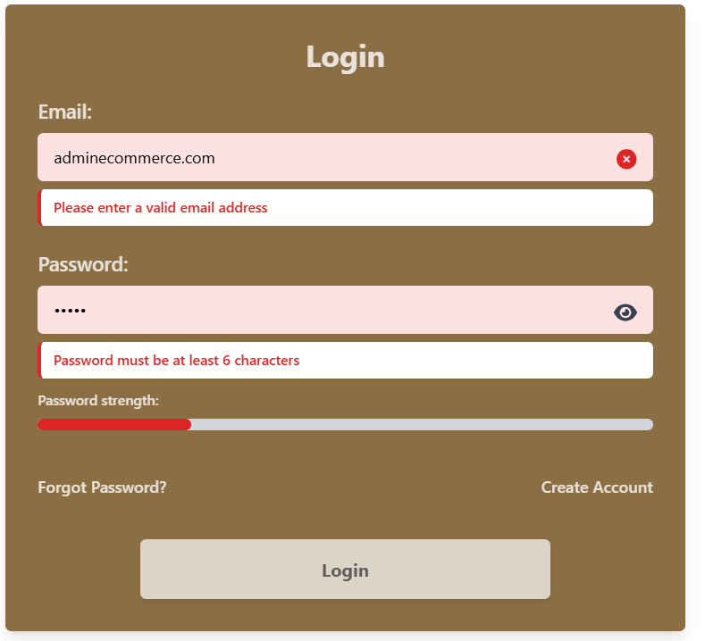
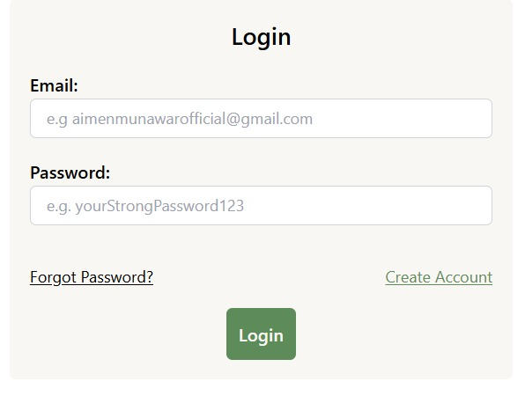
Instant Form Validation

Slide 42
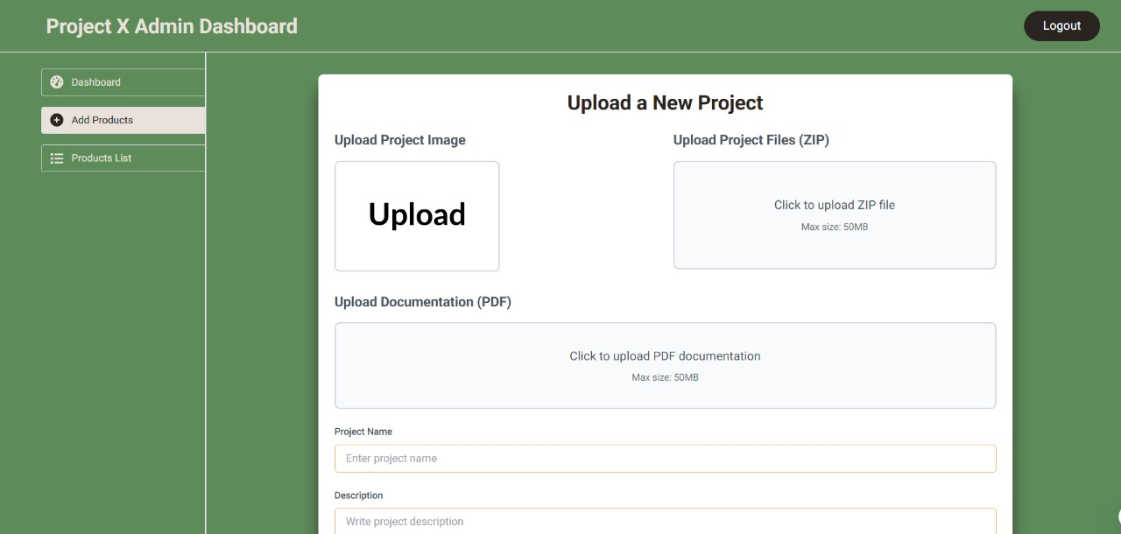
Before Instant Form Validation

Slide 43
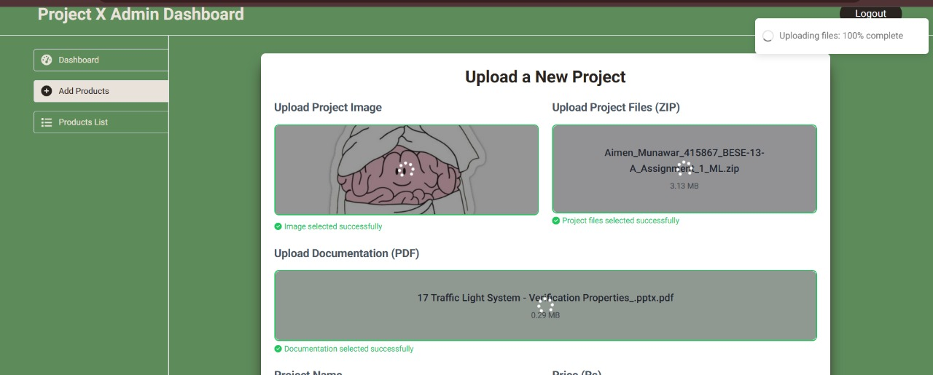
After Instant Form Validation

Slide 44
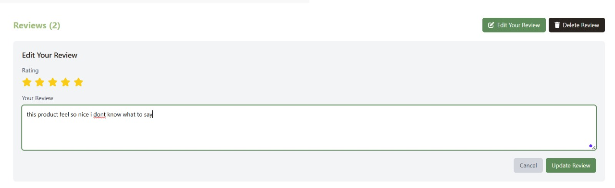
Added User Reviews

Slide 45
Thanks!

