Slide 1
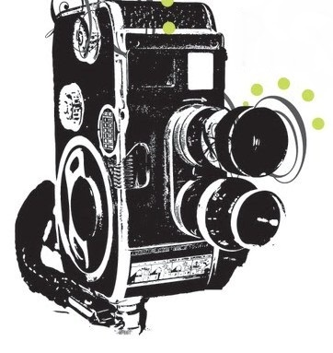
Pel lo
PHOTOGRAPHY

