Slide 1
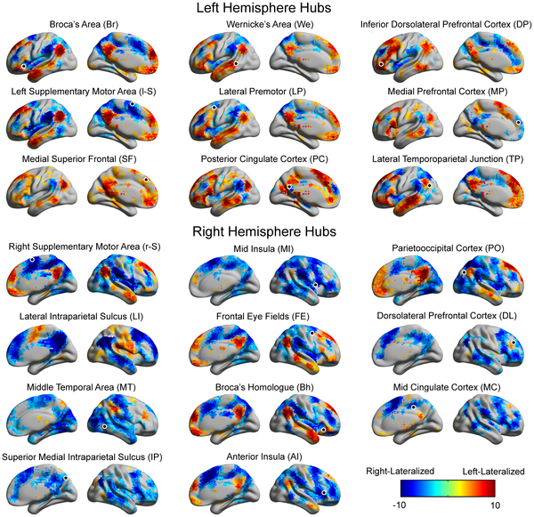

Figure 3. Significantly lateralized connections to each hub.
Nielsen JA, Zielinski BA, Ferguson MA, Lainhart JE, Anderson JS (2013) An Evaluation of the Left-Brain vs. Right-Brain Hypothesis with Resting State Functional Connectivity Magnetic Resonance Imaging. PLOS ONE 8(8): e71275. https://doi.org/10.1371/journal.pone.0071275
https://journals.plos.org/plosone/article?id=10.1371/journal.pone.0071275

