Slide 2
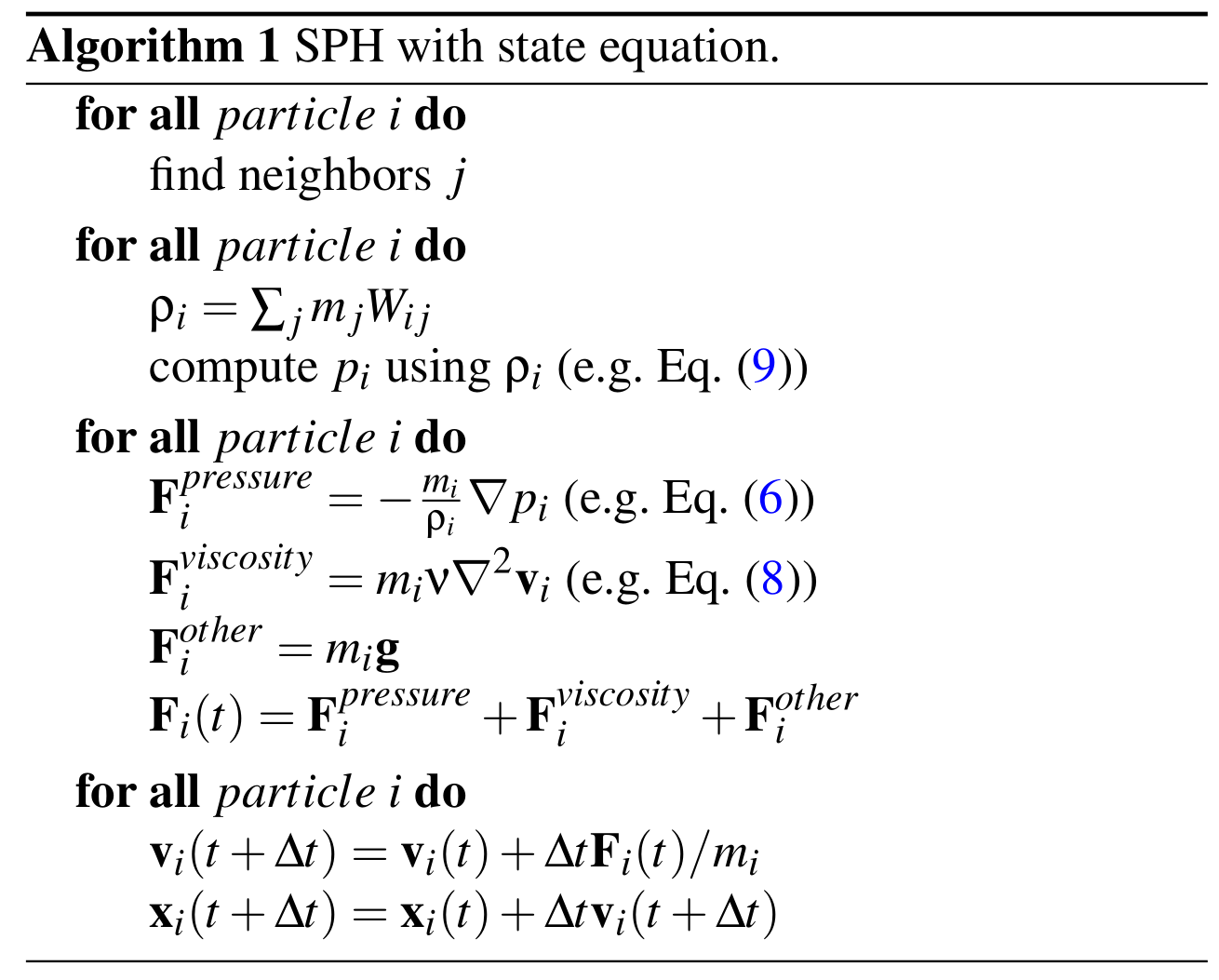
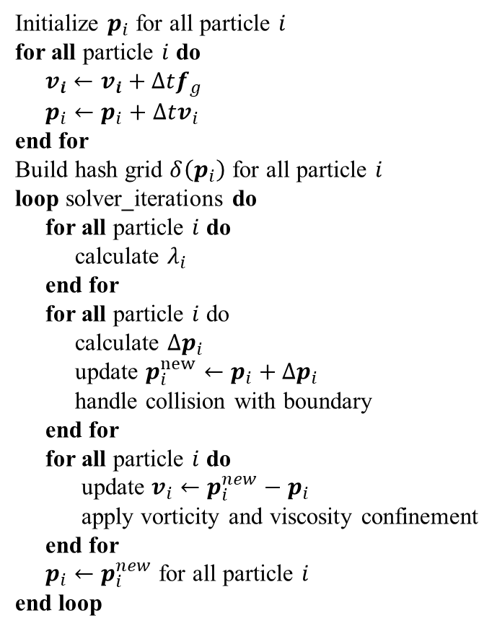
Algorithm 2 Simulation Flow
Algorithm 2 Simulation Flow
Initialize $p_{i}$ for all particle $i$
for all particle $i$ do
$v_{i}←v_{i}+Δtf_{g}$
$p_{i}←p_{i}+Δtv_{i}$
end for
Build hash grid $δ\left(p_{i}\right)$ for all particle $i$
loop solver_iterations do
for all particle $i$ do
calculate $λ_{i}$
end for
for all particle $i$ do
calculate $Δp_{i}$
update $p_{i}^{new}←p_{i}+Δp_{i}$
handle collision with boundary
end for
for all particle $i$ do
update $v_{i}←p_{i}^{new}−p_{i}$
apply vorticity and viscosity confinement
end for
$p_{i}←p_{i}^{new}$ for all particle $i$
end loop
advectKernel
getGridId
SortByGridId
computeGridRange
computeLambda
computePos
computeLambda
computePos
updateVelocity
computeXSPH
copyPos

Slide 3
Algorithm 2 Simulation Flow in kernels
Kernels
Algorithm 2 Simulation Flow
Initialize $p_{i}$ for all particle $i$
for all particle $i$ do
$v_{i}←v_{i}+Δtf_{g}$
$p_{i}←p_{i}+Δtv_{i}$
end for
Build hash grid $δ\left(p_{i}\right)$ for all particle $i$
loop solver_iterations do
for all particle $i$ do
calculate $λ_{i}$
end for
for all particle $i$ do
calculate $Δp_{i}$
update $p_{i}^{new}←p_{i}+Δp_{i}$
handle collision with boundary
end for
for all particle $i$ do
update $v_{i}←p_{i}^{new}−p_{i}$
apply vorticity and viscosity confinement
end for
$p_{i}←p_{i}^{new}$ for all particle $i$
end loop
advectKernel
getGridId
sortByGridId
computeGridRange
computeLambda
computePos
updateVelocity
computeXSPH

Slide 5
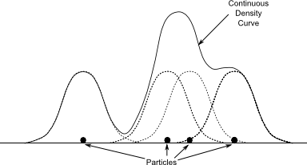

Property $A$
e.g. $ρ, \left|v\right|, p$
Particles

