Slide 2
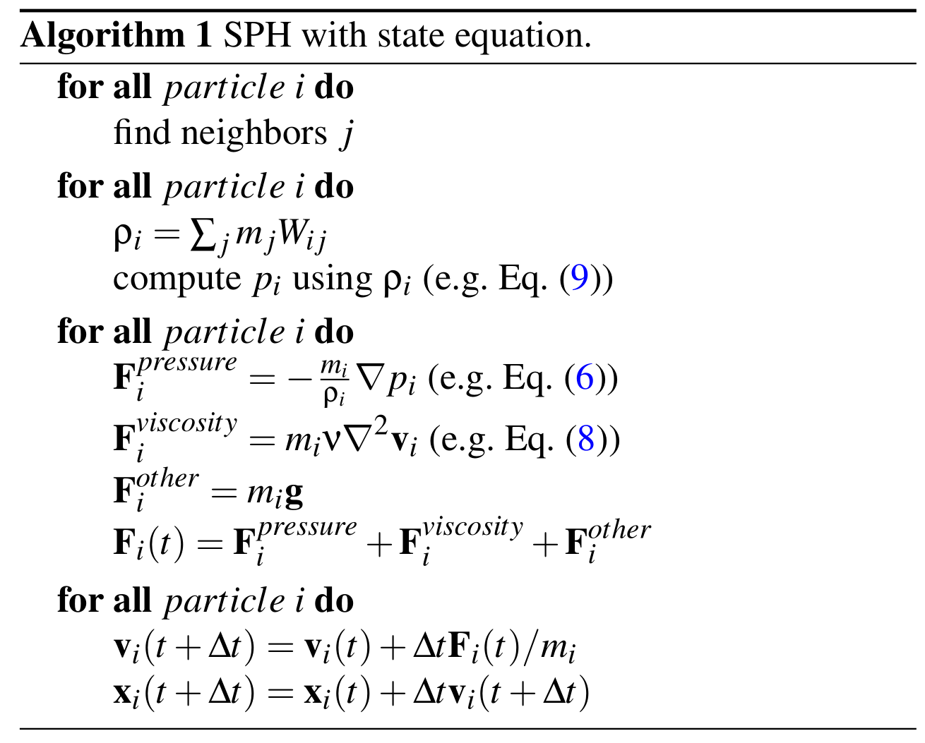
g
g
for all particle i do
apply incompressible constraint

Slide 4
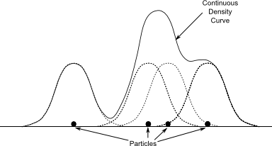

Property $A$
e.g. $ρ, \left|v\right|, p$
Particles

