Slide 2
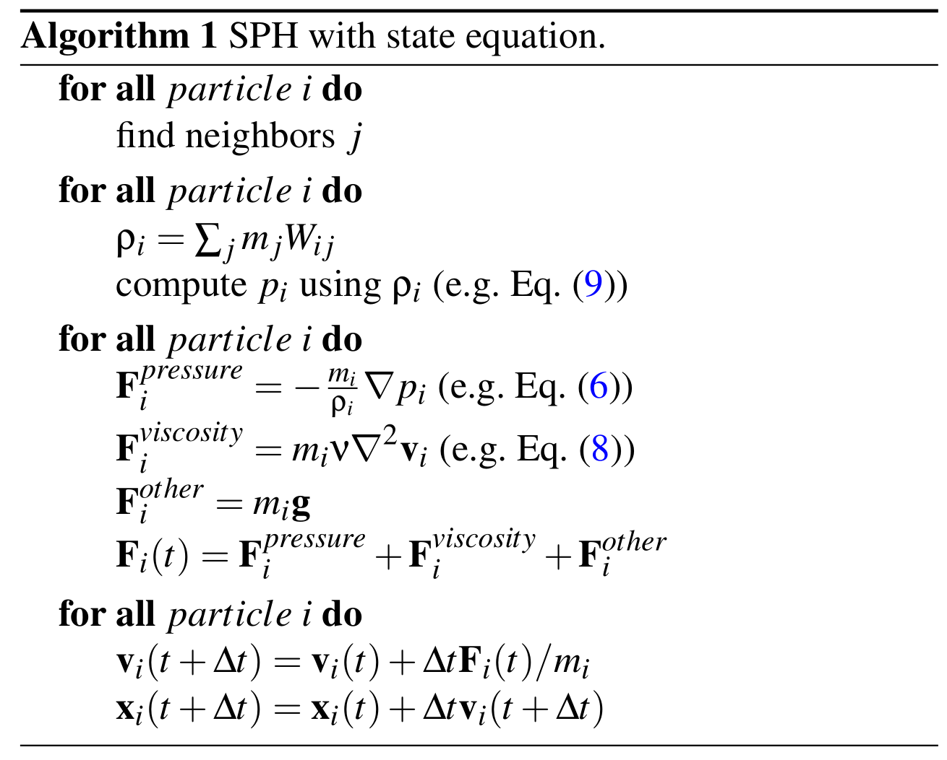
g
g
for all particle i do
apply incompressible constraint

