Slide 2
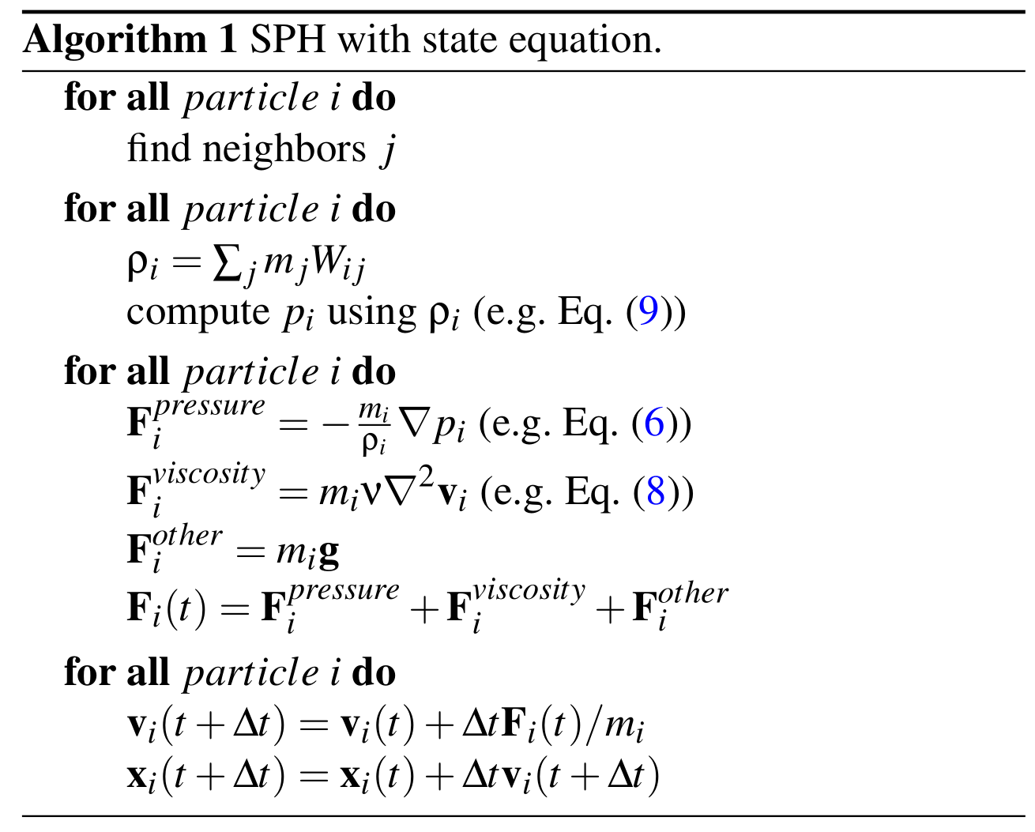
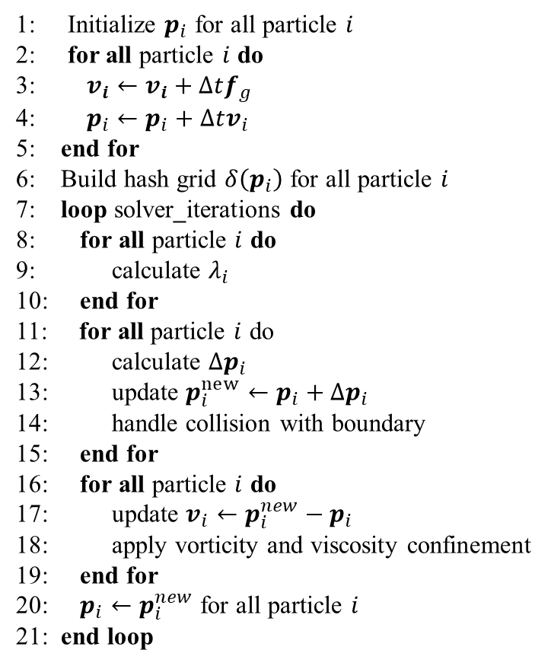
Algorithm 2 Simulation Flow
Kernels
Algorithm 2 Simulation Flow
1: Initialize $p_{i}$ for all particle $i$
2: for all particle $i$ do
3: $v_{i}←v_{i}+Δtf_{g}$
4: $p_{i}←p_{i}+Δtv_{i}$
5: end for
6: Build hash grid $δ\left(p_{i}\right)$ for all particle $i$
7: loop solver_iterations do
8: for all particle $i$ do
9: calculate $λ_{i}$
10: end for
11: for all particle $i$ do
12: calculate $Δp_{i}$
13: update $p_{i}^{new}←p_{i}+Δp_{i}$
14: handle collision with boundary
15: end for
16: for all particle $i$ do
17: update $v_{i}←p_{i}^{new}−p_{i}$
18: apply vorticity and viscosity confinement
19: end for
20: $p_{i}←p_{i}^{new}$ for all particle $i$
21: end loop
advectKernel
getGridId
sortByGridId
computeGridRange
computeLambda
computePos
computeLambda
computePos
updateVelocity
computeXSPH

Slide 3
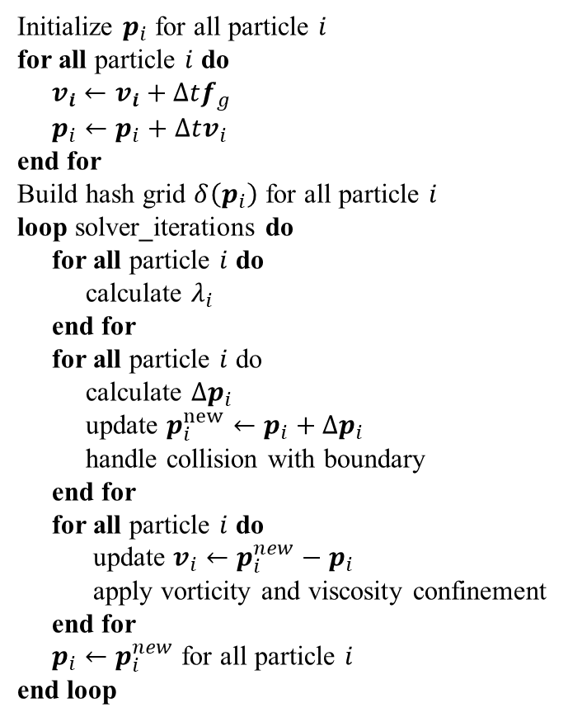
Algorithm 2 Simulation Flow in kernels
Kernels
Algorithm 2 Simulation Flow
Initialize $p_{i}$ for all particle $i$
for all particle $i$ do
$v_{i}←v_{i}+Δtf_{g}$
$p_{i}←p_{i}+Δtv_{i}$
end for
Build hash grid $δ\left(p_{i}\right)$ for all particle $i$
loop solver_iterations do
for all particle $i$ do
calculate $λ_{i}$
end for
for all particle $i$ do
calculate $Δp_{i}$
update $p_{i}^{new}←p_{i}+Δp_{i}$
handle collision with boundary
end for
for all particle $i$ do
update $v_{i}←p_{i}^{new}−p_{i}$
apply vorticity and viscosity confinement
end for
$p_{i}←p_{i}^{new}$ for all particle $i$
end loop
advectKernel
getGridId
sortByGridId
computeGridRange
computeLambda
computePos
updateVelocity
computeXSPH

Slide 5
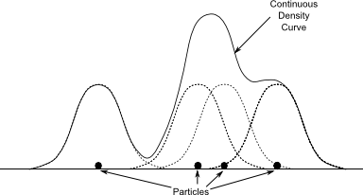

Property $A$
e.g. $ρ, \left|v\right|, p$
Particles

Slide 6
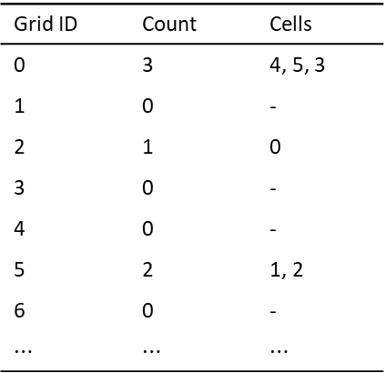

$$h$$
0
0 | 1 | 2 | 3
4 | 5 | 6 | 7
8 | 9 | 10 | 11
12 | 13 | 14 | 15
Grid ID | Count | Cells
0 | 3 | 4, 5, 3
1 | 0 | -
2 | 1 | 0
3 | 0 | -
4 | 0 | -
5 | 2 | 1, 2
6 | 0 | -
$⋯$ | $⋯$ | $⋯$
4
5
3
1
2

Slide 7
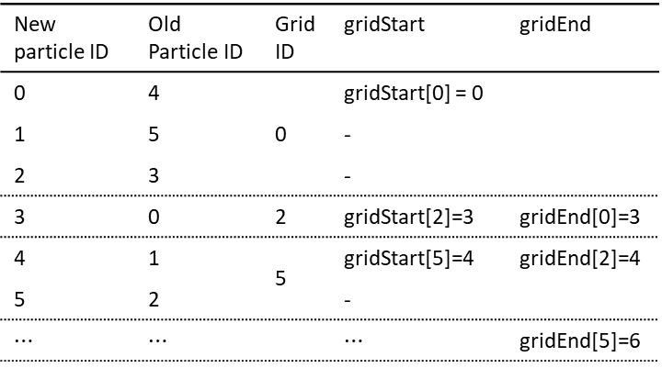
$$h$$
0
0 | 1 | 2 | 3
4 | 5 | 6 | 7
8 | 9 | 10 | 11
12 | 13 | 14 | 15
New particle ID | Old Particle ID | Grid ID | gridStart | gridEnd
0 | 4 | 0 | gridStart[0] = 0
1 | 5 |  | -
2 | 3 |  | -
3 | 0 | 2 | gridStart[2]=3 | gridEnd[0]=3
4 | 1 | 5 | gridStart[5]=4 | gridEnd[2]=4
5 | 2 |  | -
$⋯$ | $⋯$ |  | $⋯$ | gridEnd[5]=6
4
5
3
1
2

Slide 8

Vertex Buffer
Texture
Shader
Sky cubemap
d_sky
Particle $p_{i}$
Depth texture
d_depth_a
Thickness texture
d_thick
Surface Shader
Smoothed Depth
d_depth_b
Restored normal
d_normal
Final Image

Slide 9
















Eye space
NDC space
Texture coordinate
$$y$$
$$y$$
$$y$$
$$t$$
$$1$$
$$1$$
$$x$$
$$⇒$$
$$x$$
$$⇒$$
$$l$$
$$r$$
$$−1$$
$$1$$
$$x$$
$$b$$
$$−1$$
$$1$$

Slide 10




0
$$x$$
$$(x,y,z)$$
$$ρ$$
$$y$$

