Slide 1

Single Sleeping Barber Problem
ARSENE I. MUHIRE

Slide 2
Problem Description
The shop has a barber, a barber chair, and a waiting room with several chairs.
When a barber finishes cutting a customer's hair, the barber fetches another customer from the waiting room
if there is a customer, or stands by the barber chair and daydreams if the waiting room is empty.
A customer who needs a haircut enters the waiting room.
If the waiting room is full, the customer comes back later.
If the barber is busy but there is a waiting room chair available, the customer takes a seat.
If the waiting room is empty and the barber is daydreaming, the customer sits in the barber chair and wakes the barber up.

Slide 3
Definition
In computer science, the sleeping barber problem is a classic inter-process communication and synchronization problem between multiple operating system processes. The problem is analogous to that of keeping a barber working when there are customers, resting when there are none, and doing so in an orderly manner.
The Sleeping Barber Problem is often attributed to Edsger Dijkstra (1965), one of the pioneers in computer science.

Slide 4
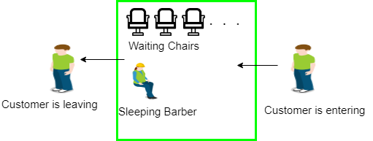
Visual Representation

Slide 5
Semaphores in os
Semaphore is a simply a variable. This variable is used to solve critical section problem and to achieve process synchronization in the multi processing environment.
The two most common kinds of semaphores are counting semaphores and binary semaphores. Counting semaphore can take non-negative integer values and Binary semaphore can take the value 0 & 1. only.
A Critical Section is a code segment that accesses shared variables and has to be executed as an atomic action. It means that in a group of cooperating processes, at a given point of time, only one process must be executing itscritical section.

Slide 6
Solution
The solution to this problem includes three semaphores.
First is for the customer which counts the number of customers present in the waiting room (customer in the barber chair is not included because he is not waiting).
Second, the barber 0 or 1 is used to tell whether the barber is idle or is working.
The third mutex is used to provide the mutual exclusion which is required for the process to execute. In the solution, the customer has the record of the number of customers waiting in the waiting room if the number of customers is equal to the number of chairs in the waiting room then the upcoming customer leaves the barbershop.

Slide 7
Solution
When the barber shows up in the morning, he executes the procedure barber, causing him to block on the semaphore customers because it is initially 0. Then the barber goes to sleep until the first customer comes up.

Slide 8
Solution
When a customer arrives, he executes customer procedure the customer acquires the mutex for entering the critical region, if another customer enters thereafter, the second one will not be able to anything until the first one has released the mutex. The customer then checks the chairs in the waiting room if waiting customers are less then the number of chairs then he sits otherwise he leaves and releases the mutex.

Slide 9
Solution
If the chair is available then customer sits in the waiting room and increments the variable waiting value and also increases the customer’s semaphore this wakes up the barber if he is sleeping.
At this point, customer and barber are both awake and the barber is ready to give that person a haircut. When the haircut is over, the customer exits the procedure and if there are no customers in waiting room barber sleeps.

Slide 10
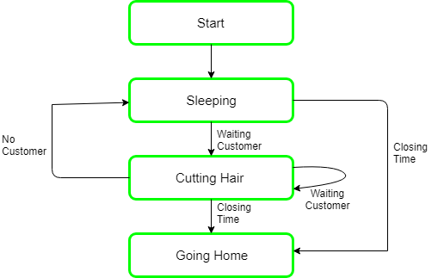
Flow CHART

Slide 11

Thank You
For Your Attention

