Slide 1
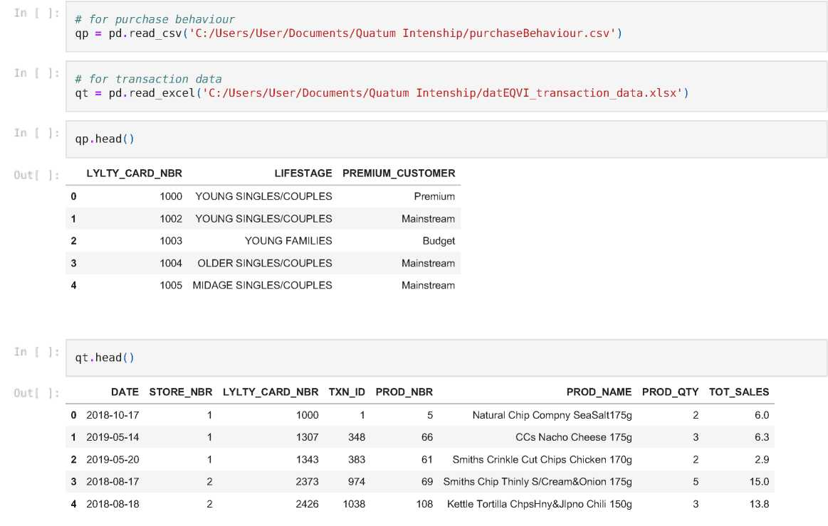

Overview of this project
This project involve careful analysis of the two dataset which are customer data and transaction data
In this project we will be performing data cleaning, wrangling, and data exploration as well as performing statiscal among the variables
Importing the dataset
Performing Exploring Data Analysis
qt. describe(include='all')
C:\Users\User\AppData\Local\Temp/ipykernel_5028/1830134173.py:1: FutureWarning: Treating datetime data as categor ical rather than numeric in '.describe' is deprecated and will be removed in a future version of pandas. Specify 'datetime_is_numeric=True' to silence this warning and adopt the future behavior now. qt.desc ribe(include=¹ all¹)
 | DATE | STORE_NBR | LYLTY_CARD_NBR | TXN_ID | PROD_NBR | PROD_NAME | PROD_QTY | TOT_SALES
count | 264836 | 264836.00000 | 2.648360e+05 | 2.648360e+05 | 264836.000000 | 264836 | 264836.000000 | 264836.000000
unique | 364 | NaN | NaN | NaN | NaN | 114 | NaN | NaN
top | 2018-12-24 00:00:00 | NaN | NaN | NaN | NaN | Kettle Mozzarella Basil & Pesto 175g | NaN | NaN
freq | 939 | NaN | NaN | NaN | NaN | 3304 | NaN | NaN
first | 2018-07-01 00:00:00 | NaN | NaN | NaN | NaN | NaN | NaN | NaN
last | 2019-06-30 00:00:00 | NaN | NaN | NaN | NaN | NaN | NaN | NaN
mean | NaN | 135.08011 | 1.355495e+05 | 1.351583e+05 | 56.583157 | NaN | 1.907309 | 7.304200
std | NaN | 76.78418 | 8.057998e+04 | 7.813303e+04 | 32.826638 | NaN | 0.643654 | 3.083226
min | NaN | 1.00000 | 1.000000e+03 | 1.000000e+00 | 1.000000 | NaN | 1.000000 | 1.500000

Slide 2
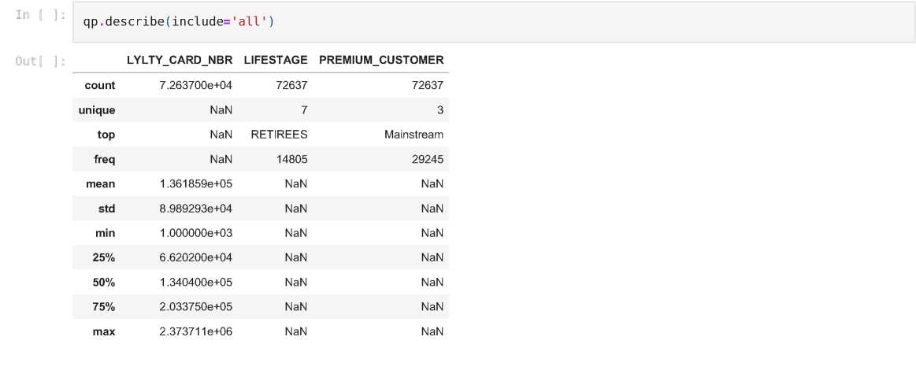

25% NaN 70.00000 7.002100e+04 6.760150e+04 28.000000 NaN 2.000000 5.400000
50% | NaN | 130.00000 | 1.303575e+05 | 1.351375e+05 | 56.000000
75% | NaN | 203.00000 | 2.030942e+05 | 2.027012e+05 | 85.000000
max | NaN | 272.00000 | 2.373711e+06 | 2.415841e+06 | 114.000000
NaN 2.000000 7.400000
NaN 2.000000 9.200000
NaN 200.000000 650.000000
Checkikng for null variables in the dataset
in
# For the transaction dataset qt.isnull().sum()
Out
]
DATE 0 STORE_NBR 0 LYLTY_CARD_NBR 0 TXN_ID 0 PROD_NBR 0 PROD_NAME 0 PROD_QTY 0 TOT_SALES 0 dtype: int64
# For the Purchacse behaviour dataset qp.isnull().sum()
LYLTY CARD NBR 0
LIFESTAGE 0
PREMIUMCUSTOMER 0
dtype: int64
Result from the checking of the null(NaN) in the dataset
We found out that there is no null data in all the columns
Checking the datatypes and converting to necessary data format
qt
DATE STORE_NBR LYLTY_CARD_NBR TXNJD PROD_NBR PROD_NAME PROD_QTY TOT_SALES
0 2018-10-17 1 1000 1 5 Natural Chip Compny SeaSalt175g 2 6.0
 | 1 2019-05-14 1 1307 348 66 | CCs Nacho Cheese 175g | 3 6.3

Slide 3


2 2019-05-20 1 1343 383 61 Smiths Crinkle Cut Chips Chicken 170g 2 2.9
3 2018-08-17 2 2373 974 69 Smiths Chip Thinly S/Cream&Onion 175g 5 15.0
4 2018-08-18 2 2426 1038 108 Kettle Tortilla ChpsHny&JIpno Chili 150g 3 13.8
264831 2019-03-09 272 272319 270088 89 Kettle Sweet Chilli And Sour Cream 175g 2 10.8
264832 2018-08-13 272 272358 270154 74 Tostitos Splash Of Lime 175g 1 4.4
264833 2018-11-06 272 272379 270187 51 Doritos Mexicana 170g 2 8.8
264834 2018-12-27 272 272379 270188 42 Doritos Corn Chip Mexican Jalapeno 150g 2 7.8
264835 2018-09-22 272 272380 270189 74 Tostitos Splash Of Lime 175g 2 8.8
264836 rows x 8 columns
For QT dataset
qt.info()
<class 'pandas.core.frame.DataFrame'> RangeIndex: 264836 entries, 0 to 264835 Data columns (total 8 columns):
# | Column | Non-Null Count |  | Dtype
0 | DATE | 264836 | non-null | datetime64[ns]
1 | STORE NBR | 264836 | non-null | int64
2 | LYLTY CARD NBR | 264836 | non-null | int64
3 | TXN ID | 264836 | non-null | int64
4 | PROD NBR | 264836 | non-null | int64
5 | PROD NAME | 264836 | non-null | object
6 | PROD QTY | 264836 | non-null | int64
7 | TOT SALES | 264836 | non-null | float64
dtypes: datetime64[ns](1), float64(1), int64(5), object(1) memory usage: 16.2+ MB
Result
We found out that out that there are 8 columns in this dataset and 264836 rows in the dataset We only need to convert Date column as (datetype)
# Converting the DATE column
#qt['DATE'] = pd.to_datetime(qt['DATE'],format='%D%m%y') #qt['DATE'] = pd.to_datetime(qt['DATE']).dt.date
# Let confirm whether the DATE as been converted qt.info()
<class 'pandas.core.frame.DataFrame'>
RangeIndex: 264836 entries, 0 to 264835 Data columns (total 8 columns):
# | Column | Non-Null Count |  | Dtype
0 | DATE | 264836 | non-null | datetime64[ns]
1 | STORE NBR | 264836 | non-null | int64
2 | LYLTY CARD NBR | 264836 | non-null | int64
3 | TXN ID | 264836 | non-null | int64
4 | PROD NBR | 264836 | non-null | int64
5 | PROD NAME | 264836 | non-null | object
6 | PROD QTY | 264836 | non-null | int64
7 | TOT SALES | 264836 | non-null | float64
dtypes: datetime64[ns](1), float64(1), int64(5), object(1) memory usage: 16.2+ MB
For Qp dataset
In
Out
1 : ] !
qp
 | LYLTY_CARD_NBR | LIFESTAGE | PREMIUM_CUSTOMER
0 | 1000 | YOUNG SINGLES/COUPLES | Premium
1 | 1002 | YOUNG SINGLES/COUPLES | Mainstream
2 | 1003 | YOUNG FAMILIES | Budget

Slide 4


3
1004 OLDER SINGLES/COUPLES
Mainstream
4 | 1005 | MIDAGE SINGLES/COUPLES | Mainstream
72632 | 2370651 | MIDAGE SINGLES/COUPLES | Mainstream
72633 | 2370701 | YOUNG FAMILIES | Mainstream
72634 | 2370751 | YOUNG FAMILIES | Premium
72635 | 2370961 | OLDER FAMILIES | Budget
72636 2373711 YOUNG SINGLES/COUPLES Mainstream
72637 rows x 3 columns
# checking the necessary information qp.info()
<class 'pandas.core.frame.DataFrame'> RangeIndex: 72637 entries, 0 to 72636 Data columns (total 3 columns):
# | Column | Non-Null Count |  | Dtype
0 | LYLTY CARD NBR | 72637 | non-null | int64
1 | LIFESTAGE | 72637 | non-null | object
2 | PREMIUM CUSTOMER | 72637 | non-null | object
dtypes: int64(1), object(2) memory usage: 1.7+ MB
This dataset is good
^{lr} ■ |: qt
DATE STORE_NBR LYLTY_CARD_NBR TXN_ID PROD_NBR PROD_NAME PROD_QTY TOT_SALES
0 | 2018-10-17 | 1 | 1000 | 1 | 5 | Natural Chip Compny SeaSalt175g | 2 | 6.0
1 | 2019-05-14 | 1 | 1307 | 348 | 66 | CCs Nacho Cheese 175g | 3 | 6.3
2 | 2019-05-20 | 1 | 1343 | 383 | 61 | Smiths Crinkle Cut Chips Chicken 170g | 2 | 2.9
3 | 2018-08-17 | 2 | 2373 | 974 | 69 | Smiths Chip Thinly S/Cream&Onion 175g | 5 | 15.0
4 | 2018-08-18 | 2 | 2426 | 1038 | 108 | Kettle Tortilla ChpsHny&Jlpno Chili 150g | 3 | 13.8
264831 | 2019-03-09 | 272 | 272319 | 270088 | 89 | Kettle Sweet Chilli And Sour Cream 175g | 2 | 10.8
264832 | 2018-08-13 | 272 | 272358 | 270154 | 74 | Tostitos Splash Of Lime 175g | 1 | 4.4
264833 | 2018-11-06 | 272 | 272379 | 270187 | 51 | Doritos Mexicana 170g | 2 | 8.8
264834 | 2018-12-27 | 272 | 272379 | 270188 | 42 | Doritos Corn Chip Mexican Jalapeno 150g | 2 | 7.8
264835 | 2018-09-22 | 272 | 272380 | 270189 | 74 | Tostitos Splash Of Lime 175g | 2 | 8.8
264836 rows x 8 columns
Removing Unwanted Character qt[Prod] columns
qt['PROD_NAME'].str.replace(r'\'W','')
C:\Users\User\AppData\Local\Temp/ipykernel_5028/1218134934.py:1: FutureWarning: The default value of regex will c hange from True to False in a future version. qt['PROD_NAME'].str.replace(r'\'W','')
Dutf ]
0
1
2
3
4
Natural Chip Compny SeaSalt175g
CCs Nacho Cheese 175g Smiths Crinkle Cut Chips Chicken 170g Smiths Chip Thinly S/Cream&Onion 175g Kettle Tortilla ChpsHny&Jlpno Chili 150g
264831 Kettle Sweet Chilli And Sour Cream 175g
264832 Tostitos Splash Of Lime 175g
264833 Doritos Mexicana 170g
264834 Doritos Corn Chip Mexican Jalapeno 150g
264835 Tostitos Splash Of Lime 175g Name: PROD_NAME, Length: 264836, dtype: object

Slide 5
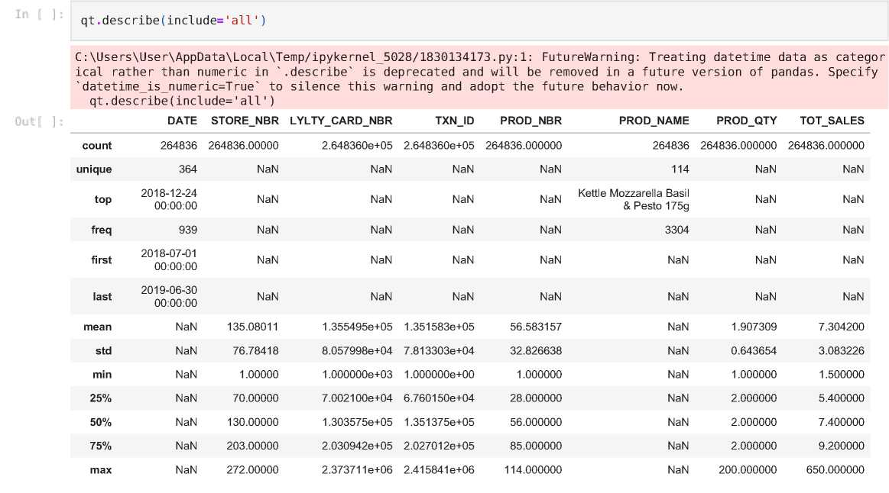


Let use descriptive statistic to found the common words in each columns
Finding the maximum character in qt dataset
qt.max()
Filter the dataset based the PROD_NAME column in descendign order
qt.sort_values(by='PROD_NAME',ascending=False)
DATE STORE_NBR LYLTY_CARD_NBR TXNJD PROD_NBR PROD_NAME PROD_QTY TOT_SALES
73952 | 2018-12-22 | 102 | 102179 | 102608 | 35 | Woolworths Mild Salsa 300g | 2 | 3.0
260719 | 2018-07-28 | 89 | 89511 | 88678 | 35 | Woolworths Mild Salsa 300g | 2 | 3.0
155482 | 2018-11-08 | 62 | 62011 | 57829 | 35 | Woolworths Mild Salsa 300g | 2 | 3.0
155483 | 2018-11-14 | 62 | 62011 | 57830 | 35 | Woolworths Mild Salsa 300g | 2 | 3.0
155524 | 2019-02-24 | 62 | 62062 | 58155 | 35 | Woolworths Mild Salsa 300g | 2 | 3.0
221469 | 2019-05-12 | 104 | 104070 | 104150 | 94 | Burger Rings 220g | 2 | 4.6
235437 | 2019-06-29 | 205 | 205018 | 204075 | 94 | Burger Rings 220g | 1 | 2.3
80539 | 2018-11-15 | 271 | 271121 | 268911 | 94 | Burger Rings 220g | 2 | 4.6
1959 | 2018-09-21 | 104 | 104187 | 104863 | 94 | Burger Rings 220g | 2 | 4.6
173583 | 2019-04-23 | 28 | 28106 | 25157 | 94 | Burger Rings 220g | 2 | 4.6
264836 rows x 8 columns
Removing Salsa Products from dataset
There are salsa products in the dataset but we are only interested in the chips category, so let's remove them

Slide 6

qt = qt[qt['PROD_NAME'].str.contains('Salsa')==False] qt
DATE STORE_NBR LYLTY_CARD_NBR TXNJD PROD_NBR PROD_NAME PROD_QTY TOT_SALES
0 | 2018-10-17 | 1 | 1000 | 1 | 5 | Natural Chip Compny SeaSalt175g | 2 | 6.0
1 | 2019-05-14 | 1 | 1307 | 348 | 66 | CCs Nacho Cheese 175g | 3 | 6.3
2 | 2019-05-20 | 1 | 1343 | 383 | 61 | Smiths Crinkle Cut Chips Chicken 170g | 2 | 2.9
3 | 2018-08-17 | 2 | 2373 | 974 | 69 | Smiths Chip Thinly S/Cream&Onion 175g | 5 | 15.0
4 | 2018-08-18 | 2 | 2426 | 1038 | 108 | Kettle Tortilla ChpsHny&JIpno Chili 150g | 3 | 13.8
264831 | 2019-03-09 | 272 | 272319 | 270088 | 89 | Kettle Sweet Chilli And Sour Cream 175g | 2 | 10.8
264832 | 2018-08-13 | 272 | 272358 | 270154 | 74 | Tostitos Splash Of Lime 175g | 1 | 4.4
264833 | 2018-11-06 | 272 | 272379 | 270187 | 51 | Doritos Mexicana 170g | 2 | 8.8
264834 | 2018-12-27 | 272 | 272379 | 270188 | 42 | Doritos Corn Chip Mexican Jalapeno 150g | 2 | 7.8
264835 | 2018-09-22 | 272 | 272380 | 270189 | 74 | Tostitos Splash Of Lime 175g | 2 | 8.8
246742 rows x 8 columns
Let's Run Descriptive Statistic
qt .describe()
STORE_NBR LYLTY_CARD_NBR TXN_ID PROD_NBR PROD_QTY TOT_SALES
count | 246742.000000 | 2.467420e+05 | 2.467420e+05 | 246742.000000 | 246742.000000 | 246742.000000
mean | 135.051098 | 1.355310e+05 | 1.351311e+05 | 56.351789 | 1.908062 | 7.321322
std | 76.787096 | 8.071528e+04 | 7.814772e+04 | 33.695428 | 0.659831 | 3.077828
min | 1.000000 | 1.000000e+03 | 1.000000e+00 | 1.000000 | 1.000000 | 1.700000
25% | 70.000000 | 7.001500e+04 | 6.756925e+04 | 26.000000 | 2.000000 | 5.800000
50% | 130.000000 | 1.303670e+05 | 1.351830e+05 | 53.000000 | 2.000000 | 7.400000
75% | 203.000000 | 2.030840e+05 | 2.026538e+05 | 87.000000 | 2.000000 | 8.800000
max | 272.000000 | 2.373711e+06 | 2.415841e+06 | 114.000000 | 200.000000 | 650.000000
Result of the descriptive Statistic
We can see customer purchasing 200 qty of chips in PROD_QTY column. Let check this customer out
In
Out
qt.sort_values(by='PROD_QTY',ascending=False)
 | DATE | STORE_NBR | LYLTY_CARD_NBR | TXN_ID | PROD_NBR | PROD_NAME | PROD_QTY | TOT_SALES
69763 | 2019-05-20 | 226 | 226000 | 226210 | 4 | Dorito Corn Chp Supreme 380g | 200 | 650.0
69762 | 2018-08-19 | 226 | 226000 | 226201 | 4 | Dorito Corn Chp Supreme 380g | 200 | 650.0
135225 | 2019-05-15 | 46 | 46296 | 42138 | 81 | Pringles Original Crisps 134g | 5 | 18.5
69523 | 2019-05-15 | 71 | 71142 | 69852 | 96 | WW Original Stacked Chips 160g | 5 | 9.5
69502 | 2018-08-18 | 55 | 55144 | 49328 | 44 | Thins Chips Light& Tangy 175g | 5 | 16.5
150883 | 2018-08-14 | 184 | 184055 | 186586 | 107 | Smiths Crinkle Cut French OnionDip 150g | 1 | 2.6
150885 | 2019-05-17 | 184 | 184152 | 187227 | 28 | Thins Potato Chips Hot & Spicy 175g | 1 | 3.3
29682 | 2018-12-04 | 174 | 174004 | 174974 | 114 | Kettle Sensations Siracha Lime 150g | 1 | 4.6
150887 | 2019-05-17 | 184 | 184205 | 187584 | 13 | Red Rock Deli Thai Chilli&Lime 150g | 1 | 2.7
32447 | 2018-08-15 | 114 | 114006 | 116914 | 111 | Smiths Chip Thinly Cut Original 175g | 1 | 3.0

Slide 7
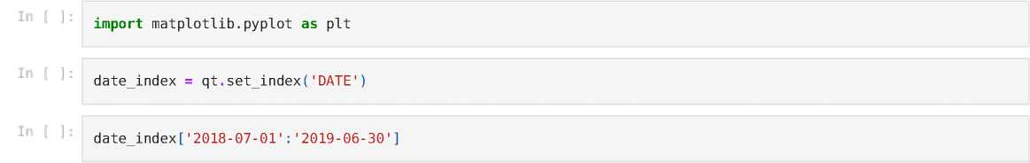
246742 rows x 8 columns
Let drop this customer out
in
qt = qt.d rop(qt["PROD_QTY"].loc[qt["PROD_QTY"]==200].index) qt.max()
Out
DATE
STORE NBR LYLTY CARD NBR TXNID PROD NBR PRODNAME PROD QTY TOTSALES dtype: object
2019-06-30 00:00:00 272 2373711 2415841 114
Woolworths Cheese Rings 190g
5
29.5
Let count the number of transaction by date
in
qt.DATE.desc ribe(include='all')
C:\Users\User\AppData\Local\Temp/ipykernel_5028/2970345509.py:1: FutureWarning: Treating datetime data as categor ical rather than numeric in '.describe' is deprecated and will be removed in a future version of pandas. Specify 'datetime_is_numeric=True' to silence this warning and adopt the future behavior now. qt.DATE.describe(include='all')
Out
count
unique
top
f req
first
last
Name:
246740
364
2018-12-24 00:00:00 865
2018- 07-01 00:00:00
2019- 06-30 00:00:00 DATE, dtype: object
Creating a column of dates that includes every day from 1 Jul 2018 to 30 Jun 2019,
qt
DATE STORE_NBR LYLTY_CARD_NBR TXNJD PROD_NBR PROD_NAME PROD_QTY TOT_SALES
0 | 2018-10-17 | 1 | 1000 | 1 | 5 | Natural Chip Compny SeaSalt175g | 2 | 6.0
1 | 2019-05-14 | 1 | 1307 | 348 | 66 | CCs Nacho Cheese 175g | 3 | 6.3
2 | 2019-05-20 | 1 | 1343 | 383 | 61 | Smiths Crinkle Cut Chips Chicken 170g | 2 | 2.9
3 | 2018-08-17 | 2 | 2373 | 974 | 69 | Smiths Chip Thinly S/Cream&Onion 175g | 5 | 15.0
4 | 2018-08-18 | 2 | 2426 | 1038 | 108 | Kettle Tortilla ChpsHny&JIpno Chili 150g | 3 | 13.8
264831 | 2019-03-09 | 272 | 272319 | 270088 | 89 | Kettle Sweet Chilli And Sour Cream 175g | 2 | 10.8
264832 | 2018-08-13 | 272 | 272358 | 270154 | 74 | Tostitos Splash Of Lime 175g | 1 | 4.4
264833 | 2018-11-06 | 272 | 272379 | 270187 | 51 | Doritos Mexicana 170g | 2 | 8.8
264834 | 2018-12-27 | 272 | 272379 | 270188 | 42 | Doritos Corn Chip Mexican Jalapeno 150g | 2 | 7.8
264835 | 2018-09-22 | 272 | 272380 | 270189 | 74 | Tostitos Splash Of Lime 175g | 2 | 8.8
246740 rows x 8 columns
Checking insight about '2018-07-01':'2019-06-30'

Slide 8

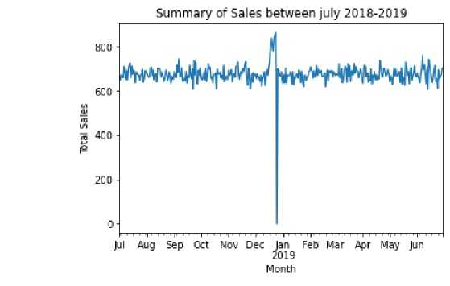
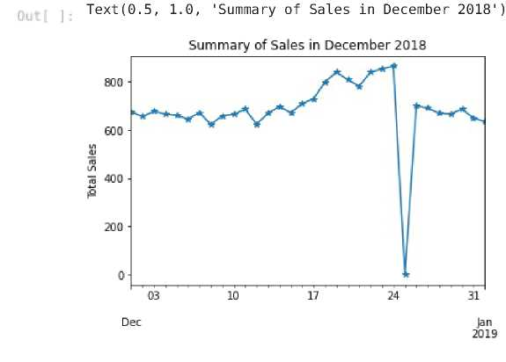
STORE_NBR LYLTY_CARD_NBR TXN_ID PROD_NBR PROD_NAME PROD_QTY TOT_SALES
DATE
2018-10-17 | 1 | 1000 | 1 | 5 | Natural Chip Compny SeaSalt175g | 2 | 6.0
2019-05-14 | 1 | 1307 | 348 | 66 | CCs Nacho Cheese 175g | 3 | 6.3
2019-05-20 | 1 | 1343 | 383 | 61 | Smiths Crinkle Cut Chips Chicken 170g | 2 | 2.9
2018-08-17 | 2 | 2373 | 974 | 69 | Smiths Chip Thinly S/Cream&Onion 175g | 5 | 15.0
2018-08-18 | 2 | 2426 | 1038 | 108 | Kettle Tortilla ChpsHny&JIpno Chili 150g | 3 | 13.8
2019-03-09 | 272 | 272319 | 270088 | 89 | Kettle Sweet Chilli And Sour Cream 175g | 2 | 10.8
2018-08-13 | 272 | 272358 | 270154 | 74 | Tostitos Splash Of Lime 175g | 1 | 4.4
2018-11-06 | 272 | 272379 | 270187 | 51 | Doritos Mexicana 170g | 2 | 8.8
2018-12-27 | 272 | 272379 | 270188 | 42 | Doritos Corn Chip Mexican Jalapeno 150g | 2 | 7.8
2018-09-22 | 272 | 272380 | 270189 | 74 | Tostitos Splash Of Lime 175g | 2 | 8.8
246740 rows x 7 columns
date_index['TOT_SALES'].resample('D').count().plot(kind='line')
pit.xlabel('Month')
plt.ylabel('Total Sales')
pit.title('Summary of Sales between july 2018-2019')
Text(0.5, 1.0, 'Summary of Sales between july 2018-2019')
We can see a lot of activity going on in Dec ending. Let check it out
id = date_index['2018-12-01':'2019-01-01']
# Let plot the sales for december
id['TOT_SALES'].resample('D').count().plot(kind='line',marker='*')
plt.xlabel('Days')
plt.ylabel('Total Sales')
plt.title('Summary of Sales in December 2018')

Slide 9


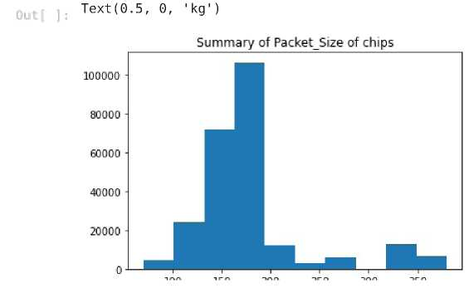
We can see that the increase in sales occurs in the lead-up to Christmas and that
there are zero sales on Christmas day itself. This is due to shops being closed on Christmas day.
Let Explore PROD_NAME column
Let check the types of chips in column and their counts
In
Out
qt.PROD_NAME.value_counts()
Kettle Mozzarella Basil & Pesto 175g 3304 Kettle Tortilla ChpsHny&Jlpno Chili 150g 3296 Cobs Popd Swt/Chlli &Sr/Cream Chips 110g 3269 Tyrrells Crisps Ched & Chives 165g 3268 Cobs Popd Sea Salt Chips 110g 3265
Sunbites Whlegrn Crisps Frch/Onin 90g 1432 RRD Pc Sea Salt 165g 1431 NCC Sour Cream & Garden Chives 175g 1419 French Fries Potato Chips 175g 1418 WW Crinkle Cut Original 175g 1410
Name: PROD_NAME, Length: 105, dtype: int64
Let create a variable for number of variable in PROD_NAME as packet size
qt['Pack Size | '] = qt['PROD_NAME'; | .astype('str').str.ext ractall(
'(\d+) ') . | unstack().fillna (''' | .sum(axis=1).astype(int)
# Let explore the Packet_Size dataset qt['Pack_Size'].desc ribe(include='all')
count 246740.000000 mean 175.583521
std 59.432118
min 70.000000
25% 150.000000
50% 170.000000
75% 175.000000
max 380.000000
Name: Pack_Size, dtype: float64
Exploration of Packet_Size dataset
We can see that the min packet size is 70kg and the maximum is 380kg
# Let plot histogram to view the data
plt.hist(x=qt['Pack_Size'].values)
plt.title('Summary of Packet_Size of chips')
plt.xlabel('kg')

Slide 10
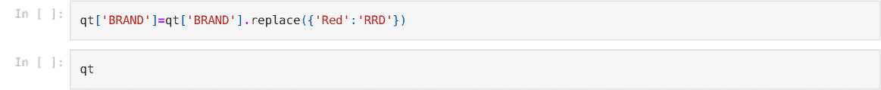
Let create a column for brand of chips by using their first string
in
qt['BRAND'] | = qt['PROD_NAME' | ] .str.split (' | '). str[0]
# Let print | out there value | value counts
qt['BRAND'] | ■value counts()
Out
Kettle | 41288
Smiths | 27390
Pringles | 25102
Doritos | 22041
Thins | 14075
RRD | 11894
Infuzions | 11057
WW | 10320
Cobs | 9693
Tostitos | 9471
Twisties | 9454
Tyrrells | 6442
Grain | 6272
Natural | 6050
Cheezels | 4603
CCs | 4551
Red | 4427
Dorito | 3183
Infzns | 3144
Smith | 2963
Cheetos | 2927
Snbts | 1576
Burger | 1564
Woolworths | 1516
GrnWves | 1468
Sunbites | 1432
NCC | 1419
F rench | 1418
Name: BRAND, | dtype: int64
Note: Some of the brand names look like they are of the same brands - such as RED and RRD, which are both Red Rock Deli chips. Let's combine these together.
DATE STORE_NBR LYLTY_CARD_NBR TXNJD PROD_NBR PROD_NAME PROD_QTY TOT_SALES Pack_Size BRAND
0 | 2018¬ 10-17 | 1 | 1000 | 1 | 5 | Natural Chip Compny SeaSalt175g | 2 | 6.0 | 175 | Natural
1 | 2019¬ 05-14 | 1 | 1307 | 348 | 66 | CCs Nacho Cheese 175g | 3 | 6.3 | 175 | CCs
2 | 2019¬ 05-20 | 1 | 1343 | 383 | 61 | Smiths Crinkle Cut Chips Chicken 170g | 2 | 2.9 | 170 | Smiths
3 | 2018¬ 08-17 | 2 | 2373 | 974 | 69 | Smiths Chip Thinly S/Cream&Onion 175g | 5 | 15.0 | 175 | Smiths
 | 2018¬ 08-18 |  |  |  |  | Kettle Tortilla
4 |  | 2 | 2426 | 1038 | 108 | ChpsHny&Jlpno Chili | 3 | 13.8 | 150 | Kettle
 |  |  |  |  |  | 150g
264831 | 2019¬ 03-09 | 272 | 272319 | 270088 | 89 | Kettle Sweet Chilli And Sour Cream 175g | 2 | 10.8 | 175 | Kettle
264832 | 2018¬ 08-13 | 272 | 272358 | 270154 | 74 | Tostitos Splash Of Lime 175g | 1 | 4.4 | 175 | Tostitos
264833 | 2018¬ 11-06 | 272 | 272379 | 270187 | 51 | Doritos Mexicana 170g | 2 | 8.8 | 170 | Doritos
264834 | 2018¬ 12-27 | 272 | 272379 | 270188 | 42 | Doritos Corn Chip Mexican Jalapeno | 2 | 7.8 | 150 | Doritos
 |  |  |  |  |  | 150g
264835 | O N> CD O | 272 | 272380 | 270189 | 74 | Tostitos Splash Of Lime 175g | 2 | 8.8 | 175 | Tostitos
246740 rows x 10 columns

Slide 11
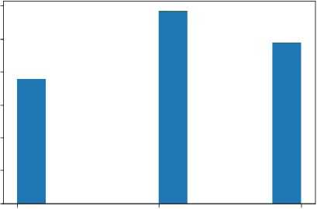
Let provide exploratory about qp dataset ( which contain Lifestage,Premium_Customer)
In f ]
qp
LYLTY_CARD_NBR LIFESTAGE PREMIUM.
0 1000 YOUNG SINGLES/COUPLES
1 1002 YOUNG SINGLES/COUPLES
2 1003 YOUNG FAMILIES
3 1004 OLDER SINGLES/COUPLES
4 1005 MIDAGE SINGLES/COUPLES
CUSTOMER
Premium
Mainstream
Budget
Mainstream
Mainstream
Mainstream
Mainstream
Premium
Budget
Mainstream
72632 | 2370651
72633 | 2370701
72634 | 2370751
72635 | 2370961
72636 | 2373711
MIDAGE SINGLES/COUPLES YOUNG FAMILIES YOUNG FAMILIES OLDER FAMILIES YOUNG SINGLES/COUPLES
72637 rows x 3 columns
' # Doing some descriptive statistics
qp. describe(include='all')
LYLTY_CARD_NBR LIFESTAGE PREMIUM_CUSTOMER
count | 7.263700e+04 | 72637 | 72637
unique | NaN | 7 | 3
top | NaN | RETIREES | Mainstream
freq | NaN | 14805 | 29245
mean | 1.361859e+05 | NaN | NaN
std | 8.989293e+04 | NaN | NaN
min | 1.000000e+03 | NaN | NaN
25% | 6.620200e+04 | NaN | NaN
50% | 1.340400e+05 | NaN | NaN
75% | 2.033750e+05 | NaN | NaN
max 2.373711e+06 NaN NaN
Result: In this dataset we have 72637 rows and 3 columns Exploring the Premium of customer with histogram
plt.hist(qp['PREMIUM_CUSTOMER']) f = plt.figure(figsize=(4000,4000))
30000
25000
20000
15000
10000
5000
0
Premium Mainstream Budget
cFinnrp Q17P with 0 fiyp<;>

Slide 12


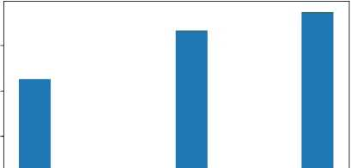
We can see that the Mainstream is the most customers we have in our store
Lifestage of the customer
In
Out
qp['LIFESTAGE'].value_ | counts()
RETIREES | 14805
OLDER SINGLES/COUPLES | 14609
YOUNG SINGLES/COUPLES | 14441
OLDER FAMILIES | 9780
YOUNG FAMILIES | 9178
MIDAGE SINGLES/COUPLES | 7275
NEW FAMILIES | 2549
Name: LIFESTAGE, dtype: | int64
we can see that Retired people are the most in our store
Merging qp and qt dataframe together by LYLTY_CARD_NBR
customer_data = pd.merge(qt,qp,on='LYLTY_CARD_NBR')
customer_data.head()
 | DATE | STORE_NBR | LYLTY_CARD_NBR | TXN_ID | PROD_NBR | PROD_NAME | PROD_QTY | TOT_SALES | Pack_Size | BRAND | LIFESTAG
0 | 2018¬ 10-17 | 1 | 1000 | 1 | 5 | Natural Chip Compny SeaSalt175g | 2 | 6.0 | 175 | Natural | YOUN SINGLES/COUPLE
1 | 2019¬ 05-14 | 1 | 1307 | 348 | 66 | CCs Nacho Cheese 175g | 3 | 6.3 | 175 | CCs | MIDAG SINGLES/COUPLE
2 | 2018¬ 11-10 | 1 | 1307 | 346 | 96 | WW Original Stacked Chips 160g | 2 | 3.8 | 160 | WW | MIDAG SINGLES/COUPLE
3 | 2019¬ 03-09 | 1 | 1307 | 347 | 54 | CCs Original 175g | 1 | 2.1 | 175 | CCs | MIDAG SINGLES/COUPLE
 |  |  |  |  |  | Smiths
4 | 2019¬ 05-20 | 1 | 1343 | 383 | 61 | Crinkle Cut Chips | 2 | 2.9 | 170 | Smiths | MIDAG SINGLES/COUPLE
 |  |  |  |  |  | Chicken 170g
Save the customer data to csv
in
customer_data.to_csv('Customer_Data.csv')
Let Perform Exploraatory Analyses on our New Dataset
Exploring the Premium of customer with histogram Exploring the Premium of customer with histogram
pit.hist(custome r_data['PREMIUM_CUSTOMER']) f = pit.figure(figsize=(4000,4000))
80000 60000 40000

Slide 13
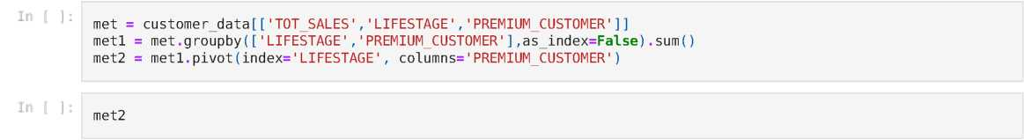
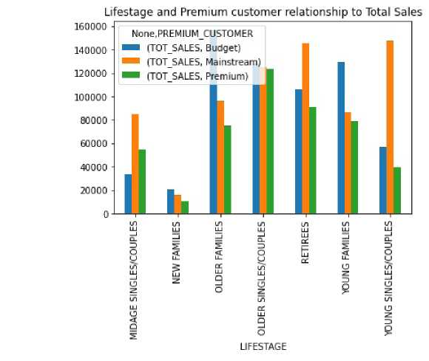
<Figure size 288000x288000 with 0 Axes>
Plotting Premium customer with total sales using pie chart
import plotly.express as px
px.pie(customer_data, values='TOT_SALES',names='PREMIUM_CUSTOMER')
Let Explore the Lifestage of the customer
Creating a dataframe to explore the relationship between lifestage and premium customer
TOT_SALES
PREMIUMCUSTOMER Budget Mainstream Premium LIFESTAGE
MIDAGE SINGLES/COUPLES | 33345.70 | 84734.25 | 54443.85
NEW FAMILIES | 20607.45 | 15979.70 | 10760.80
OLDER FAMILIES | 156863.75 | 96413.55 | 75242.60
OLDER SINGLES/COUPLES | 127833.60 | 124648.50 | 123537.55
RETIREES | 105916.30 | 145168.95 | 91296.65
YOUNG FAMILIES | 129717.95 | 86338.25 | 78571.70
YOUNG SINGLES/COUPLES | 57122.10 | 147582.20 | 39052.30
met2.plot(kind='bar',title='Lifestage and Premium customer relationship to Total Sales')
<AxesSubplot:title={'centerLifestage and Premium customer relationship to Total Sales'}, xlabel='LIFESTAGE'>

Slide 14

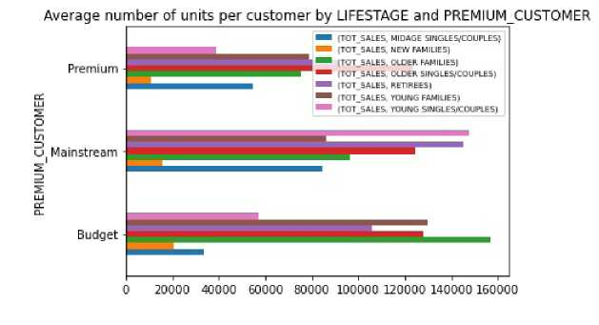
we can see from the visual that
For budget= The Older families have most purchase
For Mainsream = The YOUNG SINGLES/COUPLES have most purchase
For Premium = The YOUNG Older families have most purchase
Also, There are more Mainstream - young singles/couples and Mainstream - retirees who buy chips. This contributes to there being more sales to these customer segments but this is not a major driver for the Budget - Older families segment.
Average number of units per customer by LIFESTAGE and PREMIUM CUSTOMER
In
In
Out
met = customer_data[['TOT_SALES', 'LIFESTAGE', 'PREMIUM_CUSTOMER']]
met10 = met.groupby(['LIFESTAGE', 'PREMIUM_CUSTOMER'], as_index=False).mean()
met20 = met1.pivot(index='PREMIUM_CUSTOMER', columns='LIFESTAGE')
met20
TOT_SALES
LIFESTAGE PREMIUM_CUSTOMER | MIDAGE SINGLES/COUPLES | NEW FAMILIES | OLDER FAMILIES | OLDER SINGLES/COUPLES | RETIREES | YOUNG FAMILIES | YOUNG SINGLES/COUPLES
Budget | 33345.70 | 20607.45 | 156863.75 | 127833.60 | 105916.30 | 129717.95 | 57122.1
Mainstream | 84734.25 | 15979.70 | 96413.55 | 124648.50 | 145168.95 | 86338.25 | 147582.2
Premium | 54443.85 | 10760.80 | 75242.60 | 123537.55 | 91296.65 | 78571.70 | 39052.3
Older families and young families in general buy more chips per customer
# Let create a plot
k= met20.plot(kind='barh',title='Average number of units per customer by LIFESTAGE and PREMIUM_CUSTOMER')
plt.legend(prop={'size':7})
plt.figu re(figsize=(3000,50000))
plt.show()
<Figure size 216000x3.6e+06 with 0 Axes>
Mainstream midage and young singles and couples are more willing to pay more per packet of chips compared to their budget and premium counterparts. This may be due to premium shoppers being more likely to buy healthy snacks and when they buy chips, this is mainly for entertainment purposes rather than their own consumption. This is also supported by there being fewer premium midage and young singles and couples buying chips compared to their mainstream counterparts.
Checking for differences among the variables
Perform an independent t-test between mainstream vs premium and budget midage and young singles and couples

Slide 15
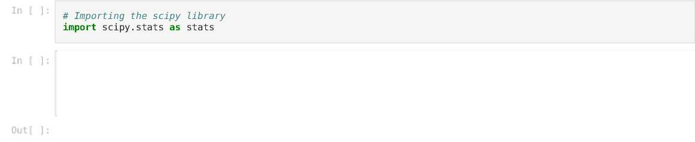

DATE STORE NBR LYLTY CARD NBR TXN ID PROD NBR PROD NAME PROD QTY TOT SALES Pack Size BRAND
LIFE
0
2018¬
10-17
2019¬
05-14
2018¬
11-10
2019¬
03-09
2019¬
05-20
1000
Natural Chip 5 Compny
SeaSalt175g
2
6.0
175 Natural
SINGLES/CC
M
SINGLES/CC
M
SINGLES/CC
M
SINGLES/CC
M
SINGLES/CC
1
1307 348
66
CCs Nacho Cheese 175g
3
6.3
175 CCs
2
1307 346
WW Original 96 Stacked
Chips 160g
₅. CCs Original ⁵⁴ 175g
2
3.8
160 WW
3
1307 347
2.1
175 CCs
4
1343 383
61
Smiths Crinkle Cut Chips Chicken 170g
2
2.9
170 Smiths
2019²⁴⁶⁷³⁵ 03-09 ²⁷²
272319 270088
89
Kettle Sweet Chilli And Sour Cream 175g
T ostitos Splash C Lime 175g
Doritos
Mexicana
170g
2 10.8 175 Kettle
SINGLES/CC
901 ft
²⁴⁶⁷³⁶ 08-13 ²⁷²
272358 270154
74
4.4 175 Tostitos
SINGLES/CC
901ft
²⁴⁶⁷³⁷ 11-06 ²⁷²
272379 270187
51
2
8.8 170 Doritos
SINGLES/CC
246738 j2-27 ²⁷²
272379 270188
Doritos Corn 42 Chip Mexican Jalapeno 150g
2
7.8 150 Doritos
SINGLES/CC
901ft
246739 Qg_22 272
272380 270189
74
Tostitos Splash C Lime 175g
2
8.8 175 Tostitos
SINGLES/CC
246740 rows x 12 columns
# Performing an independent t-test between mainstream vs premium pr = stats.ttest_ind(customer_data['TOT_SALES'][customer_data['PREMIUM_CUSTOMER'] customer_data['TOT_SALES'][customer_data['PREMIUM_CUSTOMER'] pr
== 'Mainst ream'], ==' Premium' ])
Ttest_indResult(statistic=7.274853694658667, pvalue=3.483741722163687e-13)
Result of the test shows that there is statistical significant difference between mainstream and premium customer. Since p-value is less than 0.05 and t=7.28
Let the LIFESTAGE of the customer
In [
]:
# Exploring the differences between Midage singles/couples and young singles/couples
pr1 = stats.ttest_ind(customer_data['TOT_SALES'][customer_data['LIFESTAGE'] == 'MIDAGE SINGLES/COUPLES'], customer_data['TOT_SALES'][customer_data['LIFESTAGE'] == 'YOUNG SINGLES/COUPLES'])
pr1
Out
Ttest_indResult(statistic=9.157454476390619, pvalue=5.482774689321049e-20)
Result of the test shows that there is statistical significant difference between Midage singles/couples and young singles/couples customer. Since p-value is less than 0.05 and t=9.158
customer_data['LIFESTAGE'].value_counts() Ol DER SINGI ES/COIIPI ES 50793

Slide 16

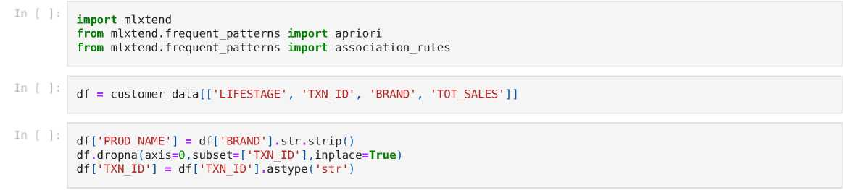

RETIREES 46431 OLDER FAMILIES 45158 YOUNG FAMILIES 40494 YOUNG SINGLES/COUPLES 33969 MIDAGE SINGLES/COUPLES 23398 NEW FAMILIES 6497
Name: LIFESTAGE, dtype: int64
in
]:
# Exploring the differences between Midage RETIREES and OLDER FAMILIES pr2 = stats.ttest_ind(customer_data['TOT_SALES'][customer_data['LIFESTAGE'] customer_data['TOT_SALES'][customer_data['LIFESTAGE']
RETIREES'],
OLDER FAMILIES'])
pr2
Out
Ttest_indResult(statistic=6.106405715247406, pvalue=1.0230774812984913e-09)
Result of the test shows that there is statistical significant difference betweenMidage RETIREES and OLDER FAMILIES customer. Since p-value is less than 0.05 and t=6.106
Performing apriori analysis to the buying patterns of different brands in our dataset
We use this techique to find out if there are brands that these two customer segments prefer more than others or there buying pattern goes together
C:\Users\User\AppData\Local\Temp/ipykernel_5028/981865250.py:1: SettingWithCopyWa rning:
A value is trying to be set on a copy of a slice from a DataFrame.
Try using .loc[row_indexer,col_indexer] = value instead
See the caveats in the documentation: https://pandas.pydata.org/pandas-docs/stable/user_guide/indexing.html#retur ning-a-view-versus-a-copy
C:\Users\User\anaconda3\lib\site-packages\pandas\util\_decorators.py:311: SettingWithCopyWa rning:
A value is trying to be set on a copy of a slice from a DataFrame
See the caveats in the documentation: https://pandas.pydata.org/pandas-docs/stable/user_guide/indexing.html#retur ning-a-view-versus-a-copy
C:\Users\User\AppData\Local\Temp/ipykernel_5028/981865250.py:3: SettingWithCopyWa rning:
A value is trying to be set on a copy of a slice from a DataFrame.
Try using .loc[row_indexer,col_indexer] = value instead
See the caveats in the documentation: https://pandas.pydata.org/pandas-docs/stable/user_guide/indexing.html#retur ning-a-view-versus-a-copy
basket = (df.groupby(['TXN_ID', 'BRAND'])['TOT_SALES'].sum().unstack().reset_index().fillna(0).set_index('TXN_ID'
def encode_0_1(x): if x <=0:
return 0 if x >=1:
return 1

Slide 17

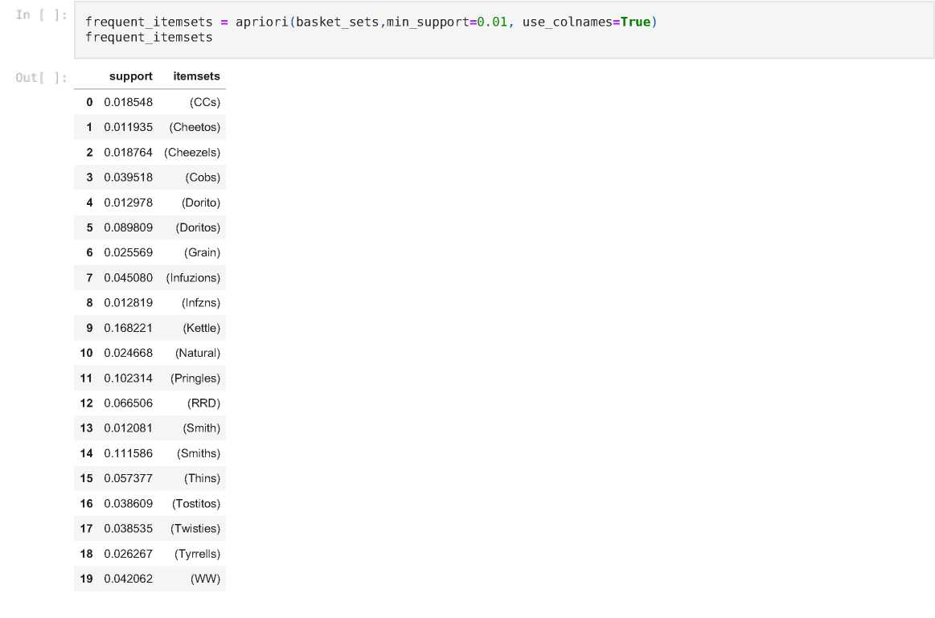
basket_sets = basket.applymap(encode_0_1)
From this pattern we can see that these are the similar pattern among the brands
Loading [MathJax]/jax/output/CommonHTML/fonts/TeX/fontdata.js

