Slide 1



NLP CA3 · EXPLAINABLE AI
GreenLens
Catching Greenwashing with AI
An explainable NLP auditor that flags misleading environmental claims in advertising and shows why.
Maitrayee Mishra · 25030422066
Aina Jain · 25030422012
Symbiosis Institute of Artificial Intelligence
Notes:
Introduce GreenLens: an explainable NLP system that audits environmental marketing claims. One-line pitch: it does not just say "greenwashing", it tells you why.

Slide 2




The Problem: Green Claims Are Hard to Verify
ADVERTISEMENT
Vague wording
Terms like "eco-friendly" or "sustainable" have no fixed meaning, so they create an impression of responsibility without a commitment.
"Eco-Friendly"
"Green"
Hard to verify
"Sustainable"
"Net Zero"
Readers cannot tell whether a claim rests on a number, a date or a certification, or on nothing at all.
"Better for the Planet"
No scalable check
Sounds good. Proves nothing.
Reviewing claims by hand does not scale. There is no simple automated way to screen thousands of ads.
Our goal: automatically flag claims that sound green but lack evidence, and explain every decision.
Notes:
Greenwashing is when a company sounds more environmentally responsible than it can prove. The difficulty is that these claims are vague and there is no automatic, scalable way to screen them. Our goal is an auditor that flags and explains.

Slide 3





Our Approach: A 5-Step Explainable Pipeline
STEP 1
STEP 2
STEP 3
STEP 4
STEP 5
Collect Ad Claims
Extract Claims
Classify the Claim
Check for Evidence
Explainable Verdict
Load 620 claims from EmeraldData (Hugging Face); clean text and labels.
Split ad text into sentences; keep those with environmental keywords.
Rule-based lexicon and TF-IDF + LogReg score risk; type: vague, specific, comparative, qualified.
Detect numbers, dates and certifications; compute a 0-10 specificity score.
Flag or clear with a confidence score, reasons and highlighted terms.
data_collection.py
claim_extraction.py
nlp_classifier.py
evidence_analyzer.py
explainability_engine.py
Output per claim: verdict · confidence · claim type · greenwashing type · specificity score · reasons · highlighted terms
Notes:
Walk left to right. Each step is a separate Python module in our Colab notebook, so the pipeline is modular and each decision is traceable. The last step is what makes it explainable.

Slide 4

Dataset: EmeraldData
620
434 / 186
train / held-out test split
environmental claims
27
Companies include
Amazon
Shell
companies covered
Starbucks
Nestlé
CC-BY-4.0
Delta
Lufthansa
open licence, geoka/EmeraldData
H&M
Zara
Semi-synthetic data: claims and labels were LLM-generated and annotated, anchored to real ESG reports and news, not scraped from live ads.
Notes:
620 claims: 225 labelled greenwashing (36%) and 395 not (64%), so the classes are imbalanced. The ML model trains on 434 and is tested on 186 unseen claims. Be upfront that the data is semi-synthetic, so absolute numbers should be revalidated on real ad copy.

Slide 5


Two Classifiers, Compared on the Same Claims
Rule-based lexicon
ML: TF-IDF + Logistic Regression
Transparent by construction. Scores each claim on four signal groups:
Learns patterns automatically from labelled claims.
Vague terms "eco-friendly", "green", "sustainable future"
1-2 gram TF-IDF features single words and short phrases
Unsupported superlatives "leading", "revolutionary", "100%"
Logistic Regression linear, so coefficients show which terms push a claim towards "greenwashing"
Broad scope "all", "every", "across its operations"
Train 434, test 186 evaluated on claims it never saw
Evidence markers numbers, dates, certifications
Why both? The lexicon is a transparent baseline needing no training; the ML model shows what learning from labels adds.
Notes:
The rule-based model encodes domain knowledge directly: vague terms, unsupported superlatives, broad scope words, and evidence markers such as numbers, dates and certifications. The ML model learns from data. We compare them on the same claims.

Slide 6

What the ML Model Learned
TOP TERMS PUSHING TOWARDS "GREENWASHING"
KEY INSIGHT
million
power
2021
electric
It is not just keying on words like "eco-friendly".
program
aims
2040
plans
Future-tense commitments ("aims", "plans", a target year like 2040) are flagged more than completed, dated actions.
Amber = future-tense commitment words
Common dataset pattern
Why it matters
A future target or small pilot is presented as an achieved, company-wide result.
The model learned a real marketing tactic, not just a word list, which supports trust in the verdicts.
Notes:
These are the Logistic Regression coefficients most associated with the greenwashing class. Notice "aims", "plans" and "2040": future targets get flagged more than completed, dated actions. That matches the most common pattern in the dataset, a future target or small pilot presented as an achieved company-wide result.

Slide 7
Worked Example: Why a Qualifier Changes the Verdict
CLAIM A
CLAIM B (QUALIFIED)
"Amazon powers 100% of its company activities with renewable energy."
"... on track to power 100% ... by 2025." (qualified version, abridged)
FLAGGED
confidence 78%
NOT FLAGGED
correctly left alone
Evidence: no date or completion qualifier. An absolute claim ("100%") with no "by [year]".
Evidence: "on track" and a target year give the claim a checkable timeframe.
Absolute: 100%
No year
No qualifier
On track
Target: 2025
Time-bound
Takeaway: GreenLens separates absolute, unqualified claims from qualified, time-bound ones, the same distinction a human reviewer would draw.
Notes:
This is the model card worked example. The first claim is absolute with no date, so it is flagged at 78% confidence. Adding "on track" and "by 2025" turns it into a checkable commitment, and the model correctly leaves it unflagged. Claim B is the qualified version quoted in the model card.

Slide 8

Model Performance
Model | Acc | Prec | Rec | F1
Rule-based lexicon | 69.4% | 58.6% | 52.9% | 0.556
ML: TF-IDF + LogReg | 74.2% | 66.7% | 58.8% | 0.625
0.556
0.625
Rule-based F1
(all 620 claims)
ML F1
(held-out test split)
Key observation. The ML model beats the rule-based lexicon on every metric (+4.8 pts accuracy, +8.1 pts precision, +5.9 pts recall) while the lexicon needs no training. Note: the lexicon is scored on all 620 claims, the ML model on 186 unseen ones, so the comparison is indicative rather than strictly like-for-like.
Notes:
ML wins on accuracy 74.2 vs 69.4, precision 66.7 vs 58.6, recall 58.8 vs 52.9, and F1 0.625 vs 0.556. The honest caveat: the rule-based F1 uses all 620 claims while the ML F1 uses only the 186 held-out claims. Recall is still below 60%, so roughly four in ten greenwashing claims are missed.

Slide 9
Audit Finding: Where the Model Struggles
Subgroup | N | Acc | Prec | Rec
Short | 333 | .724 | .741 | .581
Long | 287 | .659 | .379 | .429
Plain statement | 515 | .717 | .526 | .458
Quoted slogan | 105 | .581 | .700 | .681
-13.6 pts
-6.5 pts
slogans vs plain
long vs short
Main finding: weaker on catchy quoted slogans, the exact register real ads use. Long claims often bury a vague aspiration inside an otherwise factual sentence, which the lexicon under-weights.
Notes:
We deliberately audited our own model for bias across claim length and claim style. Accuracy drops from 71.7% on plain statements to 58.1% on quoted slogans, and from 72.4% on short to 65.9% on long claims. Long-claim precision is just 0.379. This matters because real ads are slogan-heavy.

Slide 10
What GreenLens Found Across 620 Claims
620
203
27
69%
claims audited
flagged (33%)
companies covered
agreement with gold labels
Notes:
These figures come from the GreenLens dashboard. 203 of 620 claims (33%) were flagged by the rule-based pass, which agrees with the gold labels on 69% of claims. Amazon has the most flagged claims (93), partly because it has the most claims in the dataset, so counts are not a ranking of company honesty. The most common type is misleading or vague labels (111), then overgeneralization (70).

Slide 11
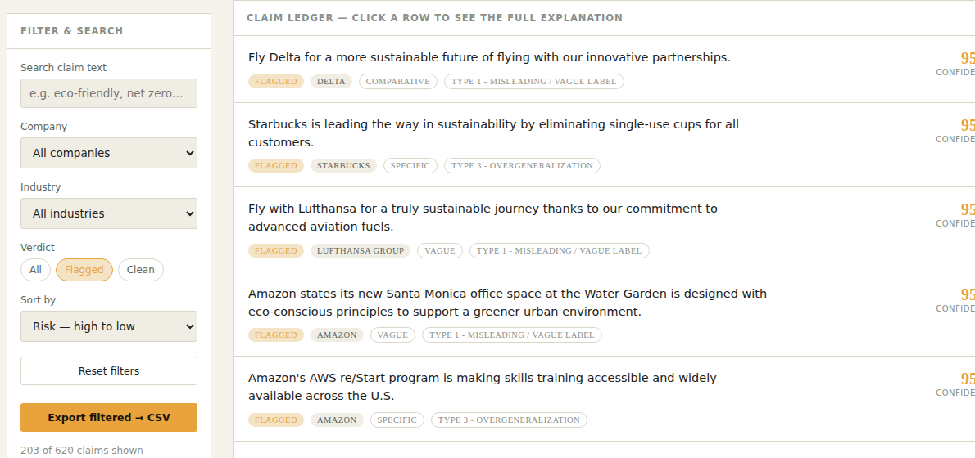
Live Demo: The GreenLens Dashboard
1
Filter
Pick Flagged, Clean, a company or an industry.
2
Select
Click any claim to open its full explanation.
3
Inspect
See highlighted suspicious words.
4
Understand
Read the reasons and confidence behind the verdict.
Claim ledger filtered to "Flagged": 203 of 620 claims shown
Also: free-text search, sort by risk or specificity, and export the filtered list to CSV.
Notes:
Switch to the live HTML dashboard here. Filter to Flagged, open a claim such as the Starbucks single-use cups claim, and show the highlighted words and reasons. Mention the CSV export for auditors.

Slide 12



Limitations & Responsible Use
LIMITATION 1
LIMITATION 2
LIMITATION 3
Semi-synthetic data
Register bias
Not a legal finding
Claims and labels are LLM-generated and annotated. Revalidate before trusting absolute numbers on real ad copy.
Underperforms on quoted, slogan-style language, which is exactly what real ads use.
"Flagged" means a claim resembles greenwashing patterns in the data, not proof of lying.
Intended use: a screening tool that routes flagged claims to human review, never automated enforcement. Recall is under 60%, so some greenwashing will be missed.
Notes:
Three honest limitations from our model card. The key framing: GreenLens is a triage tool for human reviewers, not a judge. It cannot prove intent, and it will miss some claims.

Slide 13
Key Takeaways & Next Steps
Explainability builds trust
NEXT STEPS
1
Users can see why a claim was flagged: reasons, highlighted terms, confidence.
Test on real, scraped ad copy
Add more slogan-style training claims to close the register gap
Score long claims clause by clause
Link claims to external evidence such as certifications and ESG reports
Simple models are competitive
2
A transparent lexicon reached 69.4% accuracy with no training; ML improved it to 74.2%.
Auditing the model matters
3
The slogan gap (58.1% vs 71.7%) was only visible because we checked subgroups.
GreenLens combines AI, NLP and explainability to make environmental ad claims easier to examine and question.
Notes:
Three takeaways, then next steps that directly address the limitations: real ad data, more slogan training examples, clause-level scoring and evidence linking.

Slide 14
Thank you
Questions?
Data: EmeraldData (geoka/EmeraldData), CC-BY-4.0
Tools: Python, scikit-learn, pandas, Google Colab
Team: Maitrayee Mishra and Aina Jain, SIAI
Notes:
Close and invite questions. Be ready to explain: why the F1 comparison is not strictly like-for-like, why Amazon has so many flagged claims, and why the tool is for human review.

