Slide 1
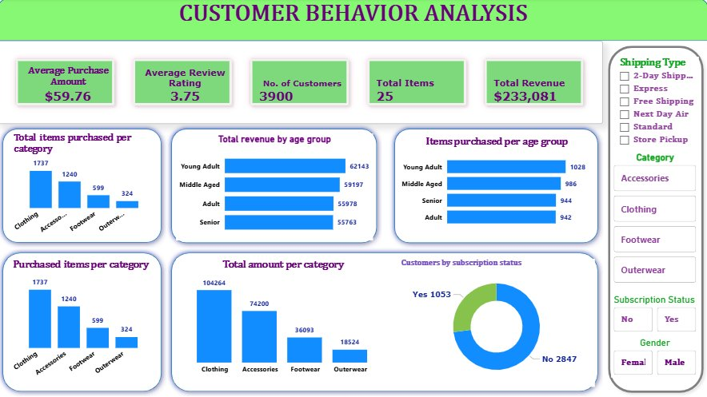
CUSTOMER
BEHAVIOR
ANALYSIS
Insights from 3,900 Retail Purchase Transactions
3,900
18
12
4
Transactions
Data Columns
SQL Queries
Categories
Python · PostgreSQL · Power BI

Slide 2
AGENDA
Project Overview
Key Business Metrics
1
2
Dataset structure, tools used, and methodology
Revenue, spend patterns, and demographic breakdown
Subscription Analysis
Product Performance
3
4
Subscriber vs. non-subscriber behavior and the gender gap
Top-rated items, discount usage, and full-price sellers
Power BI Dashboard
Recommendations
5
6
Interactive visuals built for business exploration
Three priority action areas for the business

Slide 3




01 | PROJECT OVERVIEW
THE DATASET
METHODOLOGY
3,900
Python EDA
Purchase Transactions
Data loading, cleaning, missing value imputation, feature engineering
18
Data Cleaning
Columns
Snake_case standardization, removed duplicate columns, created age_group
3
Data Categories
PostgreSQL
Loaded via SQLAlchemy, ran 12 analytical SQL queries
Data Columns Covered:
Demographics · Purchase Info · Shopping Behavior
Power BI
Built interactive dashboard for stakeholder exploration

Slide 4



02 | KEY BUSINESS METRICS
$233,081
3,900
3.75
$59.76
Total Revenue
Customers
Avg Review Rating
Avg Purchase
Revenue by Gender
Revenue by Age Group

Slide 5
03 | SUBSCRIPTION ANALYSIS
Subscriber Split
Key Findings
Only 27% subscribe
1,053 of 3,900 customers are subscribers — a significant unconverted majority.
Similar spend levels
Subscribers avg $59.49 vs. $59.87 for non-subscribers. Subscriptions drive loyalty, not higher spend.
Loyal but not subscribed
2,339 customers are Loyal (21+ purchases), yet only 958 repeat buyers subscribe — a major gap.
Zero female subscribers
All 1,053 subscribers are male. No female customer holds a subscription — a clear conversion failure.

Slide 6
04 | PRODUCT PERFORMANCE
Revenue by Category
Discount Usage vs. Full Price Sales
Most Discounted
Sells at Full Price
Hat
50%
Socks
67%
Sneakers
49%
Blouse
66%
Coat
49%
Sandals
63%
Sweater
48%
Skirt
61%
Top Rated Products
Pants
47%
Jacket
60%
Product | Rating
Gloves | ⭐ 3.86
Sandals | ⭐ 3.84
Boots | ⭐ 3.82
Hat | ⭐ 3.80
Skirt | ⭐ 3.78

Slide 7

05 | CUSTOMER SEGMENTATION
NEW
RETURNING
LOYAL
424
1,137
2,339
customers
customers
customers
11% of base
29% of base
60% of base
≤ 5 previous purchases
6–20 previous purchases
21+ previous purchases
Lowest engagement tier. Priority for acquisition campaigns.
Active shoppers — prime candidates for subscription conversion.
Core customer base. Yet only 958 of these subscribe.
Key Gap: 2,339 Loyal customers exist, but only 958 subscribe. Converting even 30% of the remaining Loyal non-subscribers would add ~400 new subscribers immediately.

Slide 8
06 | POWER BI DASHBOARD
5 KPI Cards
Revenue, spend, ratings & volume at a glance
6 Visual Charts
Bar, donut & comparison charts for all key metrics
4 Slicers
Filter by gender, category, shipping & subscription
Gender Insight
Built for interactive stakeholder exploration — no SQL required.
Filtering by Female instantly shows zero subscribers

Slide 9



07 | RECOMMENDATIONS
01
02
03
Grow the Subscription Program
Optimise Pricing & Discounting
Demographic Targeting
Target 2,339 Loyal customers not yet subscribed with a direct conversion campaign
Protect full-price products: Socks (67%), Blouses (66%), Sandals (63%) — don't discount these
Prioritise Young Adult marketing — highest revenue group at $62,143
Launch a female-targeted subscription offer — currently 0% of female customers subscribe
Investigate Hats, Sneakers & Coats — ~50% of purchases need a discount to convert
Build first-purchase incentives to grow the 11% New customer segment
Reframe the subscription value around exclusive perks, not spend increases
Create a premium loyalty tier for high-spend discount users who still spend above average
Invest in digital-first channels (social, influencer) to reach younger demographics

Slide 10
THANK YOU
Customer Behavior Analysis · 3,900 Transactions · Python + PostgreSQL + Power BI
$233K
27%
60%
0
Total Revenue
Subscription Rate
Loyal Customers
Female Subscribers
Three Priority Actions:
① Convert Loyal non-subscribers ② Protect full-price products ③ Target female customers for subscription
Questions & Discussion

