Slide 1
Ch3_Metro Ethernet
It is prohibited to modify and distribute the contents of this material without permission.
All copyrights belong to ‘Life and Power Press - 생능출판사’.

Slide 2
Opening …
This chapter is …..
Objectives: Learning…
What is a MAN(Metro Area Network) and what topology does it have?
MAN – Features, Technology, and Issues
Metro Ethernet - Concept and Background
Metro Ethernet - Features and Configurations
What is required to deploy Metro Ethernet?

Slide 3
Contents
1. MAN Overview
2. Current MAN
3. Metro Ethernet

Slide 4
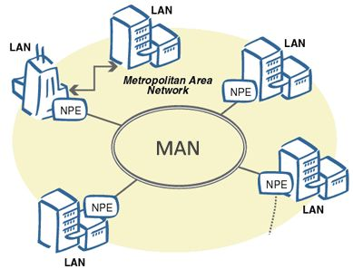
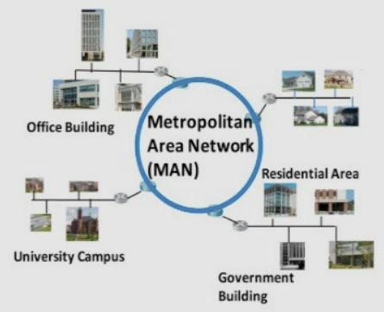
1. MAN Overview
Overview
MAN (Metropolitan Area Network) Overview
MAN Overview
MAN: Metropolitan Area Network
  Connects subscriber networks (e.g., businesses and homes) across a metropolitan area
  Provides connectivity between subscriber networks and the backbone network
Definition
  LAN-to-LAN connectivity
  Provides a path to the backbone network

Slide 5
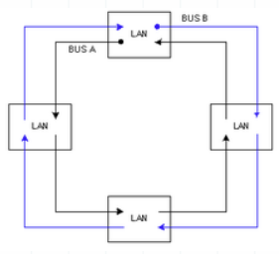
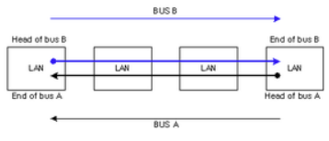
1. MAN Overview
Overview
MAN (Metropolitan Area Network) Overview
MAN Topology
DQDB(Distributed Queue Dual Bus)
  Facilitates communication between multiple LANs
  Uses a dual-bus structure
  Can be configured in a ring topology
(a) Dual Bus Topology
(b) Dual Ring Topology

Slide 6
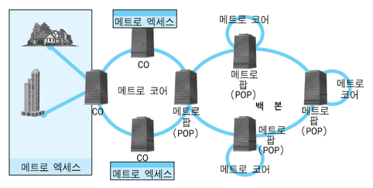
1. MAN Overview
Overview
MAN (Metropolitan Area Network) Overview
MAN Topology
A MAN typically uses a ring topology
  A MAN consists of two main network segments:
  – Metro Access: Connects subscribers to the metro network
  – Metro Core: Connects metro access networks to the backbone
Metro Access
Metro Core
POP: Point of Presence
CO: Central Office
Metro POP
Metro Core
Metro Core
Metro POP
Backbone
Metro POP
Metro POP
Metro Access
Metro Access
Metro Core

Slide 7
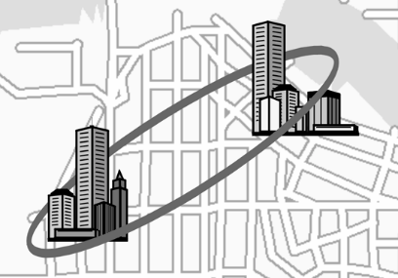
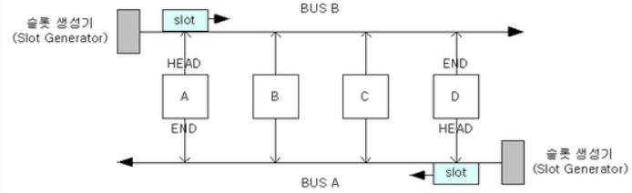
1. MAN Overview
Overview
MAN (Metropolitan Area Network) Overview
DQDB (Distributed Queue Dual Bus) - Legacy MAN Technology
An early MAN technology standardized as IEEE 802.6
Uses two unidirectional buses operating in opposite directions
Uses fixed-size slots for data transmission
Designed to interconnect LANs across metropolitan areas
Historically supported data rates up to 155 Mbps
Largely replaced by Ethernet-based MAN technologies

Slide 8
1. MAN Overview
Overview
MAN (Metropolitan Area Network) Overview
DQDB (Distributed Queue Dual Bus) - How DQDB Works
Dual-Bus Structure
  - Uses two unidirectional buses operating in opposite directions
  - Each bus continuously carries fixed-size slots
Slot-Based Transmission
  - A node transmits data by using an available slot
  - Data travels only in the direction of the selected bus
Distributed Queue
  - Nodes request transmission opportunities through the opposite bus
  - Requests are managed as a distributed queue to provide fair access
  - This mechanism helps prevent starvation
Basic Operation
  - Request → Wait for Turn → Find Available Slot → Transmit Data

Slide 9
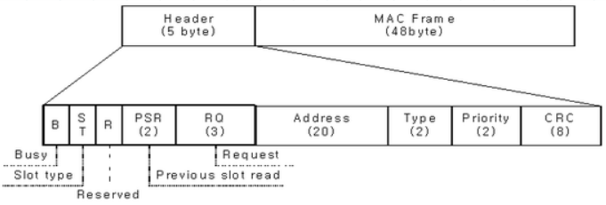
1. MAN Overview
Overview
MAN (Metropolitan Area Network) Overview
DQDB (Distributed Queue Dual Bus)
DQDB Frame
  • B (Busy): Indicates whether the slot is occupied
  • Slot Type (ST): Indicates the type of traffic carried by the slot (data or real-time traffic such as audio/video)
  • Reservation (R): Reserved for future use
  • PSR (Previous Slot Read): Indicates whether the slot was read by the previous node
  • RQ (Request): Uses 3 bits to request a slot with a specific priority
  • Address: Identifies the virtual channel (VCI)
  • Type: Indicates whether the MAC frame carries data or control information
  • Priority: Indicates the transmission priority
  • CRC (Cyclic Redundancy Check): Detects transmission errors

Slide 10
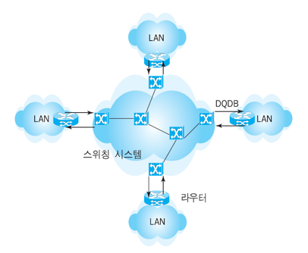
1. MAN Overview
Overview
MAN (Metropolitan Area Network) Overview
SMDS (Switched Multimegabit Data Services) - Legacy MAN Technology
Designed for high-speed data communication over MANs and WANs
Provides connectionless, packet-switched data services
Supports data rates from 1.5 Mbps (T1) to 45 Mbps (T3)
Uses network switches to efficiently forward data between subscribers
Uses bandwidth more efficiently than traditional TDM-based networks
Subscribers connect to the SMDS network through Customer Premises Equipment (CPE), such as a router
Switching System
Router

Slide 11
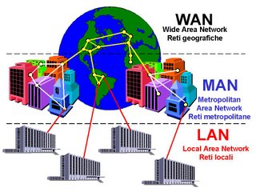
2. Current MAN
MAN
Current MAN (Metropolitan Area Network)
Role of Current MAN
Connects subscriber networks to the backbone network
  • Aggregates traffic from multiple subscriber networks
  • Provides high-speed connectivity within a metropolitan area
Handles local traffic within the metropolitan area
  • Traffic between subscriber networks can remain within the MAN
  • Only necessary traffic is forwarded to the backbone
Reduces traffic load on the backbone network
  • Improves overall network efficiency and backbone utilization

Slide 12
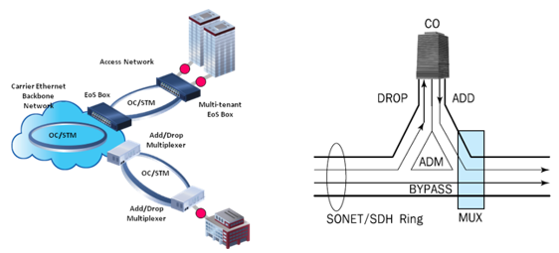
2. Current MAN
MAN
Current MAN (Metropolitan Area Network)
MAN Configuration
SONET/SDH Ring Architecture
  • Uses a high-speed optical ring to connect Central Offices (COs)
  • Traditionally based on TDM for carrying voice and data traffic
  • Provides reliable and high-capacity transport across a metropolitan area
Add-Drop Multiplexer (ADM)
  • Connects each CO to the SONET/SDH ring
  • Add: Inserts local traffic from a CO into the ring
  • Drop: Extracts traffic destined for a CO from the ring
  • Bypass: Allows other traffic to pass through without processing
Efficient Traffic Transport
  • Each CO adds or drops only the traffic it needs
  • Other traffic continues through the ring
  to its destination

Slide 13
2. Current MAN
MAN
Current MAN (Metropolitan Area Network)
MAN Configuration
Dual-Ring Architecture
  • SONET/SDH uses two fiber rings for reliable data transmission
  • One path carries normal traffic, while the other provides a protection path
  • The protection path can be used when the working path fails
Fast Failure Recovery
  • A link or node failure is quickly detected
  • Traffic is automatically switched to the protection path
  • SONET/SDH is designed to recover from failures within 50 ms
High Network Reliability
  • Ring protection minimizes service interruption
  • Provides reliable transport for high-capacity MAN traffic

Slide 14
2. Current MAN
MAN
Current MAN (Metropolitan Area Network)
Problems with Traditional MANs
Inefficient Use of Bandwidth
  • SONET/SDH was designed mainly for continuous voice traffic
  • TDM reserves bandwidth even when no data is being sent
2. Rapid Growth of Subscriber Bandwidth
  • Access networks became much faster
  • MANs became a bottleneck between subscribers and the backbone
3. Increasing Metropolitan Traffic
  • More servers and Internet services moved closer to users in large cities
  • This greatly increased traffic within MANs
4. Growth of Multimedia Traffic
  • Video, VoIP, and other multimedia services generated much more data traffic

Slide 15
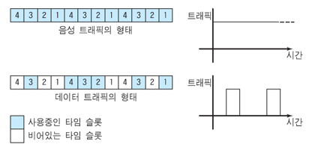
2. Current MAN
MAN
Current MAN (Metropolitan Area Network)
Problems with Traditional MANs
Inefficient Bandwidth Use in TDM-based SONET/SDH
  • Voice traffic is continuous, so reserved time slots are efficiently used
  • Data traffic is bursty, with periods of activity and inactivity
  • In TDM, time slots remain reserved even when no data is being transmitted
  • As a result, network bandwidth can be wasted
Traffic
Voice Traffic Pattern
Time
Traffic
Data Traffic Pattern
Time Slot in Use
Time
Unused Time Slot

Slide 16
2. Current MAN
MAN
Current MAN (Metropolitan Area Network)
Problems with Traditional MANs
Rapid Growth of Network Speed
  • Subscriber Networks became much faster with broadband access and high-speed Ethernet
  • Backbone networks also evolved to much higher speeds
  • Traditional MANs could not keep up with this rapid traffic growth
  • As a result, the MAN became a bottleneck between subscriber networks and the backbone
Dial-Up / ISDN
MODEM: 56Kbps
ISDN: 64/128Kbps
Broadband Access
ADSL / VDSL
(1~52Mbps)
LAN
10Mbps
LAN
100Mbps &
1Gbps/10Gbps
Gbps~Tbps Backbone
Bottleneck
MAN
ADSL/VDSL
LAN Speed-up

Slide 17
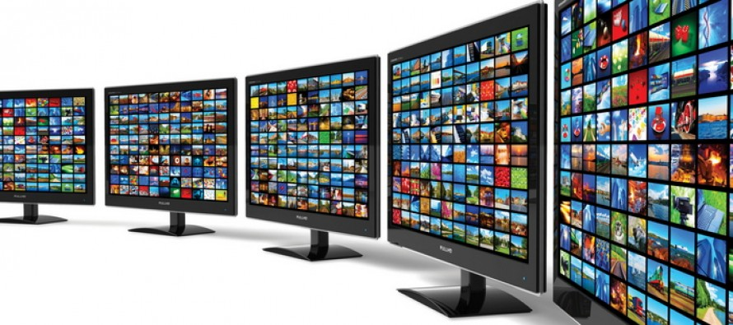
2. Current MAN
MAN
Current MAN (Metropolitan Area Network)
Problems with Traditional MANs
Growth of Internet Services
  • Internet services became increasingly distributed across multiple locations
  • More servers and data centers were deployed closer to users
  • This increased traffic within metropolitan networks
Growth of Multimedia Traffic
  • Video, VoIP, and other multimedia services generated large amounts of traffic
  • Streaming and on-demand services further increased bandwidth demand
Result
  • Traditional MANs had difficulty handling the rapidly increasing traffic

Slide 18
3. Metro Ethernet
Metro Ethernet
Metro Ethernet
Metro Ethernet
What is Metro Ethernet?
  • Uses Ethernet technology to connect networks across a metropolitan area
  • Connects subscriber networks to service provider and backbone networks
  • Extends familiar LAN Ethernet technology to a city-wide network
Why Metro Ethernet?
  • Uses packet switching, making bandwidth use more efficient than traditional TDM
  • Supports high-speed and scalable network connections
  • Easily connects Ethernet-based subscriber networks without complex protocol conversion
  • Helps overcome the bandwidth limitations of traditional MANs
Physical Infrastructure
  • Typically uses high-speed optical fiber links
  • Can use available dark fiber to build high-capacity connections

Slide 19
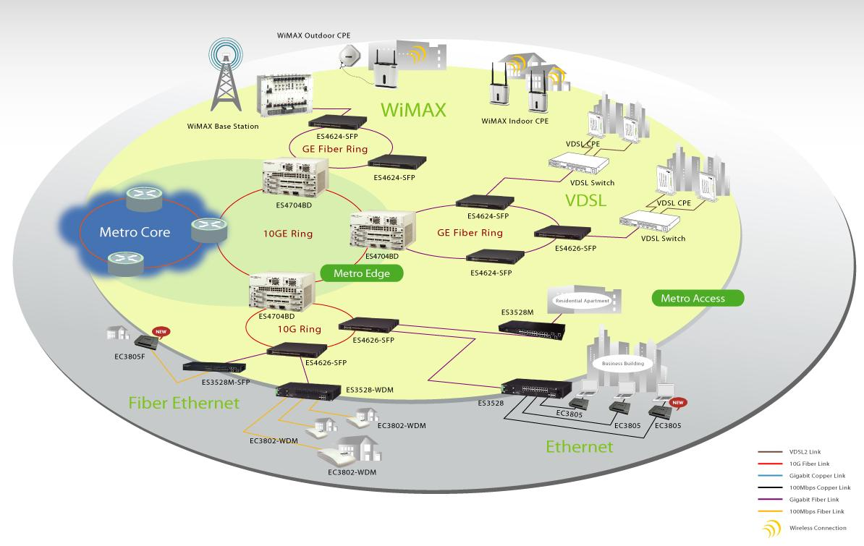
3. Metro Ethernet
Metro Ethernet
Typical Metro Ethernet

Slide 20
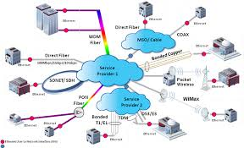
3. Metro Ethernet
Metro Ethernet
Metro Ethernet
Metro Ethernet Features = Simple + Efficient + Scalable
Ethernet-Based Technology
  • Uses widely adopted and well-established Ethernet technology
  • Supports high-speed connections and easy bandwidth upgrades
  • Uses widely available Ethernet equipment and expertise
  • Can evolve as Ethernet technology advances
Efficient Packet Switching
  • Bandwidth is shared dynamically instead of being permanently reserved
  • Better suited to bursty data traffic than traditional TDM
  • Supports flexible bandwidth for different subscribers and services
Simple Network Integration
  • Most subscriber LANs already use Ethernet
  • Reduces the need for protocol conversion
  between LANs and MANs
  • Ethernet technologies such as VLANs
  can be used across the metro network

Slide 21
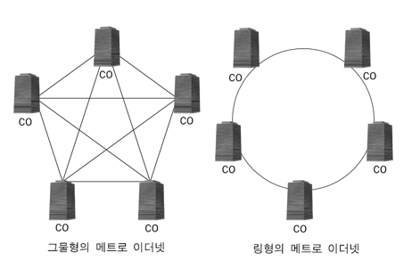
3. Metro Ethernet
Metro Ethernet
Metro Ethernet
Metro Ethernet Topology
Mesh and Ring Topologies
  • Metro Ethernet can use either a mesh or ring topology
  • Central Offices (COs) are connected using Layer 2 or Layer 3 switches
Mesh Topology
  • Provides multiple paths between COs
  • Full Mesh: Every CO is directly connected to every other CO
  • Partial Mesh: Only selected COs are directly connected
  • Provides high reliability but requires more links
Ring Topology
  • Connects COs in a ring structure
  • Provides an alternate path when a link fails
  • Requires fewer links than a full mesh
Mesh Topology
Ring Topology

Slide 22
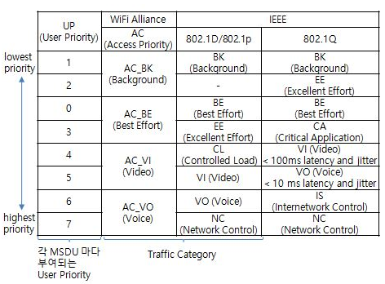
3. Metro Ethernet
Metro Ethernet
Metro Ethernet
Metro Ethernet Function
Packet Classification
  • Classifies traffic according to service requirements
  • Different traffic types can be assigned different priorities
  – Voice / Real-time traffic → High priority
  – Video traffic → Medium to high priority
  – Normal data traffic → Best effort
How Traffic Is Classified
  • Uses information in Ethernet, IP, and transport-layer headers
  • IEEE 802.1p can provide priority information at the Ethernet layer
  • DiffServ and MPLS can also be used for traffic classification and forwarding
Why Packet Classification?
  • Enables QoS (Quality of Service) for different types of traffic
  • Helps control delay, bandwidth, and congestion
User Priority per each MSDU

Slide 23

3. Metro Ethernet
Metro Ethernet
Metro Ethernet
Metro Ethernet Function
Ingress Traffic Control
  • Controls the amount of traffic entering the Metro Ethernet network
  • Limits subscriber traffic according to the contracted bandwidth
  • Excess traffic may be delayed or dropped
Bandwidth Management
  • Different service classes can receive different bandwidth guarantees
  • Packet classification is used to identify the service class
  • High-priority traffic receives guaranteed bandwidth when the network is congested
Purpose
  • Prevents one subscriber from using excessive network resources
  • Helps provide predictable service quality to different subscribers and applications
High Level Service
High Level Service
Low Level Service
Low Level Service

Slide 24
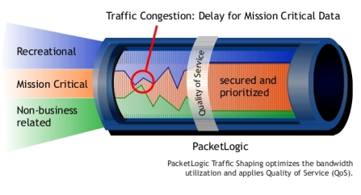
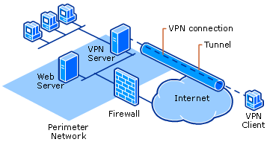
3. Metro Ethernet
Metro Ethernet
Metro Ethernet
Metro Ethernet Function
QoS (Quality of Service)
  • Provides different service levels for different types of traffic
  • Traffic is classified and assigned different priorities
  • Delay-sensitive traffic, such as voice and video, can receive higher priority
  • Bandwidth can be guaranteed or controlled according to the service level
  • Helps maintain service quality when the network is congested
VPN (Virtual Private Network)
  • Provides logically separated private networks over a shared Metro Ethernet infrastructure
  • Traffic from different customers is isolated from each other
How VPNs Are Created
  • VLAN: Separates customer traffic using VLAN IDs
  • MPLS: Uses labels to separate and forward customer traffic across the provider network
  • VLAN and MPLS can be combined to support large-scale VPN services

Slide 25
3. Metro Ethernet
Metro Ethernet
Metro Ethernet
Metro Ethernet Function
Network Resilience and Recovery
  • Metro Ethernet must continue operating even when a link or node fails
  • Redundant paths provide alternative routes for traffic
  • When a failure occurs, traffic is automatically switched to an available path
  • Ring-based networks can provide fast and efficient recovery
Resilient Packet Ring (RPR)
  • RPR was developed to provide fast recovery in packet-based ring networks
  • Traffic can be redirected around the ring when a link fails

Slide 26
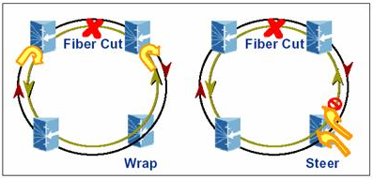
3. Metro Ethernet
Metro Ethernet
Metro Ethernet
Metro Ethernet Function
Failure Recovery in RPR (Resilient Packet Ring)
  • Wrap
  – Traffic is redirected at the nodes next to the failed link
  – The traffic “wraps” onto the opposite ring to bypass the failure
  – Provides fast recovery without changing the entire network path
  • Steering
  – Nodes are informed of the failed link
  – The source node selects a new path that avoids the failure
  – Traffic is sent directly through the available side of the ring
Key Difference
  • Wrap: Reroute traffic near the failure
  • Steering: Select a new path from the source

Slide 27
It is prohibited to modify and distribute the contents of this material without permission.
All copyrights belong to ‘Life and Power Press - 생능출판사’.

