Slide 1

Predictive Modelling Assignment: Breast Cancer Wisconsin
Goal: To classify observations (tumours) as Benign or Malignant based on cell nucleus measurements using a fine needle aspirate (FNA) image.
Normally full biopsies are performed to determine whether breast tumours are benign or malignant. This is an invasive, timely & costly procedure.
Alternatively, fine needles asperates is a less invasive, cheaper, & efficient procedure. FNA’s extract cell nuclei features to assess whether tumours are benign or malignant. But its performance can be less reliable.
Therefore, the goal of this task is to build a model that can classify and predict breast cancer tumours as benign or malignant using the information from the fine-needle aspirates.

Slide 2
The Dataset:
The dataset is from an observational cross-sectional study on women who underwent diagnostic evaluation (fine-needle aspiration) to assess if their breast cancer tumour were benign or malignant. They were recorded within the Wisconsin Breast Cancer Diagnostic database in the 1990’s. Information around the dataset is available in the “Nuclear Feature Extraction for Breast Tumor Diagnosis” study.
The dataset contains 569 observations and 30 predictor variables (cell nuclei features (such as the radius, perimeter, area, compactness, smoothness, concavity, concave points, symmetry, fractal dimension and texture) each measured three ways (mean, standard error, and largest value) ), and a binary outcome classifying 357 benign and 212 malignant tumours overall. There are no missing values.
All confusion tables & accuracy scores were assess with a classification threshold of 0.3 prioritizing sensitivity (minimising false negatives). This is because the risk of a false negative out ways a false positive.

Slide 3
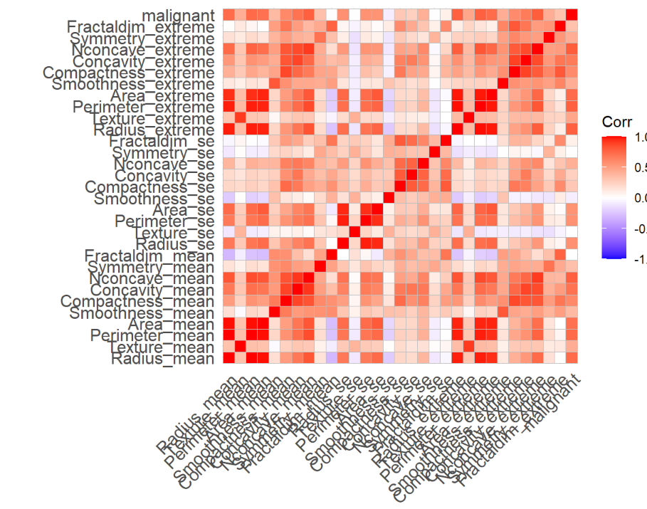
Initial Assessment:
First, I assessed for correlations in the predictors, darker colours indicating stronger correlation. I found 78 predictors to be highly correlated (correlation>.7). This would be expected as most predictors are similar measurements. During this step I also reviewed summary stat values, ensured no missing variables and split the data into a test/ train split.

Slide 4
Logistic Regression, Subset Selection, Shrinkage Methods, and Principle Component Analysis :
Fitting a logistic regression model, the model wouldn’t converge due to the strong predictive power (predictors being very good at predicting the response). Contrary to expected, logistic regression struggles with this and it causes many predictions to be 0 or 1 where the model essentially fails. Therefore, it’s values must be considered with caution.
Logistic Regression: is good for its simplicity and interpretability but risks overfitting and can preform poorly when there is high multicollinearity such as in this dataset.
Stepwise Selection: Using the logistic model predictors are added and removed with the aim of minimising AIC continuing until AIC is not reduced when additional predictors are added. This approach is more computationally efficient than full-subset selection but does risk not choosing the best model due to its greedy approach. It improves on logistic regression as less predictors are needed.
Shrinkage Methods: Ridge regression & Lasso aim to minimise residual sums of squares by applying lambda, a smoothing parameter, this reduces the coefficient’s influence reducing the risk of overfitting. Ridge shrinks but never eliminates the coefficients while Lasso shrinks and can eliminate coefficients by setting their influence at zero.
Using cross validation, the best lambda (lowest mean square error) for the Ridge Model was 0.037 and 0.00434 for the Lasso Model which additionally only 12 of the predictors. Both approaches are good as they reduce the risk of overfitting, additionally the Lasso reduces the number of predictor variables required, but both make coefficients difficult to interpret.
Principle Component Analysis (PCA): Combines predictors to create a subset of new better predictor variables. After scaling all predictor variables, only one PCA component was chosen as it explained the most variance and preformed best on the training data. Again, PCA is good as less predictor variables are used, and reduces the risk of overfitting & multicollinearity but interpretation remains low.

Slide 5
Assessing Results:
To assess results the metrics used include:
Accuracy Score:
Brier Score: Considers both discrimination (ability to differentiate cases) & calibration (are the predicted probabilities correct?) where lower values indicate better performance.
Area Under the Curve:
Calibration Curve Intercept:
Calibration Curve Slope:

Slide 6
Logistic Regression:
Fitting a logistic regression model, the model wouldn’t converge due to the strong predictive power (predictors being very good at predicting the response). Contrary to expected, logistic regression struggles with this and it causes many predictions to be 0 or 1 where the model essentially fails. Therefore, it’s values must be considered with caution.
Logistic regression is good for its simplicity and interpretability but risks overfitting and can preform poorly when there is high multicollinearity such as in this dataset.

