Slide 1
Figures for help

Slide 2
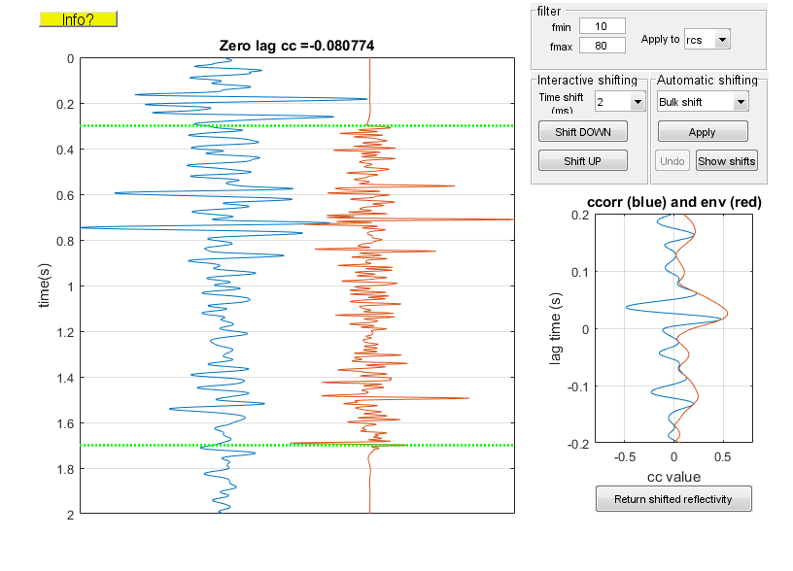
Alignment help (nonstationary trace)
F
A
A.3
C
D
B
A.1
A.2
B.1
B.2
A.4
E

Slide 3
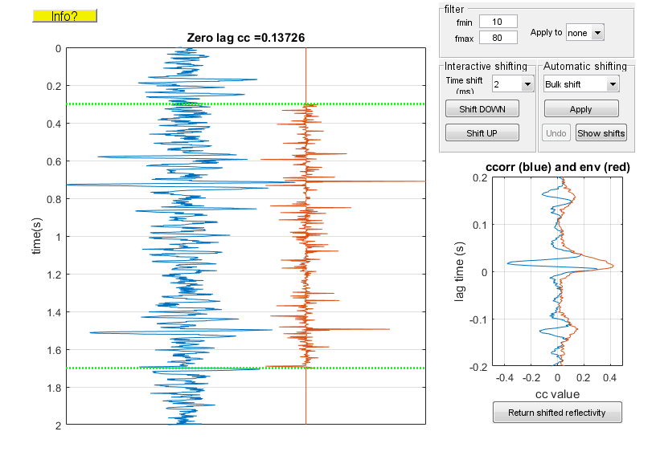
Alignment help (stationary trace)
F
A
A.3
C
D
B
A.1
A.2
B.1
B.2
A.4
E

