Slide 1
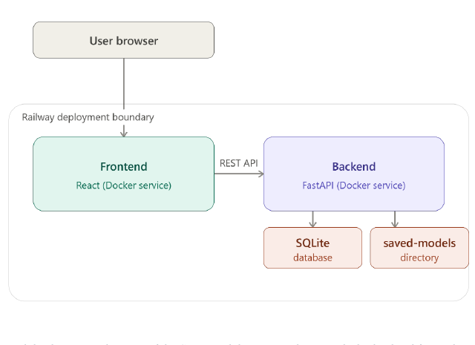
UNIVERSITY OF TECHNOLOGY, MAURITIUS
DISSERTATION PRESENTATION
Interpretable ML for
CNP fraud detection
Online card fraud.
Tested with Mauritius examples.
DETECT
EXPLAIN
DEPLOY
ALLY HOSSEN Muhammad Ismael
MSc Artificial Intelligence with Machine Learning
Supervisor: Dr. Panchoo Shireen
September 2026
Notes:
Say: this project finds online card fraud, and it shows why. Then walk through the data, the three models, the results, and the app.

Slide 2
THE PROBLEM
Fraud is rare. Accuracy is not enough.
A model can look 99% correct and still miss most fraud.
1.21%
1 : 81
3,576
of payments are fraud
one fraud for 81 genuine
fraud cases in 294,854 payments
Why this project
Aim
Many public datasets hide what each field means.
Build a detector that is accurate, easy to review, and testable in Mauritius.
A high accuracy score can still miss fraud.
US results may not work the same in Mauritius.
02
Notes:
Say: fraud is only 1.21% of payments. That is one fraud in 81. So accuracy is a bad headline. I use precision, recall, F1 and PR-AUC. The aim is a detector people can review, and that we can test in Mauritius.

Slide 3
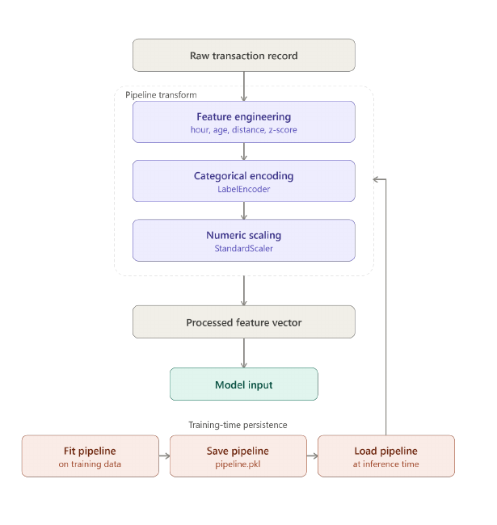
THE DATA
I use simple facts about each payment.
Only online shop types. No in-store card payments.
SEVEN INPUTS
AFTER FILTERING
294,854
payments
3,576 fraud cases
about 1 fraud in 81
Online only
grocery_net | misc_net | shopping_net
Time split
60% train | 20% tune | 20% test
Seven facts: amount, hour, age, distance, how unusual the amount is, shop type, gender
03
Notes:
Say: I kept only online shop types. 294,854 payments. Seven simple facts. Train on older payments. Test on later ones. Like real life.

Slide 4
THE MODELS
Three models. Same input.
I change the model. I keep the data and the test the same.
Same features
All three models see the same numbers for each payment.
BASELINE
RULES
ADVANCED
x
->
LR
->
RF
->
XGB
same
features
simple
baseline
many
rules
strongest
model
No fake extra fraud rows.
Fraud cases get extra weight.
I compare F1 and PR-AUC, not accuracy.
Each score becomes: APPROVED, REVIEW, or BLOCKED
04
Notes:
Say: same features go into three models. Logistic Regression is the simple baseline. Random Forest learns rules. XGBoost is the strongest. No fake fraud rows. Extra weight on real fraud. Final labels are approve, review, or block.

Slide 5
RESULTS
XGBoost is best on its own.
Tested on 58,971 later payments. Random Forest is close behind.
XGBoost
BEST ALONE
92.63%
precision
92.29%
recall
97.60%
PR-AUC
Random Forest: 91.29% F1.
Logistic Regression finds more odd cases, with more false alarms.
All three look 99% accurate. That number is misleading because fraud is rare.
05
Notes:
Say: ignore 99% accuracy. XGBoost is best: about 93% precision and 98% PR-AUC. Random Forest is very close. Logistic Regression finds more odd cases but raises more false alarms.

Slide 6
COMBINE
If one model says block, we block.
We do not take a vote. We keep the strongest warning.
Example: two models say approve. One says block. Final answer: block.
LR
100%
BLOCK
RF
9%
APPROVE
XGB
0%
APPROVE
FINAL
BLOCK
->
->
->
This way we almost never miss fraud.
We also block some genuine payments. That is the cost of being careful.
06
Notes:
Say only this. Point to the three boxes. Logistic Regression says 100 percent fraud. Random Forest and XGBoost say approve. We do not vote. We take the strictest answer. So we block. That catches almost all fraud. Some genuine payments get blocked too.

Slide 7
HOW IT WORKS
What happens to one payment
From the form to a decision a person can check.
1
CAPTURE
2
ENGINEER
3
SCORE
4
EXPLAIN
5
DECIDE
Amount, time,
place, shop type
Add distance
and how unusual the amount is
LR, RF, XGB
each give a %
Reasons
in plain words
Approve, review,
or block
MAIN IDEA
Every decision can be checked. The score is not a black box.
07
Notes:
Say: one payment goes through five steps. Capture. Add extra facts. Score with three models. Explain. Decide. A person can check every step.

Slide 8
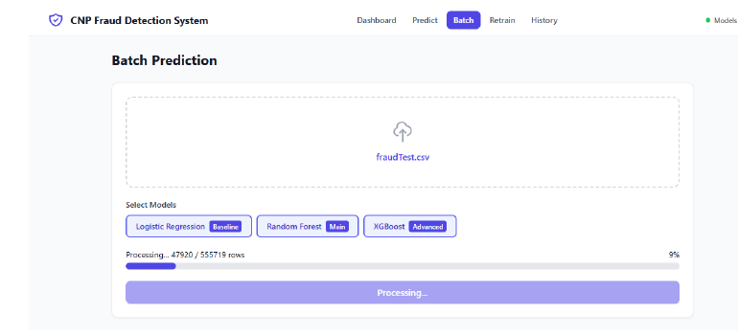
THE APP
A working app, not only a notebook.
Predict. Show reasons. Keep a history.
MAURITIUS EXAMPLES
E1
MUR 2,450 | 10:00 | 3.2 miles
APPROVED
E2
MUR 18,000 | 23:00 | 85 miles
APPROVED
E3
MUR 95,000 | 03:00 | 420 miles
FRAUD BLOCKED
What we learned
PREDICT
→
EXPLAIN
→
REVIEW
Web dashboard
-> API
E2 was meant to need review. After the online-only filter, the models approved it. SHAP showed why.
-> models, reasons, history
The form takes MUR. The model uses USD. The rate is 49.
These three examples are demos. They are not a full Mauritius study.
08
Notes:
Say: this is a real app. E1 looks normal and is approved. E3 looks extreme and is blocked. E2 did not match the first plan after the online-only filter. SHAP showed why. These are demos, not a full Mauritius study.

Slide 9
ANSWERS
Three questions. Three short answers.
The app is strong. Claims about Mauritius stay careful.
QUESTION
ANSWER
Can models find rare online fraud?
Yes. XGBoost: 92.63% precision and 97.60% PR-AUC. Random Forest is close.
RQ1
YES
Can we explain the decision and stay safe?
Yes. SHAP shows the reasons. The strictest model can still block.
RQ2
YES
Does it already work for Mauritius?
Too soon. Two of three demos matched. We still need real local data.
RQ3
PRELIMINARY
OVERALL TAKEAWAY
Good detector. Easy to review. Local proof still needed.
09
Notes:
Say: question 1 yes, models can find rare fraud. Question 2 yes, we can show reasons and still block on the strongest warning. Question 3 too soon for Mauritius. We need real local data.

Slide 10
CONCLUSION
The system works.
Mauritius proof is still early.
Next step: real local payment data.
What I built
What is next
01 Simple named features
02 Reasons in plain English
03 A careful combined decision
Real Mauritius data
More time-based features
Better score cut-offs
Questions
10
Notes:
Say: I built a working, explainable detector. I have not proved Mauritius with real bank data yet. Next: real local data, more time features, and better cut-offs.

Slide 11
CLOSING
OPEN DISCUSSION
Thank you
?
Interpretable ML for CNP fraud detection
DETECT • EXPLAIN • REVIEW
14
Notes:
Thank the audience. Invite questions. If needed, repeat: the system works, and Mauritius proof is still early.

Slide 12
Q&A
Why not one model?
They miss different cases. We keep the strongest warning.
WHY THREE
HOW WE COMBINE
LIVE DEMO
They miss different cases
We do not average
They disagreed. That helped.
One model can miss a new fraud pattern. Another can block too many genuine payments.
If any model says BLOCK, the app blocks. Missing fraud costs more than an extra check.
MUR 500,000: LR blocked at 100%. Trees approved. MUR 800 at 02:00 and 4000 miles: RF blocked at 43%.
SIMPLE RULE
If any model blocks, we block.
If one says review, we review.
If all approve, we approve.
11
Notes:
Say: three models because they fail on different cases. We do not average. If any model blocks, we block. The 500,000 rupee case was caught by Logistic Regression. The late-night far-away small payment was caught by Random Forest.

Slide 13
Q&A
What each model is for
Three jobs. One careful final decision.
BASELINE
MAIN
ADVANCED
Logistic Regression
Random Forest
XGBoost
A simple straight-line model. A huge amount can push the score to 100%.
Many small rules. It looks at clues together, such as time and distance.
Trees that learn from earlier mistakes. Best scores on the test set.
Safety net
Everyday detector
Best single model
Precision about 48% | Recall about 90%
Precision about 90% | Recall about 92%
Precision about 92% | PR-AUC about 98%
Good at extreme amounts. More false alarms.
Good when several clues appear together. Weak on brand-new extremes.
Best ranking of rare fraud. Same weak spot as Random Forest on brand-new extremes.
12
Notes:
Say: Logistic Regression is the safety net for extreme amounts. Random Forest is the everyday model for mixed clues. XGBoost has the best test scores. I keep all three so one blind spot cannot hide fraud.

Slide 14
Q&A
Trust the score. Check the red text.
The % was right. Some warning words were extra rules, not the model.
THE SCORE WORKED
THE TEXT CAN OVERSTATE
The % comes from the model.
Red bullets are extra rules.
MUR 500,000 at 02:00, 4000 miles
LR 100% BLOCKED
RF 9% APPROVED
XGB 0% APPROVED
Combined BLOCKED
Big amount always looks like risk.
Late night always looks like risk.
Far from home always looks like risk.
Even if this model did not use it as fraud.
IF ASKED
Trust the % and APPROVED or BLOCKED.
Do not treat HIGH FRAUD as the model's real reason.
13
Notes:
Say: the percentages were correct. The red HIGH FRAUD lines are extra rules in the text, not always SHAP. Trust the score and the verdict. On the extreme case, XGBoost still approved, but Logistic Regression blocked, so the app blocked.

