Slide 1
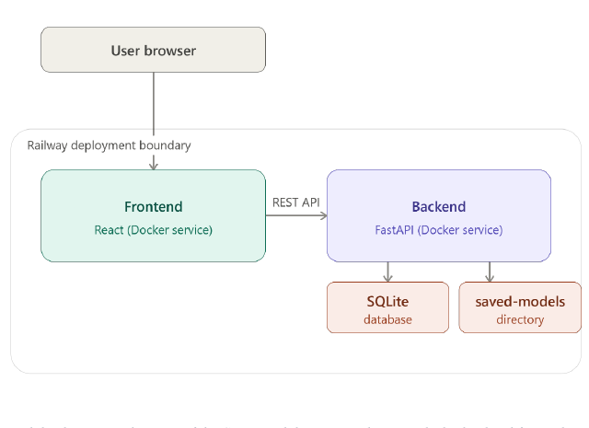
UNIVERSITY OF TECHNOLOGY, MAURITIUS
DISSERTATION PRESENTATION
Interpretable ML for
CNP fraud detection
Card-Not-Present e-commerce fraud
DETECT
EXPLAIN
DEPLOY
ALLY HOSSEN Muhammad Ismael
MSc Artificial Intelligence with Machine Learning
Supervisor: Dr. Panchoo Shireen
July 2026
Notes:
Open with the problem and the promise of the project: detect online card fraud, but keep the reasoning visible to an analyst. This presentation focuses on the method, the evidence, and what the Mauritius tests do and do not establish.
[Bullet points]
- Project goal: interpretable CNP fraud detection
- Mauritius-contextualised evaluation
- End-to-end path from data to analyst UI

Slide 2
CONTEXT
CNP fraud is rare, so accuracy alone is not enough
The project treats fraud detection as a rare-event, analyst-facing decision problem.
1.21%
1 : 81
3,576
fraud prevalence after CNP filtering
fraud to legitimate
fraud cases in 294,854 transactions
The research gap
Aim
Most benchmark datasets hide behaviour behind PCA-anonymised features.
Build a CNP fraud detector that is accurate enough to be useful, explainable enough to review, and deployable enough to test in a Mauritius context.
A high-accuracy model can still miss the minority class.
US-centric evidence does not automatically generalise to Mauritius.
02
Notes:
The key framing is the imbalance. In this filtered dataset, fraud is only 1.21 percent of transactions, or roughly one fraud case for every 81 legitimate transactions. That is why I use precision, recall, F1 and PR-AUC as the main evidence rather than accuracy alone. The project also addresses interpretability and contextual validity.
[Bullet points]
- Fraud is only 1.21% of 294,854 transactions
- Accuracy can hide minority-class failures
- Precision, recall, F1 and PR-AUC are prioritised

Slide 3
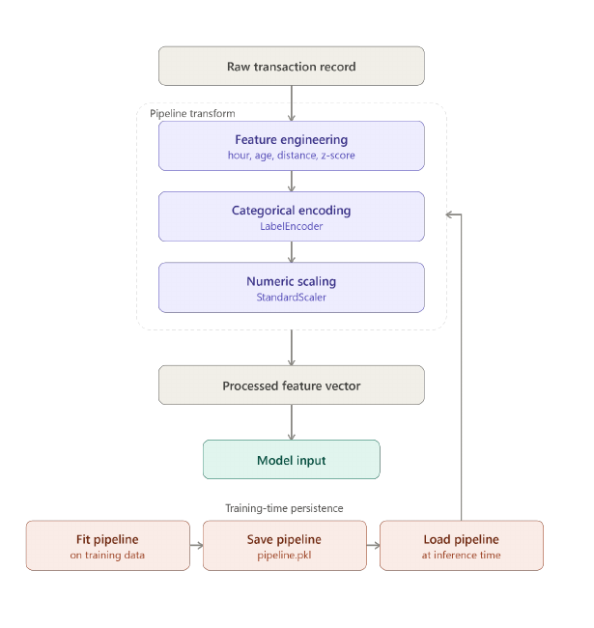
DATA AND FEATURES
Named behavioural features keep the signal interpretable
Only unambiguously online merchant categories were retained for the final CNP experiment.
7 FEATURE INPUTS
FINAL MODELLING SET
294,854
transactions
3,576 fraud cases
~81:1 imbalance
CNP filter
grocery_net | misc_net | shopping_net
Chronological split
60% train | 20% calibration | 20% validation
7 named features: amount | hour | age | distance | amount z-score | category | gender
03
Notes:
The data was filtered before feature engineering to keep the task specifically about card-not-present transactions. The seven features deliberately describe behaviour: transaction amount, time of day, age, distance from home, category-relative amount z-score, category and gender. The chronological split is intended to mimic training on historical transactions and predicting future ones.
[Bullet points]
- Filtered data: 294,854 CNP transactions and 3,576 fraud cases
- Named behavioural features keep the signal explainable
- Chronological 60/20/20 split mirrors future prediction

Slide 4
METHOD
Three models share one cost-sensitive training path
The comparison separates model capacity from the data and evaluation decisions.
One transformed input
The same engineered feature vector feeds three complementary classifiers.
BASELINE
NON-LINEAR
ADVANCED
x
->
LR
->
RF
->
XGB
engineered
features
interpretable
baseline
non-linear
ensemble
boosted
detector
No SMOTE in the final pipeline.
Native class weighting handles imbalance.
PR-AUC and F1 guide the comparison.
Runtime verdicts use three tiers: APPROVED | REVIEW REQUIRED | FRAUD BLOCKED
04
Notes:
The model comparison is intentionally compact: logistic regression provides an interpretable baseline, random forest captures non-linear rules, and XGBoost provides a stronger boosted detector. The final pipeline uses native class weighting rather than synthetic oversampling after SMOTE caused poor generalisation on new examples. Thresholds and the three-tier verdict are applied after model scoring.
[Bullet points]
- Logistic regression is the interpretable baseline
- Random Forest captures non-linear rules
- XGBoost provides a stronger boosted detector

Slide 5
RESULTS
XGBoost is strongest standalone; Random Forest is close
On the 58,971-row chronological validation set, the tree models dominate the interpretable baseline.
XGBoost
BEST STANDALONE
92.63%
precision
92.29%
recall
97.60%
PR-AUC
RF: 91.29% F1 | 96.23% PR-AUC
LR remains the sensitivity-oriented baseline.
Accuracy is omitted from the chart because all three models exceed 99% under the 81:1 class imbalance.
05
Notes:
The important result is not the small difference in accuracy. XGBoost reaches 92.63 percent precision, 92.29 percent recall, 92.46 percent F1 and 97.60 percent PR-AUC. Random Forest is close, with identical recall and slightly lower precision. Logistic regression still detects most fraud, but at a much higher false-positive cost. PR-AUC is the most meaningful summary here because it focuses on the minority class.
[Bullet points]
- XGBoost is strongest standalone: 92.63% precision
- XGBoost reaches 92.29% recall and 97.60% PR-AUC
- Random Forest is close with 91.29% F1 and 96.23% PR-AUC

Slide 6
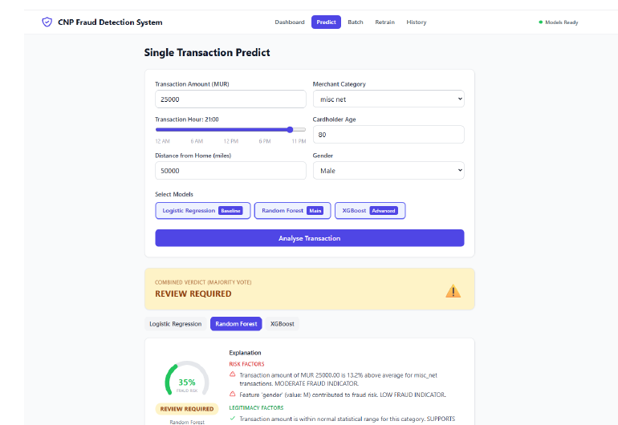
EXPLAINABILITY AND ENSEMBLE
A single strong signal can escalate the final verdict
SHAP explains the signal; the ensemble prevents disagreement from hiding a high-risk case.
SHAP turns model output into analyst language
Risk factors push the decision toward fraud.
Legitimacy factors push the decision toward approval.
The text explainer converts attributions into plain English.
Most consistently important: amount z-score | distance | hour of day
FEATURE
→
SHAP IMPACT
→
VERDICT
LR 100%
FRAUD BLOCKED
->
RF 8%
APPROVED
->
XGB 0%
APPROVED
->
MOST SEVERE VERDICT
FRAUD BLOCKED
544/545 fraud cases were FRAUD BLOCKED; none were APPROVED. Block precision was 43.07% - the intentional cost of conservative escalation.
06
Notes:
This is the reliability story of the system. SHAP shows which features push a transaction toward fraud or legitimacy, and the natural-language explanation makes that understandable to a non-technical analyst. In the extreme E3 benchmark, logistic regression produced a 100 percent fraud probability while the two tree models did not. The escalation rule therefore takes the most severe model verdict. This improves sensitivity, but it creates a precision cost: many blocked transactions still require human review.
[Bullet points]
- SHAP identifies fraud and legitimacy drivers
- Natural-language explanations make the score reviewable
- The most-severe verdict rule protects against a missed signal

Slide 7
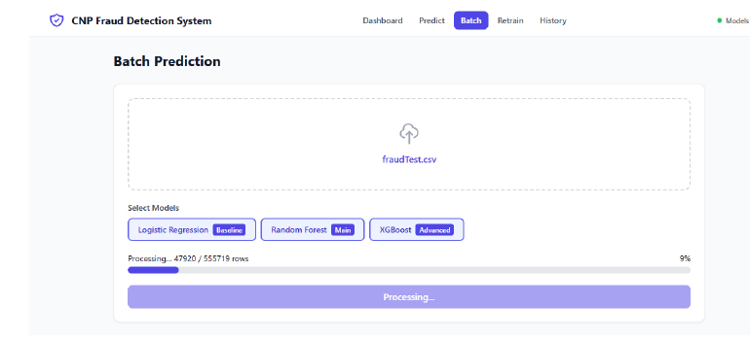
PROTOTYPE AND CONTEXT
The prototype is deployed as an analyst-facing workflow
A real application connects prediction, explanation, history and analyst review.
MAURITIUS BENCHMARKS
E1
MUR 2,450 | 10:00 | 3.2 miles
APPROVED
E2
MUR 18,000 | 23:00 | 85 miles
APPROVED
E3
MUR 95,000 | 03:00 | 420 miles
FRAUD BLOCKED
The useful surprise
PREDICT
→
EXPLAIN
→
REVIEW
React dashboard
-> FastAPI REST API
E2 changed from the intended REVIEW REQUIRED to APPROVED after CNP filtering. SHAP traced the shift to a strong negative shopping_net contribution - a limitation made visible by the explainer.
-> models + SHAP + SQLite history
MUR input is supported through a fixed 49 MUR/USD conversion in the retraining path.
Two of three benchmarks matched the intended outcome; this is illustrative, not statistical generalisation.
07
Notes:
The model is packaged as a usable workflow rather than left as an offline experiment. Analysts can submit single or batch predictions, see the ensemble verdict and SHAP explanation, inspect history and confirmed labels can be added as a future retraining loop. The three MUR benchmarks are deliberately illustrative. E1 and E3 behave as intended; E2 exposes a shift after CNP filtering, and the SHAP layer helps diagnose it.
[Bullet points]
- Analysts can run single, batch and historical predictions
- FastAPI connects the React UI to models and SQLite history
- E1 and E3 matched intent; E2 changed after CNP filtering

Slide 8
CONCLUSION
The contribution is practical -
the local generalisation claim remains preliminary
A transparent detection workflow is demonstrated; real Mauritian data is the next evidence step.
What this study adds
Next research
01 Named behavioural features
02 SHAP plus natural-language explanations
03 Cost-sensitive training and escalation-based decisions
Real Mauritian transaction data
Velocity and sequence features
Threshold calibration on held-out data
Questions
08
Notes:
Close with the balanced claim. The project contributes an interpretable feature pipeline, model comparison, SHAP explanations, an escalation rule and a working analyst-facing application. It does not yet establish statistical generalisation to Mauritius because the local test set contains only three manually constructed transactions. The clearest next steps are real local data, transaction velocity features and threshold calibration on a held-out partition. Then invite questions.
[Bullet points]
- Contributions: interpretable features, SHAP, escalation and a deployed app
- Main limitation: US-simulated data and three hand-made MUR benchmarks
- Next: local data, velocity features and held-out threshold calibration

Slide 9
INFERENCE FLOW
How one transaction moves through the system
The same decision path links behavioural features, ensemble scores and human review.
1
CAPTURE
2
ENGINEER
3
SCORE
4
EXPLAIN
5
DECIDE
Raw transaction
context
Hour · age ·
distance · z-score
LR · RF · XGB
fraud probabilities
SHAP factors
analyst message
Approved · Review
Fraud blocked
DESIGN PRINCIPLE
Traceability is the product feature: every verdict can be reviewed and explained.
09
Notes:
Use this slide to connect the research method to the prototype. A transaction is not just scored: it is transformed into named behavioural features, scored by three models, explained, and then routed into a human-readable verdict.
[Bullet points]
- Capture raw transaction attributes and context
- Engineer four derived behavioural features
- Score with LR, RF and XGB

Slide 10
ANSWERS
Three research questions, three answers
Evidence supports the prototype; local generalisation remains preliminary.
RESEARCH QUESTION
EVIDENCE / ANSWER
Can supervised models detect CNP fraud under severe imbalance?
XGBoost achieved 92.63% precision and 97.60% PR-AUC; Random Forest was close.
RQ1
YES
Can explanations and escalation make decisions more reviewable?
SHAP exposes the drivers, while the most severe model verdict is escalated for review.
RQ2
YES
Does the prototype generalise to Mauritius?
Two of three MUR benchmarks matched intent; real local data is still needed.
RQ3
PRELIMINARY
OVERALL TAKEAWAY
Accurate and explainable prototype; local generalisation remains an open question.
10
Notes:
This is the concise conclusion. The model question is answered positively, the interpretability question is answered through SHAP and escalation, and the Mauritius question remains preliminary. Finish by stating exactly what the project demonstrates and what future data is required.
[Bullet points]
- RQ1: supervised learning detects fraud despite severe imbalance
- RQ2: SHAP and escalation make decisions more reviewable
- RQ3: Mauritius generalisation is promising but preliminary

Slide 11
CLOSING
OPEN DISCUSSION
Thank you
?
Questions and discussion
Interpretable ML for CNP fraud detection
DETECT • EXPLAIN • REVIEW
11
Notes:
[Bullet points]
- Thank the audience
- Invite questions

