Slide 1
Campus Buddy
Your campus. Your people.
A verified college student platform for Virginia universities.
GMU
VT
UVA
JMU
VCU
W&M
ODU
Shayan Khan · Noe Flores · Aser Eshetu · Enoch Ogunfiditimi · Kayla Suttihprapa
CS 321 · Spring 2026 · Prof. Dr. David Samudio

Slide 2
The Problem
Students juggle 4+ disconnected platforms with zero verification
💬 GroupMe / Discord
📘 Facebook Groups
No identity verification — bots and outsiders join freely
No university filter — anyone can join, no academic focus
🛒 Facebook Marketplace
🎓 Blackboard / Canvas
No trust layer — students meet strangers for textbooks
Limited peer collaboration — lecture delivery only, no community

Slide 3
Our Solution
One verified platform — everything a college student needs
01
02
Verified Identity
Study Groups
Sign up with your @university.edu email. Domain is checked against 7 supported Virginia universities.
Create and join course-specific study groups. Only verified classmates at your school can see them.
03
04
Campus Events
Textbook Marketplace
Post and RSVP to campus events. All events are from verified students at your own university.
Buy and sell textbooks with verified classmates. Contact sellers directly via university email.

Slide 4
Requirements
Deliverables 1 & 2 — what we committed to building
Feature Backlog
5 User Stories (Feature 1)
#1 HIGH
Sprint 1
→
Shayan:
Authentication & Student Profiles
Can't verify Discord users are GMU students
→
Noe:
#2 HIGH
Sprint 2
Facebook Marketplace has no university filter
Study Group Organizer
→
Aser:
#3 MED
Sprint 3
Campus events scattered across 4 platforms
Campus Event Board
→
Enoch:
No way to find classmates selling textbooks
#4 MED
Sprint 3
Textbook Exchange Marketplace
→
Kayla:
Bots invade student Discord servers

Slide 5
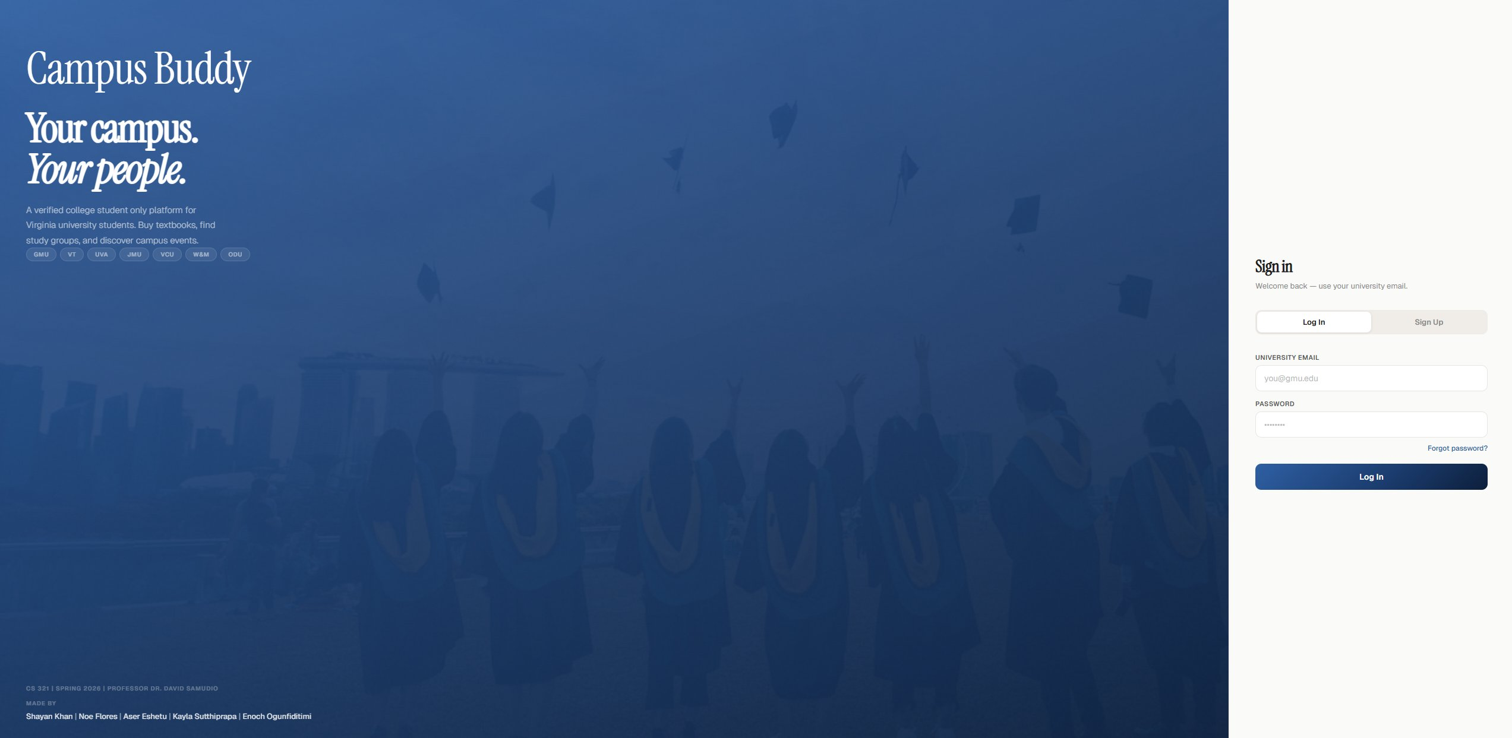
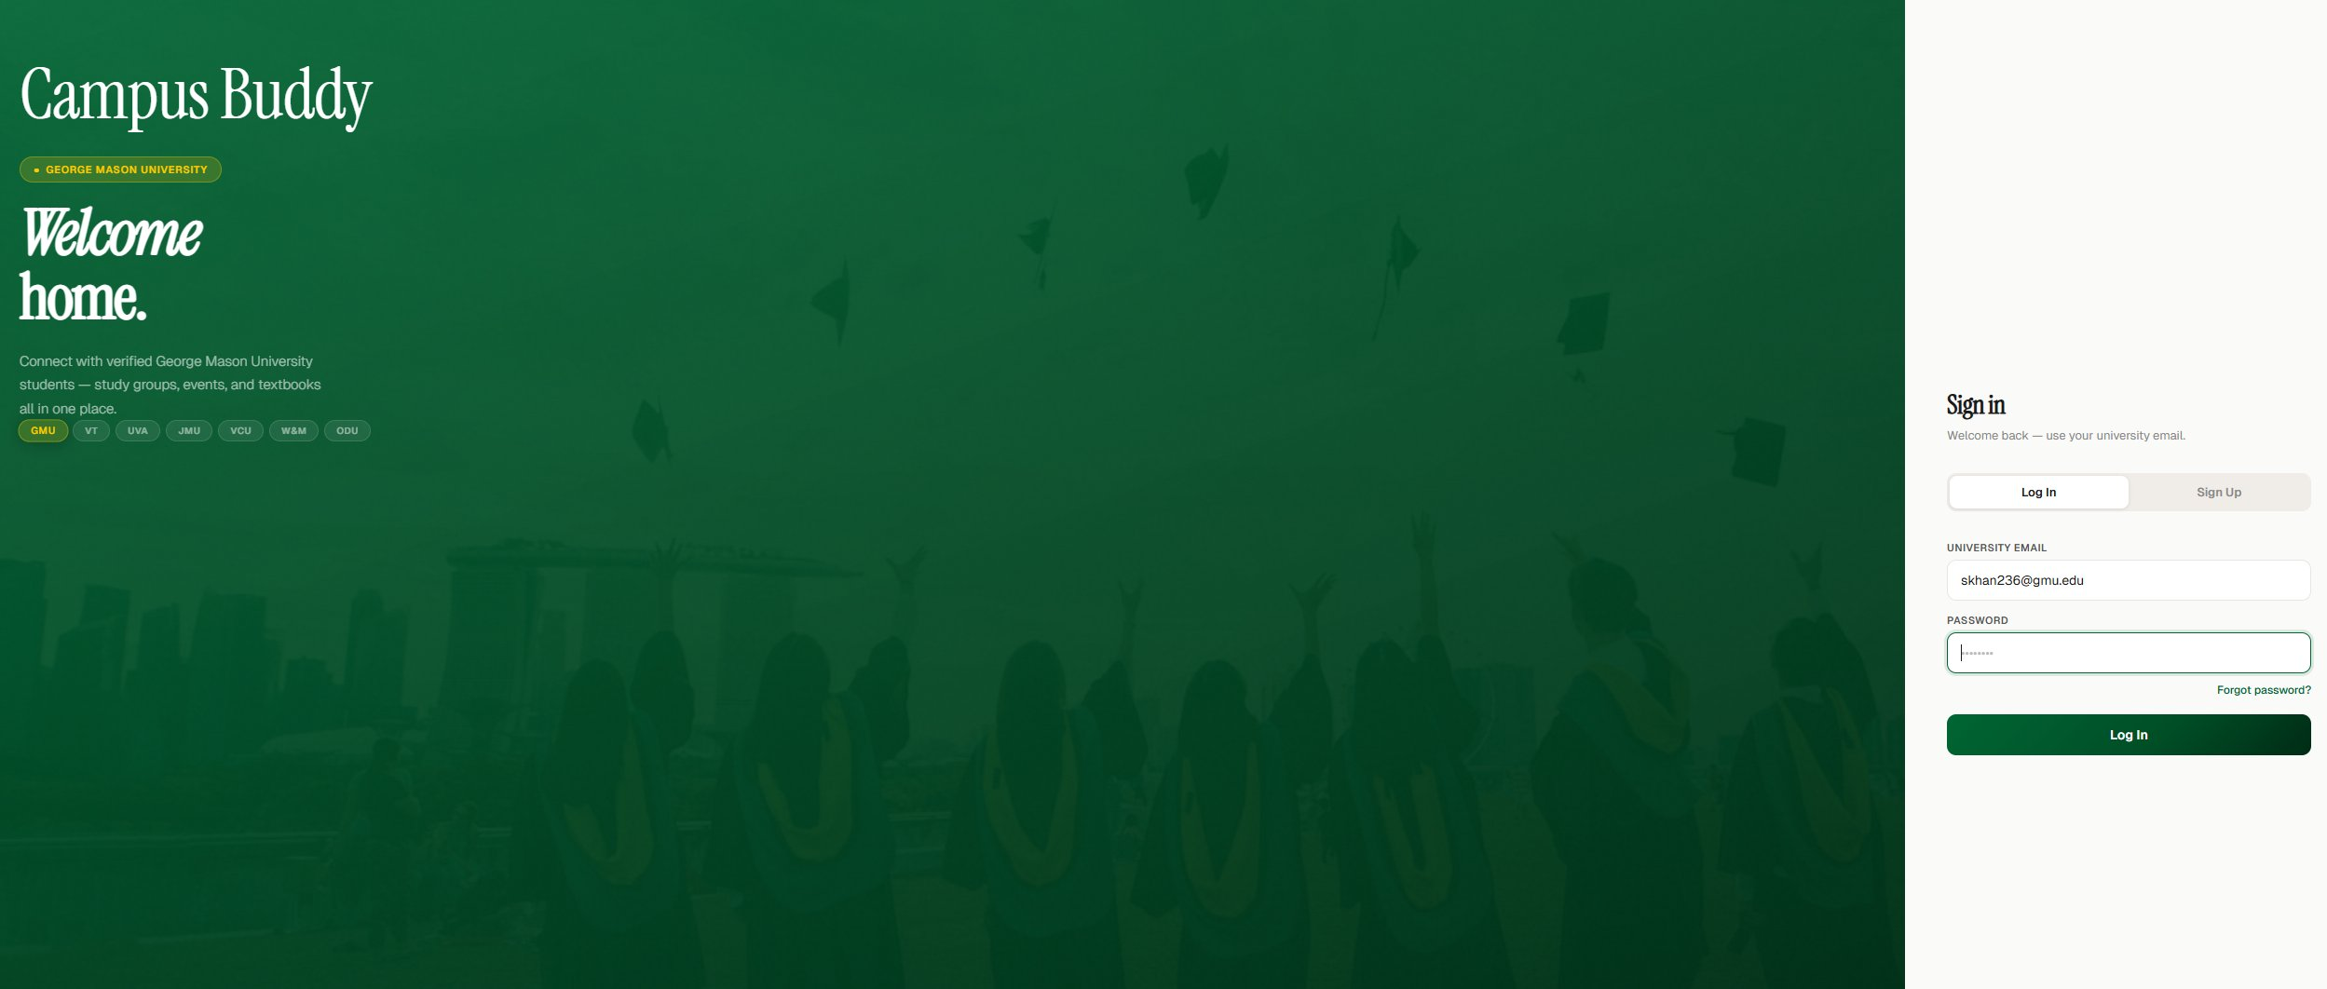
Live Demo — Authentication
University email detection + per-university theming
Default — no email typed
@gmu.edu detected → GMU green theme

Slide 6
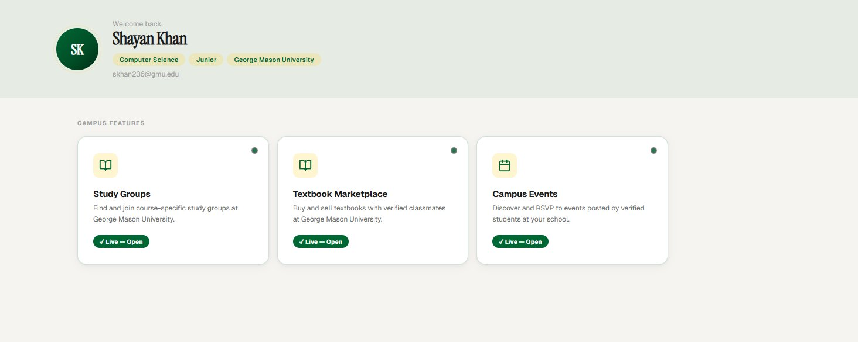
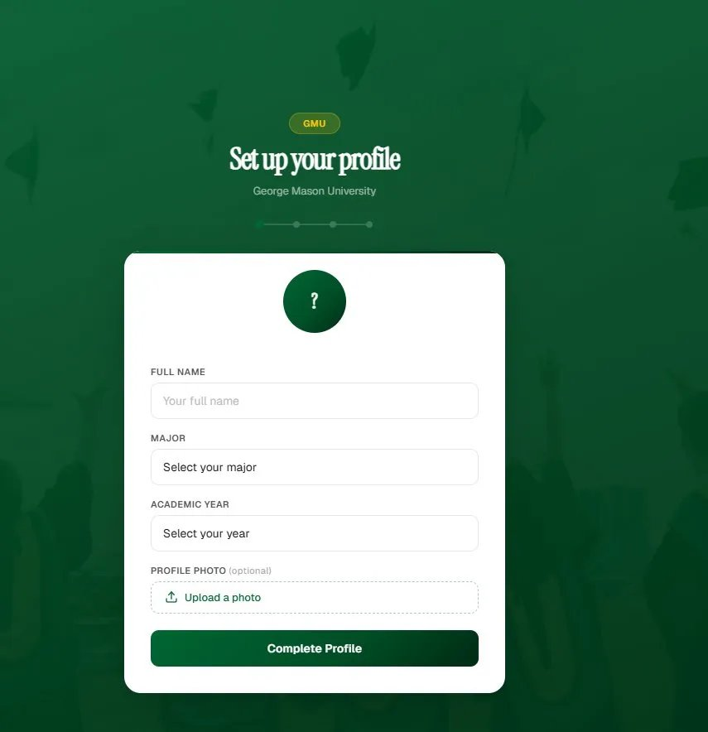
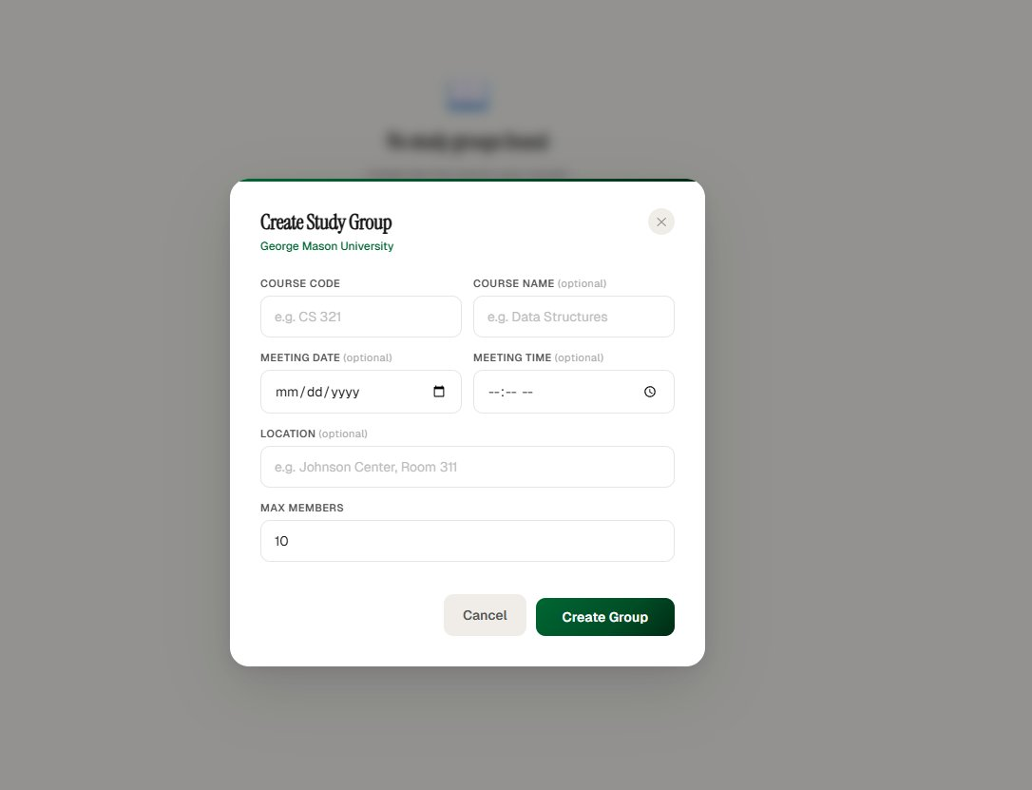
Live Demo — Dashboard
Profile with university badge + major/year tags
3 live features — all clickable from dashboard
Per-university color theming applied everywhere

Slide 7
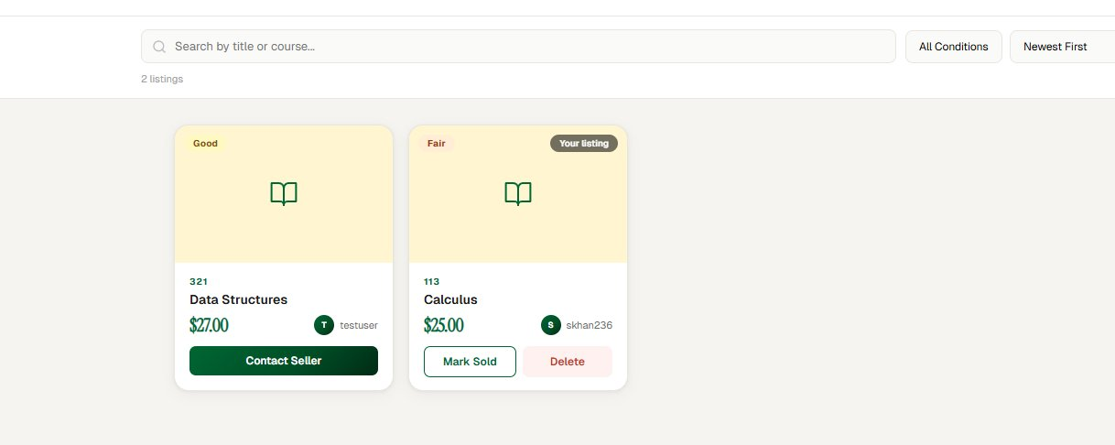
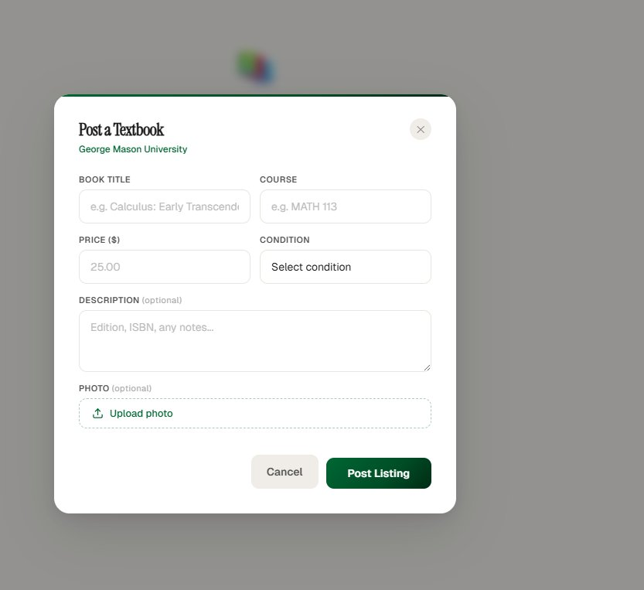
Live Demo — Textbook Marketplace
Search · filter by condition · sort by price · contact seller via university email
Listings filtered to your university only
Contact Seller → copy email or open in mail app
Owners see Mark Sold + Delete buttons
Available vs Sold tabs

Slide 8
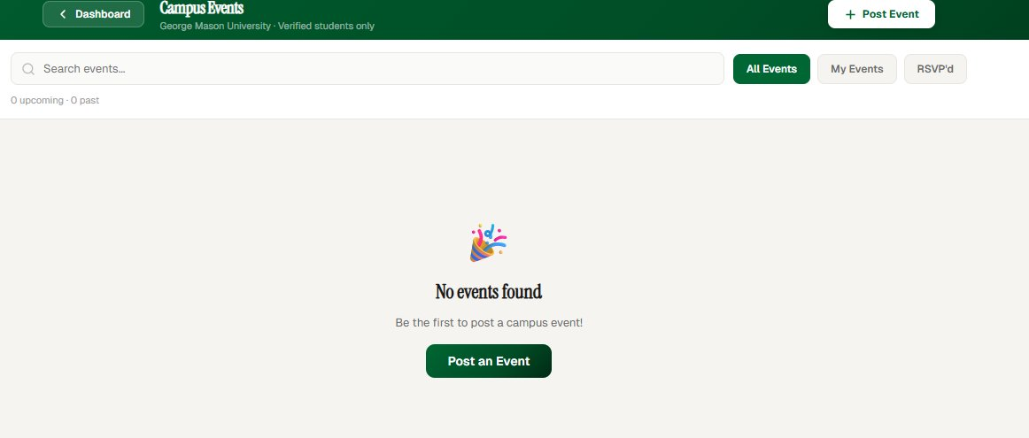
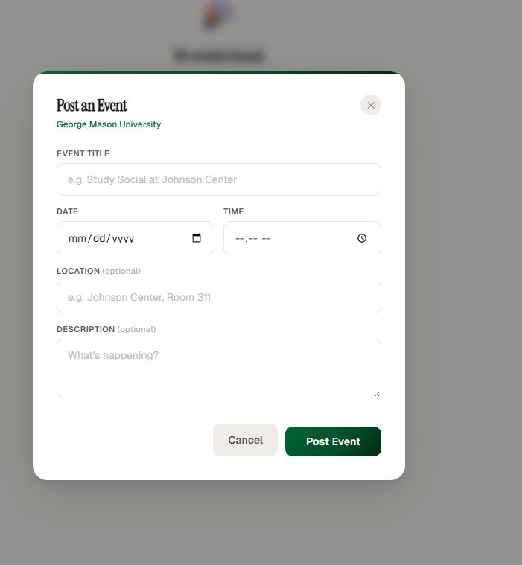
Live Demo — Campus Events
Post events · RSVP · filter by All / My Events / RSVP'd · upcoming vs past split
All events visible to verified GMU students only
Post Event modal — title, date, time, location
RSVP toggle — shows Going / un-RSVP option
My Events filter shows only your own posts

Slide 9
Design Documentation
20 diagrams — 4 per team member — conceptual + detailed class + 2 sequence diagrams each
Shayan Khan
Conceptual class · Detailed class · Sign-up sequence · Login sequence
Auth + Dashboard
Kayla Suttihprapa
Conceptual class · Detailed class · Profile setup seq · Profile edit seq
Profile Setup + Edit
Enoch Ogunfiditimi
Conceptual class · Detailed class · Create group seq · Join/Leave seq
Study Groups
Aser Eshetu
Conceptual class · Detailed class · Post event seq · RSVP seq
Campus Events
Noe Flores
Conceptual class · Detailed class · Post listing seq · Mark sold seq
Textbook Marketplace

Slide 10
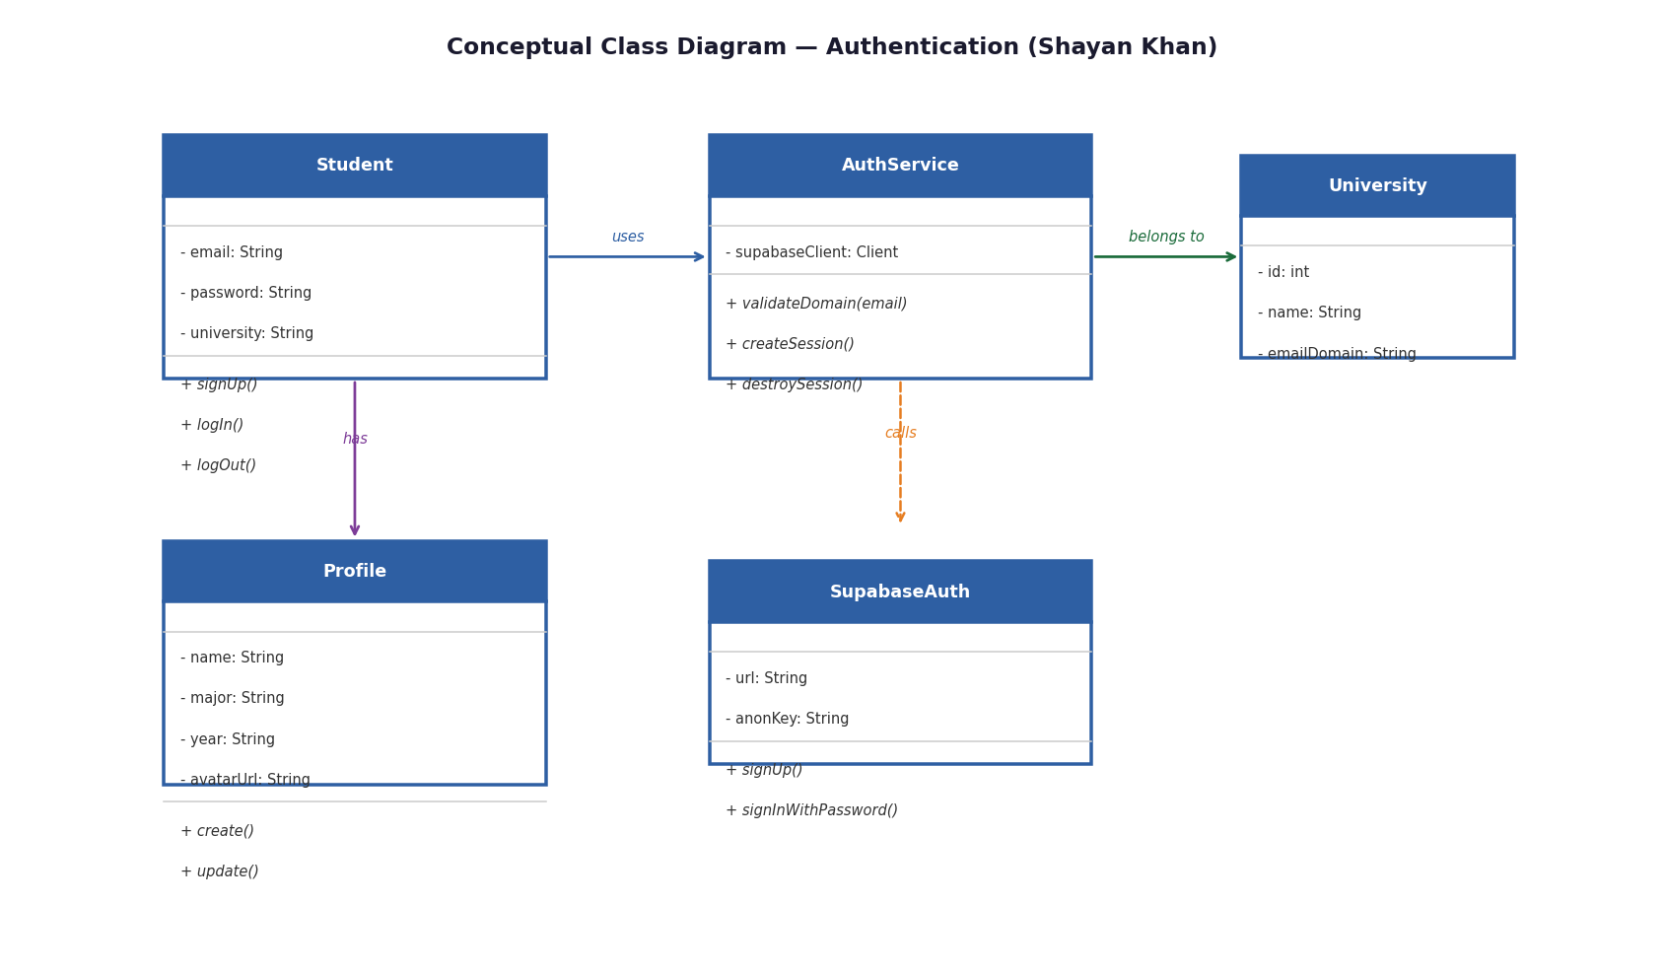
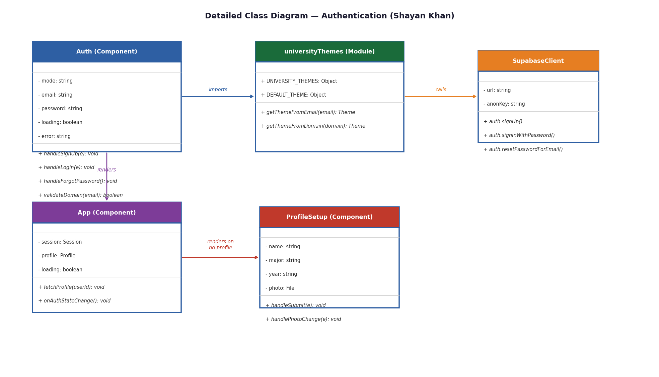
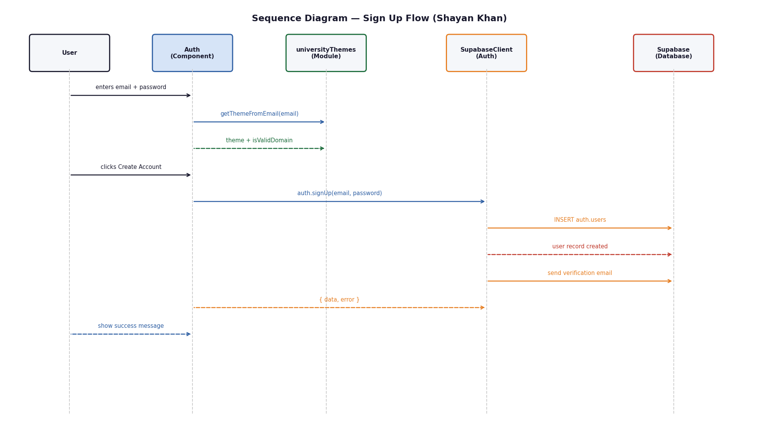
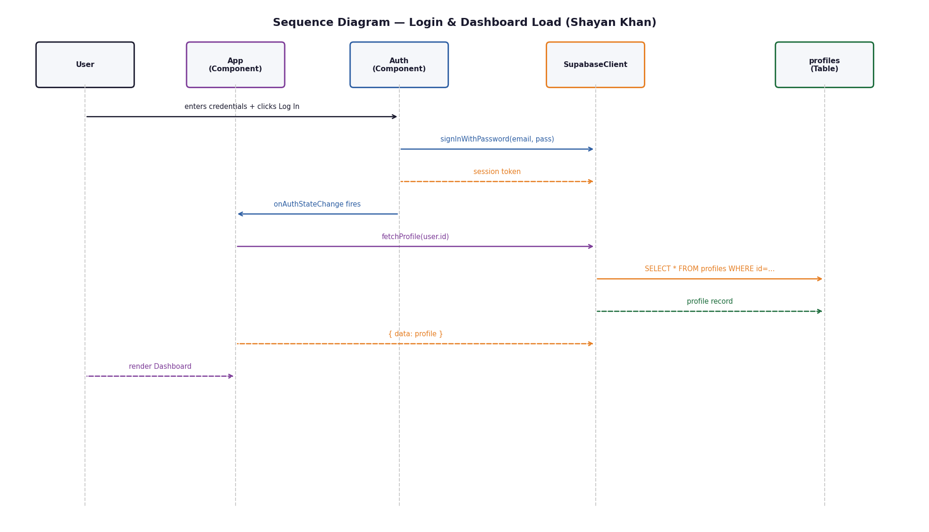
Design Diagrams — Shayan Khan
Authentication + Dashboard
Conceptual Class Diagram
Detailed Class Diagram
Sequence — Sign Up Flow
Sequence — Login & Dashboard Load

Slide 11
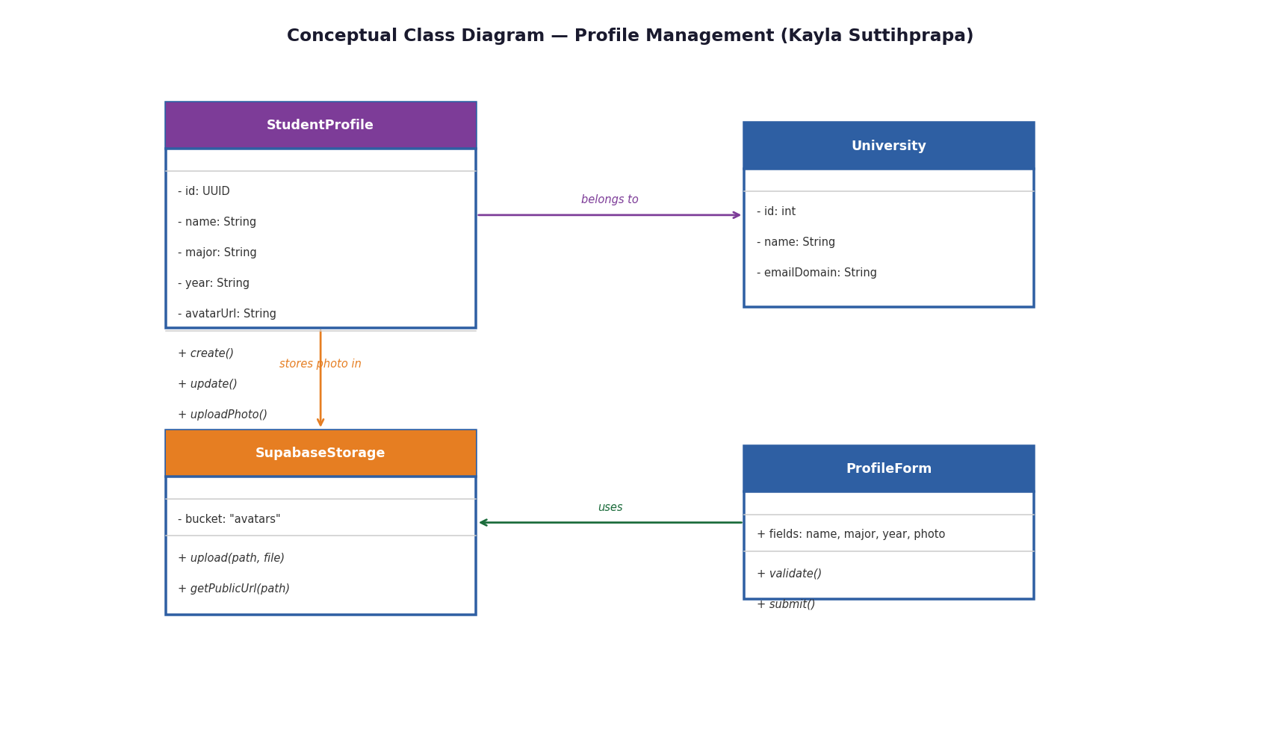
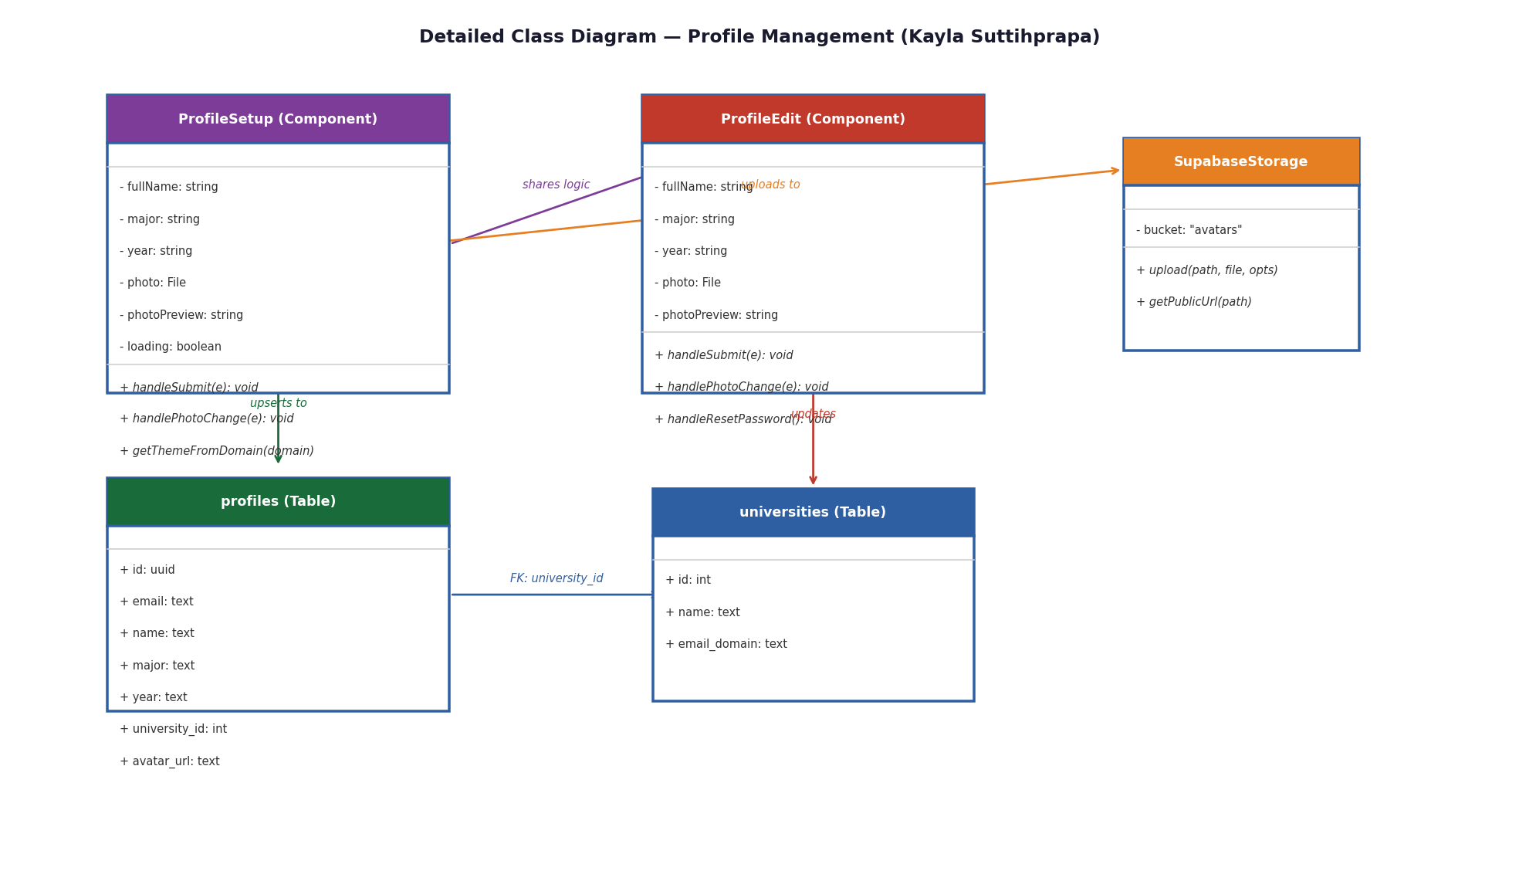
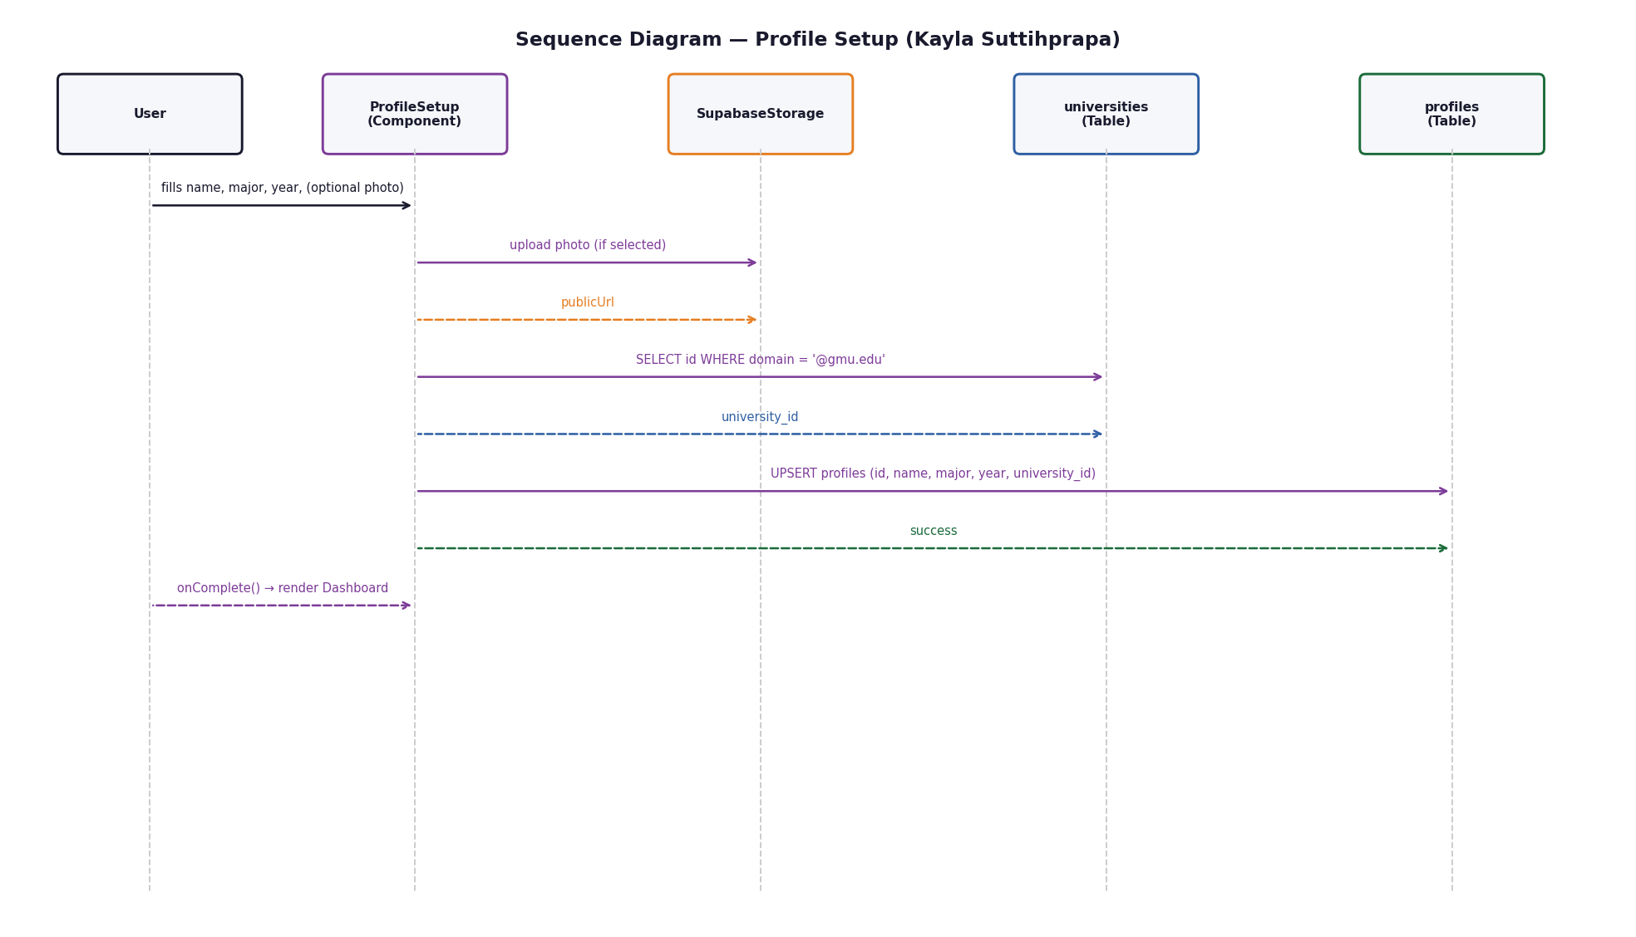
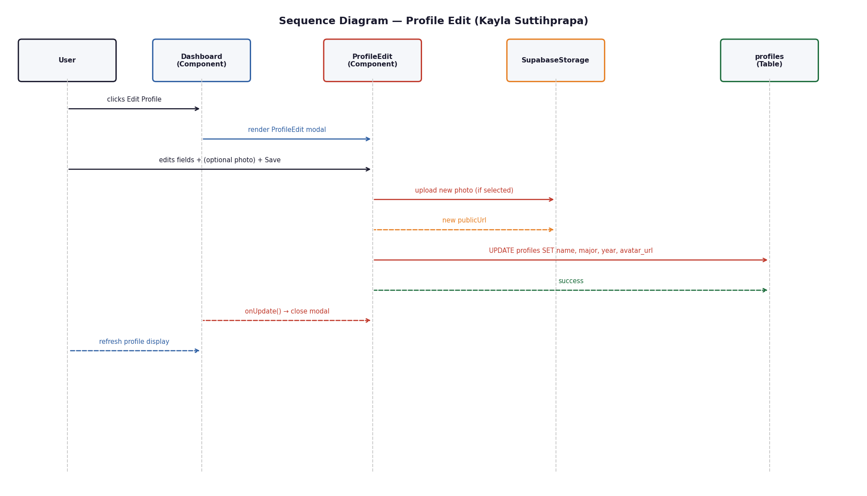
Design Diagrams — Kayla Suttihprapa
Profile Setup + Edit
Conceptual Class Diagram
Detailed Class Diagram
Sequence — Profile Setup
Sequence — Profile Edit

Slide 12
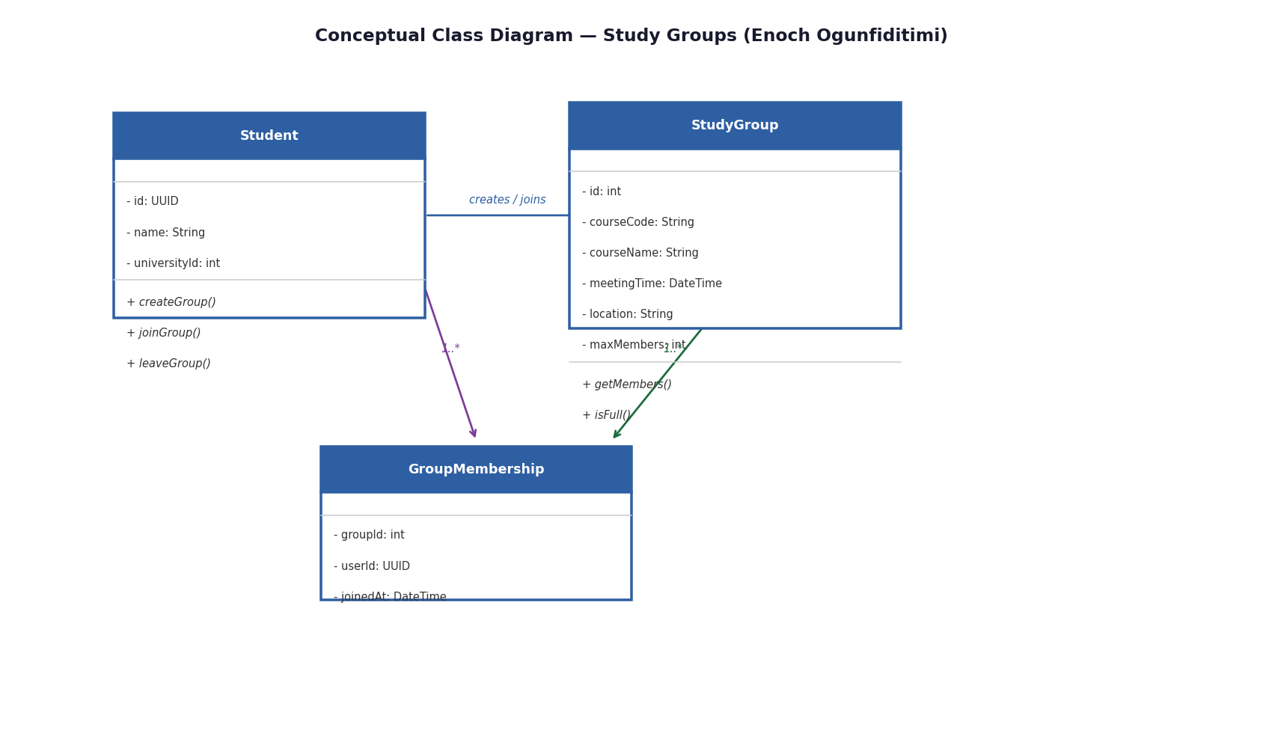
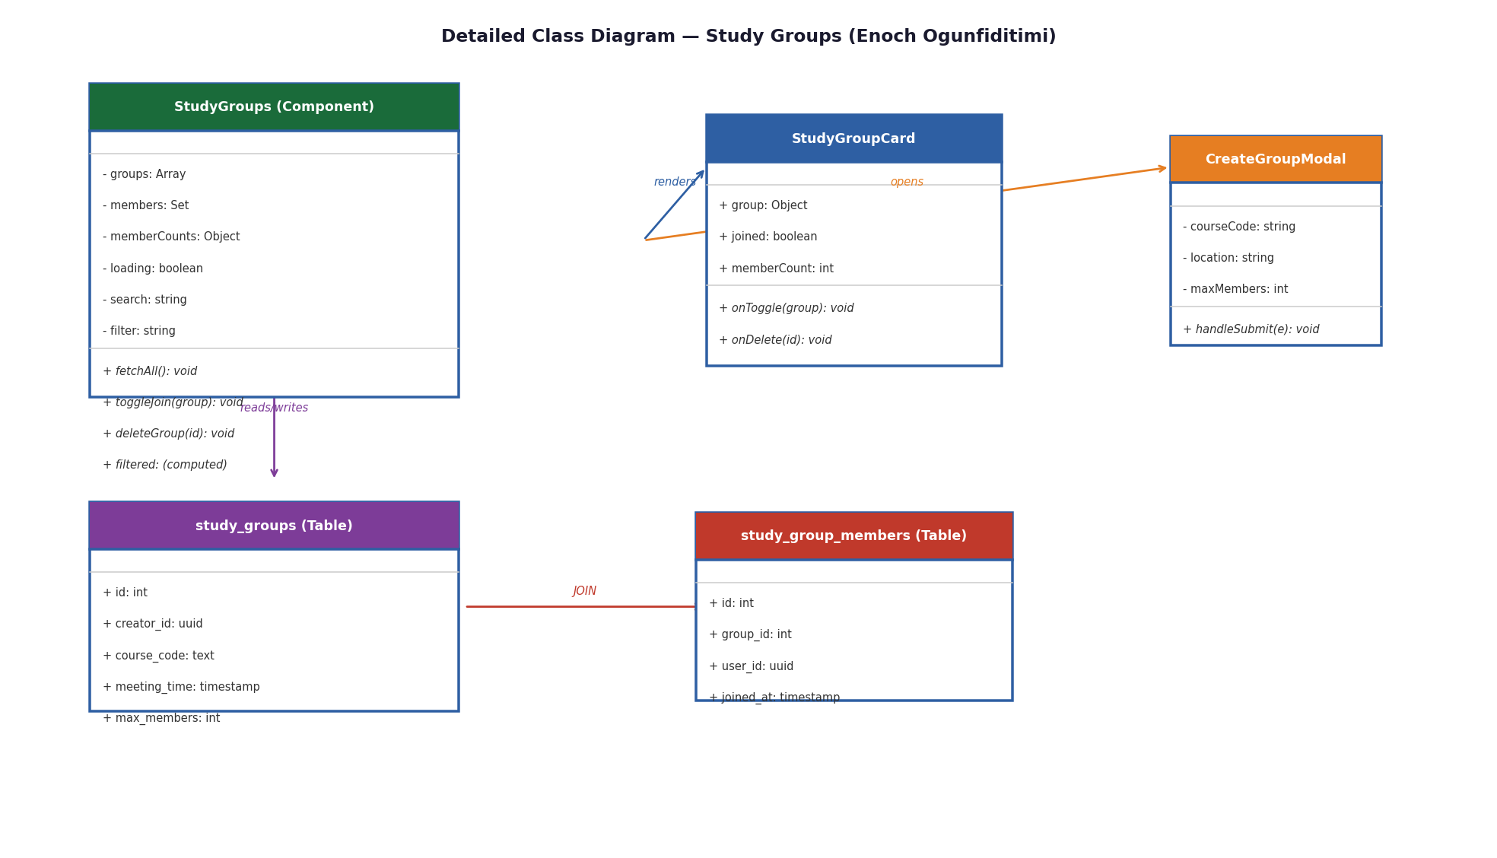
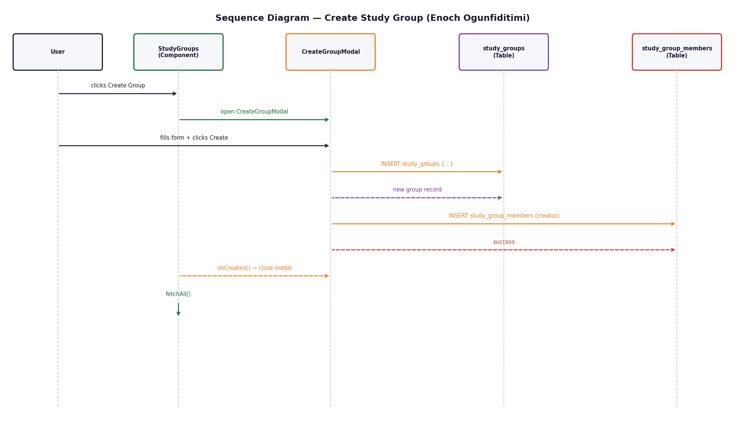
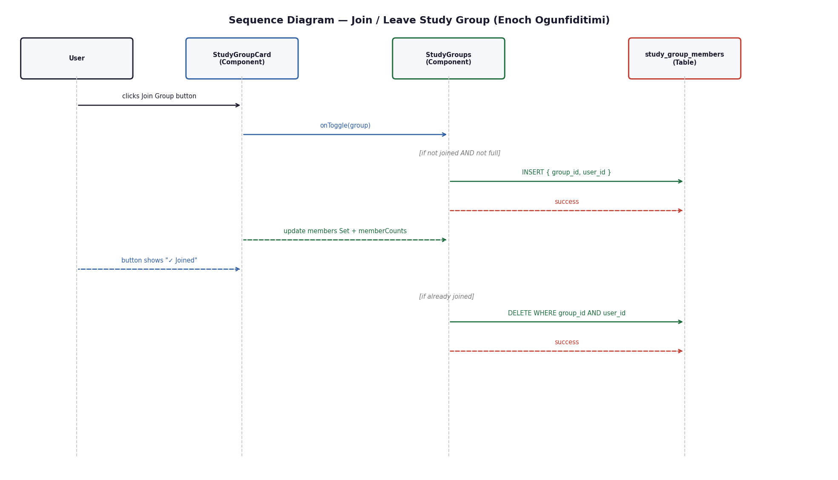
Design Diagrams — Enoch Ogunfiditimi
Study Groups
Conceptual Class Diagram
Detailed Class Diagram
Sequence — Create Study Group
Sequence — Join / Leave Group

Slide 13
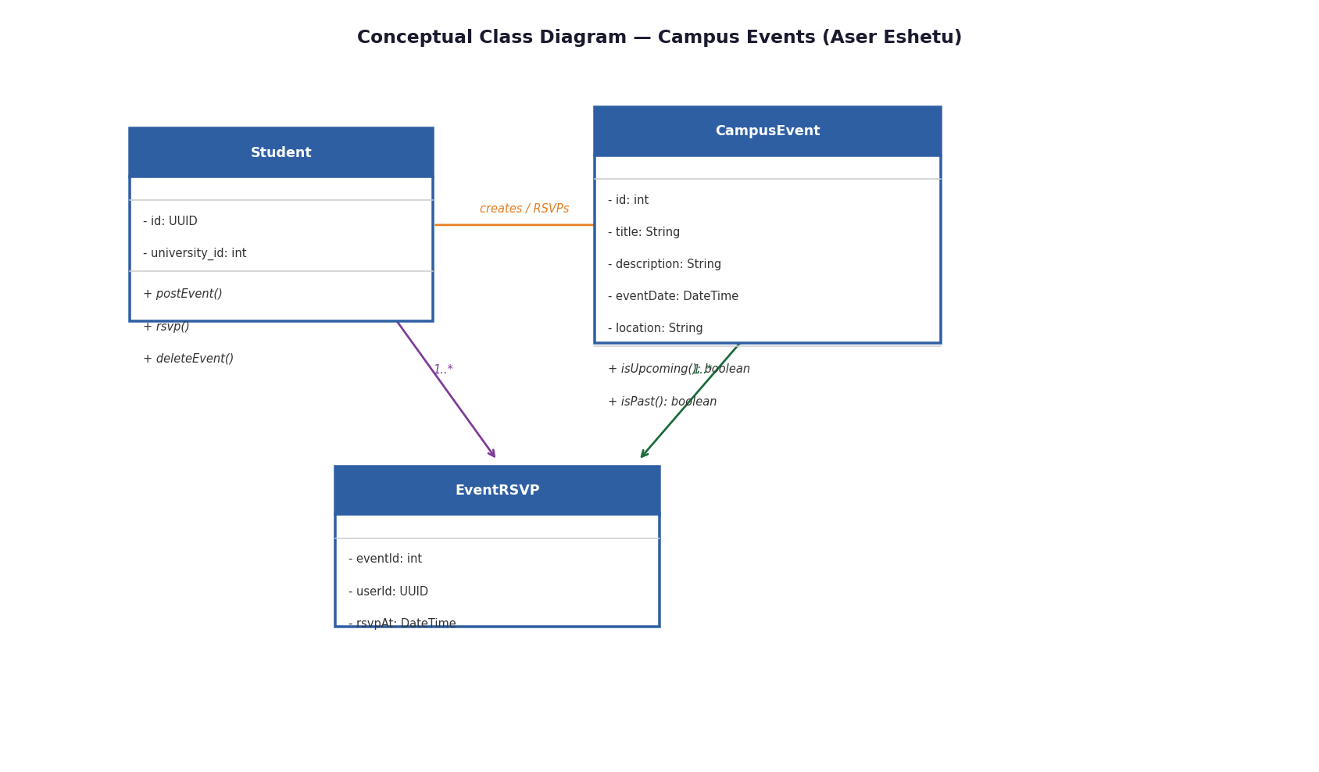
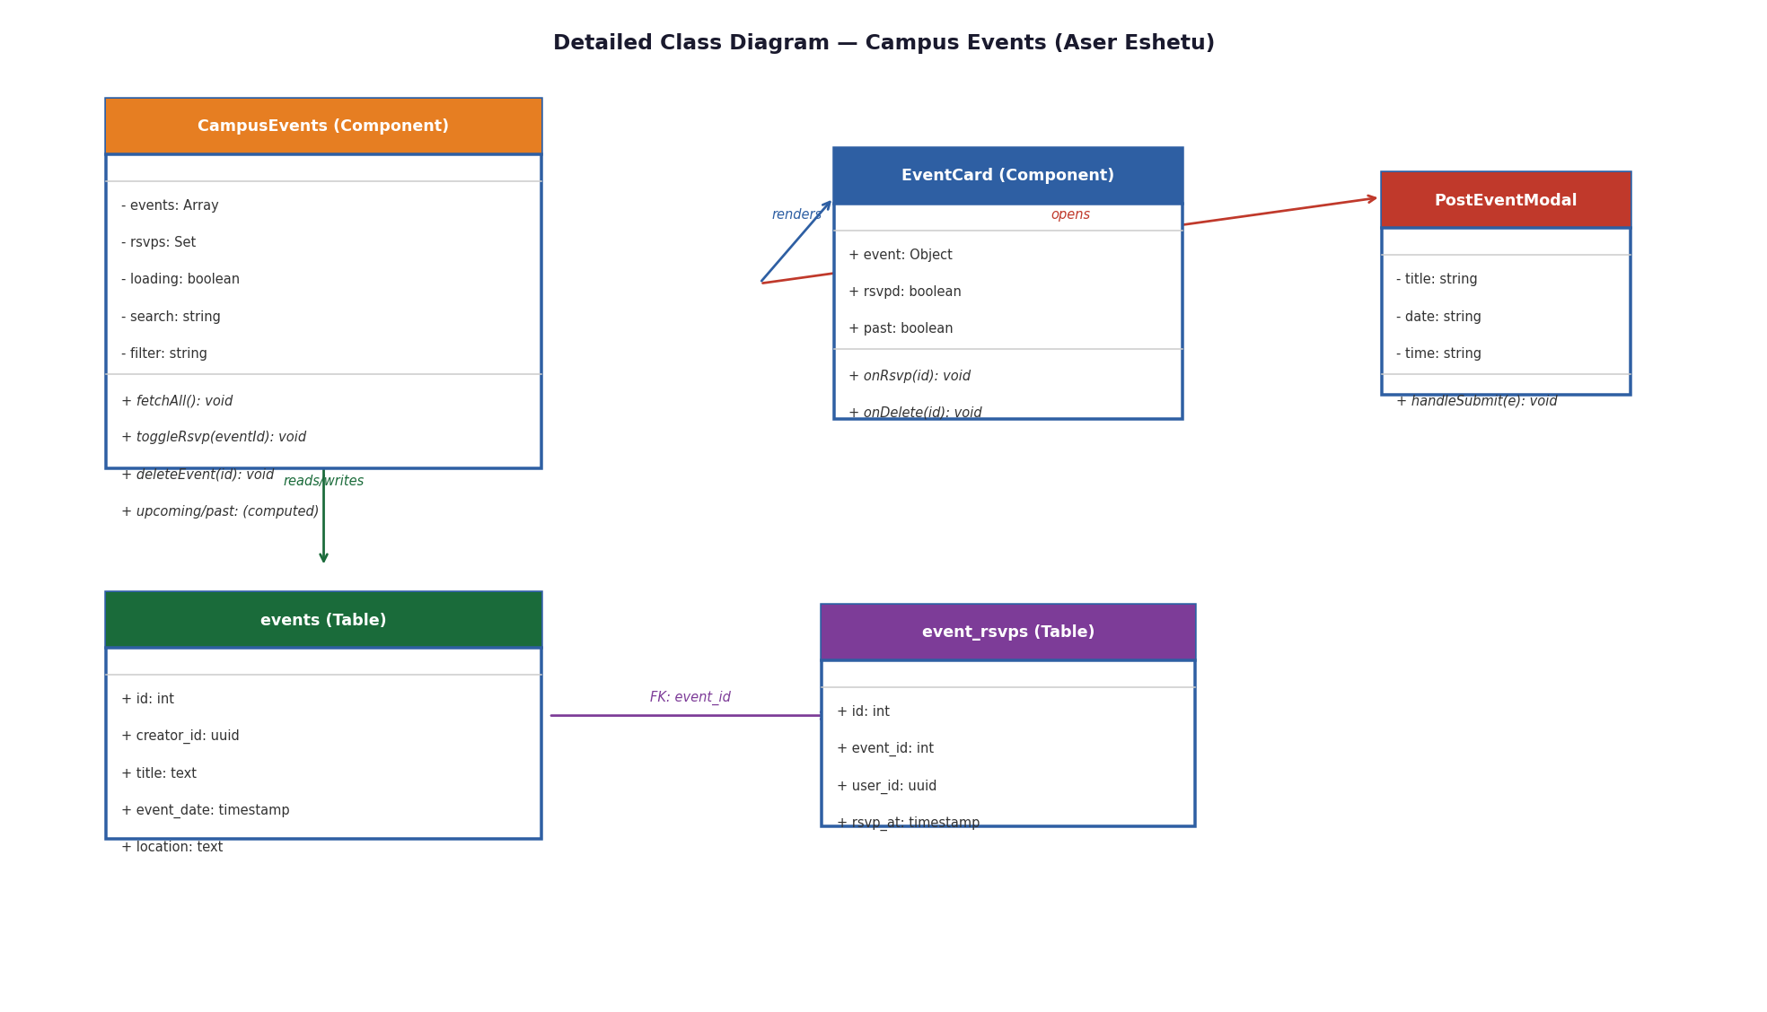
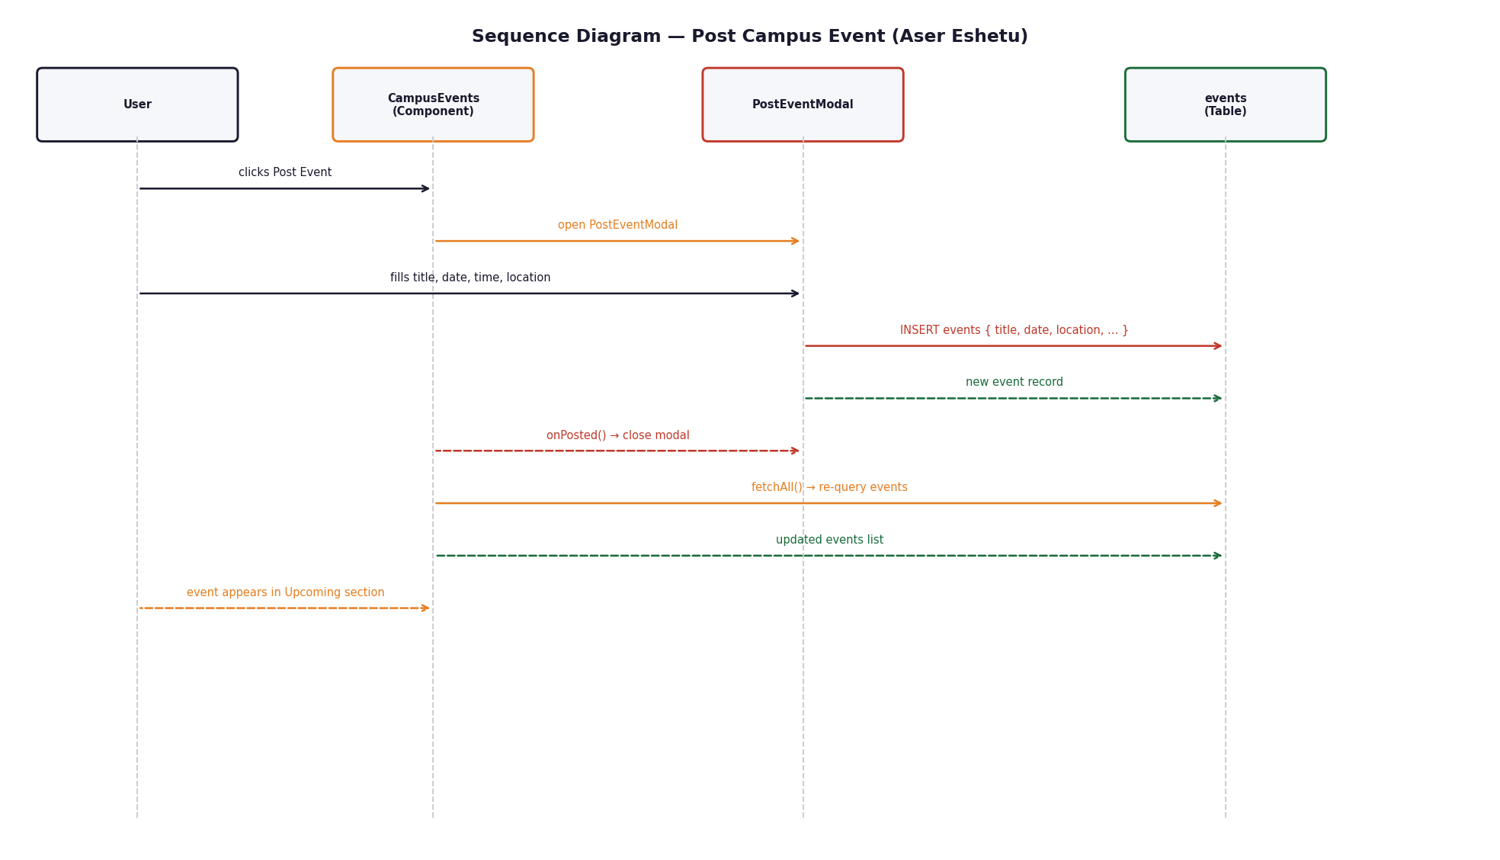
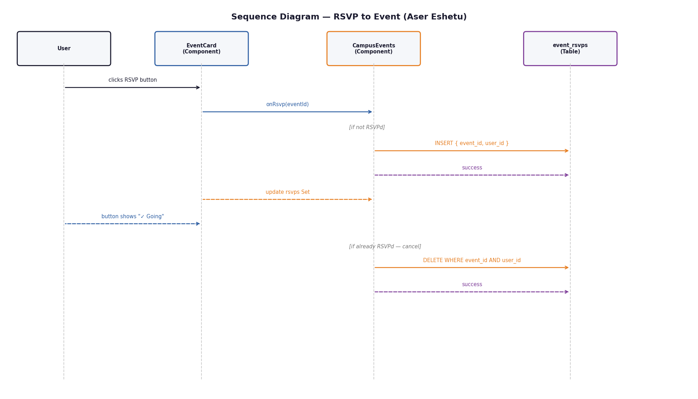
Design Diagrams — Aser Eshetu
Campus Events
Conceptual Class Diagram
Detailed Class Diagram
Sequence — Post Event
Sequence — RSVP

Slide 14
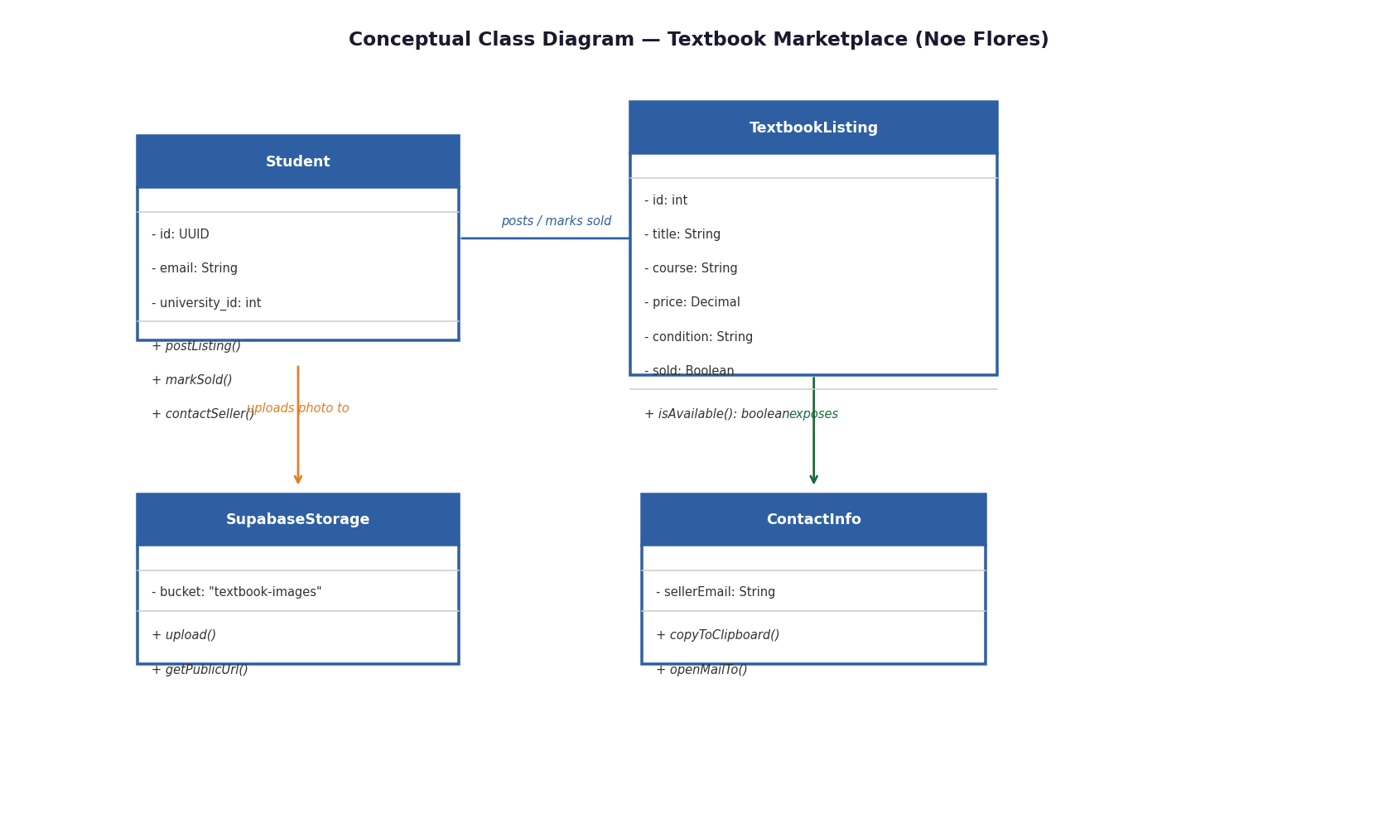
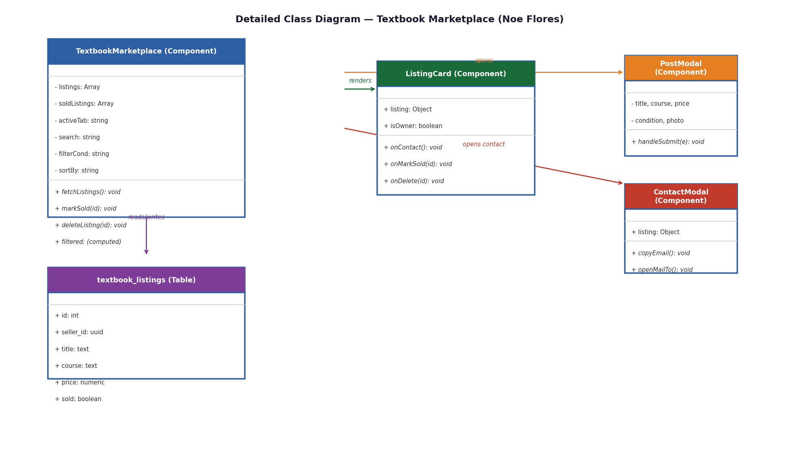
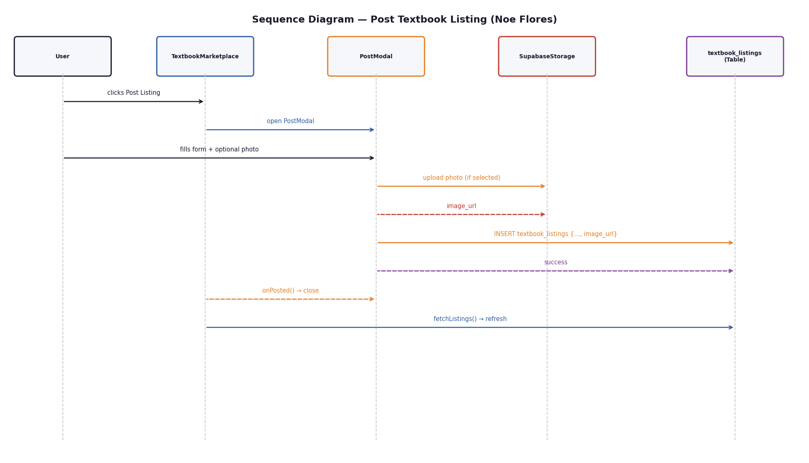
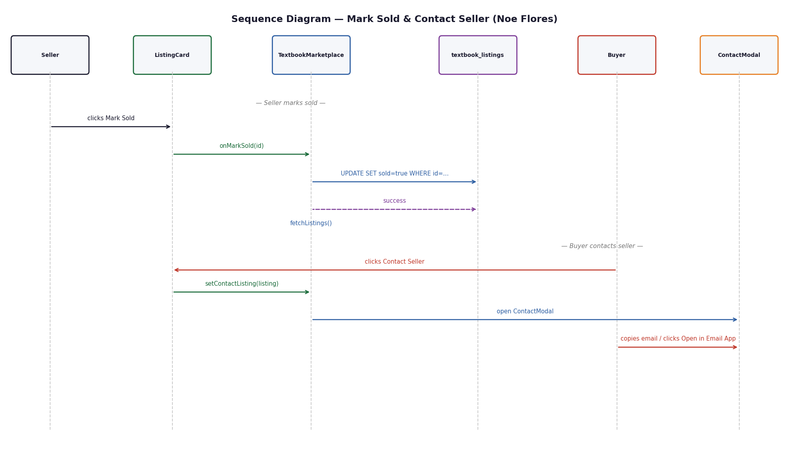
Design Diagrams — Noe Flores
Textbook Marketplace
Conceptual Class Diagram
Detailed Class Diagram
Sequence — Post Listing
Sequence — Mark Sold

Slide 15
Technologies Used
UI Layer
React
CSS
Component Composition Pattern
Business Logic Layer
Domain validation logic (universityThemes.js)
Optimistic UI updates (useMemo / useState)
Observer pattern (onAuthStateChange)
Persistence Layer
Supabase Auth — email verification + JWT sessions
Supabase PostgreSQL — 7 relational tables + RLS policies
Supabase Storage — avatars + textbook images

Slide 16
Layered Architecture
UI → Business Logic → Persistence — React + Supabase
UI Layer
Auth.js · Dashboard.js · StudyGroups.js · CampusEvents.js · TextbookMarketplace.js · ProfileSetup.js · ProfileEdit.js
↓
Business Logic Layer
Domain validation (universityThemes.js) · Membership cap enforcement (max_members) · Optimistic UI state updates · useMemo filter / sort computations · Photo upload orchestration
↓
Persistence Layer
Supabase Auth (JWT + email verification) · PostgreSQL: profiles · universities · study_groups · events · textbook_listings · event_rsvps · study_group_members · Supabase Storage: avatars · textbook-images · Row Level Security (RLS) policies

Slide 17
Challenges We Faced
01 Supabase Free Tier — Single Account
02 Schema Mismatch on First Deploy
The free tier doesn't support multi-user project access, so the entire team collaborated on schema design and SQL setup under one shared account. We mitigated this by committing the full schema to the repo as SQL files so all changes are version controlled.
The original profile schema stored university as plain text. During implementation we discovered a normalized universities table with a foreign key integer was cleaner and more scalable. We migrated early before any user data existed, so the fix was low cost.
03 RLS Policies + Anonymous Access
04 Business Logic in Components
Configuring Row Level Security correctly took several iterations. Early on, policies blocked even authenticated users from reading their own profiles. We resolved this by explicitly testing each policy before building UI on top of it.
Because React components call Supabase directly, some business logic (domain validation, membership cap) lives in components rather than a dedicated service layer. We extracted shared logic into universityThemes.js and reusable patterns to mitigate this.

Slide 18
Software Reuse
External libraries + internal shared patterns
WHAT
USED IN
WHY IT HELPED
Supabase JS Client
All components
Eliminated the need for a custom backend server entirely
React hooks (useState, useEffect, useMemo)
All components
useMemo avoids redundant filter recalculations on every render
Promise.all for parallel queries
StudyGroups · Events · Marketplace
Cuts data load time in half vs sequential awaits
Optimistic UI update pattern
StudyGroups → reused in CampusEvents
Consistent, snappy UX — state updates before Supabase confirms
Modal component pattern
ProfileEdit → all 4 feature modals
Consistent modal UX, written once, adapted 4 times
navigator.clipboard + mailto: href
TextbookMarketplace ContactModal
Native Web APIs — no backend needed for seller contact flow

Slide 19
What We Delivered
Authentication & Profiles
100% implemented
Sign up, login, domain validation, profile setup/edit, photo upload, per-university theming, forgot password
Study Group Organizer
100% implemented
Create, browse, join/leave, delete, member count, capacity enforcement, search + filter tabs
Campus Event Board
100% implemented
Post, browse, RSVP toggle, delete, upcoming/past split, search + filter tabs
Textbook Marketplace
100% implemented
List, browse, condition filter, sort, contact seller (email + mailto), mark sold, delete, photo upload

Slide 20
Campus Buddy
4 features. 7 universities. 1 verified platform.
github.com/AinzOoalGown1356/Campus-Buddy
Shayan Khan · Noe Flores · Aser Eshetu · Enoch Ogunfiditimi · Kayla Suttihprapa
CS 321 · Spring 2026 · Prof. Dr. David Samudio

