Slide 1
Endava .NET Training

Slide 2
Content
Generics
Collections
LINQ(Language Integrated Query)

Slide 3
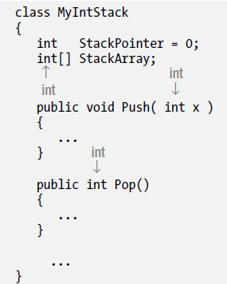
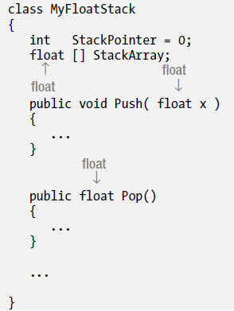
What are Generics?
Classes, structures, interfaces, delegates and methods that have placeholders(type parameters) for one or more of the types that they store or use.
You can refactor your code and add an additional layer of abstraction so that, for certain kinds of code, the data types are not hard-coded.
Notes:
Duplicated code, multiple copies of nearly identical code.,

Slide 4
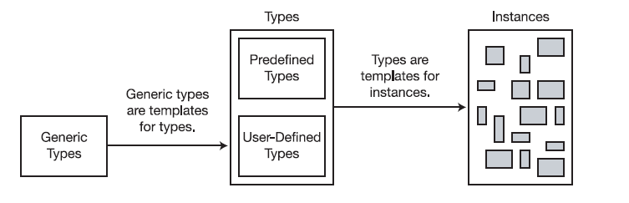
What are Generics?
With C# 2.0, Microsoft introduced the generics features, which offer more elegant ways of using a set of code with more than one type.
Generics allow you to declare type-parameterized code, which you can instantiate with different types. This means you can write the code with “placeholders for types” and then supply the actual types when you create an instance of the class.
You should be very familiar with the concept that a type is not an object but a template for an object. In the same way, a generic type is not a type but a template for a type.
Generic types are templates for types
Notes:
- Emphasis on “it’s a template for an object, rather than an type”

Slide 5
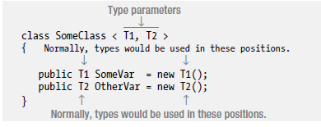
Generic Classes
Declaring generic classes is done using the following guidelines:
Place a matching set of angle brackets after the class name.
Between the angle brackets, place a comma-separated list of the placeholder strings that represent the types, to be supplied on demand. These are called type parameters.
Use the type parameters throughout the body of the declaration of the generic class to represent the types that should be substituted in.
Notes:
Emphasis on what we need to declare a class
Emphasis on “type parameters” keyword

Slide 6
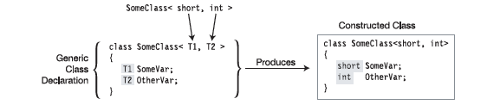
Generic Classes
You cannot create class objects directly from a generic class
To construct a class type from a generic class, list the class name and supply real types between the
angle brackets, in place of the type parameters.
The real types being substituted for the type parameters are called type arguments.
The compiler takes the type arguments and substitutes them for their corresponding type parameters throughout the body of the generic class, producing the constructed type—from which actual class instances are created.
Notes:
Emphasis on ‘type arguments’ vs ‘type parameters’
Explain how the compiles creates concrete classes from generic templates
-Supplying type arguments for all the type parameters of a generic class allows the compiler to
produce a constructed class from which actual class objects can be created.

Slide 7
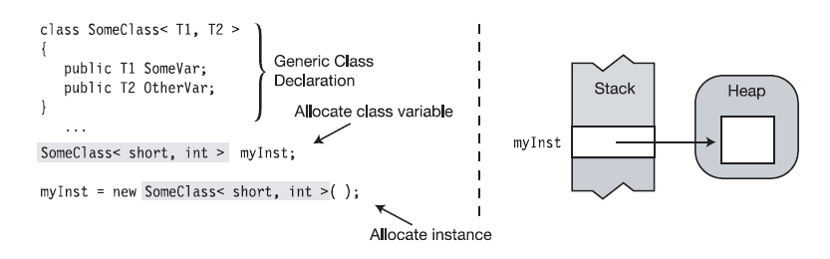
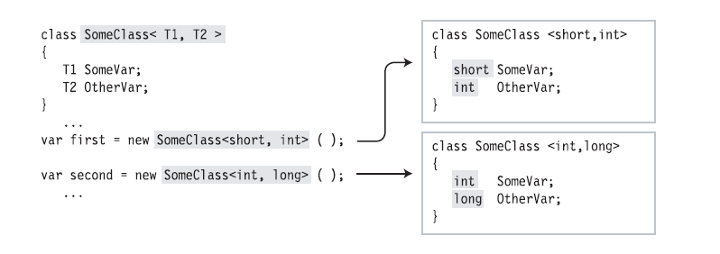
Creating Variables and Instances
As with nongeneric classes, the reference and the instance can be created separately
One class constructed with <Short,Int> and the other one with <Int, Short>
Notes:
The first line below the generic class declaration allocates a reference in the stack
for variable myInst. Its value is null.
• The second line allocates an instance in the heap and assigns its reference to the
variable.

Slide 8
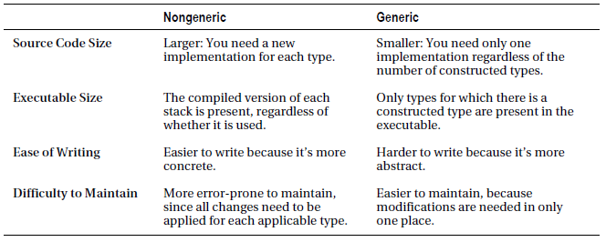
Generic vs Non-Generic Classes
Non-Generic code is larger then the Generic Code;
Non-Generic(compiled version of each class is present) vs Generic(only types for which there is a constructed type get included)
Non-Generic classes easier to write then Generic classes, but harder to maintain.

Slide 9
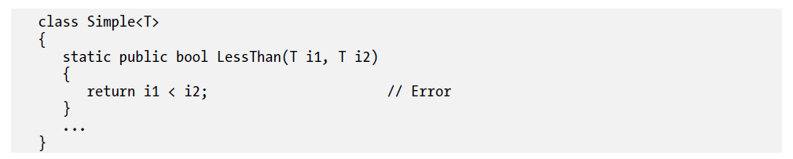

Constraints on Type Parameters
All C# objects, however, are ultimately derived from class object, so has access to methods like ToString, Equals, and GetType.
To make generics more useful, you need to be able to supply additional information to the compiler about what kinds of types are acceptable as arguments. These additional bits of information are called constraints. Only types that meet the constraints can be substituted for the given type parameter.
Constraints are listed as where clauses:
Each type parameter that has constraints has its own where clause
If a parameter has multiple constraints, they are listed in the where clause, separated by commas.

Slide 10
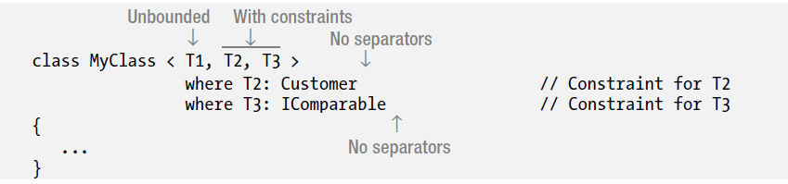
Constraints on Type Parameters: Where Clauses
The important points about where clauses are the following:
They’re listed after the closing angle bracket of the type parameter list
They’re not separated by commas or any other token
They can be listed in any order
The token where is a contextual keyword, so you can use it in other contexts

Slide 11
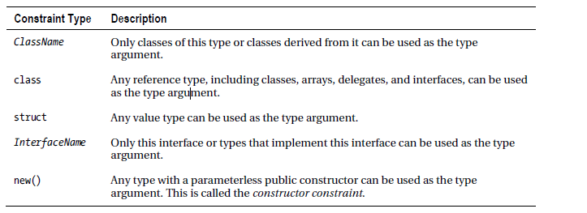
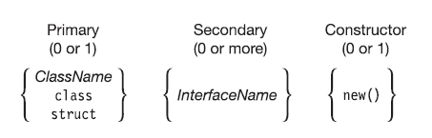
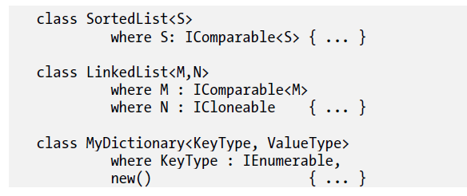
Constraint Types and Order
The where clauses can be listed in any order, however the constraints in a where clause must be placed in a particular order:
There can be at most one primary constraint, and if there is one, it must be listed first
There can be any number of InterfaceName constraints
If the constructor constraint is present, it must be listed last

Slide 12
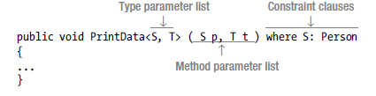
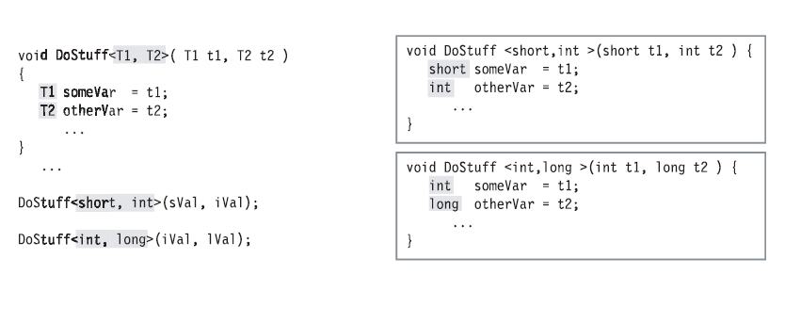
Generic methods
Unlike the other generics, a method is not a type but a member. You can declare generic methods in both generic and non-generic classes, and in structs and interfaces.
Generic methods have two parameter lists:
The method parameter list, enclosed in parentheses
The type parameter list, enclosed in angle brackets
Notes:
If you are passing parameters into a method, the compiler can sometimes infer from the types of the
method parameters the types that should be used as the type parameters of the generic method. This can
make the method calls simpler and easier to read

Slide 13
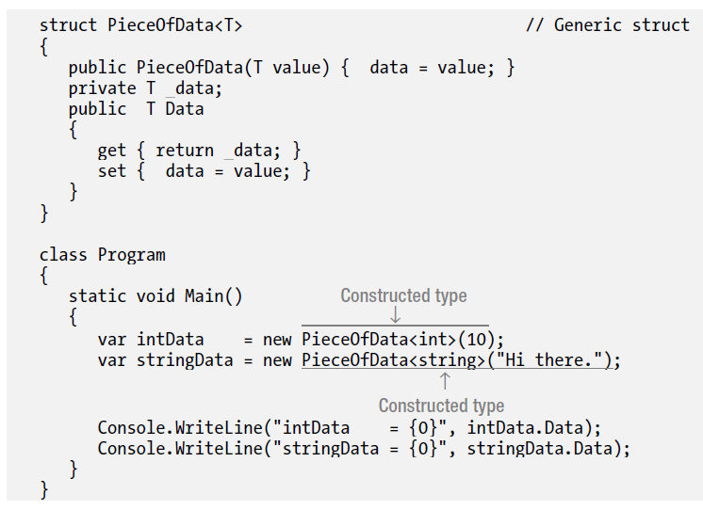
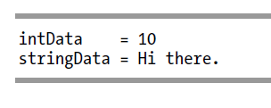
Generic structs
Like generic classes, generic structs can have type parameters and constraints.
The rules and conditions for generic structs are the same as those for generic classes.

Slide 14
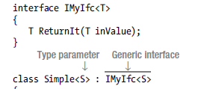


Generic Interfaces
Generic interfaces allow you to write interfaces where the formal parameters and return types of interface members are generic type parameters.
Generic interface declarations are similar to non-generic interface declarations but have the type parameter list in angle brackets after the interface name.
Two additional capabilities of generic interfaces:
Like other generics, instances of a generic interface instantiated with different type parameters are different interfaces.
You can implement a generic interface in a non-generic type.

Slide 15
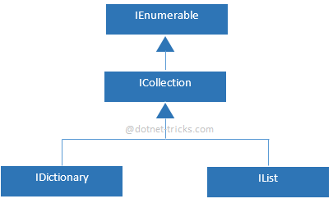
Collections
There are two ways to group objects: by creating arrays of objects, and by creating collections of objects
System.Collections namespace contains specialized classes for storing and accessing the data.
A collection is a class, so you must declare an instance of the class before you can add elements to that collection.
Unlike arrays, the group of objects you work with can grow and shrink dynamically as the needs of the application change

Slide 16
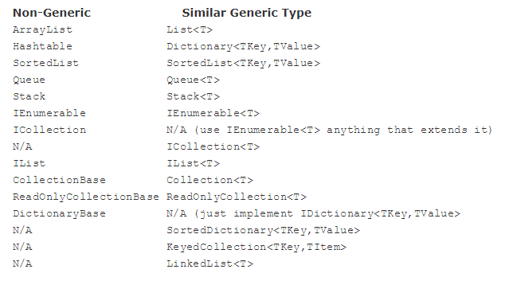
Collections vs Generic Collections
Notes:
System.Collections vs System.Collections.Generic

Slide 17
Types of collection
System.Collections.Generic
Class | Description
List<T> | Represents a list of objects that can be accessed by index. Provides methods to search, sort, and modify lists.
Queue<T> | Represents a first in, first out (FIFO) collection of objects.
Stack<T> | Represents a last in, first out (LIFO) collection of objects.
System.Collections
Class | Description
ArrayList | Represents an array of objects whose size is dynamically increased as required.
Hashtable | Represents a collection of key/value pairs that are organized based on the hash code of the key.
Queue | Represents a first in, first out (FIFO) collection of objects.
Stack | Represents a last in, first out (LIFO) collection of objects.
Notes:
You can create a generic collection by using one of the classes in the System.Collections.Generic namespace. A generic collection is useful when every item in the collection has the same data type. A generic collection enforces strong typing by allowing only the desired data type to be added.

Slide 18
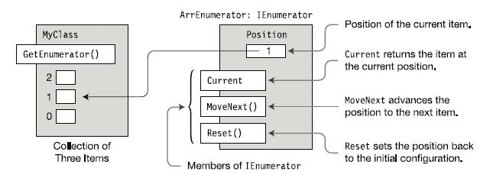
Enumerable and Enumerator
The enumerator is an object that can return each item in a collection, one by one,in order, as they’re requested. The enumerator “knows” the order of the items and keeps track of where it is in the sequence. It then returns the current item when it is requested. An Enumerable is a type that has a method called GetEnumerator and that returns an enumerator, to retrieve its item.

Slide 19
IEnumerable<T> and IEnumerator<T>
These are similar to IEnumerator and IEnumerable interfaces. The major differences between NonGeneric and Generic form are:
With NonGeneric Interface:
The GetEnumerator method of interface IEnumerable returns an enumerator class instance that implements IEnumerator.
The class implementing IEnumerator implements property Current, which returns a reference of type object, which you must then cast to the actual type of the object.
With Generic Interface:
The GetEnumerator method of interface IEnumerable returns an instance of a class that implements IEnumerator.
The class implementing IEnumerator implements property Current, which returns an instance of the actual type, rather than a reference to the base class object.

Slide 20
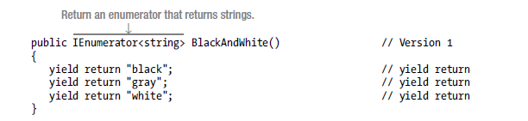
Iterators
A much simpler way of creating enumerators and enumerables is to use an Iterator. You can use the enumerators and enumerables generated by iterators wherever you would use manually coded enumerators or enumerables.
When you use the yield keyword in a statement, you indicate that the method, operator, or get accessor in which it appears is an iterator.
The yield return statement specifies the next item in the sequence to return.
The yield break statement specifies that there are no more items in the sequence.

Slide 21
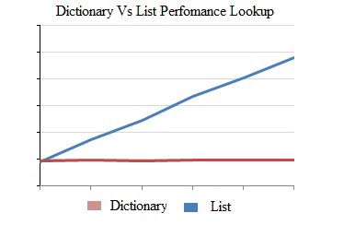
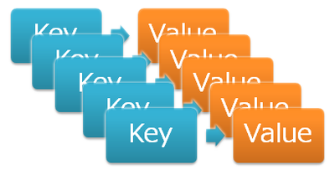
Dictionaries
The Dictionary generic class provides a mapping from a set of keys to a set of values. Each addition to the dictionary consists of a value and its associated key. Retrieving a value by using its key is very fast, close to O(1), because the Dictionary class is implemented as a hash table.
Concurrent collections
System.Collections.Concurrent | Description
ConcurrentDictionary<TKey, TValue> | Represents a thread-safe collection of key/value pairs that can be accessed by multiple threads concurrently.
ConcurrentQueue<T> | Represents a thread-safe first in-first out (FIFO) collection.
ConcurrentStack<T> | Represents a thread-safe last in-first out (LIFO) collection.

Slide 22
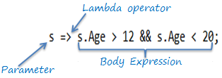

Lambda expressions – Short Intro
A lambda expression is an anonymous function that you can use to create delegates or expression tree types. Lambda expressions are particularly helpful for writing LINQ query expressions.
To create a lambda expression, you specify input parameters (if any) on the left side of the lambda operator =>, and you put the expression or statement block on the other side.
Lambda expressions are particularly helpful for writing LINQ query expressions.
The general rules for lambdas are as follows:
The lambda must contain the same number of parameters as the delegate type.
Each input parameter in the lambda must be implicitly convertible to its corresponding delegate parameter.
The return value of the lambda (if any) must be implicitly convertible to the delegate's return type.

Slide 23
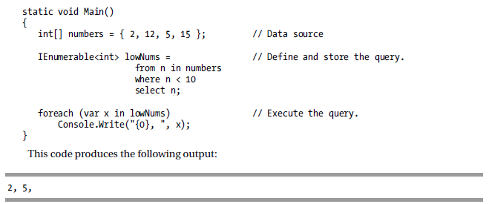
LINQ(Language Integrated Query)
LINQ stands for Language Integrated Query and is pronounced link.
LINQ is an extension of the .NET Framework and allows you to query collections of data in a manner similar to using SQL to query .databases.
With LINQ you can query data from databases, collections of program objects, XML documents, and more.

Slide 24
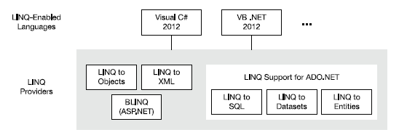
LINQ
Types that support IEnumerable<T> or a derived interface such as the generic IQueryable<T> are called queryable types.
LINQ can work with many different types of data sources, such as SQL databases, XML documents, and a lot of others.
Microsoft provides LINQ providers for a number of common data source types
New LINQ providers are constantly being produced by third parties for all sorts of data source types.
Notes:
For every data source type, however, under the covers there must be a module of code that implements the LINQ queries in terms of that data source type

Slide 25

LINQ – Anonymous Types
Anonymous types – is a language feature that allows you to create unnamed class types.
Important things to know about anonymous types are the following:
Anonymous types can be used only with local variables, not with class members.
Since an anonymous type doesn’t have a name, you must use the var keyword as the variable type.
You cannot assign to the properties of an object of an anonymous type. The properties created by the compiler for an anonymous type are read-only properties.

Slide 26
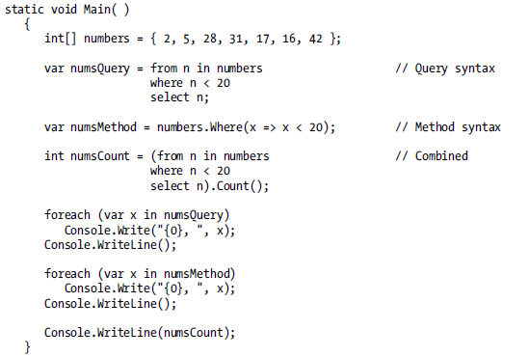
LINQ(Method Syntax vs Query Syntax)
Method syntax uses standard method invocations. The methods are from a set called the standard query operators.
Query syntax looks very much like an SQL statement. Query syntax is written in the form of query expressions.
You can combine both forms in a single query.
Notes:
Query syntax is a declarative form, which means that your query describes what you want returned, but doesn’t specify how to perform the query.
Method syntax is an imperative form, which specifies an exact order in which query methods are to be
A LINQ query can return one of two types of results: an enumeration, which lists the items that satisfy the query parameters; or a single value, called a scalar called

Slide 27
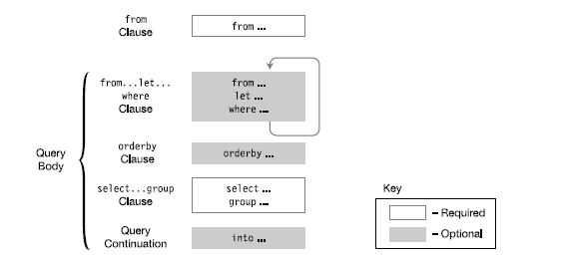
LINQ - Query Expressions structure
Query expression consists of a from clause followed by a query body.
The clauses must appear in the order shown.
There can be any number of from...let...where clauses
Notes:
There can be any number of from...let...where clauses

Slide 28

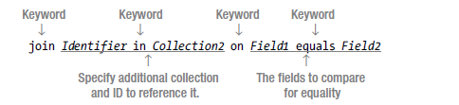
LINQ – The From Clause and Join Clause
The from clause specifies the data collection that is to be used as the data source. It also introduces the iteration variable. The important points about the from clause are the following:
The iteration variable sequentially represents each element in the data source.
Type is the type of the elements in the collection.
Item is the name of the iteration variable.
Items is the name of the collection to be queried. The collection must be enumerable
The join clause in LINQ is much like the JOIN clause in SQL.
You use a join to combine data from two or more collections.
A join operation takes two collections and creates a new temporary collection of objects, where each object in the new collection contains all the fields from an object from both initial collections
Notes:
Type is optional, because the compiler can infer the type from the collection
Multiple form clauses possible.
The foreach statement imperatively specifies that the items in the collection are to be considered in order, from the first to the last. The from clause declaratively states that each item in the collection must be considered, but does not assume an order.
• The foreach statement executes its body at the point in the code where it is encountered. The from clause, on the other hand, does not execute anything. It creates a behind-the-scenes code object that can execute the query later on. The
query is only executed if the program’s flow of control encounters a statement that accesses the query variable.

Slide 29


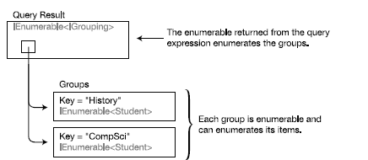


LINQ(Let, Where, OrderBy, Group Clauses)
The let clause takes the evaluation of an expression and assigns it to an identifier to be used in other evaluations.
The where clause eliminates items from further consideration if they don’t meet the specified condition. An item must satisfy all the where clauses to avoid elimination from further consideration.
The orderby clause takes an expression and returns the result items in order according to the expression. The default ordering of an orderby clause is ascending.
The group clause groups the selected objects according to a specified criterion. When items are included in the result of the query, they’re placed in groups according to the value of a particular field. The property on which items are grouped is called the key. it returns an enumerable that enumerates the groups of items that have been formed.
A query continuation clause takes the result of one part of a query and assigns it a
name so that it can be used in another part of the query

Slide 30
LINQ – Standard Query Operators
The standard query operators comprise a set of methods called an application programming interface (API) that lets you query any .NET array or collection. Important characteristics of the standard query operators are the following:
The collection objects queried are called sequences and must implement the IEnumerable<T> interface, where T is a type.
The standard query operators use method syntax.
Some operators return IEnumerable objects (or other sequences), while others return scalars. Operators that return scalars execute their queries immediately and return a value instead of an enumerable object.
Many of these operators take a predicate as a parameter. A predicate is a method that takes an object as a parameter and returns true or false depending on whether or not the object meets some criterion.
Operator Name | Description
Where | Filters the sequence, given a selection predicate.
ToList | Returns the sequence as a List<T>.
FirstOrDefault | Returns the first element of the sequence that matches the predicate. If no predicate is given, the method returns the first element of the sequence. If no element matches the predicate, it uses the default value for that type.
Single | Returns the single element from the sequence that matches the predicate. If no elements match, or if more than one matches, it throws an exception.
Count | Returns the number of elements in the sequence as an int. One overload can take a predicate and returns the number of elements in the sequence for which the predicate is true
Max | Returns the maximum of the values in the sequence.
Any | Returns a Boolean value specifying whether any elements in the sequence return true for the predicate.

Slide 31
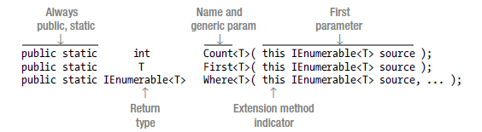
Signatures of the Standard Query Operators
The standard query operators are methods declared in class System.Linq.Enumerable. These methods, however, aren’t just any methods—they’re extension methods that extend generic class IEnumerable<T>.

Slide 32
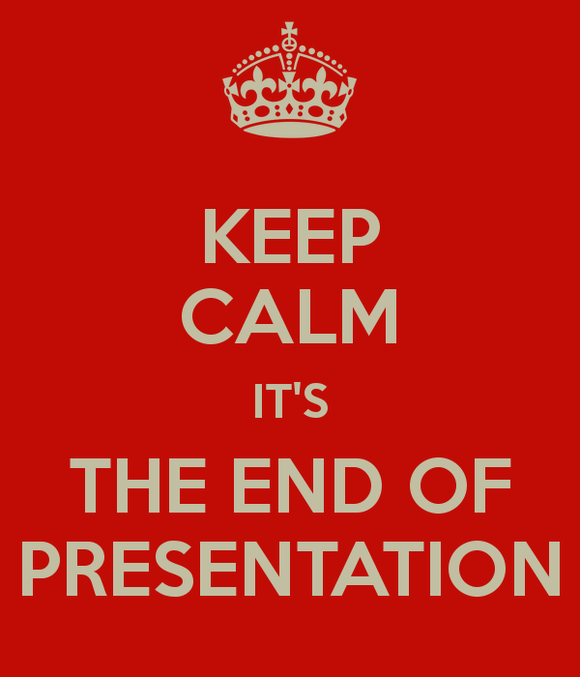

Slide 33
Thanks!
Serban Mihalachi
.NET developer
email: serban.mihalachi@endava.com
Skype id: en_serban.mihalachi

Slide 34
Reading
https://drive.google.com/file/d/0B-1ylbHWKsNWT1RWTkluNWlnckU/view?usp=sharing
https://www.youtube.com/playlist?list=PLdbkZkVDyKZU5ZXqp5YP1TS3irQKHZilU
Chapter 17: Generics
Chapter 18: Enumerators and Iterators
Chapter 19: Introduction to LINQ
Exercises
https://drive.google.com/open?id=1IsleoUSEmxYp79T-MgBiigrN38xpqyTeXOIbND_n1UQ

