Slide 1

K
KHOZO
Proposal Deck | Child Protection Technology
Project Khozo for the Department of Women and Child Development
A Mission Vatsalya-aligned platform to trace, verify, protect and restore missing children — connecting citizens, NGOs, Police, CWC, DCPU, CCIs and JJBs in one accountable, privacy-safe workflow.
Government of Maharashtra
Hon'ble Smt. Aditi Sunil Tatkare
Cabinet Minister, Department of Women and Child Development Government of Maharashtra
An initiative by Aegis School of Data Science & AI, Mumbai — AI for Social Good Submitted for the kind consideration of Hon'ble Smt. Aditi Sunil Tatkare, Cabinet Minister, Department of Women and Child Development

Slide 2
CONTEXT
The Problem We Are Trying to Solve
The gap is rarely goodwill. It is the time and traceability between a child going missing, a citizen spotting that child, and the right officer or Committee being able to act on it.
The consequence
Delay in the first hours, and loss of a single verified trail from sighting to restoration that the Department can supervise.
A citizen who spots a child often has no safe, structured way to report it.
Sightings and case records sit in separate registers, files and departments.
What is needed
Welfare follow-up after recovery — CWC production, CCI care, restoration — is tracked manually.
Not a replacement for Mission Vatsalya, but a fast intake and coordination layer that feeds it and is answerable to it.
Families have no reliable way to check progress without visiting an office.
Child identity and photographs need protection at every step of this chain.
State context
[Insert current Maharashtra missing-children figures from NCRB / State Crime Records Bureau before presentation.]
KHOZO | Proposal to WCD, Government of Maharashtra
02

Slide 3
PROPOSAL
Executive Summary
Khozo is a working platform that turns a citizen's photograph into an accountable, jurisdiction-routed child-protection action.
Built for this Department
Native roles for CWC, DCPU, SJPU, AHTU, CCI, JJB, DLSA, SARA, SAA and the State Nodal Officer — not a police tool with welfare bolted on.
Citizens, parents and NGOs report a missing child or a sighting from a phone.
Reports are verified by a scoped official before becoming a formal case.
Sightings are ranked and routed to the correct district desk automatically.
Complements, not duplicates
Unmatched sightings escalate to Childline 1098 / CWC rather than being lost.
Cases carry TrackChild, KhoyaPaya, CCTNS/FIR, NCRB and GHAR identifiers so existing Government systems stay authoritative.
Welfare, restoration and closure are tracked to a supervised outcome.
Core promise
"Your 1 click — a missing child can return home."
KHOZO | Proposal to WCD, Government of Maharashtra
03

Slide 4
DESIGN BASIS
Grounded in the Government's Own Framework
Khozo's workflows, roles and records were designed after a structured study of the Government's existing child-protection systems and statutes.
Mission Vatsalya
TrackChild
KhoyaPaya
Stakeholder structure, grievance and feedback routing, and welfare service categories follow the scheme's operating model.
Case registers, matching, district search, MIS reporting and identity linkage patterns.
Citizen-facing missing/found reporting that feeds institutional review instead of exposing child identity publicly.
GHAR (NCPCR)
CARINGS / CARA
JJ Act, 2015
Restoration and repatriation tracking, institutional handover, transfer and support needs.
Adoption governance separating SARA and SAA responsibilities and legally-free declarations.
Production before CWC/JJB within statutory timelines, Social Investigation Reports and Individual Care Plans.
Khozo is positioned as an intake and coordination layer that strengthens these systems — it does not seek to replace any of them.
Source: docs/system-audit.md
KHOZO | Proposal to WCD, Government of Maharashtra
04

Slide 5
HOW A CASE MOVES
The Khozo Workflow
1
Report
2
Verify
3
Match
4
Refer
5
Restore
Parent, citizen or NGO reports a missing child or uploads a sighting photograph, with consent recorded.
>
A scoped police / CWC / DCPU officer verifies the intake before it becomes a formal case with an FIR or GD number.
>
The sighting is ranked against registered cases and routed to the correct district desk.
>
Unmatched or at-risk sightings escalate to Childline 1098, CWC or DCPU rather than closing silently.
>
Production, care, welfare referral and restoration are tracked to a formal, recorded closure.
Nothing is lost
Nothing is unowned
Nothing is untraceable
Every intake either becomes a case, a referral or a recorded disposition. There is no silent dead end.
Cases carry a jurisdiction, an assigned desk and a transfer history when investigation moves.
Every action writes a tamper-evident audit event that the Department can later verify.
Citizens can check a receipt or FIR reference at any time and see safe progress — without any child's identity, photograph, address or guardian contact being exposed.
Source: docs/system-audit.md
KHOZO | Proposal to WCD, Government of Maharashtra
05

Slide 6
STAKEHOLDER ROLES
The Child-Protection Ecosystem, Built In
Each role below is implemented with its own scoped dashboard, permissions, jurisdiction and audit trail.
CWC
DCPU
CCI
JJB
Child Welfare Committee — production, orders, care decisions
District Child Protection Unit — district coordination and review
Child Care Institution — admission, care plan and service register
Juvenile Justice Board — proceedings, hearings and directions
SJPU
AHTU
DLSA
SARA / SAA
Special Juvenile Police Unit — child-sensitive policing
Anti Human Trafficking Unit — trafficking-risk cases
District Legal Services Authority — legal aid and compensation
Adoption governance and CARINGS-aligned records
RPF / Railways
DCRB / SCRB
State Nodal Officer
Citizens / NGOs
Railway and station-based rescue coordination
District and State Crime Records Bureau reporting
State-level escalation, oversight and MIS
Verified public reporting and sighting participation
Reunification confirmation remains restricted to Police / SJPU and command roles. Welfare roles hold welfare powers — authority is never blurred.
Source: docs/system-audit.md
KHOZO | Proposal to WCD, Government of Maharashtra
06

Slide 7
JUVENILE JUSTICE WORKFLOW
Statutory Compliance as a Product Feature
Compliance obligations the Department already carries are tracked, with due dates and overdue alerts.
24-hour production
SIR and ICP
CCI care register
Rescue time, production time, authority, order number and outcome are recorded, with the statutory deadline computed and breaches flagged.
Social Investigation Reports and Individual Care Plans are structured records with assessor, risk level and review dates.
Admission type, institution, care plan, service categories and next review date, with a district-level institutional register.
JJB proceedings
Restoration and repatriation
Formal closure
Proceeding type, board, case number, order date, next hearing and directions.
Route, handover authority, escort, documents, funding and follow-up — tracked through to closure.
Restored to family, CCI transfer, adoption or aftercare, repatriation, or traced pending reunification.
A follow-up queue surfaces overdue production, due reviews and stale cases so supervision is proactive rather than retrospective.
Source: docs/system-audit.md
KHOZO | Proposal to WCD, Government of Maharashtra
07

Slide 8
SAFEGUARDS
Child Privacy Is a Design Constraint
A missing-child platform handles the most sensitive data the State holds. Khozo was built so that openness to citizens never becomes exposure of a child.
Audit metadata is redacted too
Audit events store flags, counts and text lengths — not names, phone numbers, ID numbers or note contents.
Public screens redact guardian contacts, Aadhaar, exact addresses and photographs.
Photographs require recorded consent, stated purpose and a retention period.
Tamper-evident record
Photograph access is authenticated and jurisdiction-checked — never a public URL.
Audit events form a hash chain. Exports carry a SHA-256 digest and HMAC signature that can be verified after download.
Citizens may mark their identity confidential; review queues show masked details.
A privacy review queue governs retention, extension and anonymisation.
Anonymisation requires an approval or order reference and is fully audited.
Abuse protection
Public intake is rate-limited, OTP-verified, and abuse signals feed a command review queue with hashed identities.
Source: docs/system-audit.md
KHOZO | Proposal to WCD, Government of Maharashtra
08

Slide 9
COMMAND VIEW
Oversight and MIS for the Department
State command view
District view
Signed MIS report
Statewide caseload, reunification, pending intake, district breakdown and workflow activity for the Minister's office and State Nodal Officer.
DCPU and district desks see only their jurisdiction — cases, sightings, grievances, reviews and coverage gaps.
A scoped MIS artifact with a verifiable signature, generated on demand and audited each time.
COVERAGE
SUPERVISION
EVIDENCE
COORDINATION
Gap report
Follow-up
Signed export
Network alert
missing district desks
overdue and stale work
audit and MIS artifacts
scoped desk messaging
The coverage report tells the Department which district desks — CWC, DCPU, SJPU, CCI, JJB, RPF — are not yet onboarded in a State or district, so gaps are visible before a pilot begins rather than after it fails.
Source: docs/system-audit.md
KHOZO | Proposal to WCD, Government of Maharashtra
09

Slide 10
PUBLIC INTERFACE
Citizen Participation, Safely Channelled
Emergency routing
Public service directory
Privacy-safe bulletins
Citizens are routed by context to Childline 1098, ERSS 112 or Railway 139, paired with the correct local SJPU, CWC, DCPU or RPF desk.
A redacted directory of local child-protection response points — without exposing official accounts or internal user data.
Authorised officers publish missing-child alerts with guardian contacts, Aadhaar, addresses and protected photographs redacted.
Grievance channel
Status without exposure
Works in weak network
A Mission Vatsalya-style grievance and feedback route with a reference number and safe public status tracking.
Families check a receipt, FIR or TrackChild reference and see progress — never another child's identity.
Field reports queue in encrypted on-device storage and sync when connectivity returns — important for tribal and rural blocks.
Public registration is OTP-verified and privileged roles cannot be self-assigned — official accounts are provisioned only by authorised command users.
Source: docs/system-audit.md
KHOZO | Proposal to WCD, Government of Maharashtra
10

Slide 11
DATA SOVEREIGNTY
Face Recognition Under Indian Sovereignty
Khozo proposes Sovereign AI Aarakshak for production face recognition, so children's biometric data stays under Indian infrastructure and governance.
Honest position today
Face matching runs on Aarakshak, an Indian provider, with AWS Rekognition (Mumbai region) as an independent second opinion. A candidate is shown to an officer only where both engines agree; anything uncorroborated is withheld, not shown with a lower number.
Indian child-protection data should remain in India, under Indian institutions.
No sharing of children's facial-recognition data with foreign companies.
Integration model
Matching is isolated behind a single service boundary in the codebase.
Matching lives behind one module, so an authorised provider replaces the demo scorer without changing intake, dashboards or safeguards.
A human officer always reviews and confirms a match — the system never decides alone.
Every match decision is recorded as signed, audit-ready evidence.
Departmental assurance
Face recognition assists officers on child-protection cases only — it is not a surveillance capability.
Sources: aarakshak.com; server/src/match.js
KHOZO | Proposal to WCD, Government of Maharashtra
11

Slide 12
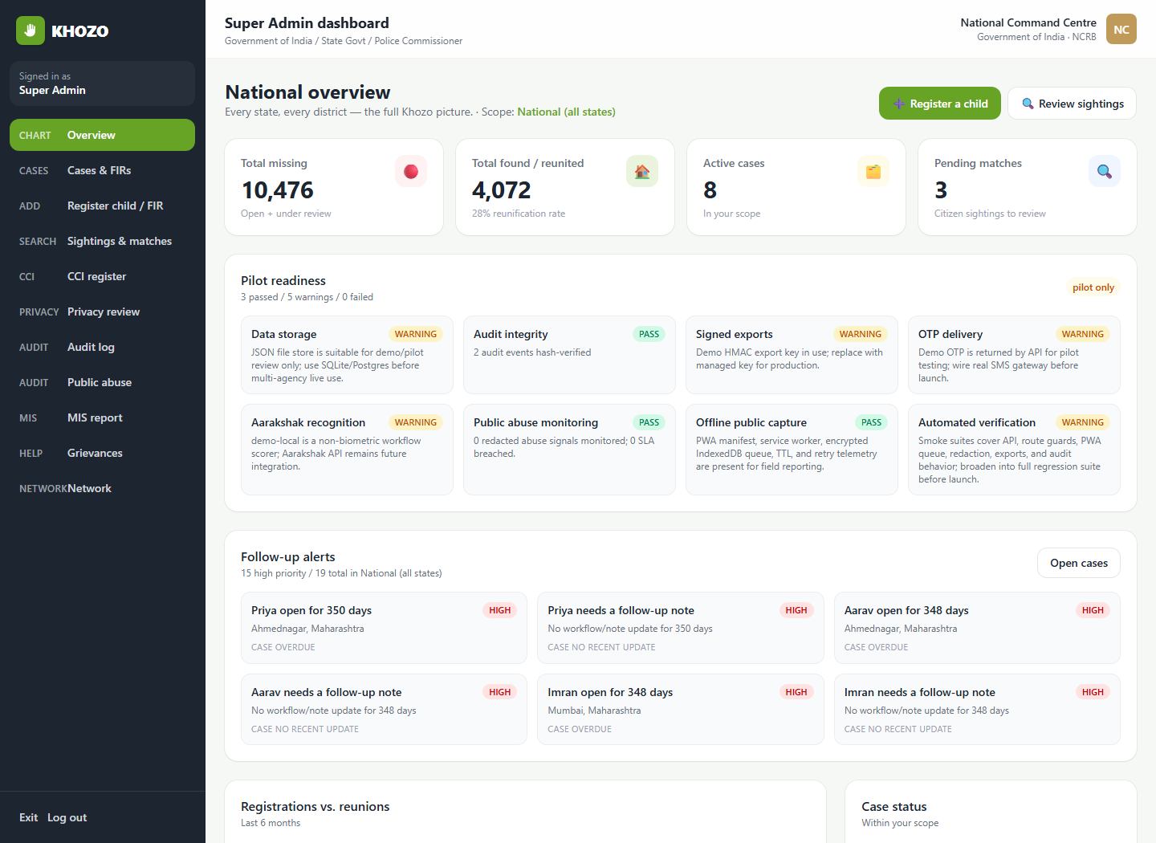
WORKING PORTAL — ACTUAL SCREENSHOT
Command Dashboard
What this shows
Role-scoped caseload, reunification, pending matches, readiness and follow-up alerts for command and district users.
docs/screenshots/overview.png
Captured from the running Khozo portal
KHOZO | Proposal to WCD, Government of Maharashtra
12

Slide 13
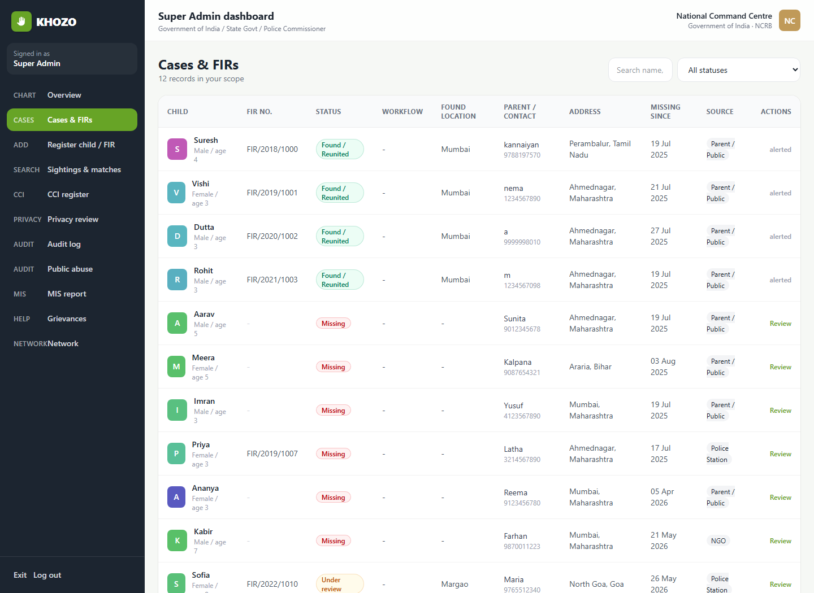
WORKING PORTAL — ACTUAL SCREENSHOT
Case and Intake Register
What this shows
Operational case list with missing-child intake, verification and FIR/GD registration workflows.
docs/screenshots/cases-firs.png
Captured from the running Khozo portal
KHOZO | Proposal to WCD, Government of Maharashtra
13

Slide 14
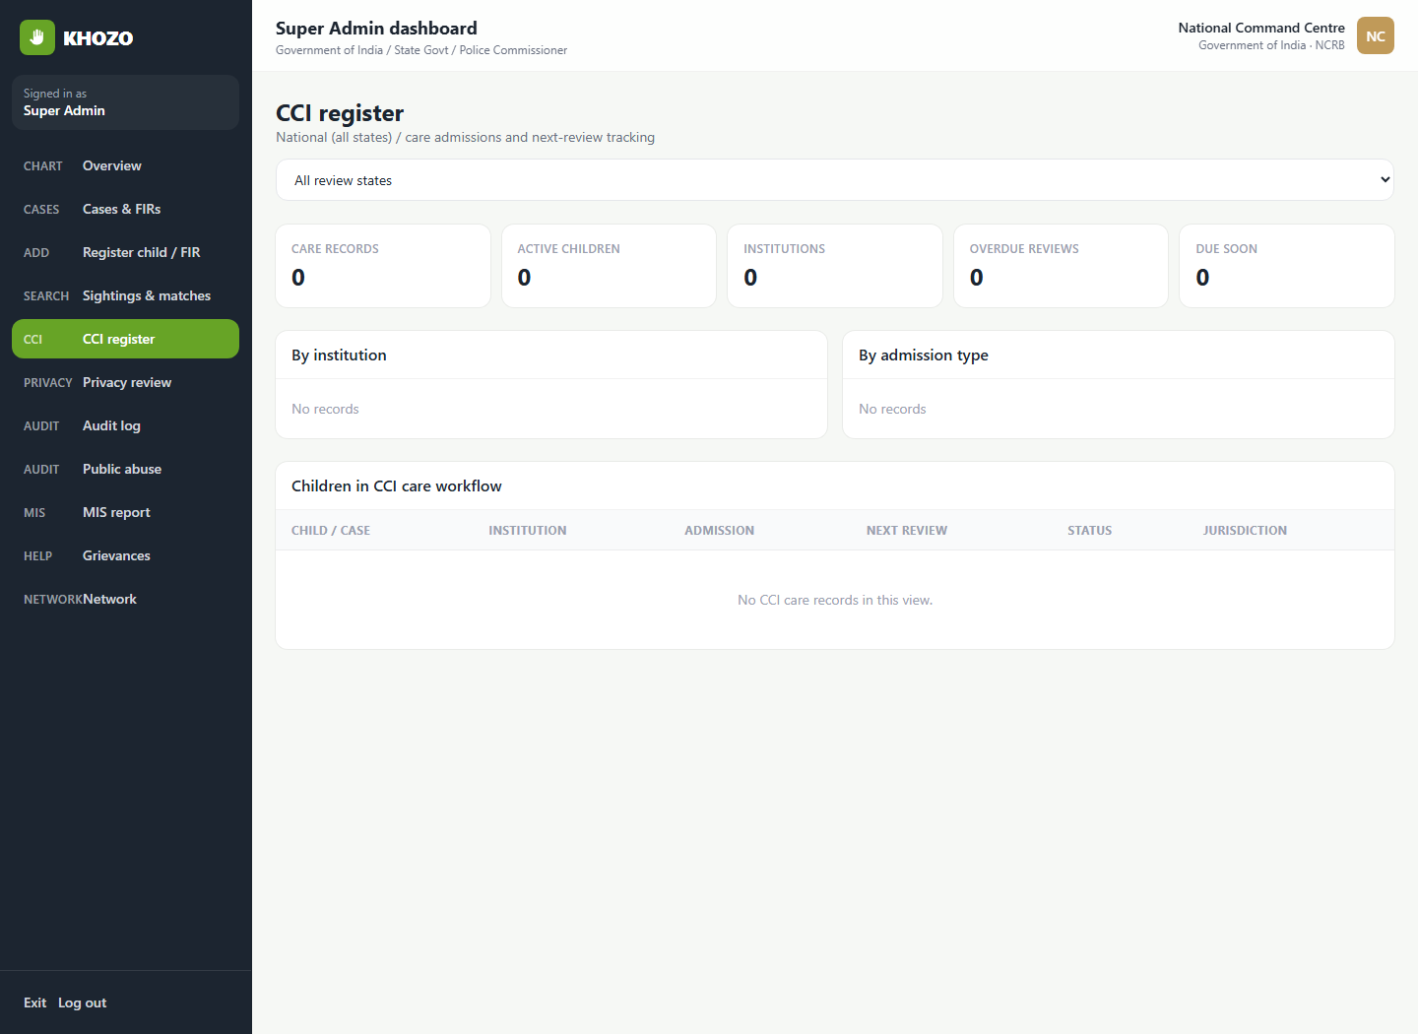
WORKING PORTAL — ACTUAL SCREENSHOT
CCI Institutional Register
What this shows
Admissions, active children, admission-type split and review-due status across Child Care Institutions.
docs/screenshots/cci-register.png
Captured from the running Khozo portal
KHOZO | Proposal to WCD, Government of Maharashtra
14

Slide 15
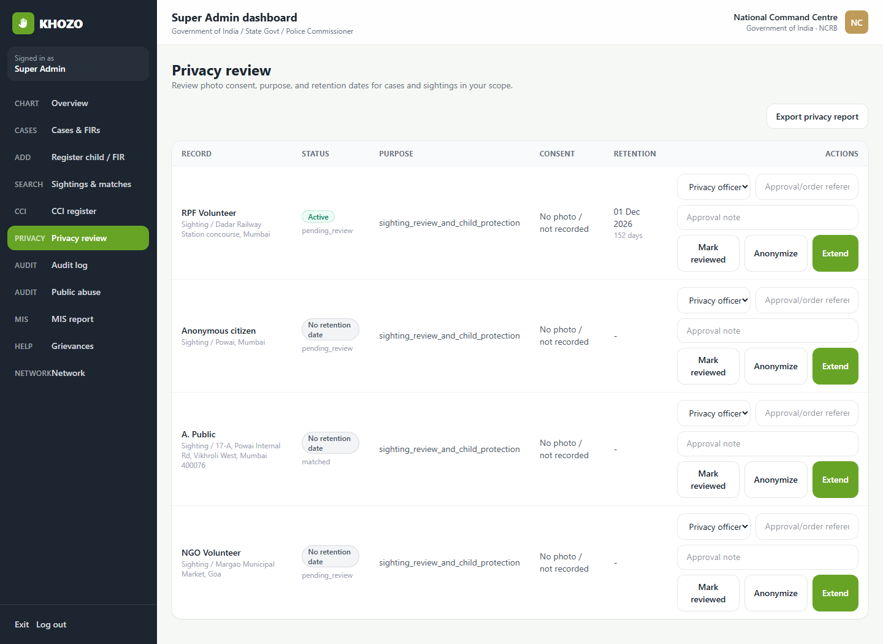
WORKING PORTAL — ACTUAL SCREENSHOT
Privacy and Retention Review
What this shows
Retention status, review, extension and approved anonymisation for case and sighting records.
docs/screenshots/privacy-review.png
Captured from the running Khozo portal
KHOZO | Proposal to WCD, Government of Maharashtra
15

Slide 16
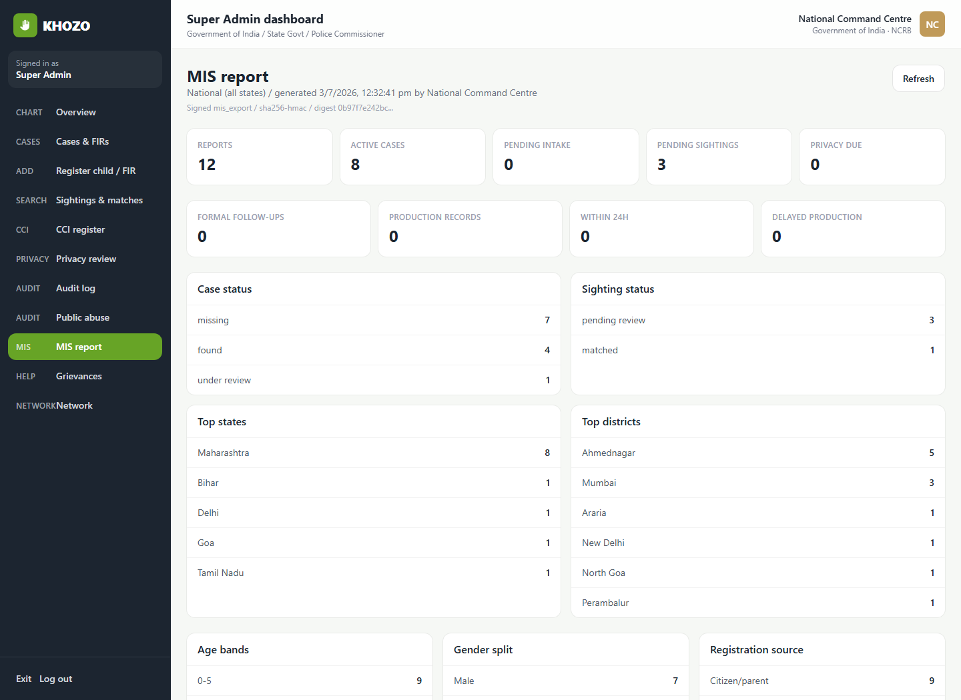
WORKING PORTAL — ACTUAL SCREENSHOT
Signed MIS Report
What this shows
Scoped MIS artifact with district breakdowns, compliance counts and a verifiable signature.
docs/screenshots/mis-report.png
Captured from the running Khozo portal
KHOZO | Proposal to WCD, Government of Maharashtra
16

Slide 17
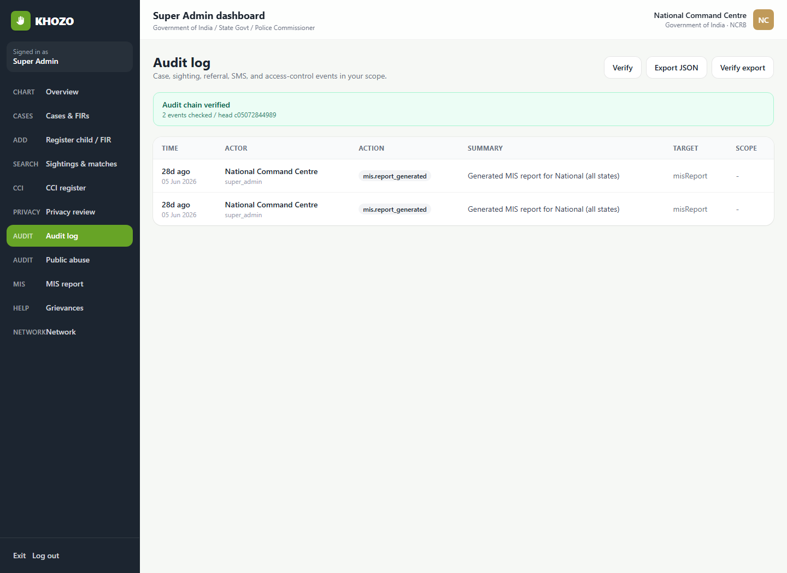
WORKING PORTAL — ACTUAL SCREENSHOT
Audit Trail
What this shows
Hash-chained audit events with integrity verification and signed export for evidence handling.
docs/screenshots/audit-log.png
Captured from the running Khozo portal
KHOZO | Proposal to WCD, Government of Maharashtra
17

Slide 18
HONEST STATUS
Where the Platform Stands Today
We wish to be candid with the Department about maturity, so that any pilot is planned on accurate ground.
Working today
To be completed before live use
End-to-end citizen intake, verification, sighting review and referral. All stakeholder roles with scoped dashboards. Statutory and welfare records. Privacy, retention and anonymisation controls. Tamper-evident audit with signed exports. Grievances, bulletins, public directory and offline field capture.
Production database in place of the demonstration store. Authorised face recognition connected via Aarakshak. Live SMS gateway for OTP and parent alerts. Government-grade hosting, security audit and key management. Full automated test coverage and operational support.
Khozo is a fully demonstrable, end-to-end prototype developed by faculty and student teams at Aegis School of Data Science & AI. It is offered to the Government in the spirit of public service. We seek the Department's direction on a supervised district pilot to validate it against real operational conditions before any wider deployment.
No live child data has been used in development. All demonstration records are synthetic.
Source: docs/system-audit.md, docs/session-handoff.md
KHOZO | Proposal to WCD, Government of Maharashtra
18

Slide 19
ROLLOUT
Proposed Maharashtra Pilot
Phase 1
Approval and governance
4–6 weeks
Department nominates the State Nodal Officer and pilot districts; SOPs agreed for verification, referral, data sharing and escalation.
Phase 2
Onboarding and hardening
6–8 weeks
Provision CWC, DCPU, CCI, JJB, SJPU and police desks; production database, hosting, security review and SMS gateway put in place.
Phase 3
Supervised district pilot
3–4 months
Live use in the selected districts with citizen and NGO participation, weekly review with DCPU and the State Nodal Officer.
Phase 4
Evaluation and scale decision
4–6 weeks
Measure verification time, referral closure, production compliance and restoration outcomes; Department decides on wider rollout.
Indicative timeline, offered for the Department's revision. Aegis will bear platform development and support costs for the pilot period.
KHOZO | Proposal to WCD, Government of Maharashtra
19

Slide 20
OUR REQUEST
What We Seek from the Department
We are not seeking funds. We seek direction, supervision and the authority to be useful.
1. Guidance on a pilot
2. Workflow validation
3. Integration direction
Nominate one or two districts and a nodal officer under whose supervision Khozo can be validated in real conditions.
Allow CWC, DCPU and CCI officers to review whether the workflows and records match how the Department actually works.
Advise on alignment with Mission Vatsalya and TrackChild, and on authorisation for face recognition.
With the Department's guidance, a student-built public-good platform can become a supervised State capability — one that shortens the time between a citizen's photograph and a child's safe return home.
We would be glad to demonstrate the working system to the Department at any date convenient to the Hon'ble Minister's office.
KHOZO | Proposal to WCD, Government of Maharashtra
20

Slide 21
KHOZO
Let every safe sighting become an accountable response.
Your 1 click
A missing child can return home
A proposal to the Department of Women and Child Development, Government of Maharashtra, for a supervised, privacy-safe, Mission Vatsalya-aligned child-protection pilot.
Next step
Offered by
Guidance on a supervised district pilot and a nodal officer.
Aegis School of Data Science & AI, Mumbai — AI for Social Good.
An initiative by Aegis School of Data Science & AI
[Presenter name] | [Designation] | [Mobile] | [Email]

