Slide 1
K
KHOZO
Government Proposal Deck
Project Khozo for Government of Assam
A web and mobile platform to help Assam Police, WCD/SCPS, NGOs and citizens find missing children, women and persons using photo reporting and face recognition.
Source: Khozo (1).pdf, slide 1; Source: khozo_proposal_v1.0.docx, Overview

Slide 2
PROPOSAL
Executive Summary
Children are the nation's assets. Khozo proposes a one-click public reporting and agency response platform to help missing children return home faster.
Proposal for Assam
Adapt the original Government/Police proposal for Assam Government, Assam Police, WCD/SCPS, district child-protection teams, NGOs and citizens.
Citizens, NGOs and police upload photos through the Khozo portal or mobile app.
A centralized secure repository stores missing-person photographs and related records.
The matching service compares uploaded images and notifies nearby police stations.
Parents receive SMS or Khozo app pop-up alerts after authorized match confirmation.
Core promise
"Your 1 click - A missing child can return home."
Source: khozo_proposal_v1.0.docx, Overview; Source: Khozo (1).pdf, slide 1
KHOZO | Proposal for Government of Assam
02

Slide 3
NEED AND INTENT
Objectives
Help parents and police
Create an online service
Find missing children while reducing manual human effort.
Use face detection, face recognition and supporting information to find missing children.
Develop mobile access
Enable public participation
Provide a mobile application for field reporting by the public and agencies.
Allow citizens to click pictures of suspicious/missing children and upload them to Khozo server.
For Assam, these objectives translate into faster reporting, faster verification and a measurable government response loop.
Source: Khozo (1).pdf, slide 2
KHOZO | Proposal for Government of Assam
03

Slide 4
WHAT KHOZO WILL BUILD
Project Scope
The project scope is to build a web and mobile app that helps the Police department, NGOs and parents find missing children, women or persons using face recognition.
Assam adaptation
Replace the proposal's Goa Government / Goa Police rollout language with Government of Assam / Assam Police ownership.
Web portal for government, police, NGOs and public users
Android app on Play Store and iOS app on App Store as free downloads
Primary users
Secure centralized cloud database for photographs and missing-person records
Police, parents, citizens, NGOs and government administrators work through role-based access layers.
Fast and accurate photo or video search against missing-person face images
Source: khozo_proposal_v1.0.docx, Project Scope and Implementation Plan
KHOZO | Proposal for Government of Assam
04

Slide 5
HOW THE RESPONSE WORKS
Workflow
1
Register
2
Upload
3
Match
4
Alert
Police register FIR; parents can also register missing-child details.
>
Public uploads a child picture using the Khozo mobile app or website.
>
Khozo service loads the picture to server and searches the missing-person repository.
>
SMS or Khozo app pop-up alert is sent to parents and nearby police station.
Photo/video search
Central database
Agency notification
The algorithm identifies a missing child, woman or person in photos or video using a private repository.
Police photographs and missing-person records are stored securely for matching and review.
Matched leads are routed to nearby police stations for action and parent notification.
Source: Khozo (1).pdf, slide 3; Source: khozo_proposal_v1.0.docx, Workflow
KHOZO | Proposal for Government of Assam
05

Slide 6
USERS AND RIGHTS
Service Accessibility Layers
Super Admin
Assam Government / Police Commissioner: all rights, overall view, drill-down, coordination messages
Admin
Assistant Commissioner / district command: view usage under police stations in jurisdiction, drill down to users
User
Police station: register missing complaints/FIRs, view registered complaints, send SMS to parents
Public
Citizens, parents and NGOs: click and upload child picture using Khozo mobile app or portal
The hierarchy mirrors the original Khozo service accessibility model while assigning Assam-specific ownership.
Source: Khozo (1).pdf, slide 5; Source: khozo_proposal_v1.0.docx, Access rules
KHOZO | Proposal for Government of Assam
06

Slide 7
DASHBOARDS
Outcome for Law Enforcement Agencies
Super Admin dashboard
Admin dashboard
Police station user
Overall Khozo usage view, drill-down to Admin/User levels, email or WhatsApp coordination with teams.
Jurisdiction view across police stations and ability to drill down to user level.
Register missing-child or missing-person complaints and view Khozo usage under station jurisdiction.
PRIMARY ACTION
RESPONSE
COORDINATION
VISIBILITY
FIR
SMS
Email/WA
Drill-down
registration and tracking
to parents after match
from dashboards
state to station
For Assam Police, the same dashboard model can support state, district and police-station command accountability.
Source: khozo_proposal_v1.0.docx, Outcome of usage of Khozo app for Law enforcement agencies
KHOZO | Proposal for Government of Assam
07

Slide 8
ROLES AND RESPONSIBILITIES
Implementation Plan
Aegis / Khozo
Government of Assam
Assam Police
Host the Khozo portal and release Android/iOS apps as free downloads. Update the app as data security rules evolve.
Provide formal ownership, designate nodal departments, approve rollout and align welfare/police channels.
Provide missing-person photographs/data, register FIRs, verify matches and coordinate local response.
NGOs and citizens
Awareness channels
Use the portal/app to upload sightings and help society participate in finding missing children.
Publicize through welfare schemes, law enforcement, media, TV, radio, internet and public campaigns.
Source: khozo_proposal_v1.0.docx, Implementation Plan and Stakeholders
KHOZO | Proposal for Government of Assam
08

Slide 9
PUBLIC VALUE
Beneficiaries
If a child or person is missing, it affects the child and the parent deeply. Khozo gives families hope by creating a faster path from sighting to official action.
Family impact
A missing-child platform is not only a technology system; it is a hope and trust system for families.
Parents can register missing-child details and receive credentials for updates.
Citizens get a simple way to report sightings instead of only informing police in person.
Government impact
NGOs can support society by using the same portal and mobile app.
A statewide rollout can strengthen citizen participation, police response and welfare coordination.
Police receive structured records, photographs and match leads in one workflow.
Source: khozo_proposal_v1.0.docx, Beneficiaries; Source: Khozo (1).pdf, slide 2
KHOZO | Proposal for Government of Assam
09

Slide 10
ROLLOUT PROPOSAL
Proposed Assam Pilot
Phase 1
Approval and setup
Nominate state nodal owners, confirm pilot districts, define FIR/data-sharing and escalation SOPs.
Phase 2
Portal and app pilot
Configure Assam roles, onboard police stations and NGOs, run citizen sighting and parent registration flows.
Phase 3
Awareness campaign
Use welfare channels, police outreach, media, radio, internet and public endorsements to drive adoption.
Phase 4
Review and scale
Measure cases registered, sightings uploaded, match review time, parent alerts and district adoption.
Source: khozo_proposal_v1.0.docx, Implementation Plan; adapted for Assam Government
KHOZO | Proposal for Government of Assam
10

Slide 11
DECISION
Proposal Ask from Government of Assam
Approve Khozo as a pilot public-good platform for missing children, women and persons across selected Assam districts.
1. Approve pilot
2. Provide data support
3. Enable public adoption
Authorize a time-bound pilot with Assam Police and WCD/SCPS participation.
Enable police-approved missing-person photographs and FIR/workflow alignment.
Promote the free app through welfare, police, media and NGO channels.
Government support can turn Khozo from a technology platform into a statewide missing-person response network.
Source: khozo_proposal_v1.0.docx, Implementation Plan and Project Scope
KHOZO | Proposal for Government of Assam
11

Slide 12
DATA SOVEREIGNTY
Sovereign AI Facial Recognition With Aarakshak
Khozo will use Sovereign AI Aarakshak for production facial recognition, so sensitive biometric and child-protection data remains under India-aligned infrastructure and governance.
Government assurance
Sovereign deployment keeps control with Indian institutions while allowing Assam Police and WCD/SCPS to use face recognition responsibly.
Aarakshak positions itself as sovereign verified presence for India's institutions.
Production recognition can be connected behind Khozo's existing match-provider boundary.
Integration model
Indian child-protection and identity data should remain in India and not be shared with foreign companies.
Khozo already isolates matching in server/src/match.js, so Aarakshak can replace the demo-local scorer without changing public intake or dashboards.
Human review gates, signed evidence packets and audit-ready decisions fit government workflows.
The current Khozo demo scorer is non-biometric; Aarakshak is the proposed production recognition provider.
Message for Assam
India data remains in India. No sharing of facial-recognition data with foreign companies.
Sources: aarakshak.com; server/src/match.js
KHOZO | Proposal for Government of Assam
13

Slide 13
PRODUCT VERIFICATION
Built Portal Feature Coverage
Checked against the actual Khozo portal routes and captured authenticated super-admin dashboard screenshots.
Current deck fit
Implemented: role-scoped overview dashboard with charts, pilot readiness and follow-up alerts.
The main proposal deck represents the original Khozo scope well: portal/app, face-match workflow, FIRs, dashboards, access layers and public participation.
Implemented: Cases & FIRs, child/FIR registration, public sightings and match review.
Implemented: stakeholder network, account provisioning, coverage gaps and network alerts.
What screenshots add
The appendix now proves the newer built modules: MIS, audit, privacy, abuse, CCI, grievances and network coverage.
Implemented: CCI register, privacy review, audit log, signed MIS report and public abuse queue.
Implemented: grievances and public-facing receipt/status workflows alongside demo login roles.
Deck gap fixed: added real dashboard screenshots so the proposal shows the product already built.
Screenshot account
Captured from superadmin@khozo.org against the local built portal.
Sources: web/src/dashboard/routes.js and docs/screenshots/*.png
KHOZO | Proposal for Government of Assam
14

Slide 14
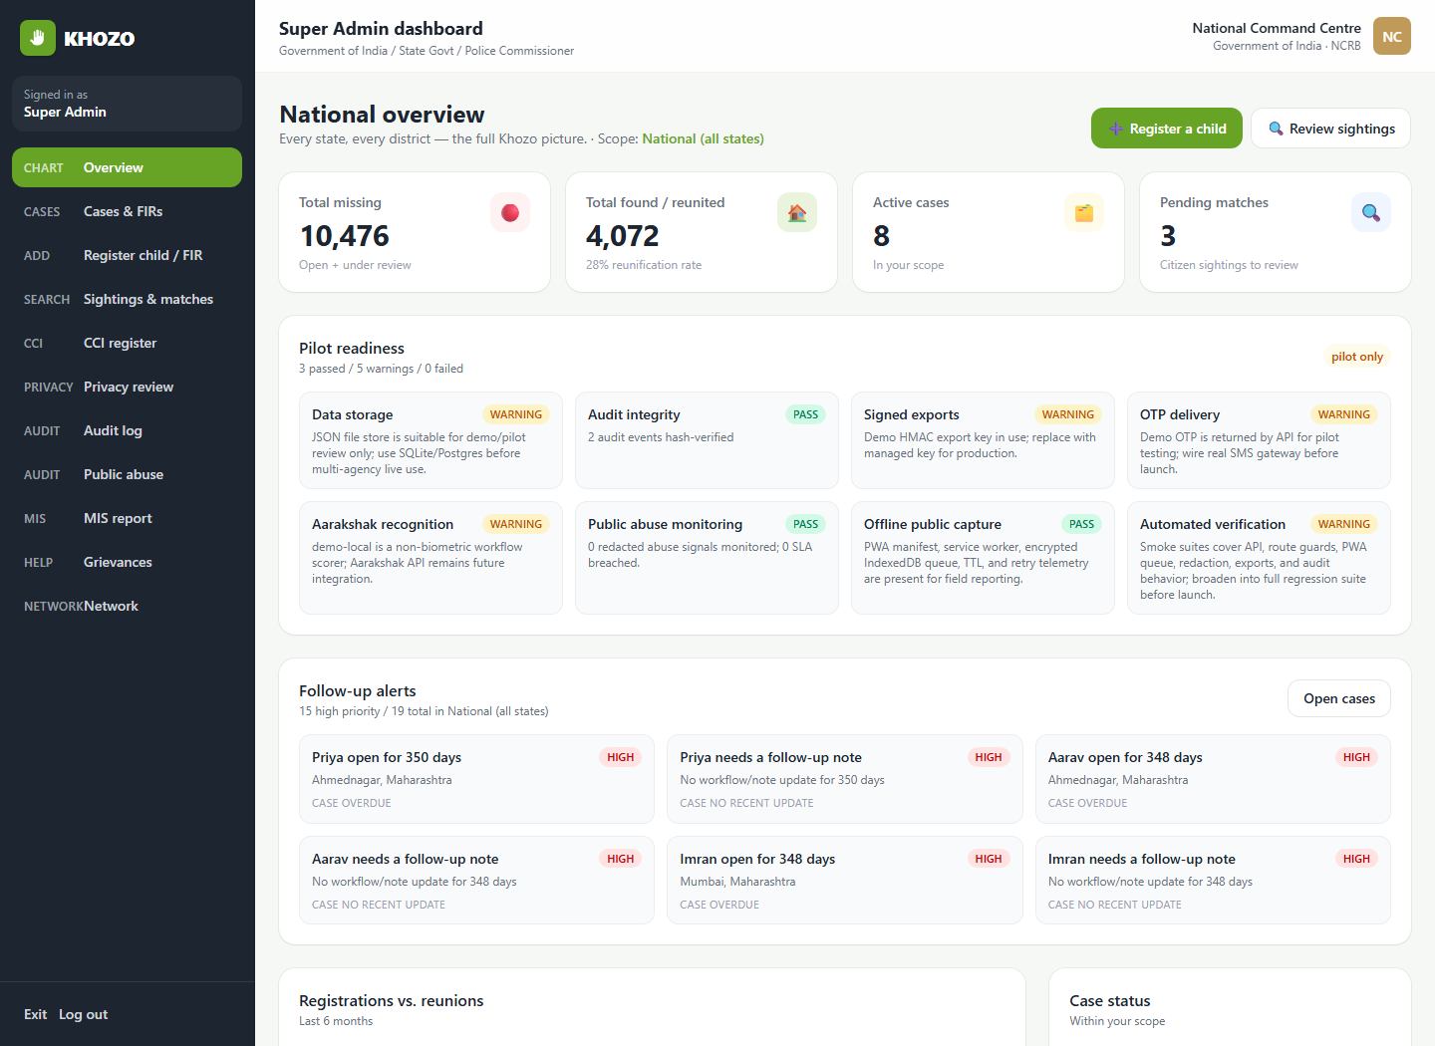
ACTUAL PORTAL SCREENSHOT
Dashboard Overview
What this proves
Role-scoped command dashboard with caseload, reunification, pending matches, readiness, follow-ups and charts.
File: docs/screenshots/overview.png
Captured from actual Khozo portal running locally
KHOZO | Proposal for Government of Assam
15

Slide 15
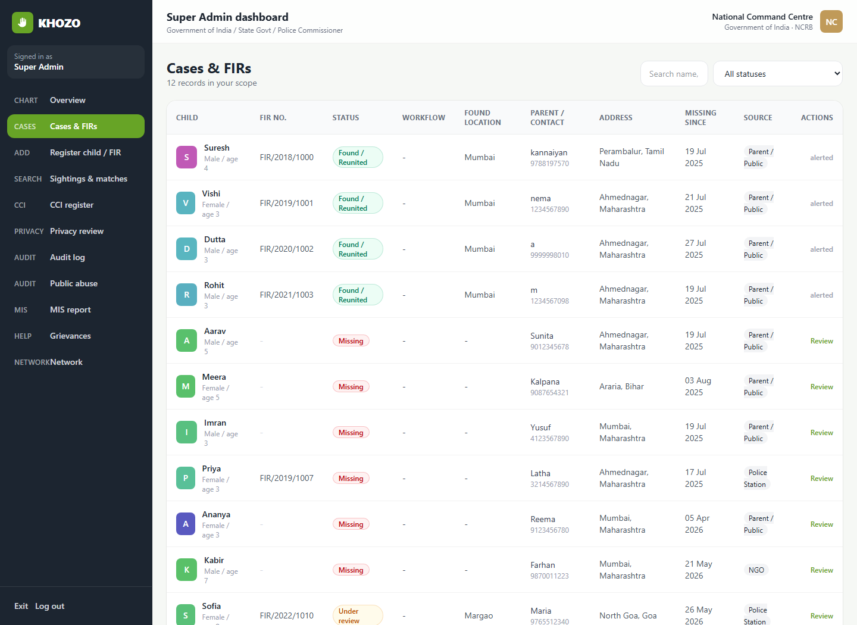
ACTUAL PORTAL SCREENSHOT
Cases, FIRs And Match Review
What this proves
Operational case list paired with missing-child/FIR workflows and reviewable sightings/matches.
File: docs/screenshots/cases-firs.png
Captured from actual Khozo portal running locally
KHOZO | Proposal for Government of Assam
16

Slide 16
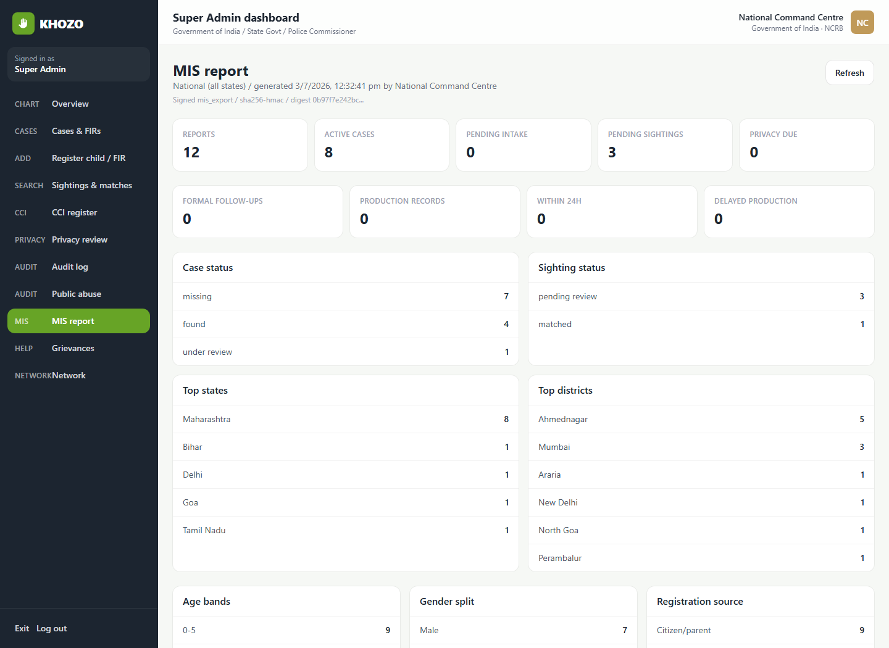
ACTUAL PORTAL SCREENSHOT
MIS, Audit And Privacy Controls
What this proves
Signed MIS report plus audit/privacy surfaces for traceability, retention and government reporting.
File: docs/screenshots/mis-report.png
Captured from actual Khozo portal running locally
KHOZO | Proposal for Government of Assam
17

Slide 17
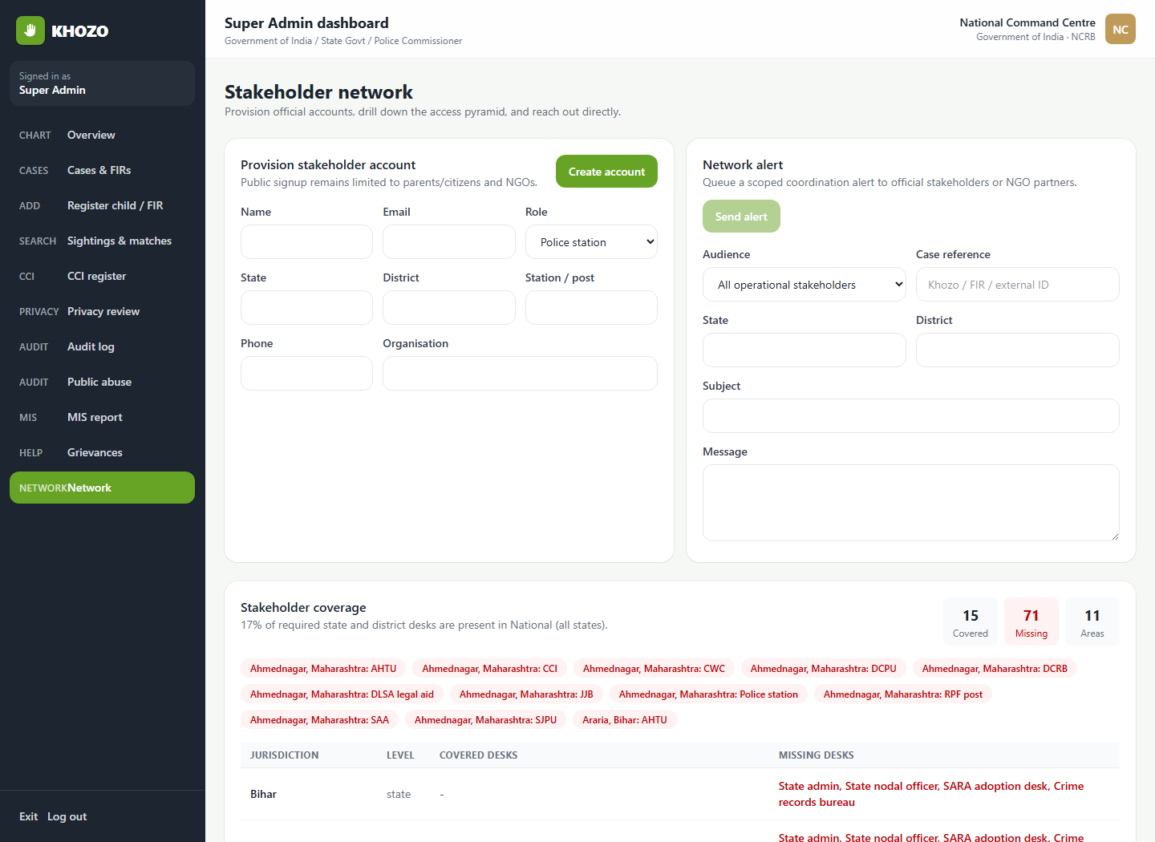
ACTUAL PORTAL SCREENSHOT
Stakeholder Network And Coverage
What this proves
Provision stakeholder accounts, send coordination alerts and inspect state/district coverage gaps.
File: docs/screenshots/network.png
Captured from actual Khozo portal running locally
KHOZO | Proposal for Government of Assam
18

Slide 18
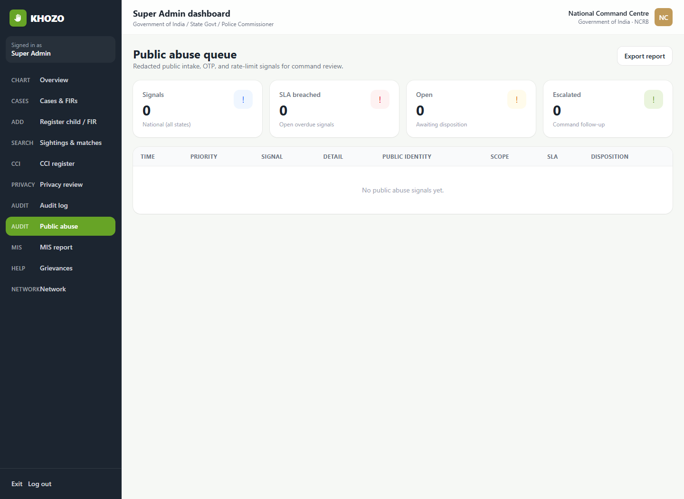
ACTUAL PORTAL SCREENSHOT
Public Abuse And Grievance Queues
What this proves
Command review queues for public intake abuse signals, OTP/rate-limit events and safe follow-up.
File: docs/screenshots/public-abuse.png
Captured from actual Khozo portal running locally
KHOZO | Proposal for Government of Assam
19

Slide 19
KHOZO
Let every safe sighting become an accountable response.
Your 1 click
A missing child can return home
Proposal to partner with Government of Assam, Assam Police and WCD/SCPS for a sovereign, India-hosted missing-child response pilot.
Next step
Technology
Approve pilot and nominate state nodal owners.
Khozo portal with Aarakshak sovereign facial recognition.
An initiative by Aegis School of Data Science

